Slide 1
Advanced Planning Brief to Industry (APBI) Strategic Acquisition Center
Office of Small and Disadvantaged Utilization Tom Leney, Executive Director, Small and Veteran Business Programs
“Promoting Small Business ”
October 22, 2014

Slide 2
VA Small Business Achievement
VA is committed to providing opportunities for all Small Business.
 | Federal Goal | VA Goal | VA Percentage | VA Dollars (billions)
 |  |  | 2014 | 2014
All small business | 23% | 34% | 36.1% | $6.59
SDVOSB | 3% | 10% | 19.4% | $3.53
VOSB | N/A | 12% | 21.6% | $3.9
Small Disadvantaged Business (SDB) – includes 8(a) | 5% | 5% | 7.9% | $1.4
Women-Owned Small Business (WOSB) | 5% | 5% | 3.3% | $0.6
Historically Underutilized Business Zone (HUBZone) | 3% | 3% | 1.7% | $0.3
As of 11/18/2013

Slide 3
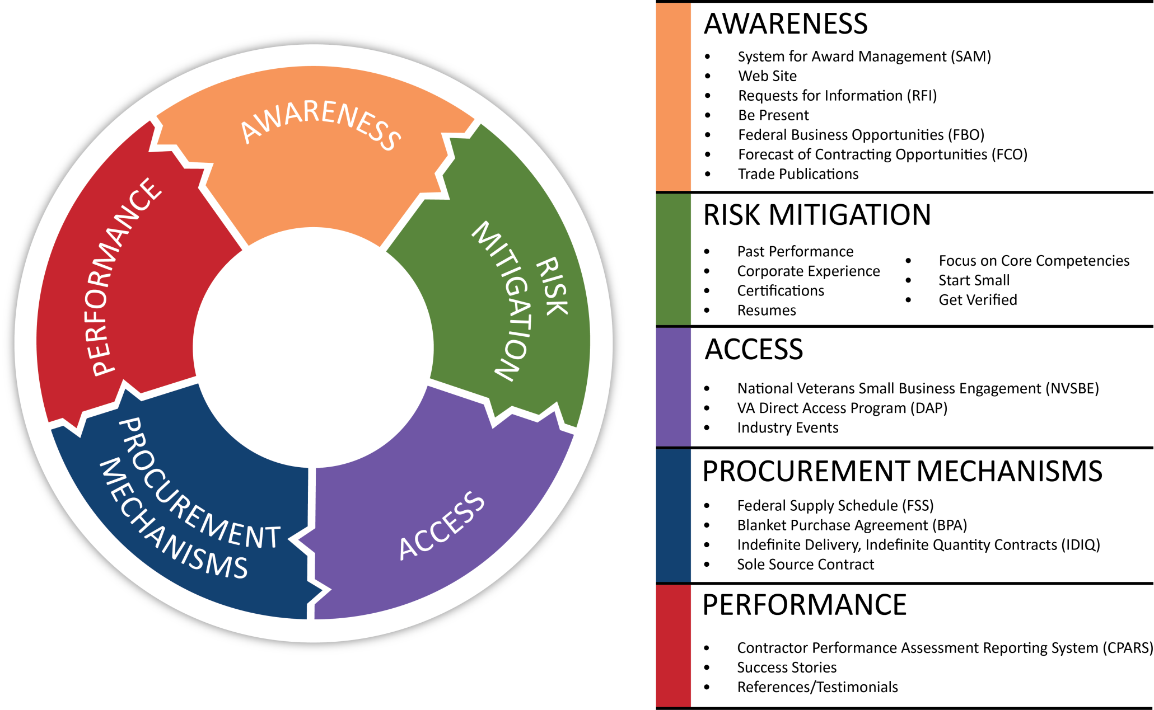
Small Business Challenges

Slide 4
Key Initiatives for FY15
State Opportunity Showcases
Commercial Connect
National Veterans Small Business Engagement

Slide 5
National Veterans Small Business Engagement (NVSBE)
Date: December 9-11, 2014
Location: Atlanta, GA
Who will be there?
Government Procurement Decision Makers
Commercial Customers
Potential Partners
We seek:
Procurement Ready Veteran-Owned Small Businesses
Large Business Partners

Slide 6
NVSBE: All About Access
Engagement =
Why come?
Identify Opportunities
Connect directly with government and commercial Procurement Decision Makers (PDMs)
Network with potential partners
Build business relationships
Business Requirement Sessions
Networking Roundtables
Dining with Decision Makers
Receptions
One-on-One follow-up sessions
Register Online: http://www.nvsbe.com/

Slide 7
What is Procurement Readiness?
Demonstrated ability to win
and to successfully perform
contracts
“In the eye of the beholder”

Slide 8
Basic Elements of Procurement Readiness
Registration
Experience
Industry Specific Licenses and Requirements
Web Site/Capabilities Statement
Knowledge of Federal Procurement Readiness and Process
Knowledge of Customer
Verified
Be present

Slide 9
How to Achieve Procurement Readiness
Partner with procurement ready businesses
Obtain Non-Government Contracts to gain experience
Compete for Small Contracts (SAT)
Seek help from programs that promote procurement readiness.

Slide 10
Help is Available
SBA Business Development Programs “Boots to Business”
Procurement Technical Acquisition Centers
Veterans Business Opportunity Centers
Minority Business Development Agency (MBDA)
SCORE (Service Corps of Retired Executives)
8(a) Business Development Program
Mentor Protégé Programs
Federal Contracting Certification

