Slide 1
Product Development (PD)
Lorraine Landfried
Deputy CIO
Steven G. Schliesman
Assistant Deputy CIO
OI&T PD June 11, 2014

Slide 2
Agenda
Product Development (PD) Organizational Overview
Who We Are
PD’s Commitments and Challenges
Dedication
Delivery
Discipline
What PD Needs from Industry
Upcoming Opportunities
Remaining for Fiscal Year 2014 (FY14)
Upcoming in FY15
Questions

Slide 3
Office of Information and Technology
Assistant Secretary, Office of Information and Technology
------------------------------
Executive in Charge and Chief Information Officer
Mr. Stephen Warren
Quality, Performance, and Oversight
Ms. Martha Orr
Customer Liaisons
Ms. Jacquelyn Patillo
Service Delivery and Engineering
Mr. Arthur Gonzales
Product Development Ms. Lorraine Landfried
Architecture, Strategy and Design
Dr. Paul Tibbits
IT Resource Management
Mr. Rom Mascetti
Information Security
Mr. Stanley Lowe

Slide 4
Product Development
PMAS Business Office
Carol Macha Carol.Macha@va.
gov
DCIO for Product Development
Lorraine Landfried
Lorraine.Landfried@va.gov
Business Operations Function
See next slide
Dashboard
Operational support
ADCIO for Project Management
Steven Schliesman Steven.Schliesman@va.gov
ADCIO for Product Support
Vacant
ADCIO for
Development Management
Dave Peters
Dave.Peters@va.gov
PMO
Incremental development
Common services
Analysis/Design
IMS
Metrics
Agile coaching/mentoring
508

Slide 5
Product Development: Business Operations Functions
DCIO for Product Development
Lorraine Landfried
Lorraine.Landfried@va.gov
Business Operations Functions
Communication & Executive Support
Kai Miller
Kai.Miller@va.gov
Budget Planning and Execution
Ray Bailey
Ray.Bailey@va.
gov
Acquisition and Contract Administration
Gelsi Argueta
Gelsomina.Argueta@va.gov
Workforce Management
Angie Weldon
Angie.Weldon@va.gov
Program Planning & Oversight
Vacant
VAOITPDPPOManagement @va.gov
Communication support
Executive support
Acquisition support
Function point counting/ analysis

Slide 6
Product Development: Project Management Leads
DCIO for Product Development
Lorraine Landfried
Lorraine.Landfried@va.gov
Project Management Service ADCIO,
Steven Schliesman Steven.Schliesman@va.gov
Benefits Delivery Products
Tracie Loving
Tracie.Loving@va.gov
Health Delivery Products
Larry Weldon
Larry.Weldon@va.gov
Corporate and Resource Systems
Stephen Levy
Stephen.Levy@va.gov

Slide 7
Commitments and Challenges
Dedication. Discipline. Delivery.

Slide 8
Discipline: PMAS
Project Management Accountability System
https://www.voa.va.gov/default.aspx
PMAS ensures that the customer, project, and vendors working on a project are aligned, accountable, and have access to necessary resources before work begins
Red Flags and Milestone Reviews reinforce accountability after work begins
PMAS is mandatory for all OI&T projects

Slide 9
Discipline: Agile
Agile is a VA-preferred methodology
Integrates with ProPath
PD completed an Agile maturity assessment in April 2013. Out of 117 projects:
10% rated as fully agile and ready for use in coaching or mentoring other project teams
32% effectively using agile principles
30% using agile principles with a blend of other project management methods
Remaining projects were unable to employ scrum techniques because of project characteristics
See GAO Study, Agencies Need to Establish and Implement Incremental Development Policies, dated May 2014

Slide 10
Discipline: ProPath
ProPath: VA’s front-end access to the standard Process Asset Library
Includes links to critical, formal approved processes, artifacts, and templates
Facilitates development of PMAS-compliant, 508-compliant, VA security-compliant products
Visual flow representation
More relevant to VA than CMMI
ProPath use is mandatory for VA development
ProPath is available on the Virtual Office of Acquisition (VOA) portal: https://www.voa.va.gov

Slide 11
More Discipline
Security
Section 508
Open Source
What’s next?
Mobile First
Role of Integrator
DevOps

Slide 12
Open Source
Why transition to an open source model?
High quality, lower costs
Drives innovation and security through participation
Governance structure embodied in a custodial foundation – Open Source Electronic Health Record Alliance (OSEHRA)
VA Mobile supports Open Source solutions, such as:
MongoDB (database)
GIT (source control)
Jira (issue tracking)
Confluence (collaboration)

Slide 13
Mobile First
Mobile app before full web app?
Commitment to HTML5
Builds on well-known HTML standards
Supported by well-known app development frameworks
Compatible with Apple, Android, and other browser-based devices with minimal device-specific customization necessary

Slide 14
Why Government As Integrator?
What do we mean by integrator?
Beyond technical compliance to mission assurance
Change management expertise
Why OI&T as the integrator?
Our systems outlive most gov/vendor relationships
Systems today aren’t only defined and useful because of their user interface—many moving parts and projects
Requires big picture perspective
Vendors are part of the solution
Government is ultimately accountable

Slide 15
DevOps: The Integration Model
OI&T is becoming a DevOps-collaborative organization
DevOps is the next evolution of PMAS
DevOps is an industry-leading best practice
Enables continuous delivery of IT functionality
Complements VA’s incremental, agile development methodology
Agile techniques like test automation, continuous integration, and test driven development are key foundational elements necessary for VA’s transition
Early adopters: Projects focused on improving Veteran access to benefits and eliminating the claims backlog
Functionality and enhancements move into production in more frequent cycles, delivering usable benefits to customers while maintaining security and operational standards

Slide 16
Why Are We Here?
Delivery
VA needs your help!
We need to help you help us
We need support and commitment to our goals

Slide 17
CY Appropriation
CY Baseline
& Certification Letters sent to Congress
Budget Execution
Begin CY Close-Out
CY
Year-End Review
Quarterly Budget Execution Review
Mid Year Budget Review
Quarterly Budget Review
Receive CY Allocation
Oct | Nov | Dec | Jan | Feb | Mar | Apr | May | Jun | Jul | Aug | Sep
BY Congressional Budget Justification (CBJ) accounting for Passback changes
FY13/14 and FY 14/15 Current Year (CY) Execution
President Submits BY Budget to Congress
BY Budget Pass back
Passback Review Revisit PY Exhibit 300/53s
Finalize BOP/EPS
Business Reviews IT Requests
BRDs due
PD builds initial BOP in BTT based on FY15 Business Requirements
Data Call for BY Quad Charts
Business Prioritization/Validation
Develop Detailed Project Budgets
OCT | NOV | DEC | Jan | Feb | Mar | Apr | May | Jun | Jul | Aug | Sep
FY 2015 Budget Year (BY) Formulation
VA Releases Multi-Year Programming Guide
Life Cycle Funding Request (LCFR) Due
Populate reportable OMB 300B projects/activities
OMB 95% Solution
OMB 99% Solution
BY+1 Budget Submitted to OMB
(EX300/53)
VA Governance reviewing, prioritizing, formulating Budget submission
Requirement Analysis & Validation of New & Existing Requirements
Develop BY+1 EX300/53
OCT | NOV | DEC | Jan | Feb | Mar | Apr | May | Jun | Jul | Aug | Sep
FY 2016 Budget Year +1 (BY+1) Planning
Develop BY+1 CPIC Strategy
Data call for
LCFR
Initial CBJ submission in support of Exhibit 300s
Final BY+1 PD EX300/53 Due to ITRM
EX 300/53
CAMS Rollover

Slide 18
How To Win PD Contracts
Understand our problems and requirements
Understand our commitments, challenges, and definition of success
Commitments: VE, Benefits Transformation, Hosting, MASS
Challenges: Volume, time, integration, funding
Integration – Who is defining interfaces?
Funding – VA might not have all the funding up front
Be prepared with flexible plans

Slide 19
How To Win VA PD Contracts
Cont’d
Demonstrate you understand our problems
Demonstrate how you can and have solve(d) that specific problem - feasibility
Make sure your teams work with product vendors and integrate into business capabilities
You can add value by providing solutions that work with or improve VA business processes.

Slide 20
How To Keep PD Contracts
Deliver results (PMAS), not excuses
Understand our big picture. Dedication. Discipline. Delivery.
Dedication: Know and understand our mission. Everything we do is to help our Veterans and those who serve them.
Delivery: PMAS, Agile, and T-4 = Successful Delivery.
Discipline: We can improve our rigor and discipline.
Section 508: Only present projects and solutions that are 508-compliant
Authority to Operate: Start thinking about ATOs on day 1
Open Source: Critical to VA’s future plans in access to healthcare
Help solve VA, VHA, OI&T and PD’s problems!

Slide 21
Remaining FY14 Opportunities
Currently Actionable
Actionable - ~$113.3M
New Competitive - ~$73.2M
Under Development
24 remaining competitive acquisitions for a total of $52,075,869.49
(1) IPT/PMO Support- 8 for a total of $21,341,961.00 **
(2) SW Development/Testing- 9 efforts for a total of $22,020,989.00
(3) SW Licenses/Maintenance- 7 efforts for a total of $8,712,919.49
** Does not include the Enterprise PMO Contract

Slide 22
FY15 – First Look
FY15 Competitive Acquisitions
166 Total New Competitive efforts for a total of $239,912,775.00
(1) IPT/PMO Support/Testing- 30 efforts for a total of $26,622,909.00
(2) HDW Purchase/Installation/Maintenance- 11 efforts for a total of $6,998,170.00
(3) SW Development/Testing- 56 efforts for a total of $114,732,602.00
(4) SW/SW Licenses/Maintenance- 54 efforts for a total of $67,086,966.00
(5) Hosting- 5 efforts for a total of $18, 648,667.00
(6) Other- 11 efforts for a total of $5,823,461.00
FY 15 Executable Options
Existing Options - ~$499.9M

Slide 23
FY15 Competitive Opportunities
Access To Care (3)
CAPRI (2)
Caregivers (1)
Comp & Pension (1)
Enterprise License Expense (3)
Health Admin Systems (4)
Health Care Efficiency (3)
Interoperability (1)
Memorials Legacy Development (3)
Mental Health Medical Legacy (1)
NMOC (6)

Slide 24
FY15 Competitive Opportunities, Cont’d
Registries (7)
Repositories (1)
Safety & Security (PIV & HSPD 12) (2)
VBMS (3)
VRM (3)
VETSNET (3)
VHA Research Medical Legacy (2)
Vista Evolution (5)
VLER Health (2)

Slide 25
Questions

Slide 26
Backup Slides

Slide 27
Visualizing VistA and Namespace
VIVIAN is a new approach
Multiple view visualizations
Integration of models such as Business Function Framework
Access to code and documentation
Demonstration
http://code.osehra.org/Prod/Visual/prod_visual.html
http://code.osehra.org/ProdDemo/Visual/vista_menus.html

Slide 28
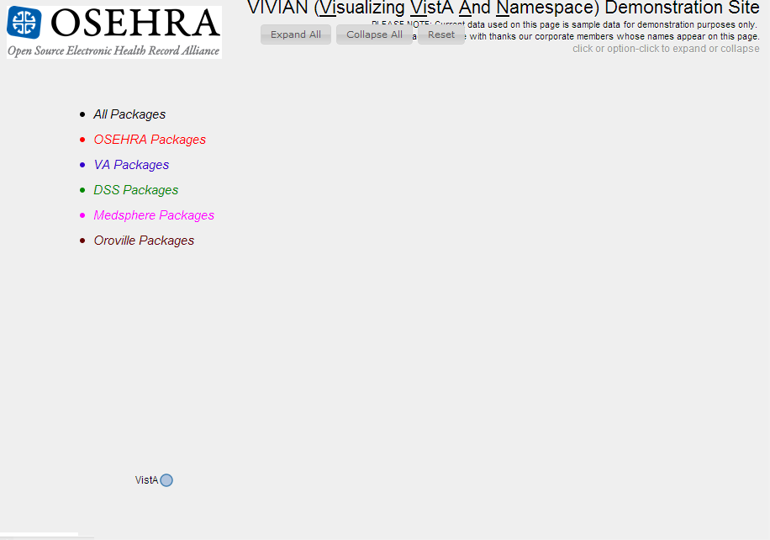
Root view from VIVIAN “Collapse All” option.
Clicking the “VistA” button expands the tree...

Slide 29
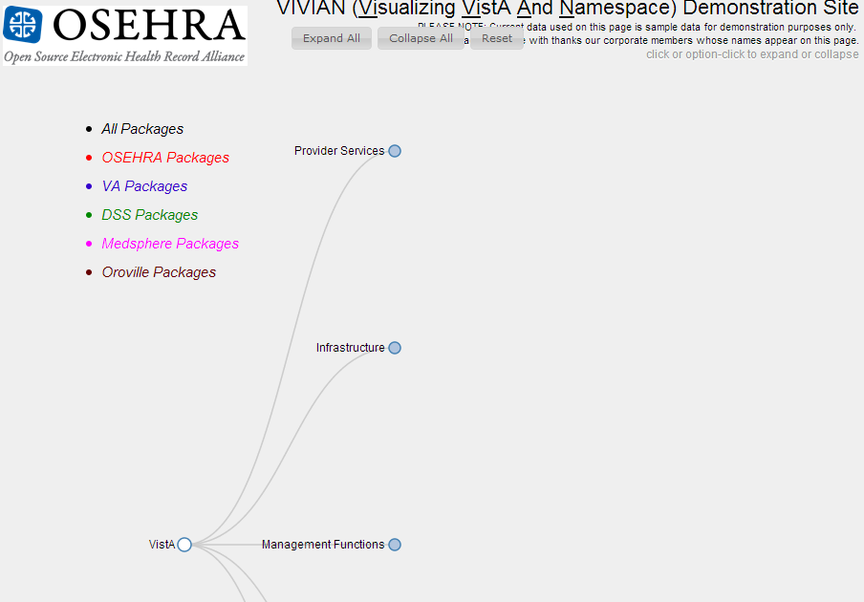
...Now we see several categories of capabilities. (We can scroll down to view the ones that aren’t now visible.)
We’ll select “Provider Services”...

Slide 30
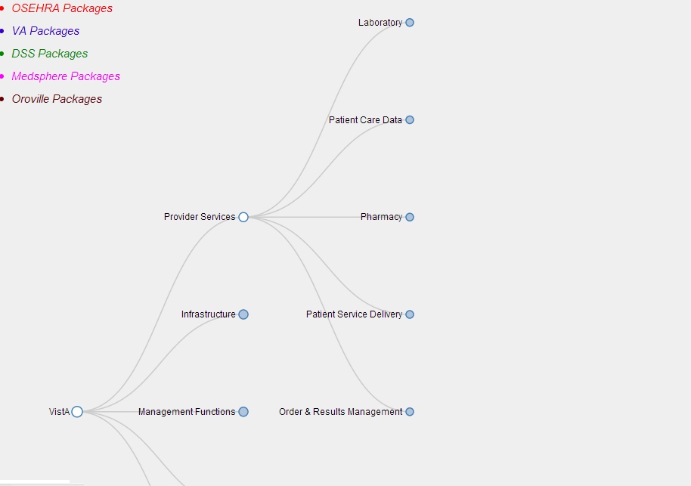
...and that subtree comes into view.
Now we select “Order & Results Management”...

Slide 31
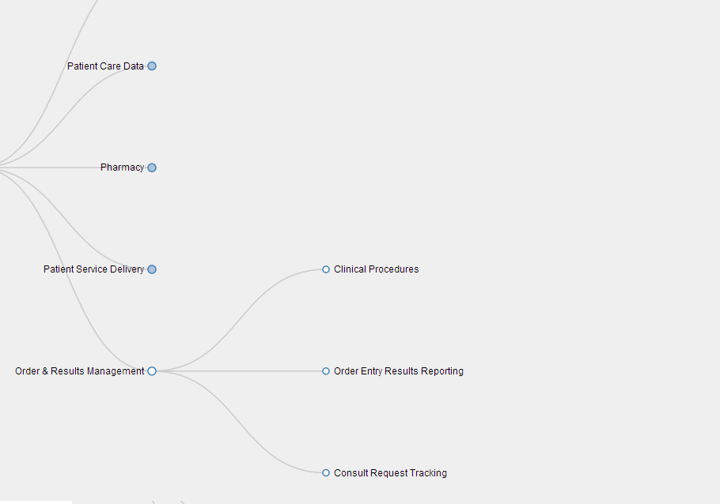
When we click on “Order Entry Results Reporting”...

Slide 32
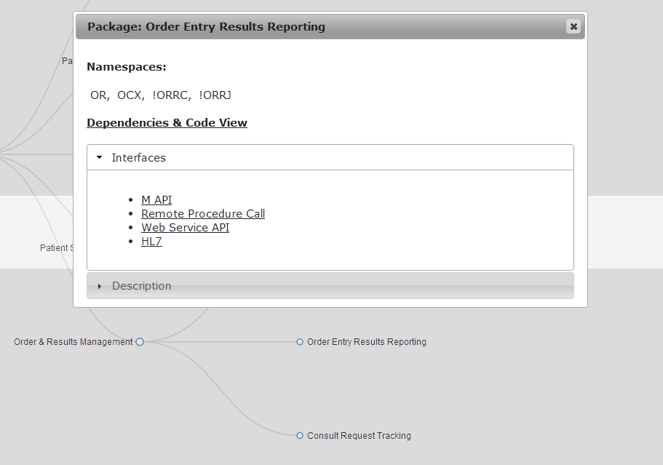
...a “modal” window pops up to let us drill down into some technical details.

