Slide 1
Advanced Planning Briefing to Industry (APBI) Strategic Acquisition Center
Office of Small and Disadvantaged Utilization Tom Leney, Executive Director, Small and Veteran Business Programs
“VA Small Business Programs Update ”
December 10, 2015

Slide 2
Current Situation
Socioeconomic Goals
Framework for Success
MyVA Verification Initiative

Slide 3
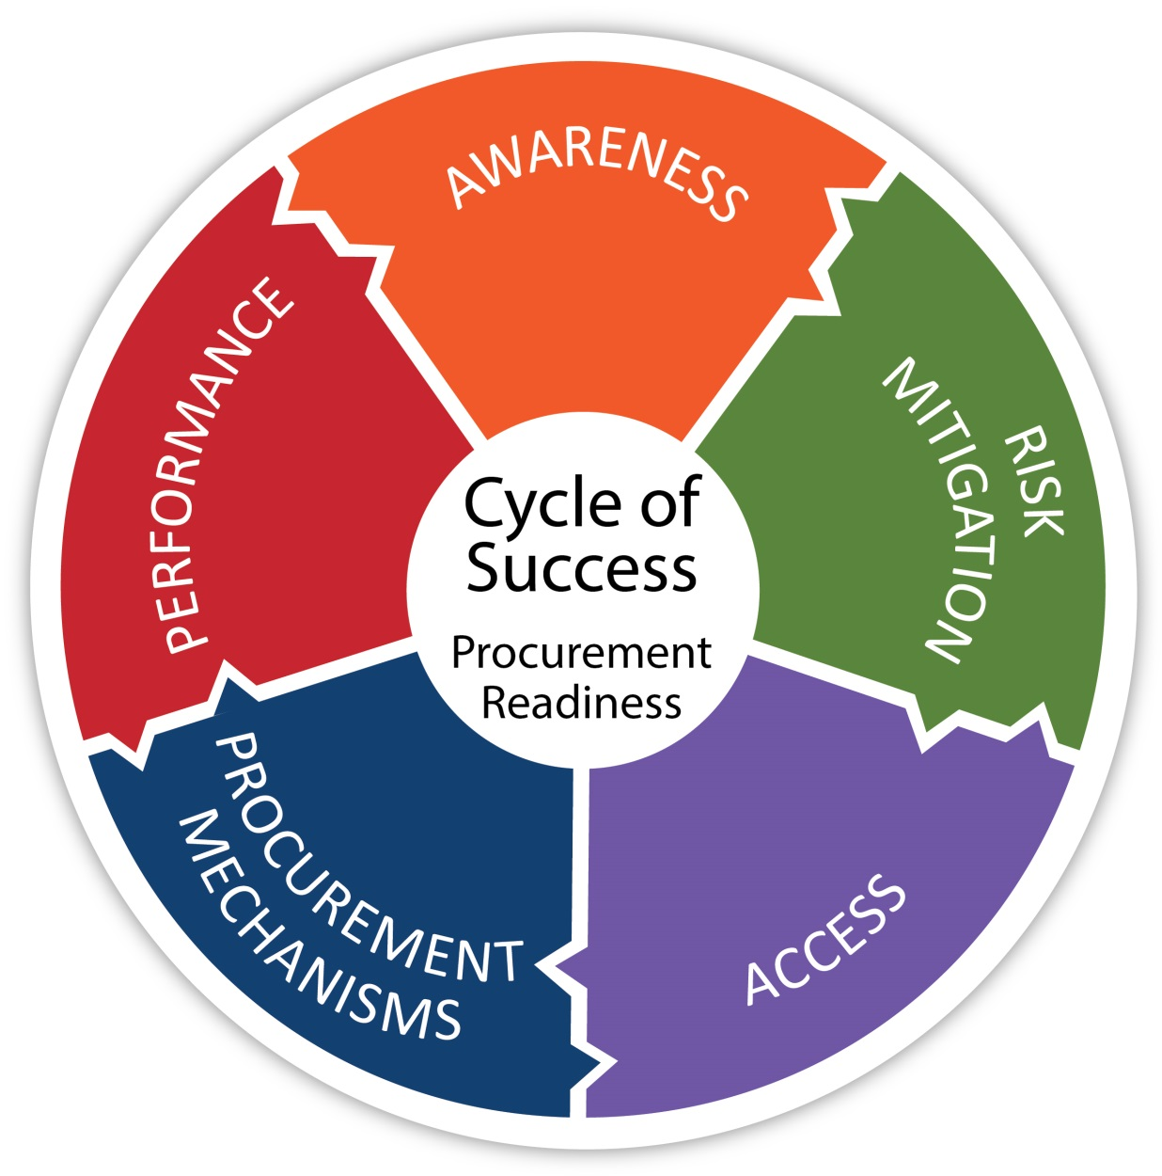
Small Business Framework for Success

Slide 4
Key Initiatives for FY 2016
Awareness: Market Research Updates
Access: Direct Access Program Updates
Risk Mitigation: Verification Updates

Slide 5
Awareness: Market Research in FY 2016
Small Business Intelligence Tool
Linkage to Direct Access Opportunities

Slide 6
Direct Access Program (DAP) in FY 2016
Communities of Interest (COI)
National Veterans Small Business Engagement (NVSBE) 2016
Minneapolis, MN from Nov 1 – Nov 3
Upcoming DAP Events
http://www.va.gov/osdbu/library/events.asp

Slide 7
Risk Mitigation: Verification Transformation
Faster, Better, Cheaper
Pre-qualification Assessment
Case Management Teams
Pre-Determination Findings

Slide 8
Risk Mitigation: Verification
Check Vendor Information Pages (VIP)
Rigorous Standards
Extensive Audit Programs
Response to Fraud Allegations

