Slide 1
Advanced Planning Brief to Industry (APBI)
Robert L. Capers, Jr.
Director, AE & Construction Contracting Policy
Office of Construction & Facilities Management (CFM)
October 22, 2014

Slide 2
Agenda
Bio
CFM Background
CFM Regional Offices
Major Program Summary
Upcoming Acquisition/Opportunities
Questions

Slide 3
Bio
Who am I?
Robert L. Capers, Jr.
Director, AE & Construction Contracting Policy, Office of Facilities Acquisition
Responsible for developing policy and guidance to oversee major construction contracting, Architect-Engineer selection and leasing.
30 years of government service (26 years with VA)

Slide 4
CFM Background
Responsible for:
Planning, designing, and construction of all major construction projects greater than $10 million.
Acquiring real property for use by VA elements through the purchase of land and buildings, as well as long-term lease acquisitions.

Slide 5
CFM Background
Responsible for:
Managing facility sustainability, seismic corrections, physical security, and historic preservation of VA’s facilities.
Delivering to Veterans, high quality buildings, additions, large scale renovations, and structural enhancements.

Slide 6
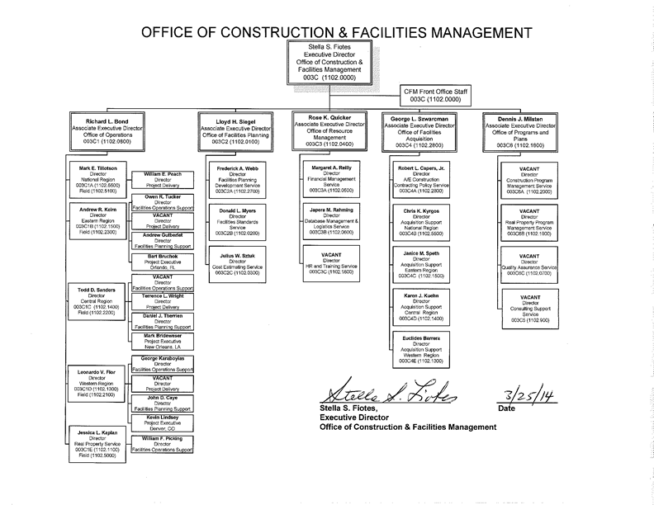
CFM Background
Chart located at: http://www.cfm.va.gov/about/cfmOrgChart.htm

Slide 7
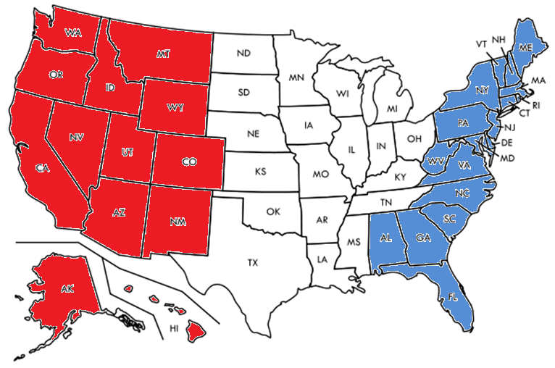
CFM Regional Offices
WEST Region (Mare Island, CA) | CENTRAL Region (N. Chicago, IL) | EAST Region (Silver Spring, MD)
DC
NATIONAL Region (Washington, DC)
PR
WEST Region:
AK, AZ, CA, CO, HI, ID, MT, NM, NV, OR, UT, WA, WY
CENTRAL Region:
AR, IA, IL, IN, KS, KY, LA, MI, MO, MN, MS, ND, NE, OH, OK, SD, TN, TX, WI
EAST Region:
AL, CT, DE, FL, GA, MA, MD, ME, NC, NH, NJ, NY, PA, PR, RI, SC, VA, VT, WV

Slide 8
Major Program Summary
Major Construction Program:
Consists of projects over $10 million.
(38 U.S. Code §8104)
Projects planned and developed by VHA, NCA, VBA or Staff Offices.
Projects are individually appropriated by Congress.
Major medical facility projects and leases require authorization by Congress.

Slide 9
Major Program Summary
Construction Funding:

Slide 10
Major Program Summary
Architect-Engineer Services:
Professional services of an architectural and engineering nature performed by contract.
CFM contracts for the following services:
Pre-Design
Schematic Design
Design Development
Construction Documents

Slide 11
Major Program Summary
Leasing Program:
Authority delegated by GSA to execute leases.
CFM Real Property Service manages the acquisition of large leases.
Leases for medically related space are funded from the medical facilities appropriation.

Slide 12
Upcoming Acquisition/Opportunities
FY2015 Projections:
VHA Major Construction
28 major projects
NCA Major Construction
7 major projects
Leases
17 major projects

Slide 13
Upcoming Acquisition/Opportunities
VHA Major 2015 Forecast Opportunities
Region | Location | Project Number | Phase | Project Description | Proposed Qtr FY15
Central | Dallas, TX | - | Land Acquisition | Land Acquisition | Q4
Central | Louisville, KY | 603-320 | Construction Documents | New Medical Center | Q4
Central | St Louis, MO | - | Land Acquisition | Land Acquisition | Q4
Central | St Louis, MO (JB) | 657-313 | Construction | Energy Plant Demo | Q2
East | Canandaigua, NY | 528-400A | Construction | OPC - Phase 1 | Q4
East | Manhattan, NY | 630-600J | Construction | Inpatient Privacy Renovations Phase 1 | Q2
East | Manhattan, NY | 630-600U | Construction | Electrical Equipment Relocation - 2A & 2B | Q3
East | Manhattan, NY | 630-600P | Construction | Ground Floor Renovation Phase 1B | Q2
East | Manhattan, NY | 630-600Q | Construction | Ground Floor Renovation Phase 2A | Q4
East | Manhattan, NY | 630-600T | Construction | Ground Floor Renovation Phase 2B | Q3
East | Perry Point, MD | 512-173 | Construction Documents | Replacement CLC | Q1
East | Pittsburgh, PA | 646-500B | Construction | ROB Connector | Q2
East | San Juan, PR | 672-085C | Construction | Bed Tower Demo and Seismic Retrofit | Q3
East | Tampa, FL | 673-900 | Schematic/Design Development Awards | New Bed Tower Schematic & DDs | Q1
East | Tampa, FL | 673-900D | Construction | New Bed Tower | Q4
West | American Lake, WA | 663-403 | Schematic/Design Development Awards | Phase 1 - Building 18 Renovation | Q1
West | American Lake, WA | 663-403 | Construction Documents | Phase 1 - Building 18 Renovation | Q3
West | Livermore, CA | 640-423 | Schematic/Design Development Awards | Livermore Realignment and Closure Phase 5 - Eng Log Bldg | Q3
West | Livermore, CA | 640-423 | Construction Documents | Livermore Realignment and Closure | Q2
West | Long Beach, CA | 600-405 | Construction | Seismic Corrections- Demo Bldgs 4 and T162 | Q2
West | Long Beach, CA | 600-405 | Construction | Seismic Corrections- Community Living Center | Q3
West | Long Beach, CA | 600-405 | Construction | Seismic Corrections- Community Living Center Parking | Q3
West | Palo Alto, CA | 640-424 | Construction | Research VMU Building | Q4
West | Portland, OR | 648-077 | PD/Schematic Design Awards | Upgrade Building 100/101 for Seismic Retrofit & Renovation | Q3
West | San Diego, CA | 664-401 | Construction | SCI and Seismic Building 11 and Parking | Q4
West | West Los Angeles, CA | 691-108 | Schematic/Design Development Awards | New Tower & B500 Seismic Corrections | Q2
West | West Los Angeles, CA | 691-406 | Construction Documents | Seismic Corrections 11 Buildings (B205/B208) | Q2
West | West Los Angeles, CA | 691-406 | Construction | Seismic Correction - 12 Buildings; Bldg 205 | Q4

Slide 14
Upcoming Acquisition/Opportunities
NCA Major 2015 Forecast Opportunities
Region | Location | Project Number | Phase | Project Description | Proposed Qtr FY15
Central | Cleveland, OH | 918-002 | Construction Documents | Ohio Western Reserve | Q4
Central | Ft Sam Houston (NC), TX | 846 | Construction | Cemetery Phase IIB Historic | Q3
East | Morovis (Bayamon), PR | 871-031 | Master Plan Schematic/Design Development Awards | Replacement Cemetery | Q3
East | Western (Elmira), NY | 936-002 | Master Plan Schematic/Design Development Awards | New National Cemetery - Phase 1 Develop | Q3
East | Western, NY | - | Land Acquisition | Land Acquisition | Q4
West | NMCP Honolulu, HI | 899-026 | Construction | Columbarium & Cemetery Improv | Q2
West | Southern Colorado, CO | 933-002 | Master Plan Schematic/Design Development Awards | New Cemetery | Q3

Slide 15
Upcoming Acquisition/Opportunities
Leases – 2015 Forecast Opportunities
Region | Location | Description | Type of Lease | NUSF | Proposed Qtr FY15
Central | Appleton, WI | Community Based Outpatient Clinic | Succeeding | 39,532 | Q1
Central | Houston, TX | Research | Succeeding | 35,435 | Q4
Central | Knoxville, IA | Community Based Outpatient Clinic | Replacement | 12,835 | Q1
Central | Lafayette, LA | Community Based Outpatient Clinic | Replacement | 29,224 | Q2
Central | Lake Charles, LA | Community Based Outpatient Clinic | New | 24,088 | Q2
Central | South Bend, IN | Outpatient Clinic | Replacement | 71,403 | Q2
Central | Springfield, MO | Outpatient Clinic | Replacement | 68,000 | Q3
East | Binghamton, NY | Community Based Outpatient Clinic | Replacement | 24,888 | Q3
East | Brick, NJ** | Outpatient Clinic | Succeeding | 34,335 | Q1
East | Buffalo, NY | Mental Health | Succeeding | 15,596 | Q1
East | Butler, PA | Health Care Center | New | 168,000 | Q2
East | Mobile, AL | Outpatient Clinic | Replacement | 65,125 | Q3
East | Savannah, GA | Community Based Outpatient Clinic | Replacement | 55,193 | Q1
East | St. Augustine, FL** | Community Based Outpatient Clinic | Replacement | 16,595 | Q3
East | Worchester, MA | Outpatient Clinic | Succeeding | 26,008 | Q1
West | Phoenix, AZ | VHA Office Space | Succeeding | 25,922 | Q4
West | San Jose, CA | Outpatient Clinic | Replacement | 72,000 | Q3
** Denotes requirement currently posted on FedBizOpps.

Slide 16
Upcoming Acquisition/Opportunities
Successful Outreach Strategies:
Posting forecasting opportunities on CFM’s and VA’s websites.
Issuing sources sought notices.
Emailing opportunities to certified SDVOSBs/VOSBs.
Conducting industry day forums.
Conducting pre-proposal conferences.
Participating in a number of industry conferences.

Slide 17
Questions
?

