Slide 1
Pursuing a GSA Schedule Contract
Office of Small Business Utilization
Syretta Dyson-Buesing
and
Shanti Kapoor

Slide 2
Agenda
Overview of GSA’s Office of Small Business Utilization
Importance of Market Research
Tips for Success
Things to Consider before Pursuing a GSA Schedule Contract
Process for Becoming a GSA Schedules Supplier

Slide 3
OSBU Overview
According to the Small Business Act as amended by Public Law 95-507, the Office of Small & Disadvantaged Business was established to:
Advocate, within each Federal Executive Agency, for the maximum practicable use of all designated small business categories within the Federal Acquisition process.
Ensure inclusion of small businesses as sources for goods and services in Federal acquisitions as prime contractors and subcontractors.
Manage the small business utilization programs for OUR respective organization.

Slide 4
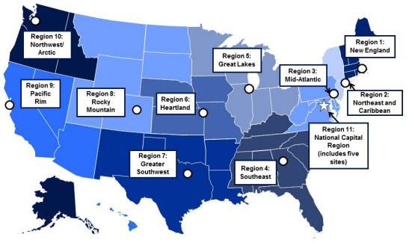
OSBU Offices
GSA’s Office of Small Business Utilization has offices located in 11 regions across the country to support and advocate for small businesses.
Region 1: Boston, MA
Region 2: New York, NY
Region 3: Philadelphia, PA
Region 4: Atlanta, GA
Region 5: Chicago, IL
Region 6: Kansas City, MO
Region 7: Ft. Worth, Texas
Region 8: Denver, CO
Region 9: San Francisco, CA
Region 10: Auburn, WA
Region 11: Washington, DC

Slide 5
Quick Definitions
A schedule is a category of products and services.
Special Item Numbers (SINs) are also known as subcategories.
A contract means, companies like yours have an agreement to provide products and services to agencies; you can use the GSA brand to sell to agencies.
A schedule offer is like a job application—who you are, why you’re competitive, and why you should be able to use the GSA brand.

Slide 6
Top 10 Schedule Sales in FY16
Schedule | Total FY16 Sales
70 - IT | $14,691.5B
OOCORP – Consolidated/Professional Services Schedule (PSS)* | $6,484.4B
874 – Mission Oriented Business Integrated Services (MOBIS)* | $1,755.4B
84 – Total Solutions Law Enforcement | $1,250.2B
71 – Furniture | $868.3M
520 – Financial and Business Solutions (FABS)* | $710.3M
51V – Hardware Superstore | $654.0M
66 – Scientific Equipment & Services | $622.8M
36 – The Office Imaging & Document Solution | $604.5M
871 – Professional Engineering Services (PES)* | $578.5M

Slide 7
Value Proposition
There are 31 Schedules
80% of GSA Schedule holders are small businesses
Approximately $50 Billion of products and services are purchased through the Schedules Program annually.
This represents 10% of overall federal procurement spending
Government agencies are required to purchase from small businesses.
Reliability of the federal customer base
Prompt Payment Act Net30

Slide 8
Managing Expectations
Marketing, building relationships, and developing a pipeline of business are crucial to success on the GSA Schedule
Why? Because the average bid takes 18-24 months
You are required to show $25K in sales within your first two years

Slide 9
Market Research: Is This Worth Pursuing?
Utilize these tools for your market research:
Latest GSA contract award information
Assess your competition
Offers published sales data of schedules contract sales
SIN Sales
Contractors already on schedule
Ability to assess the size and potential of your target market
A repository of all government transactions/receipts over $3,500
https://www.gsaelibrary.gsa.gov
https://d2d.gsa.gov/report/fas-schedule-sales-query-plus-ssq
https://www.fpds.gov/fpdsng_cms/index.php/en/
Consider the buying trends and forecasted sales for your product/service

Slide 10
FPDS Market Research

Slide 11
What is needed to use FPDS:
Your Product Service Code (PSC)

Slide 12
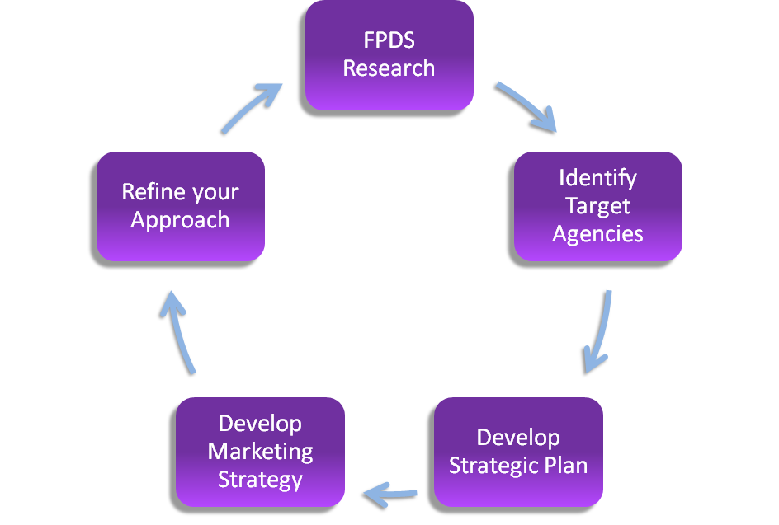
FPDS Market Research

Slide 13
Tips for Success
Create a Business Plan
https://www.sba.gov/writing-business-plan
Before committing to the Schedule contract process, experts recommend that firms create a business plan that includes items such as:
An estimate of the expected Return on Investment
A marketing plan
A determination of whether or not you have dedicated personnel for this new venture.

Slide 14
Things to Consider
Report sales and remit the Industrial Funding Fee (IFF) to GSA
Sales reports and the IFF (currently 0.75 percent of total sales) are both due 30 days after the end of each quarter. Visit the 72A Quarterly Reporting System for more information.
Participate in Contractor Assistance Visits (CAVs)
These are site visits by GSA’s Industrial Operations Analysts (IOA) that occur at least twice during a five-year contract period.
CAVs are not audits and are intended to assist and educate contractors to get the most from their contract.
The Administrative Contracting Officer (ACO) evaluate sales and ensures that vendors are meeting the $25,000 minimum sales requirement.
Creating, distributing, and maintaining your company price list
Within six months of contract award, new contractors must upload their current approved price list to GSAAdvantage!®, GSA’s online shopping and ordering system.
Forward two copies of your price list to your GSA Procurement Contracting Officer (PCO) within 30 days of award.
Keep the information on GSA Advantage!® current throughout the contract life.

Slide 15
Prerequisites
Financial stability (financials statements will be reviewed, unless seeking an IT Schedule contract)
Minimum 2 years in business (financials statements will be reviewed, unless seeking IT Schedule contract)
Demonstrate past performance
Products commercially available
Products compliant with the Trade Agreements Act (TAA), which means the end product must be manufactured or substantially altered within the U.S., or a ‘designated country” as defined by the Trade Agreements Act. (Applies to all Schedule contracts and Sales)

Slide 16
Making It Easier Initiative
IT Schedule 70 Startup Springboard:
Focuses on companies with fewer than two years of experience. In lieu of the two year corporate experience, requirement you can now:
Use professional experience of executives and key personnel as a substitute
Use project experience of key personnel
Provide financial documentation that demonstrates the company’s financial responsibility in lieu of submitting two years of financials statements.
FASt Lane:
Ensures customer agencies have quicker access to emerging technologies and innovative suppliers.
What does this mean for you?
Less than 48 hours for contract modifications
As quickly as 45 days for new offers
For more information, visit our IT Schedule 70 Roadmap at: www.gsa.gov/ITschedule70roadmap

Slide 17
Required Training
Pathways to Success
Readiness Assessment
Guidance of GSA’s Multiple Award Schedule contracts
Guidance on how to be a successful vendor
Guidance on requirements
Guidance on the offer process
Completion Certificate is required in your application (eOffer)
Completed within 1 year of application
Visit Vendor Education Center to take the course: vec.gsa.gov
Mandatory process that walks you through questions to make you think “is this the right business decision?”
Ensures you are ready to submit an offer for the right MAS contract
Identifies the right Special Item Numbers (SINs) (SINs are also known as subcategories)
Completion Certificate is required in your application (eOffer)
Completed within 1 year of application
Visit Vendor Education Center to take the course: vec.gsa.gov

Slide 18
Registrations & Certifications
Data Universal Numbering System
D-U-N-S Number
System for Award Management
SAM
The DUNS number is like a social security number—it allows us to go into SAM to make sure you are a viable company that has not been suspended or disbarred.
Unique 9 digit code to identify your business
Visit Dun & Bradstreet
You should receive your DUNS within 1 business day. Save your number for future use
Must have an active registration within 1 year of your application in SAM to do business with the government
You need to use your D-U-N-S Number to register in SAM
SAM confirms your company meets eligibility requirements to do business with the government
eOffer will automatically pull your SAM registration
Questions? Visit the Federal Service Desk
(http://fedgov.dnb.com/webform) (http://sam.gov)

Slide 19
Registrations & Certifications
Digital Certificate
Open Ratings Past Performance Report
This verifies your identity and ensures the information you provide is secure and cannot be accessed by others.
At least one must be an employee of your company. More than one person can obtain a digital certificate to work on your offer
This is necessary because paper never passes hands in the schedules program—everything is digital on eOffer
Visit either IdenTrust or Operational Research Consultant to obtain your digital certificate
Must be updated every 2 years Cost: $119; 7-14 Days
Compiles your customer surveys that GSA uses to evaluate your key personnel’s past performance
Requires a minimum of 6 customer surveys
You are required to have a score of 80% or higher
Cost: $190; 35-45 Days
Once you receive the report, save and upload with your Technical Proposal in eOffer
Questions? Email pathwaytosuccess@gsa.gov
https://www.identrust.com/gsa/index.html https://aces.orc.com/
https://www.supplierriskmanager.com/ppe-order/login

Slide 20
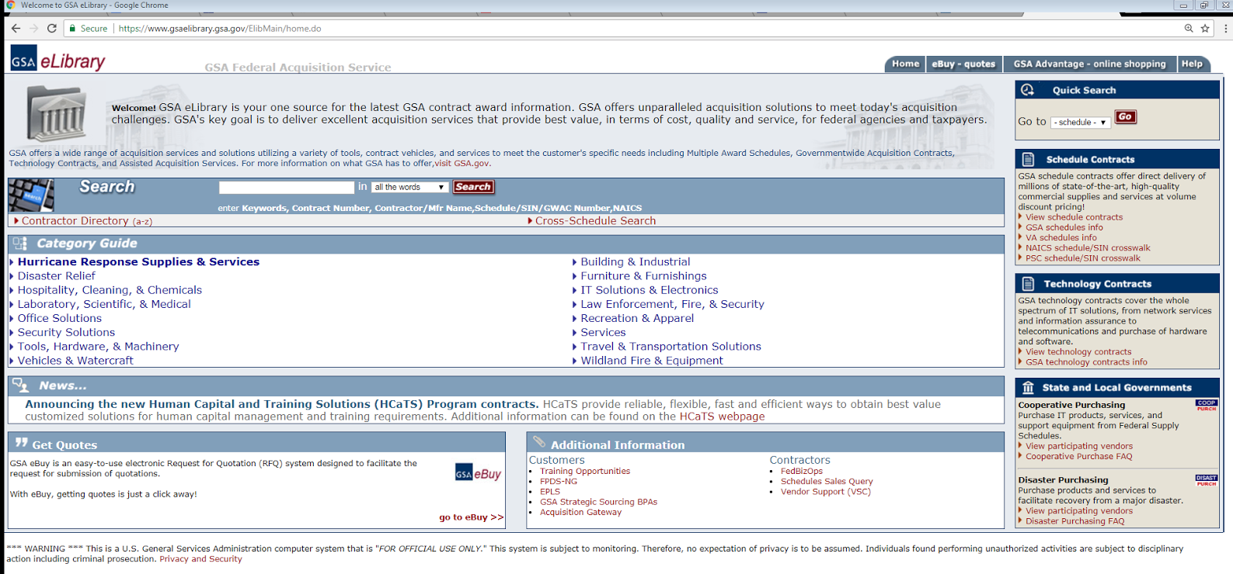
Identify the Appropriate Schedule and SIN
You can use the search box by submitting terms that relate to your product or service
If you know the Schedule you want to apply to, you can select it from the quick search box
Visit: https://www.gsaelibrary.gsa.gov/ElibMain/home.do

Slide 21
eOffer Requirements
Document Name | Definition
Agent Authorization Letter | If applicable. Must be signed by a company officer.
Readiness Assessment | Completed and Signed by Officer of the Company (Offeror). Not accepted from Consultants or Agents. Completed/dated within the past one-year period.
Pathways to Success | A copy of the Training Certificate should be uploaded.
Open Ratings Report | (Past Performance and Evaluation Report D&B) Current within one year from date of offer. Recommended Score of 80 or more.
Subcontracting Plan | If applicable, make the determination now so that the process can be completed while other reviews are being done. Must be submitted if your value is $750,000 or more and you are a large business
Ensure the offer is within scope for the SINs Applied

Slide 22
eOffer Requirements
Document Name | Definition
Commercial Sales Practice Format (CSP-1) | Template provided to outlining commercial sales only. Sales should be provided for each SIN you are applying to. Asks vendors about any written discount policies and if they are better than or equal to the pricing offered to the government.
Financial Statements (2 Years) | From date of offer (Balance Sheet, Income Statement, Net Income/Loss). Provide an explanation for any negative financial information disclosed, including negative equity or income.
Price Proposal | Outlines prices the vendor will offer to the government. This document should not be modified in anyway. Do not leave any sections blank to avoid a rejected offer.
Pricing Support | Should be the same percentage discounts being offered in the CSP. Should show same prices in the proposal template (invoices/SOW dated in current year).
Commercial Price List or Market Rate Sheet | (whichever applies)
Professional Compensation Plan | Submission of the general compensation practices printed in the Offeror’s employee handbook is often sufficient. State uncompensated overtime.

Slide 23
eOffer Requirements
Document Name | Definition
Technical Proposal | Each schedule has its own technical proposal. Please ensure you’re responding to the correct factors you’re applying to.
Letter of Supply | This is a form letter that binds the supplier or manufacturer. In other words, this is the planned company that will provide the GSA vendor with products if a GSA Schedule contract is awarded.
Previous FSS Rejections | (received within the preceding two-year period for previously awarded Schedule contracts) and rejections (received within the preceding two-year period for previously awarded Schedule contracts), pending offers for other Schedule Contracts (include the name and phone number of the assigned GSA contract specialist), and awarded Schedule contracts (include the awarded contract number and price list).
Previous Cancellations | A copy of the cancellation letter or notification Current Federal sales in excess of $25,000, as evidenced by copies of contractual documents that identify the Federal entity and the date and value of the product or services provided, Demonstration that there is a reasonable expectation that any future award will comply with clause I-FSS-639 Contract Sales Criteria, A marketing plan detailing the steps you plan to take to generate sales through a new GSA Schedule contract.

Slide 24
Relevant Systems/Platforms
Vendor Education Center: Complete pathways to success training and readiness assessment
NAICS.com: find NAICs Codes
eLibrary: Find schedule and SIN(s) that fit
SSQ: Find number of contractors on these SINS, find who has no sales, determine average sales per contract
Vendor Support Center: Determine if SIN market is growing or shrinking
GSA Advantage: Determine if your pricing is competitive with top 3 contracts
FBO: See if there are current opportunities to sell
FPDS: Determine which agencies are purchasing and through which vendors
Product Service Manual: Find your Product Service Code (PSC)
Acquisition.gov: review long term forecast of opportunities

Slide 25
WE WANT TO HEAR FROM YOU!
Please share your success stories, comments, questions, and concerns.
www.gsa.gov/askosbu
Syretta Dyson-Buesing
syretta.dyson@gsa.gov
or
Shanti Kapoor
shanti.kapoor@gsa.gov
www.gsa.gov/osbu
1-855-OSBUGSA (672-8472)

