Slide 1
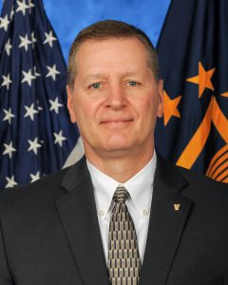
Department of veterans affairs Office of information & technology
Mr. Bill James
Deputy Assistant Secretary (DAS) DevOps
Mission Act and Human Centered Design
Advanced Planning Briefing to Industry,
June 6, 2019
FOR INTERNAL USE ONLY

