Slide 1
Advanced Planning Brief to Industry (APBI)
Tom Muir
National Cemetery Administration November 6, 2013

Slide 2
Agenda
Background/Bio
National Cemetery Administration
Major Program(s) Summary
Upcoming Acquisition/Opportunities
Questions

Slide 3
Background/Bio
Who am I?
Thomas (Tom) M. Muir
Deputy Under Secretary for Management, National Cemetery Administration (NCA)
VA Central Office, 810 Vermont Ave, NW in Washington, D.C.
Head of Contracting Activity (HCA) for NCA
Contracting – supplies, services, construction
Construction – major, minor, non-recurring maintenance, maintenance and repair
Historical preservation
Land acquisition
Information Technology

Slide 4
NCA Contracting
Mr. Thomas M. Muir
Deputy Under Secretary for Management/
Head of Contracting Activity
Tracey Boyd-Vega
Director of Contracting Service
Rob Joshua
Chief, NCA Contracting Service
Stafford Office
(Services)
Garry Harris
Chief, NCA Contracting Service
DC Office
(Construction)
Notes:
Provide your title and your major responsibilities with respect to your organization

Slide 5
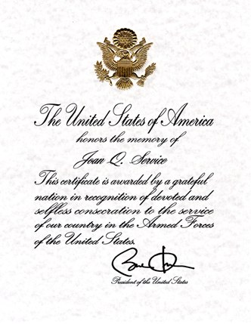
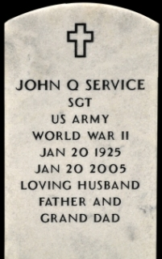
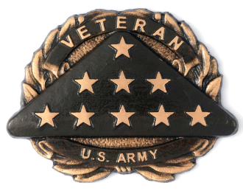
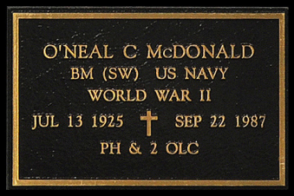
National Cemetery Administration
Mission: NCA honors Veterans and their families with final resting places in national shrines and with lasting tributes that commemorate their service and sacrifice to our Nation
Manages 131 National Cemeteries nationwide
Provides grave markers worldwide
Administers the State Cemetery Grants Program that complements the National Cemeteries network
Provides Presidential Memorial Certificates to next of kin of deceased Veterans
Notes:
Outline what your program does
Identify the mission of your program
Discuss how your mission fits into the overall VA strategic goals (if applicable)
Identify your program’s key objectives
Identify the primary Product Service Codes (PSC)

Slide 6
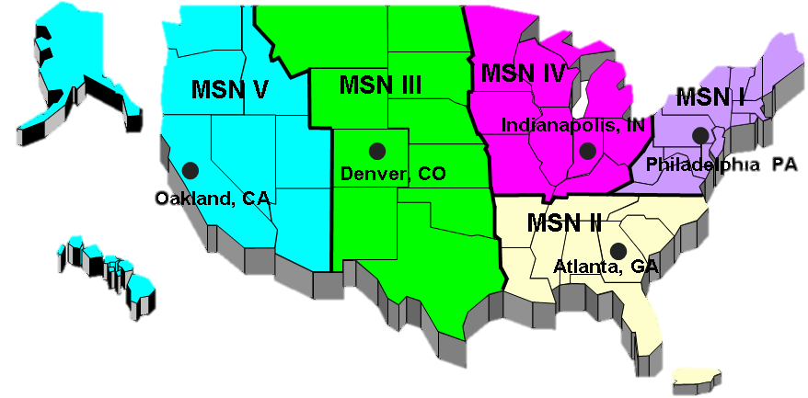
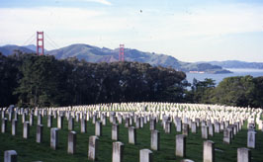
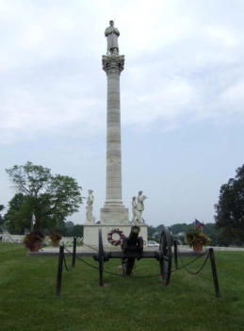
Memorial Service Networks
131 National Cemeteries
1,800 employees, 74% are Veterans;
22,200 acres, 8,800 developed acres;
3.3 million gravesites;
3.9 million interments;
124,000 interments in FY13;
358,000 markers provided in FY13;
654,000 Presidential Memorial Certificates issued in FY13;
8.1 million visitors per year

Slide 7
NCA Cemeteries
Largest: Calverton, NY at 1,045 acres
Smallest: Hampton, VA at 0.03 acres
Oldest: 14 in 1862
Newest: Washington Crossing, PA in 2010
5 new national cemeteries (2 in FL, 1 in NE, CO, and NY)
8 new rural National Veterans Burial Grounds (ME, WI, ND, MN, WY, NV, ID, and UT)
5 new urban columbaria-only (NY, CA (LA, SF), IL, and IN)
$36 million in grants to state and tribal organizations
_
National Cemetery
State Cemetery
National cemeteries offering first interments for both casketed and cremated remains

Slide 8
Type of Procurements NCA Solicits
Various Equipment
Inscription Services
Headstone & Markers- Blanks
Furniture
Grave liners
Turf Renovation/ Maintenance
Headstone Setting
Ground Maintenance
Janitorial Services
Maintenance and Repair
Mow/Trimming Services
Waste Removal
Fertilizer & Weed Control Services
Tree Pruning
Construction – A/E Services
Repair Historic Perimeter Walls
Installation of Pre-Placed Crypts
Construct Columbaria/Memorial Walls
Renovation of Lodges
Replace Fences
Replace Admin & Maint Facilities
Gravesite Development
Repair Erosion & Storm Damage
Repair Sidewalks & Roads
Repair Irrigation Systems

Slide 9
Type of Contracts Issued by NCA
Firm Fixed Price (FFP)
Indefinite delivery/indefinite quantity (IDIQ)
Commercial Items (CI)
Minor Construction
Architectural and Engineering (A & E)
Schedules (BPA’s, GSA)
Options year contracts
Sole Source (based on specific requirements)

Slide 10
NCA Contracting with Veteran-Owned and Service Disabled Veteran Owned Small Businesses
Veteran-Owned Small Business:
VA FY 2012 Goal: 12% of Total Procurement
NCA FY 2012 Actual: 84.4% ($95.6M)
Service-Disabled Veteran-Owned Small Business:
VA FY 2012 Goal: 10% of Total Procurement
NCA FY 2012 Actual: 83.8% ($95.0M)

Slide 11
Small Business Contracts by NAICS Code
2012
2011
Description | NAICS Code | Amount Obligated | Percent of Total Obligations
LANDSCAPING SERVICES | 561730 | $30,042,429.96 | 26.42%
OTHER HEAVY AND CIVIL ENGINEERING CONSTRUCTION | 237990 | $18,645,226.04 | 16.39%
CEMETERIES AND CREMATORIES | 812220 | $15,171,288.48 | 13.34%
COMMERCIAL & INSTITUTIONAL BUIDLING CONSTRUCTION | 236220 | $11,347,500.78 | 9.98%
OTHER CONCRETE PRODUCT MANUFACTURING | 327390 | $4,331,410.00 | 3.81%
2013 (as of 07/26/2013)
Description | NAICS Code | Amount Obligated | Percent of Total Obligations
LANDSCAPING SERVICES | 561730 | $34,959,636.89 | 32.00%
OTHER HEAVY AND CIVIL ENGINGEERING CONSTRUCTION | 237990 | $4,944,357.99 | 4.53%
CEMETERIES AND CREMATORIES | 812220 | $35,366,938.00 | 32.37%
COMMERCIAL & INSTITUTIONAL BUIDLING CONSTRUCTION | 236220 | $2,675,270.99 | 2.45%
OTHER CONCRETE PRODUCT MANUFACTURING | 327390 | $3,270,633.03 | 2.99%

Slide 12
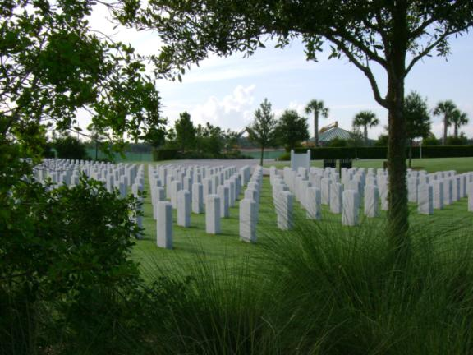
Our Needs (What NCA Buys)
Grounds maintenance
Notes:
Maintenance at some cemeteries is performed by contractors; this is especially true at cemeteries that are closed to new burials, and outlying soldiers’ lots and plots.
This is Sarasota National Cemetery on Florida’s west coast, one of our newest and still under construction.

Slide 13
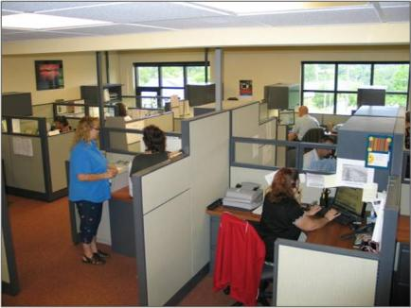
Our Needs (What NCA Buys)
Equipment and vehicles
Office supplies, equipment, and equipment maintenance
Notes:
We buy equipment and vehicles for use in cemetery operations. We work closely with manufacturers/suppliers to address our unique needs.
Here you see a Toro vehicle adapted as a casket carrier; it is small and maneuverable enough to move and operate between rows of headstones without damaging turf and nearby headstones and monuments.
We also buy office supplies and equipment and maintenance contracts for that equipment.

Slide 14
Our Needs (What NCA Buys)
Services
- Counseling and advisory
- Training
- Security
- Janitorial
- Trash and garbage
disposal
Notes:
In addition to buying things, we also contract for a number of services.
We hire training contractors/instructional designers to help us develop robust courses and training materials for our National Training Center. Here you see our Under Secretary, Steve Muro, visiting with participants in our new Caretaker Course, which contractors helped us design.
We also contract out a number of studies and surveys, as I mentioned (emerging burial; internal customer satisfaction survey, etc.)
We also hire security, janitorial and trash disposal services at our cemeteries and other offices

Slide 15
Our Needs (What NCA Buys)
Architectural and engineering services
Construction
Notes:
We are currently leading the largest expansion of national cemeteries since the Civil War.
We built 18 new national cemeteries between 1992 and 2010, and five more planned in FL (2), NE, NY, and CO.
We build in phases to meet burial demands, usually in 10-year increments.
Last year, we introduced our urban initiative, under which we will build columbarium-only satellite cemeteries in densely populated urban areas, where the existing national cemeteries are closed (NY City, San Francisco, Chicago, Indianapolis, and LA).
Obviously, this requires architectural and engineering expertise and large construction contracts.

Slide 16
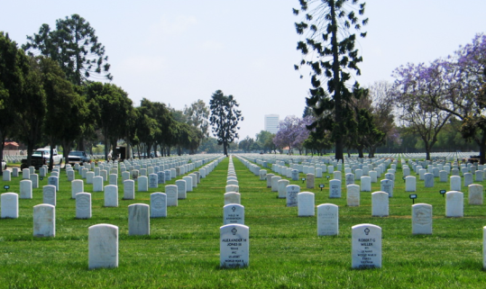
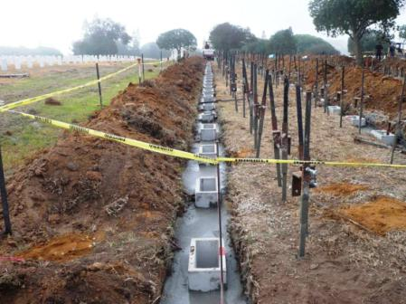
Our Needs (What NCA Buys)
Millennium projects
Notes:
We also have a number of special projects ongoing at any time, including what we call “millennium projects”, which Congress funded to help us bring cemetery appearance up to national shrine standards.
These projects include “raise and realign” efforts like the one you see here at Los Angeles National Cemetery. This employs a marker support system to keep headstones and markers correctly aligned for longer periods of time.

Slide 17
Our Needs (What NCA Buys)
Historic preservation
American Recovery and Reinvestment Act (ARRA)
Notes:
Other special projects include wide-ranging historic preservation/conservation activity, ranging from lodge and monument restoration to mothballing. Over 100 of the properties we manage date to the Civil War, so we also play an important role as caretakers of American history.
ARRA allowed us to take on a number of projects in this arena. The one you see here is restoration of a monument for Union soldiers at Knoxville National Cemetery in Tennessee.
We do not have the skills in-house to take on very much of this kind of work.

Slide 18
Additional Information
Points of Contact
Tom Muir, Deputy Under Secretary (202) 461-6234
Tracey Boyd-Vega, Director Contracting (540) 658-7206
Rob Joshua, Stafford Chief (540) 658-7201
Garry Harris, DC Chief (202) 632-5539
Tyra Lee, Small Business Rep (540) 658-7214
Other Sources of Procurement Information:
System for Award Management (SAM) http://www.sam.gov
Online Representations and Certifications Application (ORCA) https://orca.bpn.gov/
Vendor Information Pages (VIP) http://www.VetBiz.gov
Federal Business Opportunities or https://www.fedbizopps.gov/
VA Forecast of Contracting Opportunities (FCO) https://www.vendorportal.ecms.va.gov/eVP/fco/FCO.aspx
GSA eBuy https://www.ebuy.gsa.gov/advgsa/advantage/ebuy/start/
Contractor Performance Assessment Reporting System (CPARS) http://www.cpars.gov
Additional Business Resources: http://www.va.gov/osdbu/index.asp
Notes:
Add information if you have something specific to your organization or suggestions not listed. Otherwise ust dleate first bullet and leave rest of slide information as is.

Slide 19
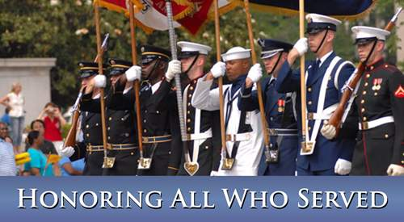
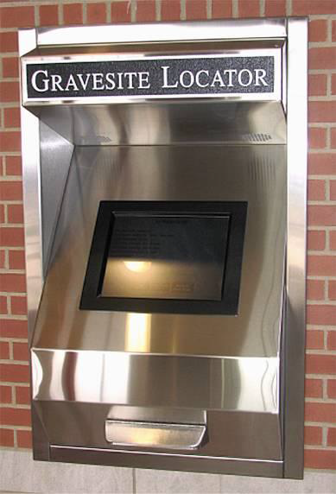
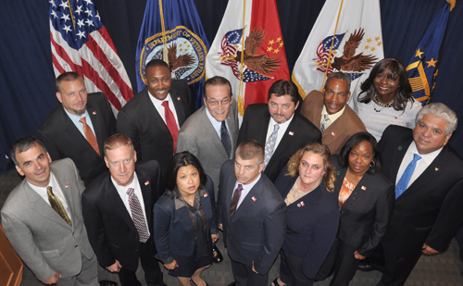
Questions
?

