Slide 1
Medical Appointment Scheduling System (MASS) Industry Day Briefing
Presented by: Dr. Mike Davies
Director, Access Clinic Administration Program
June 18, 2014

Slide 2
Agenda
The Need
Business Drivers for New Capability
Scheduling Capabilities
Implementation Challenges and Constraints

Slide 3
Defining Access (VHA)
“The timely use of personal health services to achieve the best possible health outcomes”
(IOM’s “Access to Health Care Access in America”)
Access means providing the right services, in the right place, at the right time, by the right providers, in the right way.

Slide 4
The Need
VHA Outpatient Medical Scheduling

Slide 5
The Environment
Significant increase in Veterans enrolled in VA healthcare
Total number of U.S. Veterans has shrunk 17% since 2001 from 26M to 21.6M in 2013
During that time, the number of Veterans enrolled in the VA healthcare system has increased 78%, from 5.1M in 2001 to 9.1M in 2013
Increasing healthcare needs of special Veteran populations
Aging Veterans in need of chronic disease management, geriatric services, long-term care
Younger Veterans from current conflicts in need of treatment and rehabilitation for traumatic injuries, TBI, PTSD
Veterans with mental health needs
Growing number of women Veterans requiring gender-specific services
Veterans in rural and highly rural areas without easy access to VA medical facilities
Homeless Veterans in need of a full range of support services, including healthcare

Slide 6
VistA Scheduling
Blue Screen Roll and Scroll
First installed April, 1985
30 seconds to 5 minutes to make an appointment
VA relies on “time stamps” to understand delay
VA’s early Desired Date reliability thought to be in 60% range
2011 Audit showed 90% reliability rate
2012 Study showed time stamps better than capacity measures
Recent scheduling “stand-down” revealed manipulation of time stamps, overly complex poorly understood scheduling and clinic management processes

Slide 7
The Core Problem
A single provider has clinical time represented across many clinic profiles, resulting in inability to measure/manage provider “supply”
Consequence: Time Stamps
Appointment
Created
Scheduled
Appointment
Date
Appointment
Canceled by
Clinic or Patient
Appointment
Rescheduled
Appointment
Completed
Appointment
“Desired”

Slide 8
VistA Software & Clinic Management Issues
Appointment scheduling “manual” (including entering desired date)
Electronic Work (Wait) List business rules not really automated
Recall Scheduling is a separate application
New Enrollee Appointment Request is a separate application not connected to VistA Scheduling
Consults are “loosely” connected to scheduling
Patient appointment notification letters not user friendly.
Some facilities/networks have “post-card” reminders
No other capability for patient notification/reminders
No capability for patient self-scheduling
Does not capture patient preferences for notifications or appointment times

Slide 9
Business Drivers for New Capability
Business Drivers for New Capability

Slide 10
VA Scheduling Demands
Medical care delivery has changed
Evolution of health care delivery has moved well beyond VistA Scheduling capabilities
Prevalence of tele-health, rural health, home health, electronic access, non-VA care
VA’s current Scheduling System does not meet current or future needs
No resource management capabilities
Cumbersome to support and manage new modes of care
The need to capture data for reporting has made scheduling complex
Unable to meet current demand
Scheduling is extensive
~ 85 M appointments per year
50,000 staff scheduling appointments
154 Medical Centers, 700+ Community Based Outpatient Centers (CBOCs)
High demand requires a state of the art system that balances demand and resources

Slide 11
Gaps Between Need and Current VistA Capability
While there are many gaps and limitations between how VHA wants to provide access and how VistA Scheduling enables access, there are three major points worth highlighting
Inability to Enforce or Monitor Policy results in …
Lack of transparency into supply and demand results in …
Numerous queues requesting care results in …
Different interpretations and implementations of policy
Leaves open how the data should be interpreted
And the data is not auditable
Reducing quality of data for measuring performance
Industry tools allow for automation and enforcement of business rules to support policy and directives and have extensive audit capabilities
Ineffective clinic management
With limited ability to forecast with confidence
Contributing to excessive wait times
Industry tools allow for better visibility and management of resources to better meet veteran demand
Ineffective clinic management
With inability to understand demand
Contributing to excessive wait times
Industry tools allow for management of queues for pending requests for care, integrated with scheduling capability resulting in seamless end to end experience

Slide 12
Additionally…
VistA Scheduling was created to support in-hospital, one on one, face to face appointments
Scheduling is being used to schedule non-face to face, non-one on one appointments
Telehealth
Home health
Group appointments
Extensive reporting to support billing and facility reimbursement is performed using scheduling data. This has created a burden as VistA Scheduling and its data are configured to accommodate both purposes.
These factors have resulted in a proliferation of clinic profiles
The extensive number of clinic profiles without tools to manage them results in inefficient use of provider time, inefficient use of schedulers and manual work-arounds to accommodate demand for care
Veteran population expectation for self service, to include self requesting, self scheduling are not available with VistA Scheduling

Slide 13
Vision –
Adjust to evolving Veteran and organizational needs
Provide Veterans with consistent, seamless, high quality, predictable scheduling interaction
Enable Veteran self help
Support for new models of care
Ability for any scheduler to schedule across boundaries
Develop truth and transparency
Confidence in availability of provider time
Data for improved clinic management
Efficient, timely use of scheduling staff and scheduled resources
Enable efficient, standard, error-free scheduling practices
Ability to enforce automated business rules
Ability to consolidate scheduling functions
Nationalized scheduling
Notes:
These scope statements address the business drivers

Slide 14
Technology is One Part of the Entire Solution
People
Organization structure & design
Motivators & Reward Systems
Human capital management
Workforce planning
Competencies
Leadership
Performance management
Technology
Data
Applications
Technology Infrastructure
Performance management
Policy and Process
Activities and tasks
Sequence
Information Sharing
Decision Rights
Targets and outputs
Physical Infrastructure
Locations
Facilities at each location
Workplace environment
Space, utilization targets

Slide 15
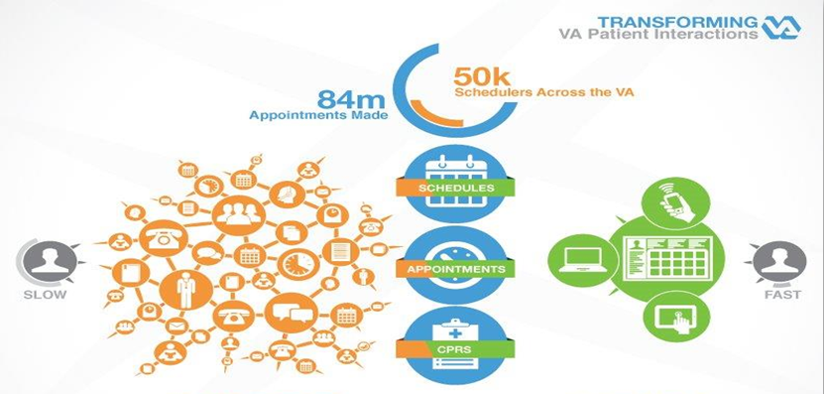
Outpatient Medical Scheduling
CURRENT
Complicated and Time Consuming
FUTURE
Streamlined Solution

Slide 16
Scheduling Capabilities
VHA Medical Appointment Scheduling System

Slide 17
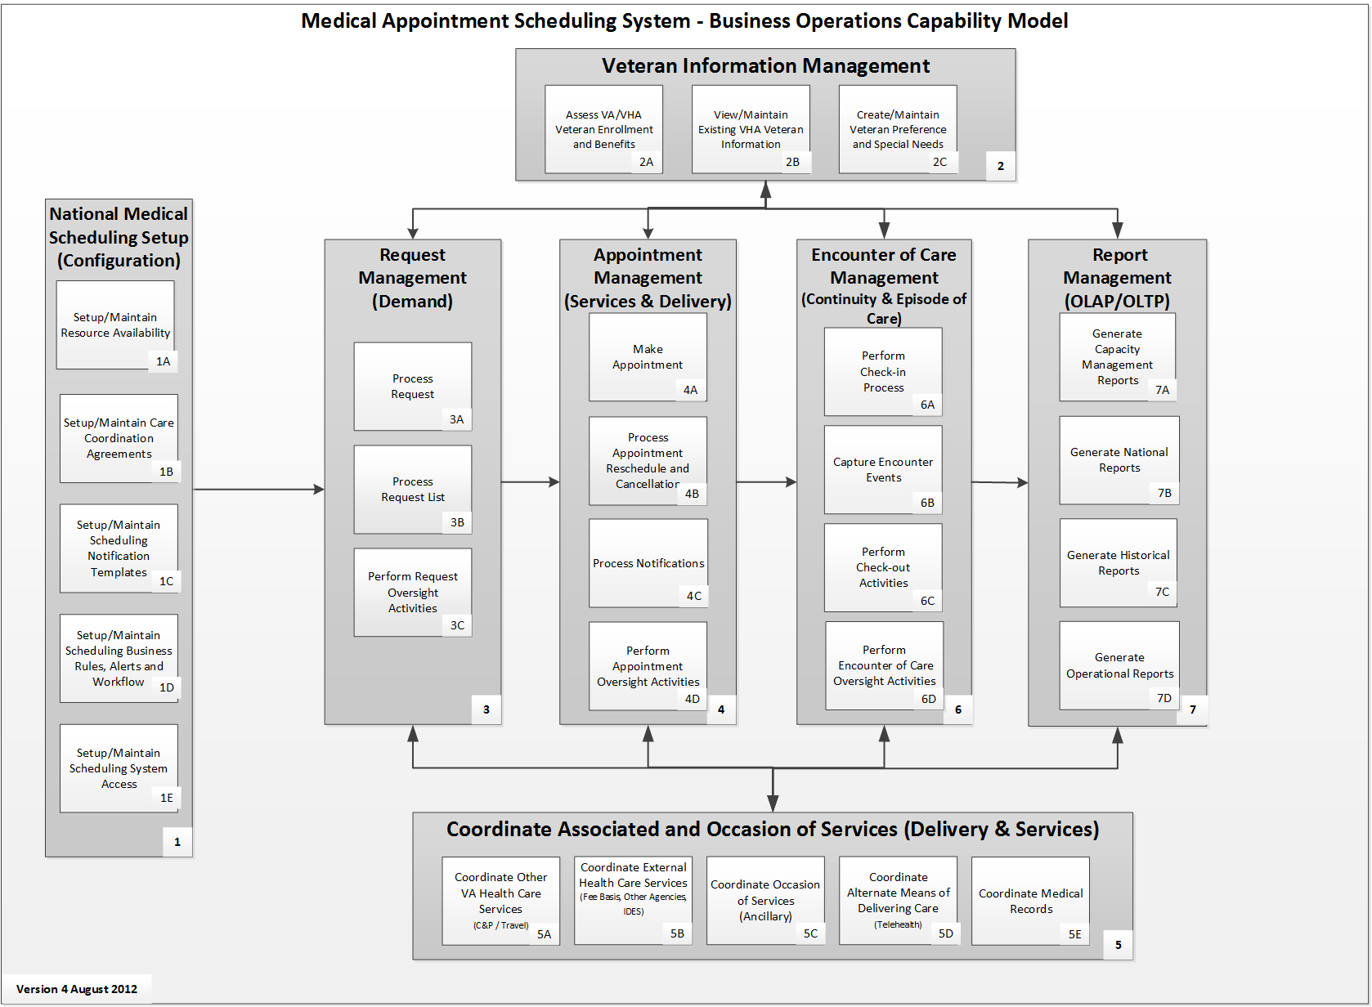
Framework

Slide 18
National Unique / High Priority Business Needs
Proactive resource management-based scheduling that schedules staff, facilities, equipment
Patient self-scheduling
Single view of the patient across facilities
Efficient, effective user interface that enables error-free scheduling of resources
VistA scheduling data must continue to support current VistA reporting, DSS coding and other non-scheduling business processes as it currently does today
Timestamps to capture Veteran cycle of care and episode of care, starting from first contact with VA
Unique time measurement data, such as: capture of desired date, create date, appointment completed date, pending future appointment date, third next available date
Scheduling information exchange with non-VA care providers

Slide 19
Capability 1: Medical Appointment Scheduling System Setup
Definition
Unique / High Priority Features
The Medical Appointment Scheduling System Setup capability establishes system operating parameters for provider, facility, and equipment, service agreements, notification templates, business rules, alerts, workflow, and system access. While business rules are established at the national level, some may be tailored at VISN and facility levels within policy constraints to ensure accurate data exchanges and consistent reporting results.
Resources, such as provider, support staff, equipment and facilities, can be configured for availability and services
Ability to create system level configurable business rules that are leveraged throughout the scheduling process
Role-based security access to schedule resources, allowing for various levels of access
Ability to develop and share templates
Configuration to mirror the multi-level construct of VHA: National, VISN, Health System, Facility, Outpatient clinics; allowing for cascading of policy via business rule enforcement

Slide 20
Capability 2: Veteran Information Management
Definition
Unique / High Priority Features
The Veteran Information Management capability provides access to a common set of Veteran-related information (such as enrollment, eligibility, benefits, and registration). The capability accommodates integration with other business units and organizations inside VA/VHA, with geographically dispersed health care locations across VA regions, between VA and community based partners, and with other government partners. Veteran special needs and preferences shall be accessible and used throughout scheduling process.
Capture special needs and preferences for each patient
Patient information must be consistent with other VA data about the patient
Patient information is shared with any facility where the patient will be seen
VHA eligibility and enrollment data (which comes from another source within VistA) integrated into scheduling process
Allow patients to schedule appointments at any facility based upon permissions of the patient and medical service
New, easily accessible reporting capability allowing for broader analysis (across VHA) and deeper analysis (category of patient, condition, era, etc.) of scheduling performance

Slide 21
Capability 3: Request Management
Definition
Unique / High Priority Features
The Request Management capability initiates the scheduling process with a request for care. The Veteran's desired date and request’s create date are key components captured during the request process. Requests are entered from a variety of input sources (such as web, mobile, email, phone) creating a standard view of information to be processed, tracked and reported.
Able to capture requests for service from multiple sources, and present them in a single view
Patients are able to request appointments using different modes such as email, web access, mobile applications, etc.
Patients are able to schedule routine or follow up appointments
Robust capability to manage multiple input sources for care requests to achieve appointment fulfillment rate standards
Able to track all dates associated with any services from VA. Dates/times should be system-protected, reportable, auditable

Slide 22
Capability 4: Appointment Management
Definition
Unique / High Priority Features
The Appointment Management capability efficiently matches the Veteran’s healthcare desire with VA resources. It assesses availability of resources from services across facilities while displaying an integrated representation in order to efficiently schedule an appointment.
This capability allows for the flexibility to cancel and reschedule appointments, and standardizes the notification process to Veterans and their families.
Appropriately capture desired date for each appointment
Automated implementation of business rules as configured when searching for resources and creating appointments
Flexibility to substitute appropriate resources assigned to appointment
Improve notification process through capture of patient preference for notification, using standard and configurable notification templates
Ability to coordinate multiple resource sets at multiple locations for a single appointment (telehealth)
Ability to link dependent appointments and activities
Create appointment for any service at any facility and delivery type based upon role-based access as defined in setup
Ability to coordinate multiple appointments for a patient
Use scheduling preferences when scheduling appointment (i.e., van riders)
Coordinate special needs throughout scheduling process

Slide 23
Capability 5: Coordinate Services
Definition
Unique / High Priority Features
The Coordinate Services capability fosters interaction between VA facilities and those external to VA, promoting effective information sharing between stakeholders. The ability to view available enterprise resources allows for the coordination and fulfillment of requests (such as compensation and pension exam, Interagency Disability Evaluation System, telehealth, fee basis, ancillary, travel and medical records). The ability to coordinate care and communicate with other government partners (such as DoD, CDC, and NIH) will provide more options, and track care across agencies.
Make data available to the travel determination process
Request scheduling data from non-VA healthcare delivery sources
Coordinate consults and resultant appointments across service lines to reduce waiting time
Schedule health care delivery modes including home based healthcare, telehealth & phone/email/web services

Slide 24
Capability 6: Encounter of Care Management
Definition
Unique / High Priority Features
The Encounter of Care Management capability is the culmination of appointment management that results in medical treatment. These activities ensure continuity of data between requests for care and delivery of care, creating the data used in wait-time reporting, capacity and resource planning, and follow-up activities to reach continuity of care goals.
Timestamps to capture patient cycle of care and episode of care, starting from first contact with VA
Efficiently exchange scheduling data with encounter data throughout scheduling process

Slide 25
Capability 7: Report Management
Definition
Unique / High Priority Features
Report Management is an overarching business capability that captures reporting needs at the national, VISN and facility levels that support operational and strategy business goals. It uses data from the scheduling application and interfacing systems. Data is used to produce reports from the service line level to the national level and may be exported/shared with external partners.
VistA scheduling data must continue to support current VistA reporting, DSS coding and other non-scheduling business processes as it currently does today
Robust data analysis features and capability based on consistent, standard data
Additional data elements captured to provide more detailed wait time and patient care measures
Capture data to report resource and capacity utilization
Visual display of data throughout scheduling process (calendar view or other)
Easily accessible reporting capability allowing for broader analysis (across VHA) and deeper analysis (category of patient, condition, era, etc.) of scheduling performance

Slide 26
Challenges, Constraints and Resulting strategy
VHA Medical Appointment Scheduling System

Slide 27
Challenges
Extensive oversight and aggressive timelines
Various organizational models for Access responsibilities and oversight
Organizational changes under way to address oversight and accountability
Paradigm shift to move to resource-centric scheduling and capacity management
Motivating users towards adoption
Ensuring scheduling data is integrated into the clinical workflow via relationship with VistA Evolution
Training Challenges
Strategy that can train 50k users without impact to operations
Current training mechanisms are inefficient
Need training mechanism that results in standard understanding of procedures, minimizing local interpretation
A way to validate understanding

Slide 28
Constraints
Clinical operations must continue
Least impact to clinical operations
Only one major change for clinical and support staff per area
Must continue to provide data for congressional reports
Cannot modify non-scheduling processes dependent on scheduling data, such as billing
Information required for scheduling will remain local and be maintained locally (at the VistA instance level)
Current VistA EHR constrains how fast we move to national resource sharing
Operational processes vary across facilities and VISNs

Slide 29
Business Strategy – Near term and Long term solutions
Enhanced management capability
CVT, GUI utilities using VistA, Mobile apps, etc.
Allows time to standardize and to identify/modify non-scheduling processes
Faster path to VHA operational improvements
Leverages 1b solution, integrated with national data sources
Integrates with Vista4/Vista Evolution
Nationally standard data and processes
COTS replacement of VistA scheduling
COTS implemented at VistA instance level
2
1b
Provide immediate, short term improvement to the local scheduling experience
1a
Notes:
How the technical implementation goes

Slide 30
Near Term Relief – Improved interfaces for Schedulers & Patients
Clinical Video Teleconferencing (CVT).
Automated, intra-facility web-based interface/system to perform scheduling for clinical video teleconferencing (CVT) and Telehealth instead of the existing manual processes
Will deliver decreased wait times, increased scheduling efficiency, decreased frustration, and overall increased satisfaction with the nationwide CVT program
Scheduling Manager App.
Changes view from “blue screen roll-and scroll” to a calendar picture view that pulls together relevant information in one screen needed to make an appointment.
Patient Directed Scheduling App.
Allows patients to self-schedule selected appointment slots.

Slide 31
Near Term Solution – Enhancement to Core Vista Scheduling Software
Enhancements to existing VistA Scheduling software
Delivers:
Resource management dashboard,
Aggregated clinical schedule
Single queue of request lists
Projected contract award: 4th Q FY14
Expect project to have three increments with development starting ~ 4th Q FY14.

Slide 32
Complete Medical Appointment Scheduling Solution
Goal is a commercial solution (open or closed source); building on the interfaces delivered during the open source competition
Proactive resource management-based scheduling that schedules staff, facilities, equipment
Provide transparency to balance supply with demand -
Provide single, consolidated view of resource availability (e.g. one calendar per clinician)
Provide single, consolidated list of appointment requests (e.g. single view of the patient)
Improved transparency through richer data for reporting
Efficient, effective user interface that enables error-free scheduling of resources
Provide consistent implementation and visibility of business rules to support scheduling policies and directives
Provide ability to seamlessly coordinate care across facilities
Provide ability for patients to self-schedule
Timestamps to capture Veteran cycle of care and episode of care, starting from first contact with VA

Slide 33
VA seeks a Partner to Improve Access to Care

