Slide 1
Advanced Planning Brief to Industry (APBI)
Norbert Doyle
VHA Chief Procurement & Logistics Officer October 22, 2014

Slide 2
Agenda
VA Overview
VHA Procurement and Logistics Overview
Office of Procurement Overview
Network Contracting Office Structure

Slide 3
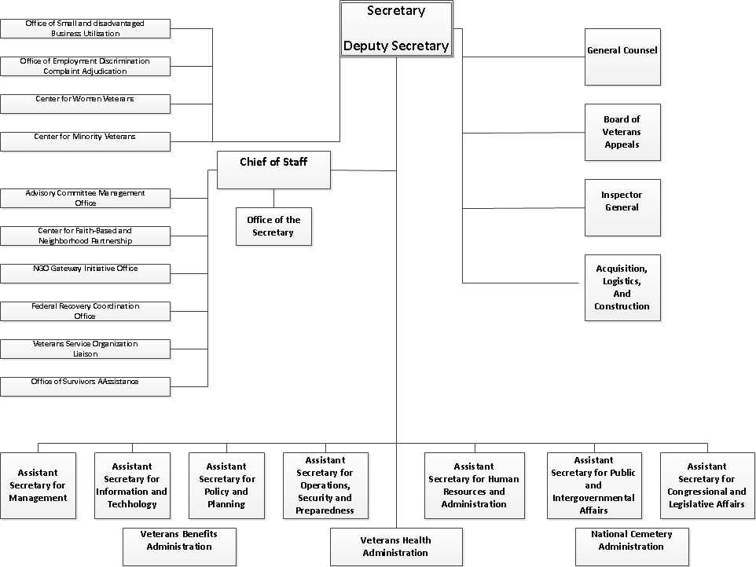
VA Overview

Slide 4
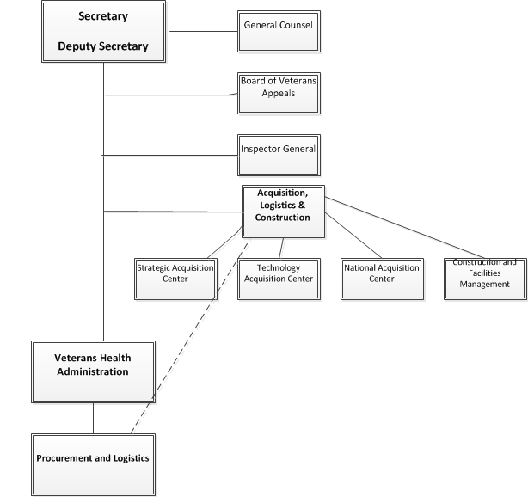
Procurement and Logistics Relationship to OALC

Slide 5
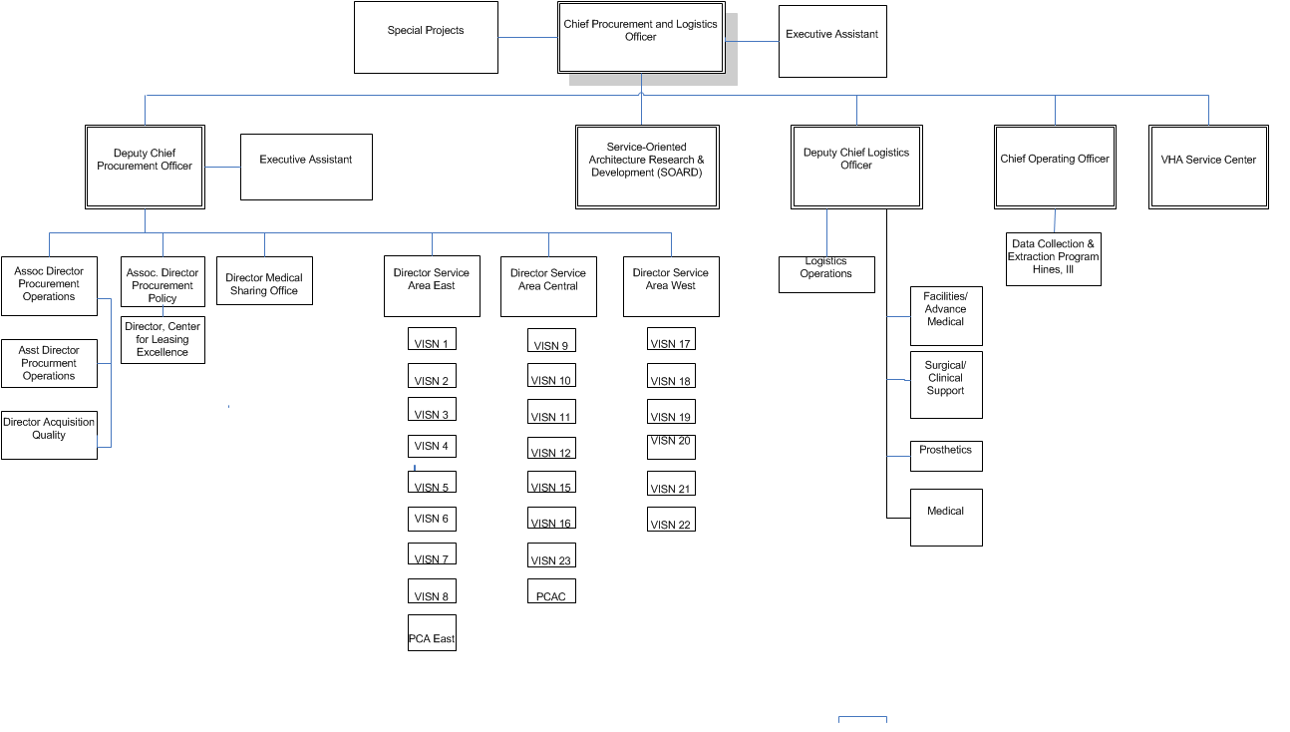
Office of Procurement and Logistics Overview

Slide 6
SAO West/Central/East Network XX Contracting Office

Slide 7
SAO West/Central/East Network XX Contracting Office

Slide 8
SAO West/Central/East Network XX Contracting Office

Slide 9
What We Buy
Construction –
Minor
Non-recurring Maintenance
$1.4B in FY 14
Supply –
Medical/Surgical
Products to keep facilities running
$2.3B in FY 14
Services –
Keep facilities running
$2.1B in FY 14

Slide 10
What We Buy (continued)
Medical Sharing –
Non-VA Medical Care (University Partners)
$1.3B in FY 14
Specialized –
Prosthetics
Leases
$650K in FY 14

Slide 11
Questions
?

