Slide 1
1
150 Years of Keeping the Promise
Advanced Planning Briefing to Industry (APBI)
Mr. Thomas Muir
Deputy Under Secretary for Management
October 22, 2014
150 Years of Keeping the Promise

Slide 2
Briefing Agenda
History and Mission
Field Structure
Budget and Workload Data
Eligibility and Scheduling
Benefits
Excellence
Future Burial Needs
NCA Contracting
What We Buy
Questions
Notes:
This is what I will cover during our time together today.
Please stop me with any questions.

Slide 3
NCA History
First national cemeteries established in 1862
Prior, soldiers buried
where they fell
“To care for him who shall have borne the battle, and for his widow and his orphan.”
(2nd Inaugural Address, March 4, 1865)
Commander-in-Chief Lincoln
Notes:
We are currently commemorating the 150th anniversary of the Civil War and of the establishment of national cemeteries.
The first national cemeteries were developed during the Civil War, and we still manage about 100 properties dating to that period.
Before the cemeteries were established, soldiers were typically buried where they died in battle. In 1862, Congress enacted legislation authorizing President Abraham Lincoln to purchase grounds for use as national cemeteries.
As commander-in-chief and a Veteran himself, Lincoln understood the sacrifices of soldiers and their families. In his Second Inaugural Address, he pledged the nation “To care for him who shall have borne the battle and for his widow and his orphan.” That remains VA’s motto today.
.

Slide 4
NCA Mission
The National Cemetery Administration (NCA) honors Veterans and their families with final resting places in national shrines and lasting tributes that commemorate their service and sacrifice to our Nation.
NCA Vision
To be the model of excellence for burial and memorial benefits for our Nation’s Veterans and their families
Notes:
Our mission statement highlights NCA’s obligation to honor Veterans and families.
All of us at NCA view our mission as a Sacred Trust.
Our mission drive our vision: to be THE MODEL OF EXCELLENCE in providing burial services to Veterans and their families. Our commitment to excellence is reflected in our passion for customer service which I explain in further detail in our next slide.

Slide 5
NCA Responsibilities
Provide burial space for Veterans and eligible family members
Maintain national cemeteries as national shrines
Administer the Federal grants program for construction of state and tribal Veterans cemeteries
Furnish headstones, markers and medallions for the graves of Veterans around the world
Administer the Presidential Memorial Certificate (PMC) Program
Administer the First Notice of Death (FNOD) program
Notes:
This is what NCA is responsible for. The first four are statutory missions, under Title 38.
As you saw in our mission statement, we provide burial for Veterans and eligible family members and maintain their burial sites as national shrines, so each of our visitors departs feeling these places are worthy of Veterans’ service and sacrifice.
We administer a grants program for construction of State and Tribal Veterans cemeteries.
We furnish headstones, markers and medallions, and we administer the Presidential Memorial Certificate program.
We also manage VA’s First Notice of Death program, which provides centralized processing for notifications of Veteran deaths. We assumed this responsibility from VBA administratively—that is, it is not one of our statutory missions.
I will touch on these responsibilities in more detail as we move through the presentation.

Slide 6
Partners in Managing Military
and Veterans Cemeteries
VA – 131
VA grant-funded cemeteries - 91
Army - 30
Interior - 14
Gettysburg National Cemetery, PA
ABMC - 25
Notes:
Most of the national cemeteries were managed by the Army Department until 1973, when Congress passed a law transferring many of the national cemeteries to the Veterans Administration, creating the National Cemetery System. The name was changed to the National Cemetery Administration in 1998.
However, other entities still manage Veterans and military cemeteries today, as shown here. VA has oversight of 131 cemeteries, plus 33 other soldiers’ lots, plots and monument sites.
The Army still manages two national cemeteries—Arlington National Cemetery and the one at the Soldiers’ Home in D.C.—as well as another 28 post cemeteries. Pat Hallinan, a former director of NCA field programs, is now the Executive Director of the Army Cemeteries Program.
The Department of Defense also has additional cemeteries at the service academies and on other installations nationwide.
14 more national cemeteries are run by the National Park Service, which is part of the Department of the Interior. Those cemeteries, like Gettysburg—which you see in this photo—are interpreted in conjunction with the Civil War battlefields where soldiers fought and died.
The American Battle Monuments Commission oversees another 25 burial grounds for fallen members of the U.S. military; they are all overseas in places like Normandy. The Commission is a separate agency within the Executive Branch.
And finally, states, territories, and tribes also run 93 Veterans cemeteries. We’ll talk more about those later. (2 of 93 are tribal cemeteries…Monte Calvario in Arizona/Pascua Yaqui Tribe.; Rosebud Sioux in Rosebud, SD)

Slide 7
NCA Field Offices
Indianapolis activities: MSN IV; Cemetery Development and Improvement Service; HR Center
St. Louis activities: National Training Center; National Cemetery Scheduling Office; First Notice of Death Office
Notes:
90 of our 131 national cemeteries are open, which means they provide at least one burial option for first interments. The remaining/closed cemeteries only offer second interments; most are satellites of larger, open cemeteries and many are contracted out for maintenance.
For administrative purposes, our national cemeteries fall under five regional offices, called Memorial Service Networks‒or MSNs‒as shown here. They are located in Philadelphia; Atlanta; Denver; Indianapolis, and Oakland. The largest numbers of cemeteries and personnel are concentrated along the east coast, in MSNs I and II.
Each is led by an SES-level Executive Director and the director’s staff. The MSNs provide direction, operational oversight, engineering, HR, and contracting assistance to the cemeteries located in their geographic areas.
Indianapolis is the base for the Cemetery Development and Improvement Service and our HR Center.
Our training center, cemetery scheduling office and First Notice of Death office are co-located in St. Louis.

Slide 8
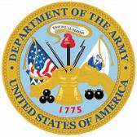
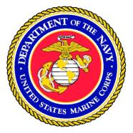
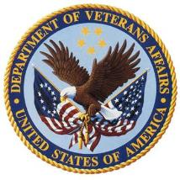
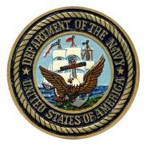
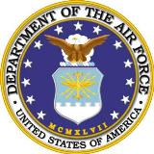
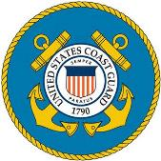
Veterans Serving Veterans
1,772 employees
About 87% of our employees work outside of DC
Over 74% of NCA employees are Vets
highest of any
Federal agency
Includes 450+ returning Veterans from Iraq and Afghanistan
Notes:
The NCA employees 1772 FTW. About 87% of our employees work outside of DC, in both wage-grade and general-schedule positions.
One of the things we are most proud of at NCA is the huge percentage of Veterans in our workforce.
Nearly three-quarters (74.7%) of our employees are Vets. If you take out Central Office, that moves closer to 80%.
That’s the highest percentage—by far!—in any Federal agency.

Slide 9
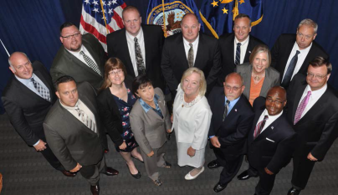
National Training Center
Cemetery Director Intern Class of 2013 (right)—August 8, 2014
Graduation of the first class of NCA Cemetery Caretaker Apprentice Program—November 15, 2013 (below right)
On-site training as part of the NCA Caretaker Training Program (below)
Notes:
NCA has developed a number of best practices which promote national shrine status, reduce maintenance costs, encourage efficiencies and are environmentally conscientious.
1. Raise and Realign Projects - All headstones and markers are maintained at proper height and alignment. To achieve this standard, we have completed raise and realign projects at 85 national cemeteries since 2001. These projects must meet strict technical specifications to be consistent with National Shrine standards. These are “before & after” pictures from a raise & realign project. The “after” photo you just saw is the result of using headstone/marker support systems in our raise and realign projects.
2. Installation of Support Systems: The systems vary but they are all designed to keep headstones from sinking and becoming mis-aligned over time. In the case of the system shown on the right, a trench is dug and filled with gravel; the boxes sit on the gravel, and concrete is poured between the boxes to stabilize them. The boxes themselves contain sand or gravel to allow slight adjustments to headstones, as needed.
This approach saves both time and money and—most importantly—will keep our cemeteries looking beautiful longer
3. Use of pre-placed crypts: We have been recognized with the VA Sustainability Award for improvements in the methods, materials, and equipment to pre-place concrete burial vaults at new and existing state and Federal Veterans cemeteries. Previously, we excavated and placed the vaults in the gravesite just prior to burial. By pre-placing the vaults, we decreased land requirements and gravesite construction costs by 50% due to land not purchased and sod and irrigation systems not installed. This program also reduces annual maintenance costs by $34,000 per acre due to reduced mowing, irrigation, pesticide/fertilizer applications, and correcting soil settlement. They help keep headstones from sinking.
4. Sustainability is very much on our minds as we plan our new cemeteries … especially in areas like Colorado, California (Bakersfield N/C pictured) and in Texas, where water is at a premium. But the truth is, water is an issue in more states than people tend to realize—including in the south and southeast. In some places, we can get water—but the cost is prohibitive. In other places, water isn’t available in the quantities we’ve used in the past. And in some places, the climate is not hospitable to traditional turf—which certainly impacts appearance.
At our three “water-wise” cemeteries--Ft Bliss, National Memorial Cemetery in Arizona, and Bakersfield we use decomposed granite (instead of typical turf) and individual drip emitters for trees, shrubs, other plants. Our goal is to make cemetery operations more sustainable by doing what makes sense--for the environment, and financially--in each location…while maintaining cemeteries as beautiful national shrines.
National Training Center located in St. Louis. 2013-14 Cemetery Director Class graduated on August 8, 2014. Next class scheduled for September 8, 2014.
The National Cemetery Administration Cemetery Director Intern Class of 2015 matriculated September 8th to begin 49 weeks of classroom and field training in leadership, business acumen, NCA history and culture, and cemetery operations. Eleven of the 12 class members are Veterans, representing the Army, Navy, Air Force and Marines. Eight of the 12 come from within VA—five from NCA and three from VHA. NCA’s National Training Center in St. Louis serves as the base of operations for the group. Upon graduation in August 2015, they will report to 1 of 131 VA-managed national cemeteries as a director or assistant director.

Slide 10
Volunteer Support
Guardians of the Cemetery, Washington Crossing National Cemetery, Newtown, PA (above left); Vaca Valley Garden Club, Sacramento Valley National Cemetery, CA (above)
Volunteers donated 304,123 hours of service to national cemeteries in FY13
Valued at $6.5 million
Notes:
We also receive support from thousands of volunteers nationwide.
Our volunteers donated over 300,000 hours of service in 2013, valued at about $6.5 million.
Some volunteers help beautify cemeteries. Others greet visitors and direct traffic. Still more do clerical work.
Others perform funeral honors for Veterans being laid to rest; that’s one of the most critical duties our volunteers fulfill, and families value their participation.

Slide 11
President’s Budget Request FY15*
Line Item | Amount Requested (in millions of dollars)
Operations and Maintenance | $256.8
Major Construction | 10.0
Minor Construction | 60.0
Veterans Cemetery Grants Program | 45.0
Total, Discretionary | 371.8
Total, Compensation and Pension | 120.8
Notes:
VA’s burial and memorial programs are funded from both discretionary and mandatory accounts.
Mandatory funding of about $120.8 million is provided from the Compensation and Pension account, managed by the Veterans Benefits Administration (VBA). These funds are used to pay for burial benefits, including the purchase of headstones, markers, medallions ($85.3 million)and pre-placed crypts, and for partial reimbursements for privately purchased grave liners ($35.5 million). This table highlights all of NCA’s discretionary funding in the President’s FY15 Budget Request, totaling $371.8 million:
-O&M: $256.8 million to fund 1,767 FTE and the operation of VA national cemeteries, soldiers lots, and monument sites and their maintenance as national shrines.
-Major Construction: $10 million includes $7.5 million for land acquisition and $2.5 million for advance planning activities such as master planning for new cemeteries and expansion at existing national cemeteries, environmental assessments at national cemeteries, and performing facility condition assessments at national cemeteries, soldiers lots, and monument sites under the jurisdiction of NCA.
-Minor Construction $60 million to address infrastructure deficiencies and for gravesite expansion and columbaria projects to keep existing national cemeteries open. This amount includes $2 million for land acquisition.
-Grants: $45 million for grants to assist states and tribal organizations in establishing, expanding, or improving Veterans cemeteries.
This level of funding will enable us to meet an increasing demand for benefits and services, while still maintaining the outstanding customer service NCA is known for.

Slide 12
FY2013 Benefits Workload Data
Service | Completed
Interments | 124,787
Headstones and Markers Provided | 358,572
Presidential Memorial Certificates Provided | 654,470
Medallions Provided | 8,995
Notes:
Here’s a quick recap of services provided during Fiscal Year 2013:
We conducted close to 125,000 interments—a record number for NCA;
Processed applications for more than 358,572 markers and headstones;
Ordered nearly 655,000 Presidential Memorial Certificates,
And provided nearly 9,000 bronze Veterans medallions.
Currently, we provide perpetual care for 3.9 mil Veterans, service members, Reservists and family members in 3.3 mil gravesites.

Slide 13
FY2013 Recap: Interment Workload
Rank | Cemetery | Total Interments
1 | Riverside (CA) | 8,267
2 | Florida (FL) | 6,836
3 | Calverton (NY) | 6,309
4 | Ft. Snelling (MN) | 5,022
5 | Jefferson Barracks (MO) | 4,799
6 | Ft. Logan (CO) | 4,130
7 | Ft. Rosecrans/Miramar (CA) | 4,110
8 | Ft. Sam Houston (TX) | 4,021
9 | Dallas-Ft. Worth (TX) | 3,878
10 | Willamette (OR) | 3,797
Notes:
These were the Top 10 VA cemeteries nationwide for 2013, ranked by interment workload.
Riverside averages more than 150 burials per week—which can mean as many as 30 per day.
64% of first full-casket burials occur in the 20 busiest cemeteries.

Slide 14
Eligibility Criteria and Scheduling
Any member of the U.S. Armed Forces who dies on active duty
Any Veteran who was discharged under qualifying conditions (other than dishonorable)
National Guard members and Reservists with 20 years of qualifying service, who are entitled to retired pay
Spouses, minor children and certain parents
The National Cemetery Scheduling Office serves all national cemeteries, seven days a week, 362 days a year
Toll Free Number:
1-800-535-1117
Notes:
The groups you see here are generally eligible for burial in a VA national cemetery.
Under the “Corey Shea Act”, Congress extended burial benefits to certain parents of eligible service members buried in a VA cemetery—when those service members are killed in action or during combat-related training activities.
We will find space in any national cemetery, even one generally closed to new interments, for service members killed in action.
We do not take reservations in national cemeteries.
However, we are able to do “set asides” for dual-Veteran couples—where each spouse has eligibility in their own right—so they can be buried in adjoining graves.
You will want to be aware that Title 38, United States Code, section 2411 prohibits interment or memorialization of persons who have committed federal or State capital crimes. Only applies to the perpetrator and does not affect eligibility of other family members.
I also want to describe the process of determining eligibility and scheduling interments because its critical aspect of our commitment to customer service.
Burial in a national cemetery begins when a Veteran or family members dies, and the next of kin or a funeral director contacts our National Cemetery Scheduling Office.
This office is open seven days a week, 362 days a year—we don’t staff it on Thanksgiving, Christmas and New Year’s Day.
The National Scheduling Office now supports all VA cemeteries, including providing bilingual representatives to support requests for interment at Puerto Rico National Cemetery.
As I said earlier, the center is staffed with experts to help determine eligibility for burial, so it relieves cemetery directors of the responsibility to consider eligibility and sensitive cases.
An appeal process is available for families to appeal denial of burial or requests for headstones and markers.
We are also launching more aggressive outreach in FY 15 to increase awareness and utilization of NCA burial benefits that Veterans, Service members and family members have earned and deserve.

Slide 15
Burial Benefits
Burial in a national cemetery:
Gravesite
Opening and closing of the grave
Grave liner
Perpetual care of the gravesite
Headstone, Markers or Niche Covers
Presidential Memorial Certificate
Bronze Medallion
U.S. Flag (VBA benefit)
Military Funeral Honors (DoD)
Notes:
Now, let me be more specific about the benefits we provide to Veterans.
All veterans with qualifying discharges are offered the dignity of committal or memorial services in a national cemetery.
At no cost to the family, burial at a national cemetery includes use of a committal shelter for services, the gravesite, grave liner, opening and closing of the grave, a headstone or marker, and perpetual care within a national shrine.
In addition to providing burial space, NCA also offers other ways to commemorate Veterans—through our Memorial Programs Service.
A government-furnished headstone or marker is available for Veterans who are interred in private cemeteries. Approximately 2/3 of the approximately 360,000 government-furnished headstones and markers we provide each year are placed on Veterans’ gravesites in private, state, or DOD cemeteries.
Families can also receive a Presidential Memorial Certificate, expressing the Nation’s gratitude and honoring the deceased’s memory. In 2013, we delivered more than 650,000 certificates to loved ones.

Slide 16
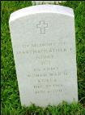
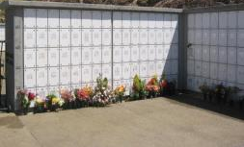
Memorial Benefits
“In Memory of…”
Upright
Headstone
Presidential
Memorial
Certificate
Burial Flag
Niche Covers
Bronze Medallion
Flat Marker

Slide 17
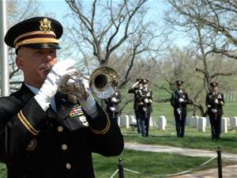
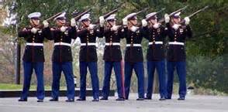
Military Funeral Honors
Department of Defense (DoD) is responsible for providing military funeral honors
Veterans organizations may assist in the provision of military funeral honors
NCA cemetery staff may assist in coordinating military funeral honors

Slide 18
American Customer
Satisfaction Index (ACSI)
In 2013, NCA again achieved the highest
ranking of any participating organization – 96%!
Fifth consecutive time!
Notes:
Our commitment to excellence is reflected in our unsurpassed record of achievement on the American Customer Satisfaction Index. We participate every three years; the most recent is the 2013 survey. Five consecutive times during the past 13 years, NCA attained the highest score of any participating entity, public or private on the index…which was founded at the Ross School of Business at the University of Michigan and now administered by a ACSI LLC. In fact, we received the highest rating in ACSI history! (96)
NCA surpassed over 100 other federal agencies, and industry leaders like Lincoln and Apple. And even better news is that we improved on our rating in 2010!
We value and act on the feedback and recommendations we receive from the ACSI, our own customer surveys, and the various advisory committees within VA—such as those representing minority and women Veterans—as well as from participating in forums like this.
All of this input helps us better serve Veterans, their families and their survivors.

Slide 19
2013 Survey of Satisfaction
Conducted annually
since 2001
Mailed to next of kin and funeral directors
Ties to strategic plan goals for customer service and cemetery appearance; i.e., 100% satisfaction by 2015
Columbarium, Indiantown Gap National Cemetery, PA
Notes:
In addition to external validation of our commitment to excellence, NCA conducts an annual survey of our primary customers – Veterans, their families and funeral directors who act as Veteran and family agents at their time of need. The survey is administered by an independent research contractor. In 2013 24,000 surveys were mailed to NOK and 8,000 to funeral directors from 3-12 months after interment of a Veteran or eligible family member in a national cemetery.
Generally very pleased with results:
-Overall, 98% of respondents were satisfied with their experiences.
-96% agreed service was excellent.
-99% agreed cemetery appearance was excellent.
- 99% agreed that they would recommend the national cemetery to Veteran families at their time of need. (“trust”)
Goals in our strategic plan call for 100% of respondents to agree that service and appearance are excellent, so we still have some work to do by 2015.
And the percentage of cemeteries that met or exceeded our strategic performance targets for cemetery appearance and “trust increased for the third consecutive year in 2013. (71%)

Slide 20
NCA Best Practices
BEFORE
AFTER
Raise and Realign projects
Installation of Support Systems
Sustainability Efforts
Pre-placed crypts
Notes:
NCA has developed a number of best practices which promote national shrine status, reduce maintenance costs, encourage efficiencies and are environmentally conscientious.
1. Raise and Realign Projects - All headstones and markers are maintained at proper height and alignment. To achieve this standard, we have completed raise and realign projects at 85 national cemeteries since 2001. These projects must meet strict technical specifications to be consistent with National Shrine standards. These are “before & after” pictures from a raise & realign project. The “after” photo you just saw is the result of using headstone/marker support systems in our raise and realign projects.
2. Installation of Support Systems: The systems vary but they are all designed to keep headstones from sinking and becoming mis-aligned over time. In the case of the system shown on the right, a trench is dug and filled with gravel; the boxes sit on the gravel, and concrete is poured between the boxes to stabilize them. The boxes themselves contain sand or gravel to allow slight adjustments to headstones, as needed.
This approach saves both time and money and—most importantly—will keep our cemeteries looking beautiful longer
3. Use of pre-placed crypts: We have been recognized with the VA Sustainability Award for improvements in the methods, materials, and equipment to pre-place concrete burial vaults at new and existing state and Federal Veterans cemeteries. Previously, we excavated and placed the vaults in the gravesite just prior to burial. By pre-placing the vaults, we decreased land requirements and gravesite construction costs by 50% due to land not purchased and sod and irrigation systems not installed. This program also reduces annual maintenance costs by $34,000 per acre due to reduced mowing, irrigation, pesticide/fertilizer applications, and correcting soil settlement. They help keep headstones from sinking.
4. Sustainability is very much on our minds as we plan our new cemeteries … especially in areas like Colorado, California (Bakersfield N/C pictured) and in Texas, where water is at a premium. But the truth is, water is an issue in more states than people tend to realize—including in the south and southeast. In some places, we can get water—but the cost is prohibitive. In other places, water isn’t available in the quantities we’ve used in the past. And in some places, the climate is not hospitable to traditional turf—which certainly impacts appearance.
At our three “water-wise” cemeteries--Ft Bliss, National Memorial Cemetery in Arizona, and Bakersfield we use decomposed granite (instead of typical turf) and individual drip emitters for trees, shrubs, other plants. Our goal is to make cemetery operations more sustainable by doing what makes sense--for the environment, and financially--in each location…while maintaining cemeteries as beautiful national shrines.

Slide 21
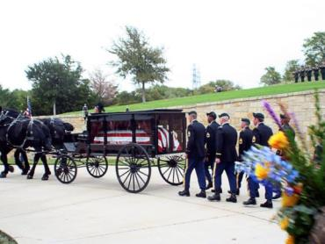
National Shrine Recognition
Gold Awards
Dallas-Ft. Worth
Georgia
Quincy (IL)
Green Awards
Danville (IL)
Fayetteville (AR)
Florida
Ft. Custer (MI)
Ft. McPherson (NE)
Dallas-Ft. Worth
Ohio Western Reserve
Black Hills (SD)
Dallas-Ft. Worth National Cemetery
Notes:
Our national shrine commitment is central to our culture of accountability. It comes down to this: we operate our national cemeteries in a manner befitting the Veterans whose service we honor and commemorate.
This is a photo from Dallas-Ft. Worth National Cemetery, which attained National Shrine status in 2013.
So far, 11 national cemeteries have met or exceeded the standards required to achieve “national shrine” status.
The National Cemetery Shrine Scorecard consists of selected NCA Operational Standards and Measures considered most important to the visual impact the cemetery has on Veterans’ families and cemetery visitors.

Slide 22
Percentage of Vets Served*
100
90
80
70
60
50
40
30
20
10
0
% of Veterans Served
FY01
FY04
FY07
Fiscal Year
FY12
FY17
*By an open national, state or tribal Veterans cemetery within 75 miles of home
Notes:
One of our key performance measures at NCA is the percentage of Veterans served by a burial option in an open national or state Veterans cemetery, within 75 miles of their homes. The study used this metric as well.
This is very much in keeping with the Secretary’s priority of ensuring Veterans and families have access to the benefits and services they earned through their service and sacrifice.
At the beginning of Fiscal Year 04, approximately 75% of Veterans were served with a burial option.

Slide 23
Three Pronged Approach
Extend the service life of existing cemeteries
Develop new national cemeteries
Five (5) national cemeteries planned
Five (5) Urban cemeteries
Eight (8) Rural cemeteries
State and Tribal Cemetery Grant Program
Jefferson Barracks National Cemetery, MO
Notes:
We are committed to meeting Veterans’ burial needs, today and in the future. The first prong is to extend the service life of existing cemeteries.
This is our top priority, because we want to prevent the loss of a burial option for Veterans who are currently served by a national cemetery. This approach includes expansion projects designed to keep existing national cemeteries open–by developing additional gravesites and columbaria, or by acquiring additional land. The photo shown here is of the new columbarium at Jefferson Barracks.
There is an increasing trend nationwide for cremation instead of full-casket burials. Almost half of burials (49%) in national cemeteries are for cremated remains, and we have some new cemeteries where the rate is far higher.
By adding columbaria to existing cemeteries, we are responding to this trend, while also keeping space available for those Veterans who choose to be buried in-ground.
The second prong in our strategy is to build new cemeteries.
We are currently leading the largest expansion of national cemeteries since the Civil War, having built 18 new cemeteries since 1992.
We recently established a new Veterans’ population threshold for determining the location of new national cemeteries. It is 80,000 Veterans within 75 miles of a proposed site. (The old threshold was defined as 170,000 Veterans within 75 miles.)
Under this change in policy, five new national cemeteries are planned. These new cemeteries will provide a burial option to approximately 500,000 currently unserved Veterans.
Under our urban initiative, we will be establishing columbarium-only sites in densely populated, major metropolitan areas.
We have also recently established a new Rural Burial Initiative.
The third prong is to establish State and Tribal cemeteries.

Slide 24
National Cemetery Construction
Western NY area
Chicago area
Omaha National Cemetery, NE
San Francisco
area
New York City area
Indianapolis area
Southern CO area
Los Angeles area
Tallahassee National
Cemetery, FL
Cape Canaveral National Cemetery, FL
New National Cemetery
Urban Initiative
Notes:
The five new national cemeteries will be in: Tallahassee, Florida; Scottsmoor, Florida (which is above Titusville, to serve the Melbourne-Daytona area); Omaha, Nebraska; Western New York, and Southern Colorado. These sites are shown here in PURPLE. We have acquired land for all five of the new cemeteries and we are “on pace” to break ground this fall for the new Florida cemeteries.
-Under our Urban Burial Initiative, we will be establishing columbarium-only satellite sites in five urban locations: Chicago, Indianapolis, Los Angeles, New York and San Francisco.
Construction of these facilities will better serve urban areas comprised of approximately two million Veterans and address concerns raised by NCA’s customers regarding time and distance challenges associated with accessing national cemeteries. Two of the cemeteries have been named. Tallahassee National and Cape Canaveral National. Both in Florida.

Slide 25
Rural Initiative
MT
ND
ID
ME
WY
WI
UT
NV
NCA is establishing National Veterans Burial Grounds in eight states.
In May 2014, VA dedicated the first of these rural cemeteries (Yellowstone National Cemetery) in Laurel, Montana (see inset picture).
150 Years of Keeping the Promise
Notes:
Under our Rural Burial Initiative, 132,000 currently unserved Veterans will gain convenient burial options in North Dakota, Wisconsin, Wyoming, Montana, Utah, Maine, Idaho and Nevada.
These National Veterans Burial Grounds will be NCA-owned and managed lots. The plan is to share a position with a local VHA facility; primary duty would be to oversee interments and contracts at the burial grounds, while remaining time would be spent in support of VHA.
We recently completed the purchase of Yellowstone National Cemetery in Laurel, Montana (see inset picture), the first of these rural cemeteries.

Slide 26
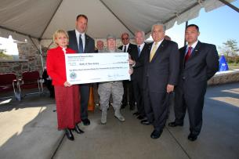
State and Tribal Cemetery Grants Program
VA provides 100% of development costs
93 operational state and tribal cemeteries in 45 states, Guam and Saipan
Over $566 million in grants awarded since 1988
32,000 burials in FY2013
6 new state and tribal cemeteries projected to open between now and 2015
Administrative Building Sicangu Akicita Owicahe (Rosebud Sioux Tribe Veteran Cemetery)
White River, SD
Grant Award Presentation November 2012
BG William C. Doyle Veterans
Memorial Cemetery, Wrightstown, N.J.,
Notes:
Encouraging states and tribes to build cemeteries is the 3rd prong in our strategy.
93 VA-funded state and tribal cemeteries in 45 states, Guam and Saipan. Among them is Sicangu Akicita Owicahe (Rosebud Sioux Tribe Veteran Cemetery, White River, SD). Dedicated in August 2013, Administration Building is pictured here.
In total, we have awarded over $578 million in grant funds since grants program authorization in 1978.
During FY13, state and tribal cemeteries conducted 32,000 burials

Slide 27
Independent Study on Emerging Burial Practices
Nationwide survey with Veterans
Burial options
“Green burials”
Study and survey presented to NCA senior leadership
NCA expects to use the study as a cornerstone of its new Strategic Plan 2015-2021
Notes:
NCA has received the draft of an independent study on Emerging Burial Practices and results of a nationwide survey of Veterans regarding their satisfaction with current burial options and interest in possible new options, e.g. “green burials”, in our national cemeteries. Booz Allan Hamilton presented the study and survey findings to NCA senior leadership on August 24, 2014. NCA expects to use the study as a cornerstone of its new Strategic Plan 2015-2021.

Slide 28
NCA Contracting
Mr. Thomas M. Muir
Deputy Under Secretary for Management/
Head of Contracting Activity
Ms. Tracey Boyd-Vega
Director of Contracting Service
Mr. Robelto Joshua
Chief, NCA Contracting Service
Stafford Office
(Services)
[Vacant]
Chief, NCA Contracting Service
DC Office
(Construction)
Ms. Tyra Lee
Small Business Advocate
Notes:
Provide your title and your major responsibilities with respect to your organization

Slide 29
2014 NCA Veterans Small Business Program
NCA goal of 84%; awarded 85.01%
NCA FY14 | Total FY14 Percentage | Total FY14 Dollars
FY14 Small Business Awards | 85.01% | $158,154,252.07
FY14 SDVOSB Awards | 64.12% | $119,296,966.62
FY14 VOSB Awards | 66.02% | $122,836,723.58
FY14 WOSB Awards | 4.77% | $8,881,960.23
FY14 Minority Business Awards | 33.81% | $62,899,261.98
FY14 HUBZone Awards | 6.61% | $12,303,145.77

Slide 30
FY14 Small Business Contracts by NAICS Code
Small Business contracts by NAICS code Description | NAICS Code | Amount Obligated | Percent of Total Obligations
CUT STONE AND STONE PRODUCT MANUFACTURING | 327991 | $37,604,593.01 | 19.72%
LANDSCAPING SERVICES | 561730 | $31,462,975.83 | 16.50%
CEMETERIES AND CREMATORIES | 812220 | $21,333,372.25 | 11.19%
OTHER HEAVY AND CIVIL ENGINEERING CONSTRUCTION | 237990 | $13,932,534.09 | 7.31%
COMMERCIAL & INSTITUTIONAL BUIDLING CONSTRUCTION | 236220 | $8,215,938.28 | 4.31%

Slide 31
Type of Procurements NCA Solicits
Various small equipment and tools
Inscription Services
Headstone & Markers- Blanks
Furniture
Grave liners
Turf Renovation/ Maintenance
Headstone Setting
Ground Maintenance
Janitorial Services
Maintenance and Repair
Mow/Trimming Services
Waste Removal
Fertilizer & Weed Control Services
Tree Pruning
Construction – A/E Services
Repair Historic Perimeter Walls
Installation of Pre-Placed Crypts
Construct Columbaria/Memorial Walls
Renovation of Lodges
Replace Fences
Replace Admin & Maint Facilities
Gravesite Development
Repair Erosion & Storm Damage
Repair Sidewalks & Roads
Repair Irrigation Systems
Notes:
Notes

Slide 32
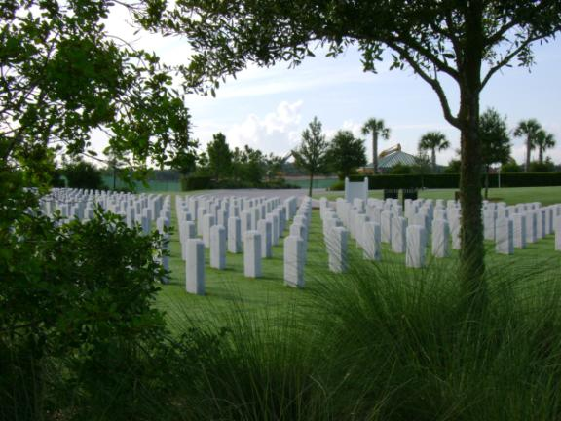
Our Needs (What NCA Buys)
Grounds maintenance
Notes:
Maintenance at some cemeteries is performed by contractors; this is especially true at cemeteries that are closed to new burials, and outlying soldiers’ lots and plots.
This is Sarasota National Cemetery on Florida’s west coast, one of our newest and still under construction.

Slide 33
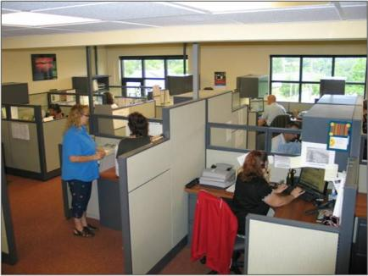
Our Needs (What NCA Buys)
Equipment and vehicles
Office supplies, equipment, and equipment maintenance
Notes:
We buy equipment and vehicles for use in cemetery operations. We work closely with manufacturers/suppliers to address our unique needs.
Here you see a Toro vehicle adapted as a casket carrier; it is small and maneuverable enough to move and operate between rows of headstones without damaging turf and nearby headstones and monuments.
We also buy office supplies and equipment and maintenance contracts for that equipment.

Slide 34
Our Needs (What NCA Buys)
Services
- Counseling and advisory
- Training
- Security
- Janitorial
- Trash and garbage
disposal
Notes:
In addition to buying things, we also contract for a number of services.
We hire training contractors/instructional designers to help us develop robust courses and training materials for our National Training Center. Here you see our Under Secretary, Steve Muro, visiting with participants in our new Caretaker Course, which contractors helped us design.
We also contract out a number of studies and surveys, as I mentioned (emerging burial; internal customer satisfaction survey, etc.)
We also hire security, janitorial and trash disposal services at our cemeteries and other offices

Slide 35
Our Needs (What NCA Buys)
Architectural and engineering services
Construction
Notes:
We are currently leading the largest expansion of national cemeteries since the Civil War.
We built 18 new national cemeteries between 1992 and 2010, and five more planned in FL (2), NE, NY, and CO.
We build in phases to meet burial demands, usually in 10-year increments.
Last year, we introduced our urban initiative, under which we will build columbarium-only satellite cemeteries in densely populated urban areas, where the existing national cemeteries are closed (NY City, San Francisco, Chicago, Indianapolis, and LA).
Obviously, this requires architectural and engineering expertise and large construction contracts.

Slide 36
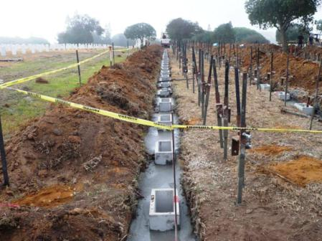
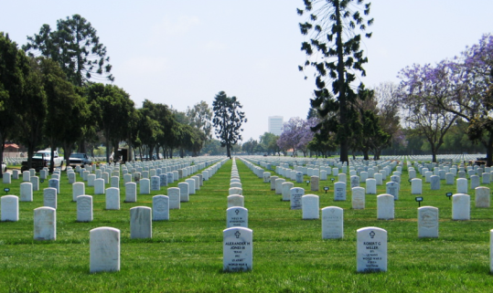
Our Needs (What NCA Buys)
Millennium projects
Notes:
We also have a number of special projects ongoing at any time, including what we call “millennium projects”, which Congress funded to help us bring cemetery appearance up to national shrine standards.
These projects include “raise and realign” efforts like the one you see here at Los Angeles National Cemetery. This employs a marker support system to keep headstones and markers correctly aligned for longer periods of time.

Slide 37
Our Needs (What NCA Buys)
Headstones and Markers
Including many on-site inscription services
Historic preservation
Medallions
Notes:
Other special projects include wide-ranging historic preservation/conservation activity, ranging from lodge and monument restoration to mothballing. Over 100 of the properties we manage date to the Civil War, so we also play an important role as caretakers of American history.
ARRA allowed us to take on a number of projects in this arena. The one you see here is restoration of a monument for Union soldiers at Knoxville National Cemetery in Tennessee.
We do not have the skills in-house to take on this kind of work.

Slide 38
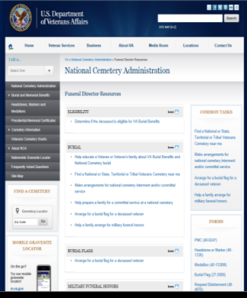
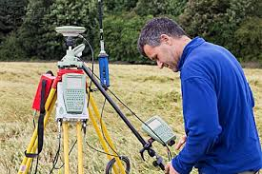
Our Needs (What NCA Buys)
Information Technology
Web site maintenance
GPS and GIS of grave sites and headstones/markers
Mobile applications

Slide 39
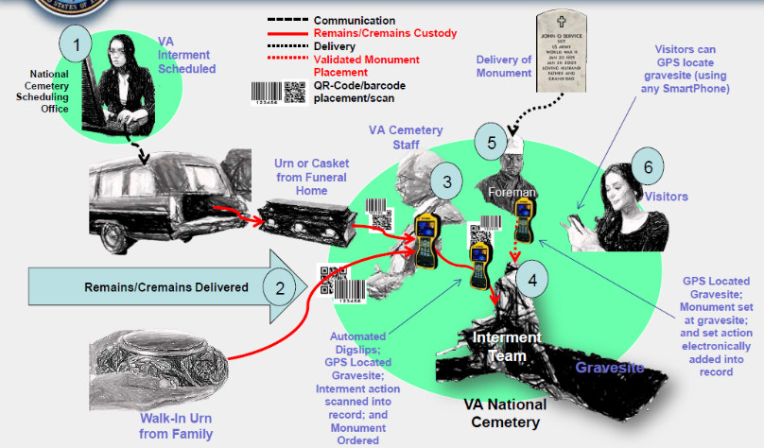
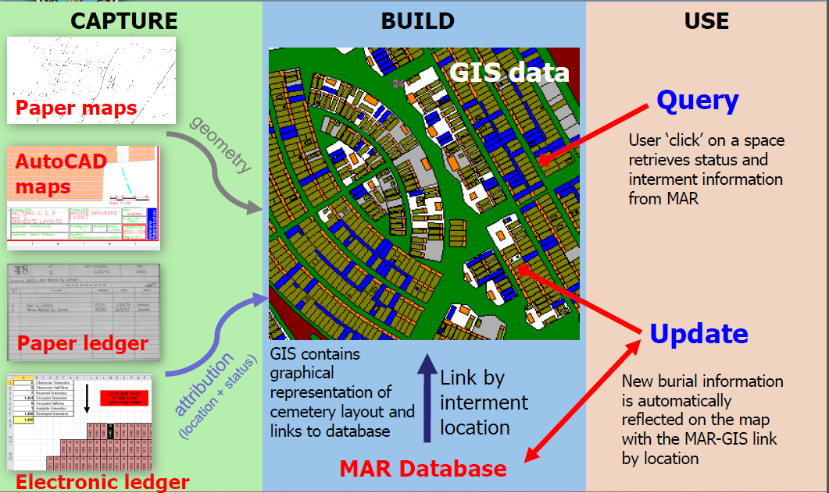
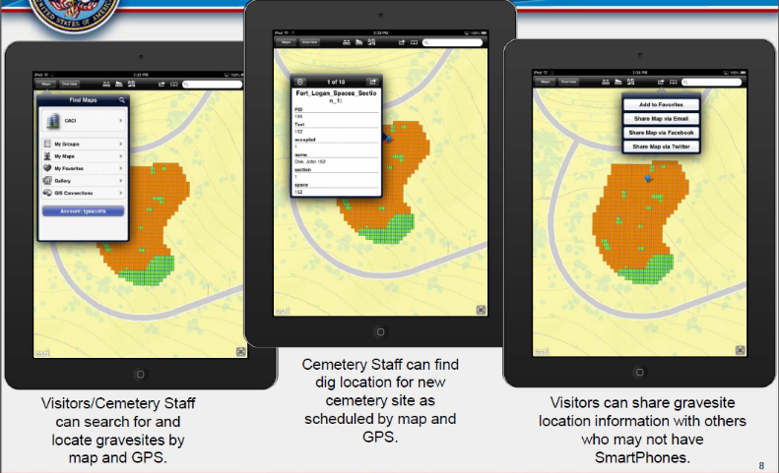
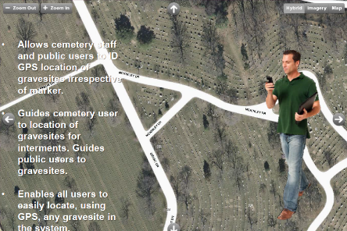
Memorial Benefits Management System (MBMS) Migrating to Modernized Capabilities
Remains Tracking: State of the Art technologies to ensure quality, accurate, timely and efficient management of remains
Digital Real Estate Management: Timely, GIS based, and cost effective management of cemeteries and plots
Mobile Technologies: To support employee productivity and visitors needs in the field

Slide 40
Points of Contact
Points of Contact:
Tom Muir, Head Contracting Activity (202) 461-6234
Tracey Boyd-Vega, Director (540) 658-7206
Rob Joshua, Stafford Chief (540) 658-7201
[Vacant], DC Chief (202) 632-5539
Tyra Lee, Small Business Rep (540) 658-7214
Other Sources of Procurement Information:
System for Award Management (SAM) http://www.sam.gov
Online Representations and Certifications Application (ORCA) https://orca.bpn.gov/
Vendor Information Pages (VIP) http://www.VetBiz.gov
Federal Business Opportunities or https://www.fedbizopps.gov/
VA Forecast of Contracting Opportunities (FCO) https://www.vendorportal.ecms.va.gov/eVP/fco/FCO.aspx
GSA eBuy https://www.ebuy.gsa.gov/advgsa/advantage/ebuy/start/
Contractor Performance Assessment Reporting System (CPARS) http://www.cpars.gov
Additional Business Resources: http://www.va.gov/osdbu/index.asp

Slide 41
1
150 Years of Keeping the Promise
Thank you
Questions or follow up:
Tom Muir
Thomas.muir@va.gov
(202) 461-6234
150 Years of Keeping the Promise

