Slide 1
2023 National Veterans Small Business Engagement
Business Opportunities Session
Department of Veterans Affairs
Technology Acquisition Center
https://WWW.VOA.VA.GOV

Slide 2
Acquisitions and Contractual Authority Disclaimer
Acquisitions and contractual commitments can only be made by Government officials having expressed authority to enter into such agreements on behalf of the United States Government. The only Government officials with such authority are Warranted Contracting Officials. Any discussions of procurement requirements do not constitute contractual direction or authorization of any kind. Future contractual directions, if any, shall only come from the cognizant Department of Veterans Affairs Warranted Contracting Officer.

Slide 3
2023 National Veterans Small Business Engagement
Agenda
Welcome & Introductions
Overview
Organization Structure
Business Opportunities
Resources
Q&A

Slide 4
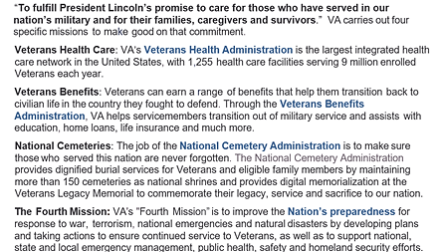
2023 National Veterans Small Business Engagement
Mission Statement

Slide 5
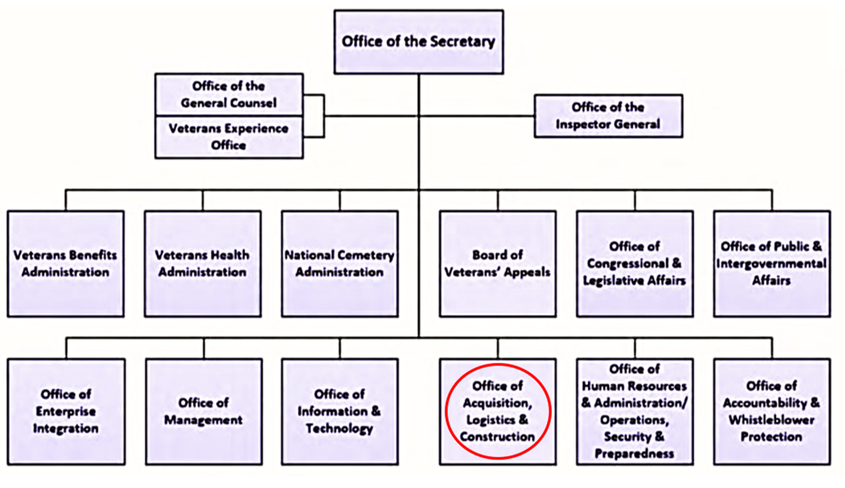
2023 National Veterans Small Business Engagement
VA Organization Overview

Slide 6
2023 National Veterans Small Business Engagement
OALC Organization Structure

Slide 7
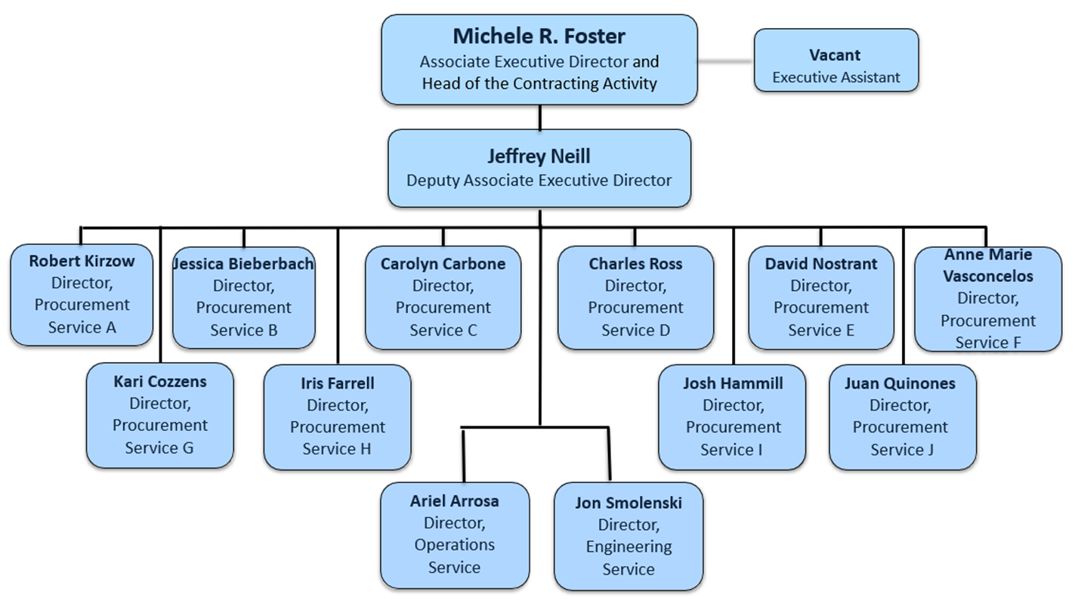
2023 National Veterans Small Business Engagement
TAC Organization Structure

Slide 8
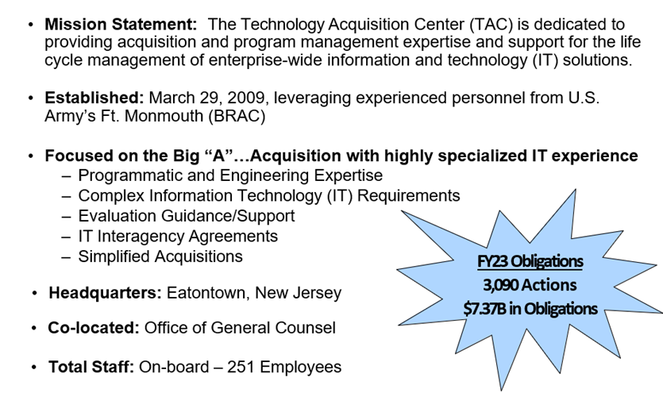
2023 National Veterans Small Business Engagement
TAC Mission and Background

Slide 9
2023 National Veterans Small Business Engagement
TAC Business Partners
The TAC purchases IT products and services used across the VA enterprise
Primary customer is the Office of Information and Technology (OIT)
Other major customers the TAC supports include the following VA
organizations/administrations and their subordinate offices:
Electronic Health Record Modernization Integration Office (EHRM IO)
Veterans Health Administration (VHA)
Veterans Benefits Administration (VBA)
National Cemetery Administration (NCA)
VA Staff Offices
External Federal Agencies

Slide 10
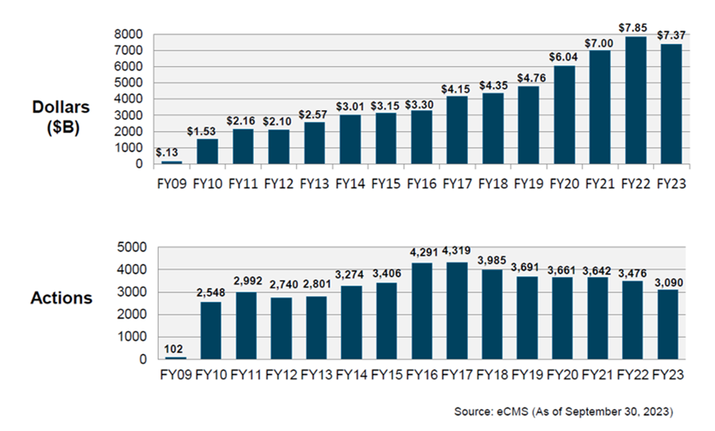
2023 National Veterans Small Business Engagement
TAC Dollars and Actions

Slide 11
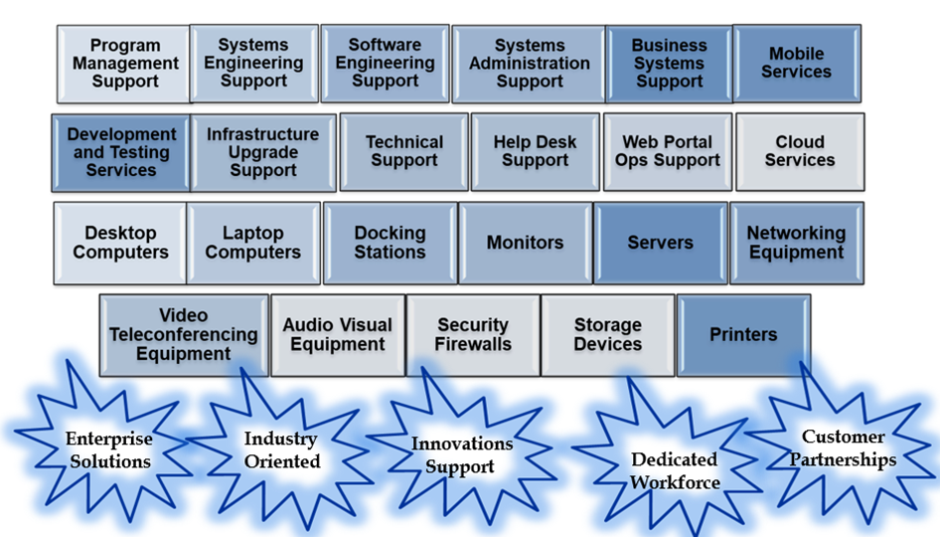
2023 National Veterans Small Business Engagement
What the TAC Buys

Slide 12
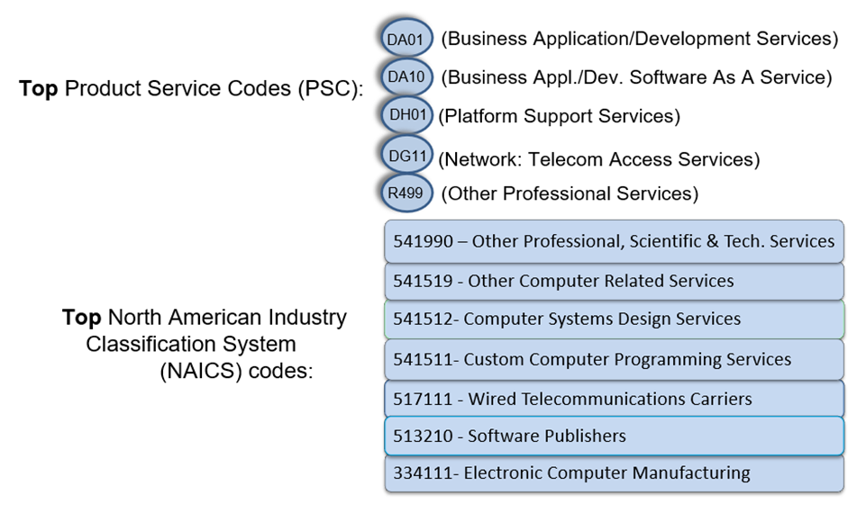
2023 National Veterans Small Business Engagement
Examples of TAC Procurements

Slide 13
2023 National Veterans Small Business Engagement
Veterans First Contracting Program
Establishes a Contracting Order of Priority throughout VA
Service-Disabled Veteran Owned Small Business (SDVOSB)
Veteran Owned Small Business (VOSB)
Historically Underutilized Business Zone (HUBZone) AND 8(a) Business Development Program (Equivalent Priority)
Women Owned Small Business (WOSB) AND Other Small Business Preference
Please refer to the Veterans Affairs Acquisition Regulation (VAAR) for more detailed information.

Slide 14
2023 National Veterans Small Business Engagement
Veterans First Contracting Program
Authorizes VA the unique authority to award set-aside and sole source contracting opportunities to BOTH SBA-certified SDVOSB and VOSB firms.
VA MUST Set-Aside: If there’s a reasonable expectation that offers will be received from two or more SDVOSB/VOSB eligible firms.
VA MAY award Sole Source: To a responsible SDVOSB/VOSB concern if the anticipated award price (including options) will not exceed $5 million.
Note: SBA manages the SDVOSB Contracting Program for the Federal Government. Only VA has the authority to award set-aside and sole source contracting opportunities to SBA-certified VOSB firms.
Please refer to the VA Acquisition Regulation (VAAR) for more detailed information on the Veterans First Contracting Program (Public Law 109-461).

Slide 15
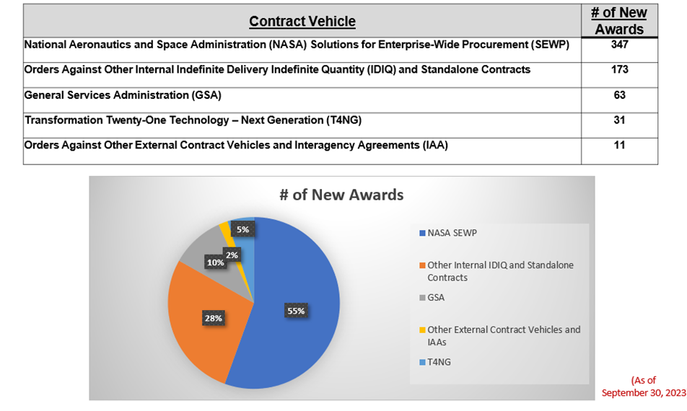
2023 National Veterans Small Business Engagement
The TAC’s most commonly used vehicles

Slide 16
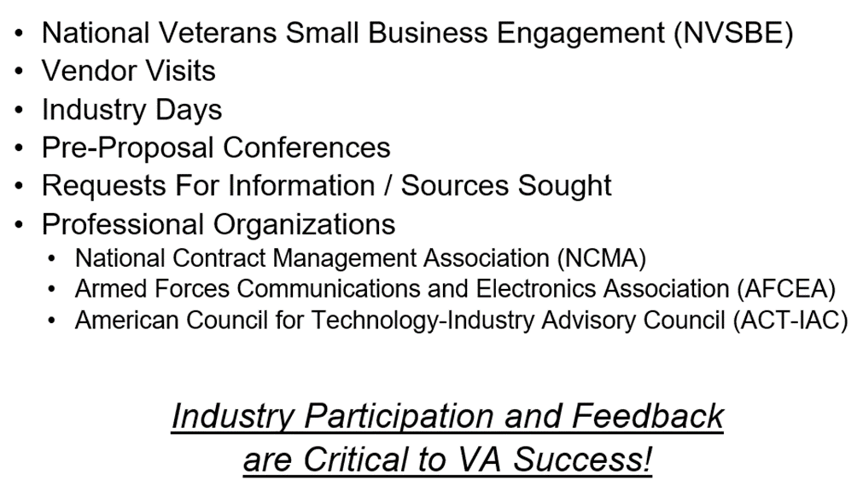
2023 National Veterans Small Business Engagement
Marketing Opportunities

Slide 17
2023 National Veterans Small Business Engagement
TAC Podcasts

Slide 18
2023 National Veterans Small Business Engagement
OIT IT Vendor Management Office (VMO)
The TAC recommends contacting the Office of Information and Technology (OIT) to set-up a meeting with OIT VMO to present your company’s capabilities.
The Point of Contact for OIT is:
James Woodard
Supervisor, IT Vendor Management Office
Main Office: 202-461-5600
ITVMO@va.gov

Slide 19
2023 National Veterans Small Business Engagement
VA Pathfinder

Slide 20
2023 National Veterans Small Business Engagement
TAC Small Business Liaison
Serves as the TAC interface with the VA Office of Small and Disadvantaged Business Utilization (OSDBU) and the Small Business Administration (SBA)
Responds to queries from Small Businesses on conducting business with the TAC
Promotes compliance with Public Law 109-461 (Veterans First Contracting Program), ensuring priority is given to SDVOSBs/VOSBs.
Tony Owens
Tony.Owens2@va.gov
848-377-5233

Slide 21
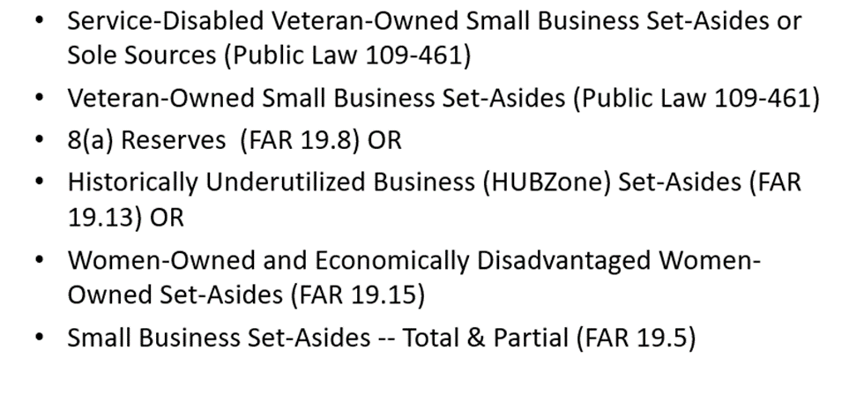
2023 National Veterans Small Business Engagement
Small Business Programs

Slide 22
2023 National Veterans Small Business Engagement
Resources to Identify VA Opportunities

Slide 23
2023 National Veterans Small Business Engagement
Example Past and Current TAC Contracts
Transformation Twenty-One Total Technology – Next Generation (T4NG)
Enterprise contractual solution covering a wide range of IT and Health IT Services,
Including program management and strategic planning, systems and software engineering, enterprise networks, cyber security, operations and maintenance.
37 Active Contracts (17 SDVOSBs and 20 LBs)
$22.3 Billion Ceiling
$5.575 Billion Ceiling Available for Other Federal Agencies
Period of Performance: 3/7/2021 to 3/6/2026
Enterprise-Wide Cloud Capacity and Services
Provides Microsoft Azure and Amazon Web Services Infrastructure as a Service, Platform as a Service and Software as a Service for existing programs/projects that are currently in the cloud as well as new programs/projects that will be migrated to the cloud.
One Contract (SDVOSB); $495 Million Total Value
Period of Performance: 9/6/2017 to 9/5/2022

Slide 24
2023 National Veterans Small Business Engagement
Forecast of Opportunities
Requirement | Description | Anticipated Date Needed | Range of Value $ | VA CO
L-Soft Maintenance Recompete | TBD | FY24 - 1st Qtr | Less than $25,000 | Evan.Schlisserman@va.gov
GitHub Enterprise | TBD | FY24 - 2nd Qtr | Less than $25,000 | Lori.Walker1@va.gov
SmartSheet SaaS | TBD | FY24 - 1st Qtr | Less than $25,000 | Kathryn.Pantages@va.gov
NetScout Maintenance | TBD | FY24 - 1st Qtr | Between $25,000 and $100,000 | Patrick.Hamilton2@va.gov
Salem- Paging System | TBD | FY24 - 1st Qtr | Between $25,000 and $100,000 | Matthew.Truex1@va.gov
ViTel Net | TBD | FY24 - 4th Qtr | Between $25,000 and $100,000 | Debra.Clayton2@va.gov
Amplifire | TBD | FY24 - 1st Qtr | Between $25,000 and $100,000 | Edward.Hebert@va.gov
Dino Maintenance | TBD | FY24 - 1st Qtr | Between $25,000 and $100,000 | Edward.Hebert@va.gov

Slide 25
2023 National Veterans Small Business Engagement
Forecast of Opportunities
Requirement | Description | Anticipated Date Needed | Range of Value $ | VA CO
SCHEDUALL Software Maintenance | TBD | FY24 - 1st Qtr | Between $25,000 and $100,000 | Claudetta.Smith@va.gov
Automated Lab and Radiology Results Letter Services | TBD | FY24 - 1st Qtr | Between $100,000 and $250,000 | Kendra.Casebolt@va.gov
Omnicell Server Upgrade | TBD | FY24 - 1st Qtr | Between $100,000 and $250,000 | Michael.Weckesser@va.gov
NetScout Maintenance | TBD | FY24 - 1st Qtr | Between $100,000 and $250,000 | Mary.Accomando@va.gov
Octopus Deploy | TBD | FY24 - 1st Qtr | Between $100,000 and $250,000 | Heather.Utt@va.gov
Sacramento-Stockton Campus-CBOC VOIP | TBD | FY24 - 1st Qtr | Between $100,000 and $250,000 | Kendra.Casebolt@va.gov
Computrition (VA-23-00094373) | TBD | FY24 - 1st Qtr | Between $100,000 and $250,000 | Edward.Hebert@va.gov
ProVation Software Maintenance | TBD | FY24 - 1st Qtr | Between $100,000 and $250,000 | Brett.Schwerin@va.gov

Slide 26
2023 National Veterans Small Business Engagement
Forecast of Opportunities
Requirement | Description | Anticipated Date Needed | Range of Value $ | VA CO
Cisco Voice over Internet Protocol Equipment - Orlando | TBD | FY24 - 1st Qtr | Between $100,000 and $250,000 | Lori.Walker1@va.gov
Sun Nuclear Premier Support | TBD | FY24 - 1st Qtr | Between $100,000 and $250,000 | Kathryn.Pantages@va.gov
Vocera Service Contract | TBD | FY24 - 1st Qtr | Between $100,000 and $250,000 | Lori.Walker1@va.gov
VISN 4 Prescription Text Messaging and Refill Reminders | TBD | FY24 - 2nd Qtr | Between $250,000 and $500,000 | Matthew.Newell@va.gov
Building Management Control System | TBD | FY24 - 1st Qtr | Between $250,000 and $500,000 | Kendra.Casebolt@va.gov
Theradoc for VISTA/DSS Medical Device Interface | TBD | FY24 - 1st Qtr | Between $250,000 and $500,000 | Edward.Hebert@va.gov
VA CDI Pro Software Services l VISN 12 - Jesse Brown VAMC | TBD | FY24 - 1st Qtr | Between $250,000 and $500,000 | Matthew.Newell@va.gov
Martinsburg CRRC Audio/Visual Equipment Upgrade | TBD | FY24 - 2nd Qtr | Between $250,000 and $500,000 | Brett.Schwerin@va.gov

Slide 27
2023 National Veterans Small Business Engagement
Forecast of Opportunities
Requirement | Description | Anticipated Date Needed | Range of Value $ | VA CO
Theradoc EMR Software | TBD | FY24 - 1st Qtr | Between $250,000 and $500,000 | Lori.Walker1@va.gov
VISN10 Computrition Software | TBD | FY24 - 1st Qtr | Between $250,000 and $500,000 | Debra.Clayton2@va.gov
Vocera Maintenance/Support | TBD | FY24 - 1st Qtr | Between $250,000 and $500,000 | Matthew.Newell@va.gov
Symplr - Credentialing | TBD | FY24 - 1st Qtr | Between $250,000 and $500,000 | Mary.Accomando@va.gov
Interoperability TEFCA QHIN Analysis | TBD | FY24 - 1st Qtr | Between $250,000 and $500,000 | Michael.Weckesser@va.gov
Hewlett Packard Enterprise (HPE) Superdome (SD) Flex 280 Servers_Digital Veterans Platform (DVP) | TBD | FY24 - 1st Qtr | Between $500,000 and $1,000,000 | Peter.Lewandowski@va.gov
Quest TOAD ELA | TBD | FY24 - 3rd Qtr | Between $500,000 and $1,000,000 | Kendra.Casebolt@va.gov
Summit Data Platform (SDP): Analytics Query Accelerator | TBD | FY24 - 4th Qtr | Between $500,000 and $1,000,000 | Matthew.Newell@va.gov

Slide 28
2023 National Veterans Small Business Engagement
Forecast of Opportunities
Requirement | Description | Anticipated Date Needed | Range of Value $ | VA CO
Audio/Visual Equipment Installation and Maintenance Support | TBD | FY24 - 1st Qtr | Between $500,000 and $1,000,000 | Mary.Accomando@va.gov
Data Analytics Software Platform for MEDVAMC Perioperative Care Services | TBD | FY24 - 1st Qtr | Between $500,000 and $1,000,000 | Edward.Hebert@va.gov
FSC National Call Center Fraud Prevention Solution | TBD | FY24 - 1st Qtr | Between $1,000,000 and $5,000,000 | Diana.Armesto@va.gov
ADRT Legacy System | TBD | FY24 - 1st Qtr | Between $1,000,000 and $5,000,000 | Christopher.Minetti@va.gov
DSS PeriOP Management Service Contract Software | TBD | FY24 - 1st Qtr | Between $1,000,000 and $5,000,000 | Kathryn.Pantages@va.gov
Unicom System Architect and Focal Point Maintenance | TBD | FY24 - 3rd Qtr | Between $1,000,000 and $5,000,000 | Troy.Loveland@va.gov
IBM Cognos Subscription and Support | TBD | FY24 - 2nd Qtr | Between $1,000,000 and $5,000,000 | Patrick.Hamilton2@va.gov
Maximo | TBD | FY24 - 1st Qtr | Between $1,000,000 and $5,000,000 | Matthew.Newell@va.gov

Slide 29
2023 National Veterans Small Business Engagement
Forecast of Opportunities
Requirement | Description | Anticipated Date Needed | Range of Value $ | VA CO
Health Data and Analytics Platform: Enterprise Data Catalog Subscription - Collibra Enterprise Platform | TBD | FY24 - 3rd Qtr | Between $1,000,000 and $5,000,000 | Joseph.Jones6@va.gov
VISN 4 ITM Software and Support | TBD | FY24 - 1st Qtr | Between $1,000,000 and $5,000,000 | Mary.Accomando@va.gov
VCS Food Ordering Online and Mobile Application | TBD | FY24 - 1st Qtr | Between $1,000,000 and $5,000,000 | Kathryn.Pantages@va.gov
WAN.003.6 JSA Riverbed Maintenance | TBD | FY24 - 1st Qtr | Between $1,000,000 and $5,000,000 | Michael.Weckesser@va.gov
Application Packaging and Testing Supplement | TBD | FY24 - 1st Qtr | Between $1,000,000 and $5,000,000 | Kathryn.Pantages@va.gov
Insight Team Guidehouse | TBD | FY24 - 2nd Qtr | Between $1,000,000 and $5,000,000 | Matthew.Truex1@va.gov
OPS - PA Human Capital Measurement and Analytics Program Support | TBD | FY24 - 1st Qtr | Between $1,000,000 and $5,000,000 | Christopher.Minetti@va.gov
NCA Digital Services Content Support | TBD | FY24 - 1st Qtr | Between $1,000,000 and $5,000,000 | Brett.Schwerin@va.gov

Slide 30
2023 National Veterans Small Business Engagement
Forecast of Opportunities
Requirement | Description | Anticipated Date Needed | Range of Value $ | VA CO
MongoDB Enterprise Licenses, Maintenance, and Technical Support | TBD | FY24 - 1st Qtr | Between $1,000,000 and $5,000,000 | Edward.Hebert@va.gov
ICW Replacement | TBD | FY24 - 4th Qtr | Between $5,000,000 and $10,000,000 | Mary.Accomando@va.gov
Compliance, Risk and Remediation (CRR) - Business Office Support | TBD | FY24 - 2nd Qtr | Between $5,000,000 and $10,000,000 | Peter.Lewandowski@va.gov
DigiCert | TBD | FY24 - 1st Qtr | Between $5,000,000 and $10,000,000 | Troy.Loveland@va.gov
CUI Controlled Classified Information | TBD | FY24 - 2nd Qtr | Between $5,000,000 and $10,000,000 | Debra.Clayton2@va.gov
Strategic Planning Coordination & Support Services | TBD | FY24 - 2nd Qtr | Between $5,000,000 and $10,000,000 | Kendra.Casebolt@va.gov
PACT Act Tool | TBD | FY24 - 1st Qtr | More than $10,000,000 | Kathryn.Pantages@va.gov
Fusion/JAWS/ZoomText Enterprise Licenses | TBD | FY24 - 2nd Qtr | More than $10,000,000 | Kendra.Casebolt@va.gov

Slide 31
2023 National Veterans Small Business Engagement
Forecast of Opportunities
Requirement | Description | Anticipated Date Needed | Range of Value $ | VA CO
SaaS Cancer Registry System | TBD | FY24 - 2nd Qtr | More than $10,000,000 | Kendra.Casebolt@va.gov
VISN 8 PACS Maintenance and Support | TBD | FY24 - 2nd Qtr | More than $10,000,000 | Patrick.Hamilton2@va.gov
Imperva Maintenance Recompete | TBD | FY24 - 2nd Qtr | More than $10,000,000 | Patrick.Hamilton2@va.gov
IT Strategic Communications (ITSC) | TBD | FY24 - 3rd Qtr | More than $10,000,000 | Heather.Utt@va.gov
Online Scheduling and CIE-Front End | TBD | FY24 - 1st Qtr | More than $10,000,000 | Joseph.Jones6@va.gov
Citrix Software, Hardware Maintenance and Technical Support | TBD | FY24 - 2nd Qtr | More than $10,000,000 | Debra.Clayton2@va.gov
Electronic Freedom of Information Act Software | TBD | FY24 - 2nd Qtr | More than $10,000,000 | Patrick.Hamilton2@va.gov
VCS Store Inventory Mgmt Solution | TBD | FY24 - 2nd Qtr | More than $10,000,000 | Debra.Clayton2@va.gov

Slide 32
2023 National Veterans Small Business Engagement
Forecast of Opportunities
Requirement | Description | Anticipated Date Needed | Range of Value $ | VA CO
Financial Management Support Services | TBD | FY24 - 1st Qtr | More than $10,000,000 | Matthew.Truex1@va.gov
Insurance Card Buffer Web (ICBWeb) Software Licenses, Maintenance and Support | TBD | FY24 - 1st Qtr | More than $10,000,000 | Troy.Loveland@va.gov
Clinisys Software and Services | TBD | FY24 - 1st Qtr | More than $10,000,000 | Mary.Accomando@va.gov
VA Audio Response Software as a Service (SaaS) Solution | TBD | FY24 - 2nd Qtr | More than $10,000,000 | John.Fields3@va.gov
VA Enterprise Human Capital Management Modernization | TBD | FY24 - 2nd Qtr | More than $10,000,000 | Kendra.Casebolt@va.gov

Slide 33
2023 National Veterans Small Business Engagement
Questions

