Slide 1
Advanced Planning Brief to Industry (APBI)
Tom Murphy
Veterans Benefits Administration December 10, 2015

Slide 2
Agenda
Background
VBA Service Offerings & Transformation
Big Picture: VBA Contract Services
Major Program(s) Summary
Upcoming Acquisition/Opportunities
Questions

Slide 3
Background
Veterans Benefits Administration
Administers programs that delivered more than $90 billion in FY15 for Veterans across the following business lines:
Programs are managed with an annual budget of $3 billion through nationwide network of 56 regional offices
Compensation | Pension
Education | Home Loan Guaranty
Life Insurance | Vocational Rehabilitation

Slide 4
VBA Missions & Service Offerings: FY15 and FY16 To Date
COMPENSATION
Paid est. $70.5B to nearly 4.5M Veterans in FY15
Completed record-breaking 1.4M claims in FY15
3.1M non-rating end products completed in FY15 – 15% higher than FY14
EDUCATION
Provided est. $12.3B to over 1M beneficiaries in FY15
4M claims processed in FY15
Post-9/11 GI Bill paid $58B to 1.5M students and schools since inception
PENSION & FIDUCIARY
Paid est. $5.5B in Pension benefits to over 500K Veterans & survivors in FY15
Paid est. $6.3B in DIC to an estimated 386K survivors in FY15
Over 183K Fiduciary beneficiaries on the rolls in FY15 – 10K more than FY14
LIFE INSURANCE
Insured 6.4M beneficiaries in FY15
11th largest Insurance program in U.S.
Provides over $1.3T in coverage under 10 lines of protection
Paying insurance death claims in avg. of 3.4 days at 99.7% accuracy
VBA
TRANSFORMATION
VOCATIONAL REHABILITATION & EMPLOYMENT
Nearly 100K Veterans received an estimated $1.2B in VR&E benefits in FY15
132K participants in FY15 – 7% more than FY14
22K employees
$96B in benefits distribution
$2.5B in general operating expenses
HOME LOAN GUARANTY
Over 2.4M home loans on the books
Guaranteed 631K loans in FY15 (44% more than FY14) totaling $153B
Lowest foreclosure rate for 25 of 30 quarters
BENEFITS ASSISTANCE SERVICE
Over 5.3M registered eBenefits users
461K Facebook likes; 66K Twitter followers to date
Over 50K outreach hours and over 2.15M encounters with Veterans, family members & survivors in FY15
TRANSITION & EMPLOYMENT
Held 55K TAP events reaching 520K Servicemembers & families in FY15
Veterans Employment Center hired 365K+ Veterans; employers committed to hire 668K+ in FY15
*FY15 estimated actuals

Slide 5
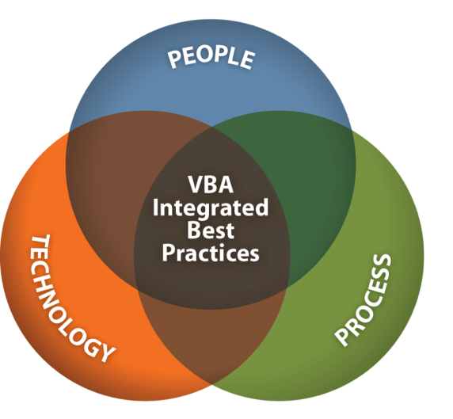
Phase One of VA’s Transformation Plan implemented high-impact people, process, and technology initiatives through a systematic, repeatable process
IMPLEMENTED!
People
How we’re organized and trained
Quality Review Teams
Intake Processing Centers
Segmented Lanes
Cross-functional Teams
Challenge Training
Process
“Bang for the buck” improvement opportunities
Fully Developed Claims (FDC)
Disability Benefits Questionnaires (DBQ)
Rules Based Calculators
Rater Decision Support Tools (Evaluation Builder)
100% Certified Service Treatment Records (STR)
Simplified Notification Letters (SNL)
Technology
Systems that enable us to do our jobs better
Online Veterans Relationship Management systems
- eBenefits online self-service portal
- Stakeholder Enterprise Portal for VSOs
Veterans Benefits Management System
Post-9/11 GI Bill automated processing

Slide 6
Phase 2 VBA’s Transformation Plan built on Phase 1 accomplishments
Almost done!
People
How we’re organized and trained
Customized, Modular Training
VHA Clinicians in Regional Offices
New eRO Positions & Standards
eClaims Training and Outreach
Process
“Bang for the buck” improvement opportunities
Additional Automation to Reduce Touch Time
Fully Developed eClaims
Non-Rating Claims Automation
Live Manual
Technology
Systems that enable us to do our jobs better
VBMS 9.1
National Work Queue
“Gold Standard” Electronic Service Treatment Records
TeleHealth Exams
Notes:
Approved A. Hickey 2.18.14

Slide 7
Big Picture: VBA Contract Services
VBA currently has approximately 65 active
Central Office service contracts.

Slide 8
Big Picture: VBA Contract Services (continued)

Slide 9
Major Program(s) Summary
VBA’s Major Program Support Areas:
Compensation
Medical Disability Examinations
Scanning/Mail/Records Storage
VBMS
Transition Assistance Program
Centralized Payments

Slide 10
Major Program(s) Summary
Compensation
Private Medical Records National Deployment
Support with retrieving Veteran medical records from private health providers
Dependency Claims Processing
Assistance with preparing live dependency claims for processing
Skill Certification Instrument
Support services in the development, implementation, and maintenance of various Skill Certification Instruments for Veteran Service Representatives, Rating Veteran Service Representatives, Pension Maintenance Center Veteran Service Representative, Decision Review Officer, and other positions as developed

Slide 11
Major Program(s) Summary
Medical Disability Examinations
Support conducting disability examinations to support claims processing for Veterans who have filed a claim for disability compensation or pension benefits
Increases access to physicians for file reviews or exams, improving claims service to beneficiaries

Slide 12
Major Program(s) Summary
Scanning/Mail/Records Storage
Veterans Claims Intake Program, Document Conversion & Digitized Mail Handling Services
Enable the intake of relevant claims data and paperless claims processing through conversion of paper claims documents and data into searchable PDF images uploaded into VBMS, directly supporting national deployment of VBMS
Help transition VBA from paper to digital operations – a critical success factor in our organizational transformation

Slide 13
Major Program(s) Summary
Veterans Benefits Management System (VBMS)
Business Architecture and Requirements Testing
Analyzing IT automation and document process improvements to be implemented through change management, beginning with Compensation and later extending to other business lines
Initial compensation work encompasses reviewing the entire disability claims process including establishment, development, rating, award, appeals, metrics, workflow and the electronic folder
Program Management Support Services
Full range of program support services to successfully support the VBMS Program Management Office with integration, deployment, management, operations and maintenance of the standardized business processes and services

Slide 14
Major Program(s) Summary
Transition Assistance Program
300 contractual, trained and deployed Benefits Advisors – many of whom are Veterans themselves – permanently staffed at more than 280 military installations worldwide to provide Benefits briefings required for all transitioning Servicemembers
These Benefits Advisors provide valuable information on VA benefits for healthcare, life insurance, home loans, disability compensation and the Post 9/11 GI Bill®

Slide 15
Major Program(s) Summary
Centralized Payments
Payments for VA-wide services that VBA receives (infrastructure costs)
Examples include:
Financial operations (i.e., VBA’s use of the franchise fund debt management center and financial services center)
Human capital improvement program (HR support)
Fees for procurement activities
Transit benefits

Slide 16
Upcoming Acquisition/Opportunities
In FY16, VBA plans to spend $880M in contracts primarily on existing services, to expand operations for Medical Exams, Scanning/Mail/Records Storage, TAP, and Centralized Payments
New spending (~1% of total budget) will be for studies and analyses to better prepare VBA for future investments

Slide 17
Questions
?

