Slide 1
Advanced Planning Brief to Industry (APBI)
PDUSB Danny Pummill
Veterans Benefits Administration November 6, 2013

Slide 2
Agenda
Background/Bio
Major Program(s) Summary
Upcoming Acquisition/Opportunities
Questions

Slide 3
Background/Bio
Who am I?
Principal Deputy Under Secretary of Benefits
Administer programs that deliver more than $84 billion (FY14) in benefits for Veterans in:
Programs are managed with an annual budget of $2.9 billion through nationwide network of 56 regional offices
Compensation | Pension
Education | Home Loan Guaranty
Life Insurance | Vocational Rehabilitation

Slide 4
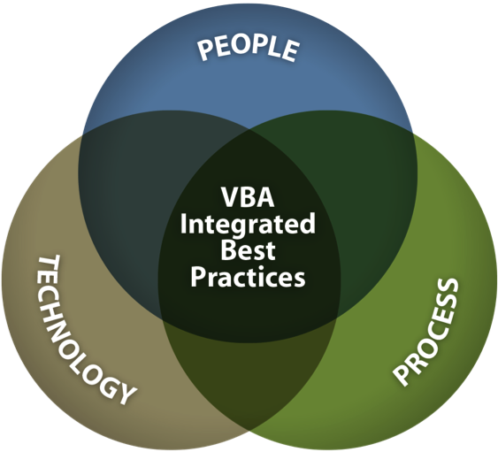
VBA’s Transformation Plan systematically implements high-impact initiatives across people, process, and technology org. dimensions
People
How we’re organized and trained
Intake Processing Centers
Segmented Lanes
Cross-functional Teams
Challenge Training
Skills Certification
Quality Review Teams
Process
Improvement opportunities that give “big bang for the buck”
Simplified notification letter to Veterans
New rater decision support tools for consistency
Evaluation Builder
Rules-Based Calculators
Fully Developed Claims (FDC)
Electronic Disability Benefits Questionnaires (DBQs)
Paperless CAPRI Records
Acceptable Clinical Evidence (ACE)
Appeals Design Teams*
Private Medical Records (PMR)*
Technology
Systems that enable us to do our jobs better
Online Veterans Relationship Management systems
eBenefits online self-service portal
Stakeholder Enterprise Portal for VSOs*
Veteran Online Application Direct Connect*
Unified Desktop, Virtual Hold, Scheduled Callback
Veterans Benefits Management System
Post-9/11 GI Bill paperless claims processing system
Virtual Lifetime Electronic Record

Slide 5
Major Program(s) Summary
3 Key Categories of VBA Mission Support
Operations
Operations Support
Studies/Analysis
Veterans Opportunity to Work (VOW) to Hire Heroes Act
Veterans Claim Intake Program (VCIP)
Contract Medical
Training
Program Management Support
Operations Analysis
Business Process Reengineering (BPR)
Policy Analysis

Slide 6
Partnership Investments
VBA’s operating budget invests ~$500 million in private-sector partnerships

Slide 7
Partnership Opportunities
Close to 100 partnership opportunities

Slide 8
Major Program(s) Summary
Operations
VOW/VEI gives VBA and DoD tools to provide Servicemembers with a more seamless transition to Veteran status
Up to 307,000 military personnel are projected to transition out of the military in the next four years
VBA is increasing awareness of and access to benefits, and getting Veterans enrolled as soon as possible
VCIP helps transition VBA from paper to digital operations– a critical success factor in our organizational transformation
Contract Medical increases access to physicians for file reviews or exams, improving claims service to beneficiaries
Veterans Opportunity to Work (VOW) to Hire Heroes Act
Veterans Claim Intake Program (VCIP)
Contract Medical

Slide 9
VOW/VEI Project Summary
Background:
Pre-VOW, VBA presented four-hour benefits briefings, in lecture format, to large audiences of transitioning Servicemembers in a one to four-day transition seminar
A major feature of VOW/VEI is the evolution of TAP to the much more robust Transition GPS (Goals – Plans – Success) program
Under Transition GPS, VBA conducts interactive presentations to classes of up to 50 students, and briefers provide one-on-one assistance for Service members
Program/Project Manager: VBA/DoD Program Office
Current Status:
Project is in first full year and distributed across 250+ installations, CONUS and OCONUS
Transition GPS briefings are currently executed via contractor-performance
Future Trends/Opportunities:
Under contract performance, the “briefer/trainer” requirements will be evaluated for possible transition to government-FTE performance
Over the next several years, VBA benefits information offered via Transition GPS will be embedded and become a routine part of learning in the life-cycle of Servicemembers

Slide 10
VCIP Project Summary
Background:
A principal component of VBA’s Transformation plan is to fully transition into a paperless disability claims processing environment
The Veterans Benefits Management System (VBMS), VBA’s web-based digital processing system, is fully deployed to all 56 regional offices
Transitioning the intake of paper claims and claims-related source material to digital images and data is a critical success factor to ensure VBMS is optimally leveraged
Program/Project Manager: Office of Business Process Integration
Current Status:
Initiated contracts in July ‘12 with two vendors to provide document conversion services
VBMS electronic folders (eFolders) are populated with images and data extracted from paper files – as of this month, VCIP achieved over 315 million images uploaded to eFolders
This contract also enables VBA to utilize data-driven, statistically valid sampling methods to ensure document conversation standards are met
Future Trends/Opportunities:
Throughout FY 2014 the VCIP team anticipates a growth rate of 48+ million images/month
VCIP is a key enabler of VBA’s Transformation Plan for VA to completes its goals in 2015

Slide 11
Major Program(s) Summary
Operations Support
VBA is focused on increasing production of benefits claims and increasing quality and accuracy of decisions
Training is critical to transformation’s goal to improve quality to 98% by 2015
VBA developed a national training curriculum, and launched Quality Review Teams to conduct in-process reviews
In June 2011, before transformation began, 12-month quality was 83%
Today, our 3-month quality is at 90% –medical issue level quality is 97%
VBA also relies heavily on contractor support for program management to carry out day-to-day operations
Training
Program Management Support

Slide 12
Training Project Summary
Background:
VBA utilizes industry-proven technical training systems for employee training and development
As a result, VBA continues to initiate projects in instructional systems, evaluation and human performance analysis for the purposes of increasing organizational performance through training
These projects create technical training (initial and refresher) for specific job positions in VBA and program evaluation
Program/Project Manager: VBA Office of Technical Training and Evaluation
Current Status:
Training requirements are continually evolving and life-cycle maintenance is ongoing: initial training is complete for many positions; others have training in development
Future Trends/Opportunities:
VBA is currently linking our training system to VA’s competency-based system
VBA is using agile development techniques for efficiency in development of training products
Training will continue to evolve to support technological innovation

Slide 13
Major Program(s) Summary
Studies/Analysis
VBA’s organizational transformation encourages more efficient and effective operations to serve Veterans
Previous analyses streamlined operations, reduced waste and improved work effectiveness
VBA’s new Organizational Model –segmented lanes, intake processing centers and cross-functional teams – stemmed from these studies
In 2012 we reduced the most common errors in claims by 50% after an in-depth Six Sigma analysis and BPR
VBA will continue to rely on in-depth analytical capabilities to improve benefits delivery
Operations Analysis
Business Process Reengineering (BPR)
Policy Analysis

Slide 14
BPR Project Summary
Background:
VBA’s Vocational Rehabilitation and Employment Service is undergoing its own unique organizational transformation
VR&E sought to improve its use of automation, the manner in which services are provided, and ultimately the performance of its personnel
Specifically, VR&E needed a staffing model to determine future requirements, and a system to follow up with Veterans who have been rehabilitated or discontinued
Program/Project Manager: Vocational Rehabilitation and Employment Service
Current Status:
Staffing model is in development; follow-up questionnaires to Veterans who have completed rehabilitation or discontinued services are also in development
Largest challenge is personnel time split between operations and process improvement
Future Trends/Opportunities:
Staffing model will be complete for use by FY 2015 budget review and FY 2016 budget planning
Staffing Model will give VR&E the ability to systematically forecast FTE needs on a national level

Slide 15
Workload Measurement Project Summary
Background:
In 2001 a work measurement study was conducted at Regional Loan Centers (RLC) in VBA’s Loan Guaranty business line to develop work rate standards for all activities
This study was re-conducted beginning last year: The field office study was completed this spring; the central office study was completed in October
Based on these work rate standards, VBA will develop a model to improve resource allocation across offices and business units to improve service to Veterans
Program/Project Manager: Loan Guaranty Service
Current Status:
Team spent several weeks documenting 176 work activities and over 30,000 processes completed, developing detailed descriptions; an electronic survey/work log was administered to 8 RLCs and central office
Market research was challenging because specific details were not readily available regarding efficiency-based allocation studies conducted by private-sector partners
Future Trends/Opportunities:
VBA is committed to efficient and effective operations, and cutting unnecessary costs
In addition to standard “refresh” studies, further studies are expected to take place whenever significant policy or technological changes take effect

Slide 16
Questions
?

