Slide 1
Advanced Planning Briefing to Industry
Steven G. Schliesman
Assistant Deputy CIO
for Project Management
OI&T PD June 11, 2014

Slide 2
The Need
VHA Outpatient Medical Scheduling

Slide 3
VA Scheduling Demands
Medical care is changing
Evolution of health care delivery has moved well beyond VistA Scheduling capabilities
Prevalence of telehealth, rural health, home health, electronic access
VA’s current scheduling system is antiquated and frustrating to use for both our Veterans and Providers
Was created to support face-to-face care delivery
The need to capture data for reporting has made system cumbersome for scheduling
Private sector is rapidly moving forward with Scheduling capability
Scheduling is extensive
About 85 million appointments per year
50,000 staff scheduling appointments
154 Medical Centers, 700+ Community Based Outpatient Centers (CBOCs)
High demand requires a state of the art system that seamlessly balances demand and resources

Slide 4
Pain Points
Extensiveness of scheduling
Access to provider availability
Inability to collect metrics
Inability to perform predictive data analysis
Information and data sharing
Notifications process
Customer satisfaction
Inability to link and associate appointments
Role-based access
Workload prioritization

Slide 5
Scope
Adjust to evolving Veteran and organizational needs
Provide Veteran with consistent, seamless, high quality, predictable scheduling interaction
Veteran self help
Support for new models of care
Ability for any scheduler to schedule across boundaries
Develop truth and transparency
Confidence in availability of provider time
Data for improved clinic management
Efficient, timely use of scheduling resources
Enable efficient, standard, error-free scheduling practices
Ability to enforce automated business rules
Ability to consolidate scheduling functions
Nationalized scheduling

Slide 6
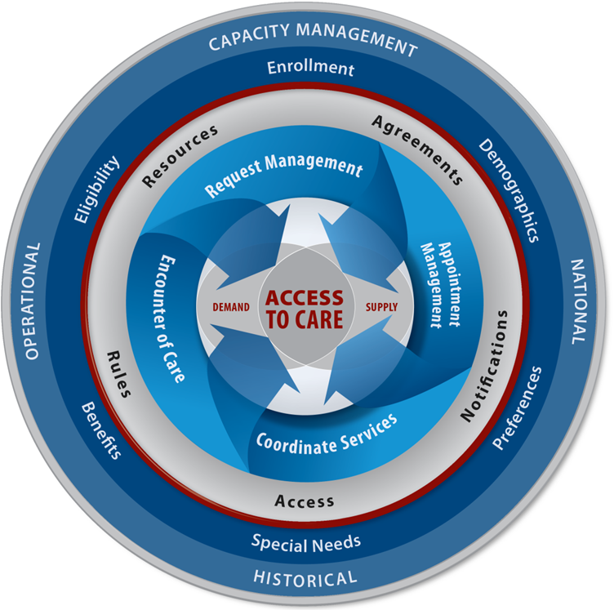
One Vision for the Future
Capabilities
Setup/Configuration
Veteran Information
Request Management
Appointment Management
Coordinate Services
Encounter of Care
Reporting

Slide 7
Scheduling Capability Overview
VistA Scheduling is dependent upon 41 legacy VistA packages
71 legacy VistA packages are dependent upon VistA Scheduling
These dependencies represent over a thousand individual integration points
http://code.osehra.org/dox/Package_Scheduling.html
A generic enterprise service must be created to ensure the synchronization of appointment data between the new MASS and legacy VistA, and other VA consumers and producers
The MASS is a system of systems that must provide enterprise services enabling current and future applications access to scheduling and related data
Legacy integration points will be migrated to MASS provided enterprise services over time
MASS will provide enterprise services to integrate with legacy packages as required

Slide 8
Medical Appointment Scheduling System (MASS) FY14-15 Overview
FY14 plans
High level business requirements developed
Interested parties should review/respond to FedBizOpps Announcement Number VA118-14-I-0352
Industry Day June 18, 2014, McLean, VA
Industry One-on-Ones June 30-July 2, Crystal City, VA
MASS COTS/Development/Integration Award 4Q
Key focus/initiatives for FY15
Elaboration of business requirements
Continued development/integration
Initial test environment and preliminary testing
Planning for phased releases
Notes:
Strong turn-out expected for Industry Day (reached max of 50 interested companies on 6/4/14)
FedBizOpps.gov: https://www.fbo.gov/index?s=opportunity&mode=form&id=6672c05c6f046cf98d178d8981884d94&tab=core&tabmode=list&

Slide 9
MASS Industry Day
Purpose: Provide Industry with a detailed overview of VHA and IT requirements for MASS
Hosted by VHA and OI&T PD on June 18, 2014
Format
VA presents four-hour briefing
Industry submits questions in written form
VA provides responses in afternoon
All Q&A will be posted as an amendment to FBO by June 20, 2014
Location: MITRE-2 Building (N), The MITRE Corporation, 7515 Colshire Drive, McLean, Va.
Notes:
Strong turn-out expected for Industry Day (reached max of 50 interested companies as of 6/4/14)

Slide 10
MASS One-on-One Meetings with Industry
Purpose: Industry provides briefing, and if possible, demonstrates COTS scheduling application
Hosted by VHA and OI&T PD from June 30 to July 2, 2014 (45 min & 3-person limit allotted to each company)
Location: VHA Conference Center, 2011 Crystal Drive, Crystal City, Va. 22202

Slide 11
MASS RFI
FedBizOpps Solicitation Number VA118-14-I-0352 posted on May 30, 2014
FedBizOpps included the VHA MASS Business Blueprint outlining the clinical operational requirements of MASS, current technical architecture documents and specific questions to Industry regarding VA approach
Industry submitting answers to VA questions in report format by June 25, 2014
Notes:
https://www.fbo.gov/index?s=opportunity&mode=form&id=6672c05c6f046cf98d178d8981884d94&tab=core&tabmode=list&

