Slide 1
1
150 Years of Keeping the Promise
Advanced Briefing to Industry (APBI)
Ms. Anita R. Hanson Deputy Under Secretary for Management
December 10, 2015

Slide 2
Briefing Agenda
History and Mission
Field Structure
Benefits
Excellence
Future Burial Needs
NCA Contracting
What We Buy
Questions
Notes:
This is what I will cover during our time together today.
Please stop me with any questions.

Slide 3
NCA History
Omnibus bill of 1862, signed into law on July 17, authorized President Lincoln to purchase grounds for use as national cemeteries
Fourteen national cemeteries established in 1862
Previously soldiers were buried where they fell
NCA Mission
The National Cemetery Administration (NCA) honors Veterans and their families with final resting places in national shrines and lasting tributes that commemorate their service and sacrifice to our Nation.
NCA Vision
To be the model of excellence for burial and memorial benefits for our Nation’s Veterans and their families
Notes:
The National Cemetery Administration’s history dates back to the Civil War when in 1862 Congress authorized President Lincoln to purchase grounds for use at national cemeteries. Fourteen were established that year. Previously soldiers were buried where they fell. Today, the National Cemetery Administration manages 133 national cemeteries across the nation along with 33 soldiers’ lots.
Our mission--The National Cemetery Administration (NCA) honors Veterans and their families with final resting places in national shrines and lasting tributes that commemorate their service and sacrifice to our Nation.
Our vision--To be the model of excellence for burial and memorial benefits for our Nation’s Veterans and their families

Slide 4
NCA Responsibilities
Provide burial space for Veterans and eligible family members
Maintain national cemeteries as national shrines
Administer the Federal grants program for construction of state and tribal Veterans cemeteries
Furnish headstones, markers and medallions for the graves of Veterans around the world
Administer the Presidential Memorial Certificate (PMC) Program
Administer the First Notice of Death (FNOD) program
Notes:
This is what NCA is responsible for. The first four are statutory missions, under Title 38.
As you saw in our mission statement, we provide burial for Veterans and eligible family members and maintain their burial sites as national shrines, so each of our visitors departs feeling these places are worthy of Veterans’ service and sacrifice.
We administer a grants program for construction of State and Tribal Veterans cemeteries.
We furnish headstones, markers and medallions, and we administer the Presidential Memorial Certificate program.
We also manage VA’s First Notice of Death program, which provides centralized processing for notifications of Veteran deaths. We assumed this responsibility from VBA administratively—that is, it is not one of our statutory missions.
I will touch on these responsibilities in more detail as we move through the presentation.

Slide 5
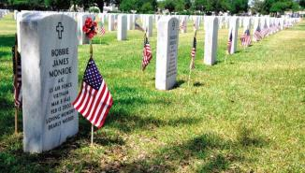
Partners in Managing Military
and Veterans Cemeteries
VA – 133
VA grant-funded State/Tribal cemeteries - 96
Army – 30
Arlington National Cemetery
Interior – 14
Gettysburg National Cemetery, PA
American Battle Monuments Commission – 25
Overseas cemeteries
Biloxi National Cemetery
Biloxi, MS
Notes:
We also partner with several other government agencies.
As I mentioned previously, VA manages 133 national cemeteries across the country and has provided grants for state and tribal cemeteries
The Army still manages two national cemeteries—Arlington National Cemetery and the one at the Soldiers’ Home in D.C.—as well as another 28 post cemeteries.
14 more national cemeteries are run by the National Park Service, which is part of the Department of the Interior. Those cemeteries, like Gettysburg are interpreted in conjunction with the Civil War battlefields where soldiers fought and died.
The American Battle Monuments Commission oversees another 25 burial grounds. They are all overseas in places like Normandy. The Commission is a separate agency within the Executive Branch.

Slide 6
St. Louis activities: National Training Center; National Cemetery Scheduling Office; First Notice of Death Office
Indianapolis activities: Cemetery Development and Improvement Service; HR Center
Denver, CO
Indianapolis, IN
Philadelphia, PA
Oakland, CA
Atlanta, GA
Regional Offices
Notes:
This is how our new alignment within MyVA looks. 92 of our 133 national cemeteries are open, which means they provide at least one burial option for first interments. The remaining closed cemeteries only offer second interments; most are satellites of larger, open cemeteries and many are contracted out for maintenance.
For administrative purposes, we have five regional offices within the new MyVA regions on the slide. They are located in Philadelphia; Atlanta; Denver; Indianapolis, and Oakland. The largest numbers of cemeteries and personnel are concentrated along the east coast in what is now the North Atlantic Region and the Southeast Region.
Each is led by an SES-level Executive Director and the director’s staff. They provide direction, operational oversight, engineering, HR, and contracting assistance to the cemeteries located in their geographic areas.
Indianapolis is the base for the Cemetery Development and Improvement Service and our HR Center. Our training center, cemetery scheduling office and First Notice of Death office are co-located in St. Louis. Our Operations &Maintenance budget for FY 15 was $256.6 million to fund over 1,800 FTE and the operation of VA national cemeteries.

Slide 7
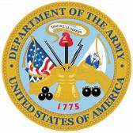
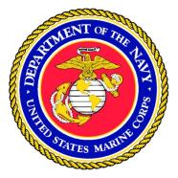
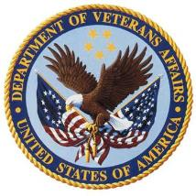
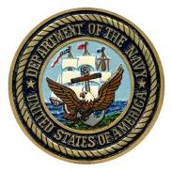
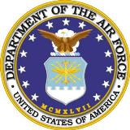
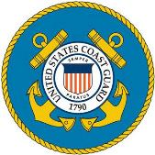
Veterans Serving Veterans
1,841 employees as of October 31, 2015
About 87% of our employees work outside of DC
Over 74.35% of NCA employees are Vets
highest of any
Federal agency
Includes 450+ returning Veterans from Iraq and Afghanistan
28.09% are disabled Veterans
Notes:
A bit about our workforce.
The number of NCA employees fluctuates between 1700-1800 employees. About 87% of our employees work outside of DC.
One of the things we are most proud of at NCA is the huge percentage of Veterans in our workforce.
Nearly three-quarters (74.25%) of our employees are Veterans.
That’s the highest percentage—by far!—in any Federal agency.
Also 28.09% of our employees are disabled Veterans.

Slide 8
Burial Benefits
Burial in a national cemetery:
Gravesite
Opening and closing of the grave
Grave liner
Perpetual care of the gravesite
Headstone, Markers or Niche Covers
Presidential Memorial Certificate
Bronze Medallion
U.S. Flag (VBA benefit)
Military Funeral Honors (DoD)
Notes:
Now, let me be more specific about the benefits we provide to Veterans.
All veterans with qualifying discharges are offered the dignity of committal or memorial services in a national cemetery.
At no cost to the family, burial at a national cemetery includes use of a committal shelter for services, the gravesite, grave liner, opening and closing of the grave, a headstone or marker, and perpetual care within a national shrine.
In addition to providing burial space, NCA also offers other ways to commemorate Veterans—through our Memorial Programs Service.
A government-furnished headstone or marker is available for Veterans who are interred in private cemeteries. Approximately 2/3 of the approximately 360,000 government-furnished headstones and markers we provide each year are placed on Veterans’ gravesites in private, state, or DOD cemeteries.
Families can also receive a Presidential Memorial Certificate, expressing the Nation’s gratitude and honoring the deceased’s memory. In 2013, we delivered more than 650,000 certificates to loved ones.

Slide 9
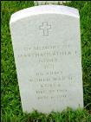
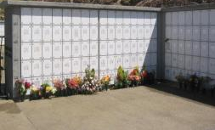
Memorial Benefits
“In Memory of…”
Upright
Headstone
Presidential
Memorial
Certificate
Burial Flag
Niche Covers
Flat Marker
Bronze Medallion
Notes:
These are examples of different memorial benefits we provide.
The Presidential Memorial Certificate was established under President Kennedy and have continued since. The certificates are signed by the incumbent president and sent to the loved ones of the deceased Veterans.
Veteran Benefits
Gravesite
Opening and closing of the grave
Grave liner
Perpetual care of the gravesite
Memorial Benefits
Headstone, Markers or Niche Covers
Bronze Medallion
Presidential Memorial Certificate
U.S. Flag
Military Funeral Honors

Slide 10
American Customer
Satisfaction Index (ACSI)
In 2013, NCA again achieved the highest ranking of any participating organization public or private
Fifth consecutive time!
Notes:
Like many public and private organizations, every three years we participate in the American Customer Satisfaction Index (ACSI). ACSI is the only national cross-industry measure of customer satisfaction in the United States measuring satisfaction of consumers of products and services offered by both foreign and domestic firms with significant share in U.S. markets. It’s an important customer satisfaction indicator.
NCA participates in the survey every three years. Upon completion of the 2013 survey, we, once again, attained the highest score of any participating entity, public or private on the index…in fact, in 2013, we received the highest rating in ACSI history! (96) which is 28 points higher than the federal government average of 68. This was also the 5th consecutive time we achieved the highest score.
We value this feedback we receive from ACSI, our own customer surveys, the various advisory committees such as this one and congress.
All of this input helps us better serve Veterans, their families and their survivors.

Slide 11
NCA’s Contracting Program

Slide 12
NCA Contracting
Ms. Anita Hanson
Deputy Under Secretary for Management/
Head of Contracting Activity
Ms. Tracey Boyd-Vega
Director of Contracting Service
Mr. Robelto Joshua
Chief, NCA Contracting Service
Stafford Office
(Services)
Mr. Harry Parker
Chief, NCA Contracting Service
DC Office
(Construction)
Ms. Tyra Lee
Small Business Advocate
Notes:
This provides you with a overview of our contracting operation.

Slide 13
2015 NCA Veterans Small Business Program
NCA FY15 | Total FY15 Percentage | Total FY15 Dollars
FY15 Small Business Awards | 81.13% | $149,296,418.96
FY15 SDVOSB Awards | 59.13% | $108,813,079.27
FY15 VOSB Awards | 61.36% | $112,913,365.66
FY15 WOSB Awards | 7.05% | $12,982,814.65
FY15 Minority Business Awards | 18.06% | $33,230,151.73
FY15 HUBZone Awards | 9.97% | $18,348,445.59
Notes:
As you can see, NCA is a high achiever in support of the Veteran Small Business Program.

Slide 14
FY15 Small Business Contracts by NAICS Code
Small Business contracts by NAICS code Description | NAICS Code | Amount Obligated | Percent of Total Obligations
CUT STONE AND STONE PRODUCT MANUFACTURING | 327991 | $41,711,160.13 | 23.29%
LANDSCAPING SERVICES | 561730 | $27,690,954.30 | 15.46%
CEMETERIES AND CREMATORIES | 812220 | $17,680,876.91 | 9.80%
OTHER HEAVY AND CIVIL ENGINEERING CONSTRUCTION | 237990 | $9,556,496.24 | 5.34%
COMMERCIAL & INSTITUTIONAL BUIDLING CONSTRUCTION | 236220 | $8,015,556.62 | 4.48%
Notes:
Top 5 NAICS codes for procurement actions in FY 2015

Slide 15
Type of Procurements NCA Solicits
Various small equipment and tools
Inscription Services
Headstone & Markers- Blanks
Furniture
Grave liners
Turf Renovation/ Maintenance
Headstone Setting
Ground Maintenance
Janitorial Services
Maintenance and Repair
Mow/Trimming Services
Waste Removal
Fertilizer & Weed Control Services
Tree Pruning
Construction – A/E Services
Repair Historic Perimeter Walls
Installation of Pre-Placed Crypts
Construct Columbaria/Memorial Walls
Renovation of Lodges
Replace Fences
Replace Admin & Maint Facilities
Gravesite Development
Repair Erosion & Storm Damage
Repair Sidewalks & Roads
Repair Irrigation Systems
Equipment (mowers, trimmers, etc)
Notes:
This slide provides you with a good idea about the types of solicitations we do in NCA. The majority of these contracts are base with options and are used to maintain and upkeep the cemeteries to National Shrine Standards. All FY16 contracts will be solicited through Fed Biz Ops

Slide 16
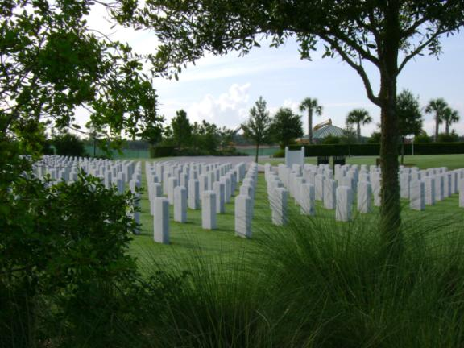
Our Needs (What NCA Buys)
Grounds maintenance
Notes:
Maintenance at some cemeteries is performed by contractors; this is especially true at cemeteries that are closed to new burials, and outlying soldiers’ lots and plots.
This is Sarasota National Cemetery on Florida’s west coast, one of our newest and still under construction.

Slide 17
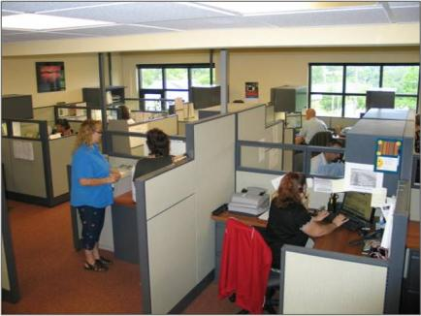
Our Needs (What NCA Buys)
Equipment and vehicles
Office supplies, equipment, and equipment maintenance
Notes:
We buy equipment and vehicles for use in cemetery operations. We work closely with manufacturers/suppliers to address our unique needs.
Here you see a Toro vehicle adapted as a casket carrier; it is small and maneuverable enough to move and operate between rows of headstones without damaging turf and nearby headstones and monuments.
We also buy office supplies and equipment and maintenance contracts for that equipment.

Slide 18
Our Needs (What NCA Buys)
Architectural and engineering services
Construction
Notes:
We are currently leading the largest expansion of national cemeteries since the Civil War.
We built 18 new national cemeteries between 1992 and 2010, and five more planned in FL (2), NE, NY, and CO.
We build in phases to meet burial demands, usually in 10-year increments.
Last year, we introduced our urban initiative, under which we will build columbarium-only satellite cemeteries in densely populated urban areas, where the existing national cemeteries are closed (NY City, San Francisco, Chicago, Indianapolis, and LA).
Obviously, this requires architectural and engineering expertise and large construction contracts.

Slide 19
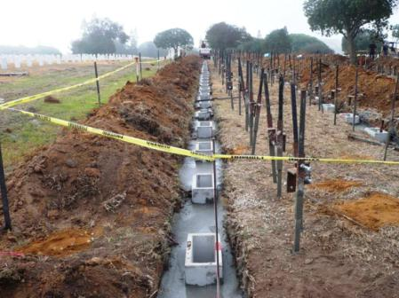
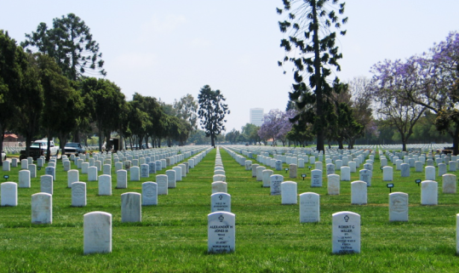
Our Needs (What NCA Buys)
Millennium projects
Notes:
We also have a number of special projects ongoing at any time, including what we call “millennium projects”, which Congress funded to help us bring cemetery appearance up to national shrine standards.
These projects include “raise and realign” efforts like the one you see here at Los Angeles National Cemetery. This employs a marker support system to keep headstones and markers correctly aligned for longer periods of time.

Slide 20
Our Needs (What NCA Buys)
Headstones and Markers
Including many on-site inscription services
Medallions
Historic Preservation Services
Notes:
Other special projects include wide-ranging historic preservation/conservation activity, ranging from lodge and monument restoration to mothballing. Over 100 of the properties we manage date to the Civil War, so we also play an important role as caretakers of American history.
American Recovery and Reinvestment Act of 2009 or as referred to as ARRA allowed us to take on a number of projects in this arena. The one you see here is restoration of a monument for Union soldiers at Knoxville National Cemetery in Tennessee.
We do not have the skills in-house to take on this kind of work.

Slide 21
Our Needs (What NCA Buys)
Headstones and Markers
Including many on-site inscription services
Medallions
Historic preservation
Notes:
Other special projects include wide-ranging historic preservation/conservation activity, ranging from lodge and monument restoration to mothballing. Over 100 of the properties we manage date to the Civil War, so we also play an important role as caretakers of American history.
ARRA allowed us to take on a number of projects in this arena. The one you see here is restoration of a monument for Union soldiers at Knoxville National Cemetery in Tennessee.
We do not have the skills in-house to take on this kind of work.

Slide 22
Points of Contact
Points of Contact:
Tracey Boyd-Vega, Director (540) 658-7206
Rob Joshua, Stafford Chief (540) 658-7202
Harry Parker, DC Chief (202) 632-5433
Tyra Lee, Small Business Rep (540) 658-7214

Slide 23
Other Sources of Procurement Information
System for Award Management (SAM) http://www.sam.gov
Online Representations and Certifications Application (ORCA) https://orca.bpn.gov/
Vendor Information Pages (VIP) http://www.VetBiz.gov
Federal Business Opportunities or https://www.fedbizopps.gov/
VA Forecast of Contracting Opportunities (FCO) https://www.vendorportal.ecms.va.gov/eVP/fco/FCO.aspx
GSA eBuy https://www.ebuy.gsa.gov/advgsa/advantage/ebuy/start/
Contractor Performance Assessment Reporting System (CPARS) http://www.cpars.gov
Additional Business Resources: http://www.va.gov/osdbu/index.asp

Slide 24
Questions?
Anita R Hanson
anita.hanson1@va.gov
24
Notes:
That concludes my briefing today. Thank you for your time. I would be happy to take any questions you have.

