Slide 1
Department of Veterans Affairs (VA)
Women-owned Small Business (WOSB) Symposium
Thomas McGrath
Director, CVE
Andrieka McCrane
Chief, Verification and Executive
Support Services
28 April, 2018
Notes:
CVE Scorecard
Working Paper
Thomas McGrath
Director, Center for Verification and Evaluation

Slide 2
Agenda
CVE’s Leadership (Federal)
Veteran First Contracting Program
Mission Statement
What is Verification
MyVA Verification Processing Stages
Available Resources
Help Use Help You
Questions

Slide 3
CVE Leadership (Federal):
CVE Leadership (Federal):
Thomas McGrath - Director
John Perkins- Deputy Director
Bill Macken- COR/Team Lead, MyVA Verification
Ben Ward- COR/Team Lead, Risk
Terrence Moultrie-COR/Team Lead, Verification & Executive Support Services and Contact Center

Slide 4
Veteran First Contracting Program
The Veteran First Contracting Program within the Department of Veterans Affairs (VA) was created under Public Law (P. L.) 109-461. This contracting program was created for Veteran-Owned Small Businesses (VOSB) and expanded the Service-Disabled Veteran-Owned Small Business (SDVOSB) contracting program for VA procurements. The P. L. was implemented in two regulations published in the Federal Register: VA Acquisition Regulation and 38 CFR Part 74.
The Veteran business owners and the Government mutually benefit from this program. Upon approval, the Program Participant has documented proof of eligibility. This gives confidence to VA that VOSB and SDVOSB set-asides are being awarded to legitimate firms owned and controlled by Veterans or Service-Disabled Veterans. This helps stimulate the small business community and create growth for the economy.

Slide 5
Mission Statement
The Verification Program (VP): To verify and re-verify SDVOSBs and VOSBs through a rigorous and thorough process to open opportunities within the VA procurement process and reduce risk.; CVE sustains this process by educating, training and engaging Veterans through recurring outreach.

Slide 6
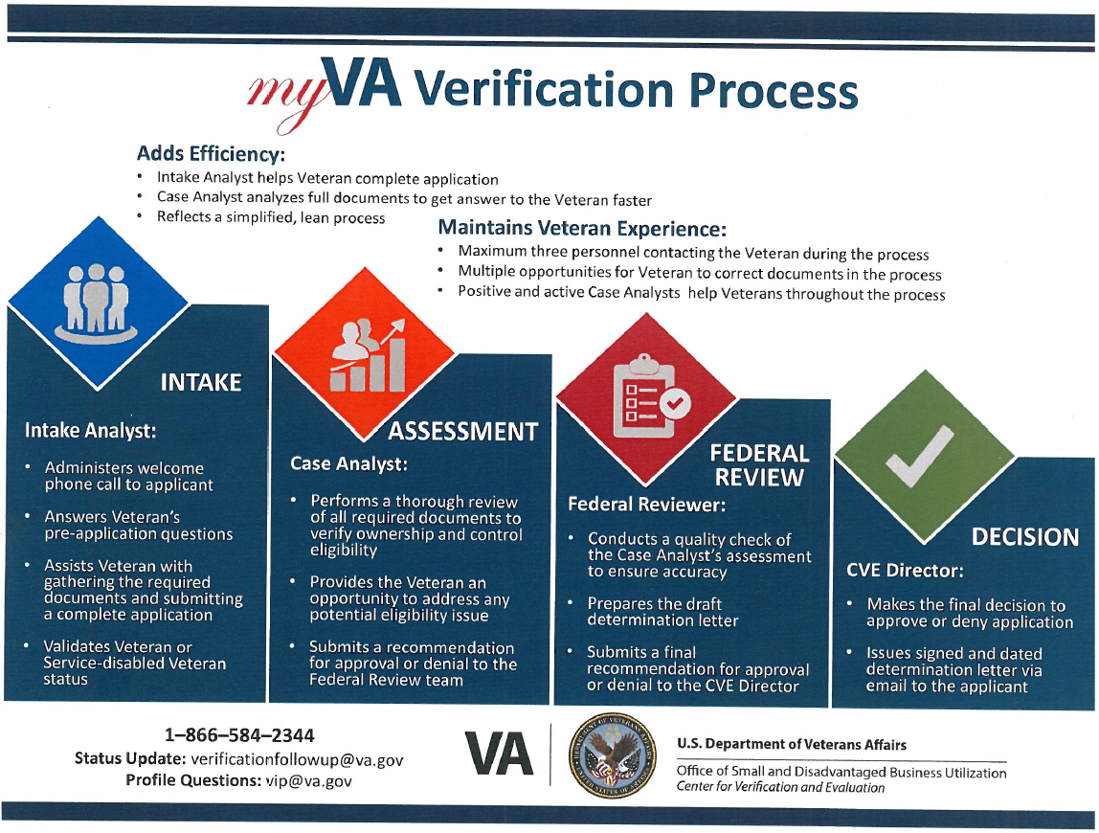
MyVA Verification Process
Intake

Slide 7
Available Resources
CVE Certified Verification Assistance Counselor https://www.va.gov/osdbu/verification/assistance/counselors.asp
Webinars
Pre-Application https://www.va.gov/osdbu/verification/you_asked_we_listened.asp
How to Stay Verified “
Preparing for Re-Verification “
SOC Education and Training http://www.va.gov/osdbu/outreach/soc/training.asp
Seminars
Training and Event Calendar http://www.va.gov/osdbu/library/events.asp
Doing Business With VA Reference Guide
Procurement Readiness Reference Guide
Notes:
CVE Certified Verification Assistance Counselor Provides:
Workshops and Seminars
Workshops and Seminars to teach you what you need to know and connect you with other small businesses.
One-on-One Counseling tailored to the specific needs of your business – always free of charge!
Matchmaking Events that connect you with agency buyers who need your product.

Slide 8
Available Resources Cont.’
Frequently Asked Questions (FAQs) https://www.va.gov/osdbu/faqs/
You Asked; We Listened! 91 FAQs on our website.
Most are linked to a comprehensive Fact Sheet or Verification Assistance Brief (VAB)
Fact Sheets https://www.va.gov/osdbu/library/factsheets.asp
13 Fact Sheets on our website. These products provide short and concise information on various facets of the Verification Program.
Verification Assistance Briefs (VABs) https://www.va.gov/osdbu/verification/assistance/briefs.asp
You Asked; We Listened! 17 VABs on our website. These products provide in-depth background and discussion on many of the major facets of the program.
Verification Processing Statistics https://www.va.gov/osdbu/verification/statistics.asp
Application Dispositions and Processing Times
Top 10 Reasons for Denial
Notes:
Frequently Asked Questions (FAQs):
You Asked; We Listened! 91 FAQs on our website.
Most are linked to a comprehensive Fact Sheet or Verification Assistance Brief (VAB)
Fact Sheets https:
You Asked; We Listened! 13 Fact Sheets on our website. These products provide short and concise information on various facets of the Verification Program.
Verification Assistance Briefs (VABs)
These products provide in-depth background and discussion on many of the major facets of the program.
Verification Processing Statistics:
Application Dispositions and Processing Times
Top 10 Reasons for Denial

Slide 9
Questions?
This concludes the briefing portion of the briefing; the floor is open to address any questions you may have.

