Slide 1
Advanced Planning Brief to Industry (APBI)
Norbert Doyle
VHA Chief Procurement & Logistics Officer November 6, 2013

Slide 2
Agenda
VA Overview
VHA Procurement and Logistics Overview
Office of Procurement Overview
Network Contracting Office Structure

Slide 3
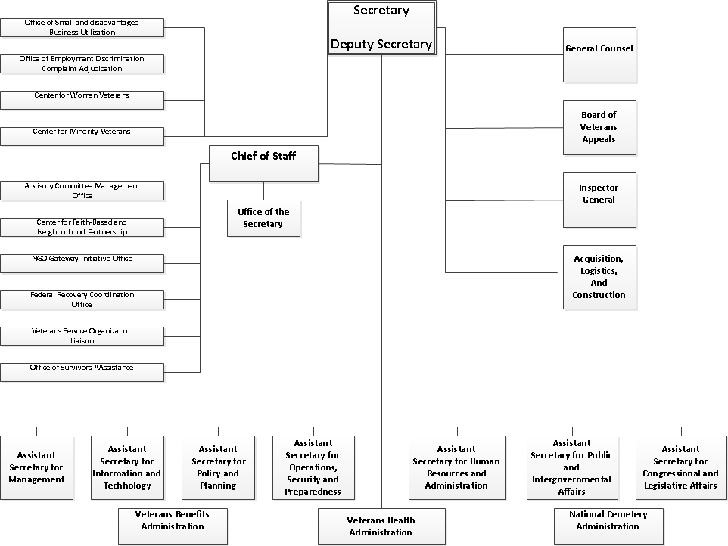
VA Overview

Slide 4
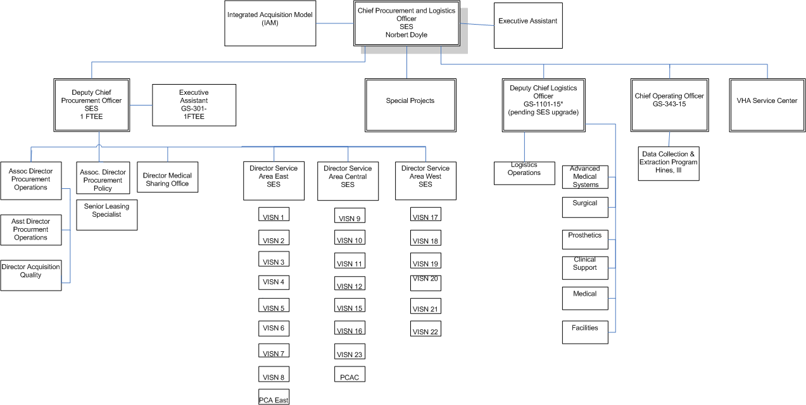
Office of Procurement and Logistics Overview

Slide 5
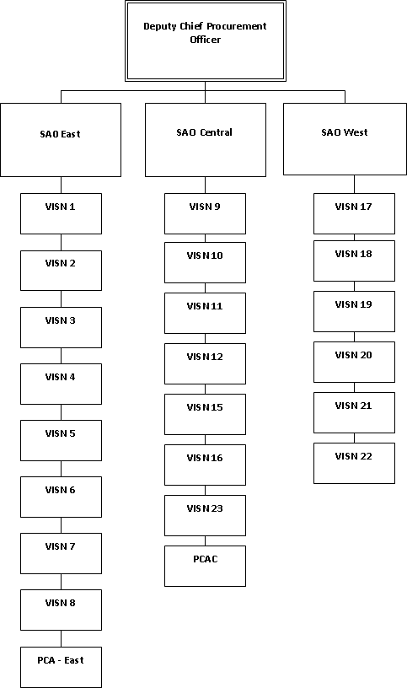
Office of Procurement

Slide 6
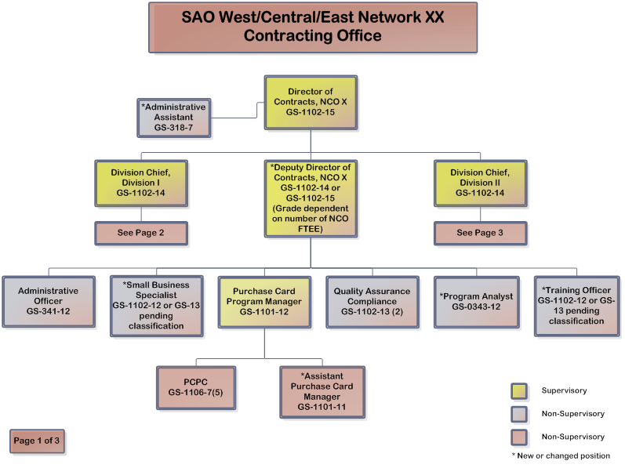
SAO West/Central/East Network XX Contracting Office

Slide 7
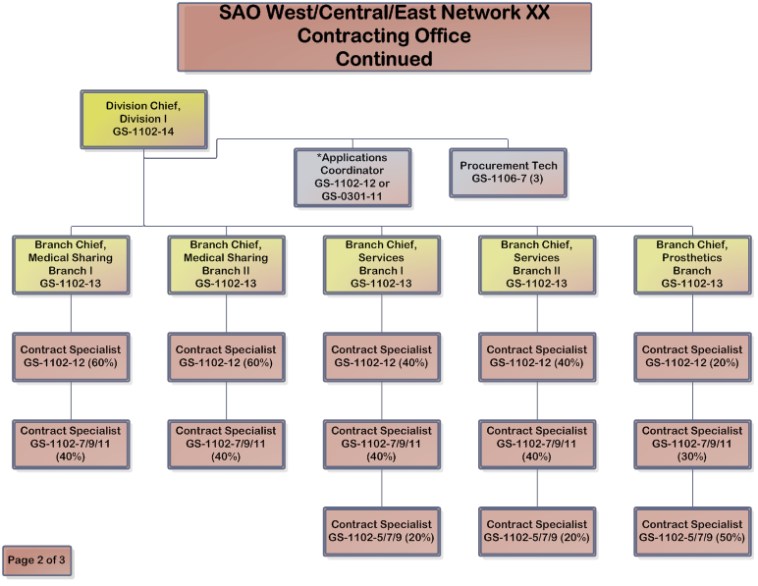
SAO West/Central/East Network XX Contracting Office

Slide 8
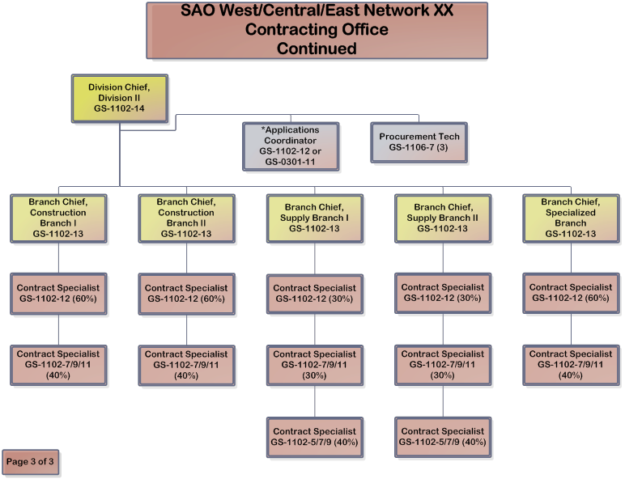
SAO West/Central/East Network XX Contracting Office

Slide 9
Questions
?

