Slide 1
Office of Procurement, Acquisition and Logistics
Advanced Planning Brief to Industry
June 26, 2024
Notes:
Introduction Slide Notes

Slide 2
Administrative Remarks
Questions may be answered as time permits following some of today’s presentations; alternatively, we ask that you hold your questions so they may be answered as part of the OIT Round Table discussion later this morning.
Information presented during today’s briefings is subject to change.
Government responses to today’s questions should be considered ADVISORY.

Slide 3
Administrative Remarks (Cont.)
The registration list, briefing charts, TAC future contracting opportunities list and the recording of the event will be available on https://www.voa.va.gov under the “Advanced Planning Brief to Industry 2024” library within a week of today’s event.
Parking Advisory: Please pay at the two foot-stations on Levels 2 and 3 before heading to your vehicles. Simply scan your QR code and pay via MasterCard or Visa. This will help lead to an efficient exit.

Slide 4
Office of Procurement, Acquisition and Logistics
Technology Acquisition Center (TAC) Update
for the
Advanced Planning Brief to Industry
Jeffrey C. Neill
Associate Executive Director
June 26, 2024

Slide 5
Agenda
Organizational Overview
Yearly Obligations
Workload and Forecasted Opportunities
T4NG and T4NG2 Update
CEDAR and SPRUCE Update
Tips to build partnerships as a subcontractor

Slide 6
Technology Acquisition Center
ORGANIZATIONAL
OVERVIEW

Slide 7
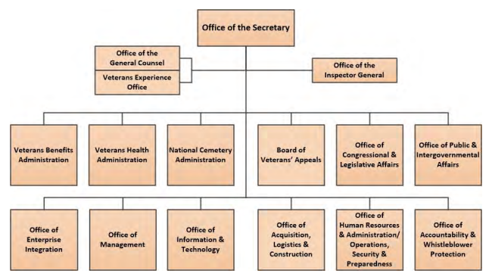
VA Organizational Chart
5
Notes:
The TAC falls under the Office of Acquisition, Logistics, and Construction (circled in red).
The TAC buys all IT goods and services over $100k for the VA enterprise regardless of customer or funding type. The TAC’s biggest customer, in terms of the number of actions we execute and the volume of dollars we obligate, is the Office of Information and Technology (OIT) (just to the left of OALC on the org charts above); led by VA’s Chief Information Officer (CIO), they are the IT steward for the entire VA. We also issue contracts on behalf of the Veterans Benefits Administration (VBA), the Veterans Health Administration (VHA), and the National Cemetery Administration (NCA).
TAC Overview

Slide 8
OALC Organization Chart
Honorable
Denis R. McDonough
Secretary of Veterans Affairs
Honorable
Tanya Bradsher
Deputy Secretary of Veterans Affairs
Michael D. Parrish
Chief Acquisition Officer,
Principal Executive Director, OALC
Angela Billups, Ph.D.
Executive Director and Senior Procurement Executive,
Office of Acquisition and Logistics, OALC
Phillip W. Christy
Deputy Executive Director, OALC
Michael Brennan, Ph.D.
Executive Director,
Office of Construction and Facilities Management, OALC
Christopher D. Parker
Associate Executive Director,
Head of the Contracting Activity, Strategic Acquisition Center
Jeffrey C. Neill
Associate Executive Director,
Head of the Contracting Activity,
Technology Acquisition Center
Christopher D. Parker
Acting Associate Executive Director,
Head of the Contracting Activity,
National Acquisition Center

Slide 9
TAC Organizational Structure
Jeffrey C. Neill
Associate Executive Director
Richard Hicks
Staff Assistant
Aldrich Nichols
Executive Assistant
Vacant
Deputy Associate Executive Director
Robert Kirzow
Director, Procurement Service A
Jessica Bieberbach,
Director, Procurement Service B
Carolyn Carbone
Director, Procurement Service C
Charles Ross
Director, Procurement Service D
David Nostrant
Director, Procurement Service E
Anne Marie Vasconcelos
Director, Procurement Service F
Kari Cozzens
Director, Procurement Service G
Iris Farrell
Director, Procurement Service H
Joshua Hammill
Director, Procurement Service I
Juan Quinones
Director, Procurement Service J
Ariel Arrosa
Director, Operations Service
Jon Smolenski
Director, Engineering Service

Slide 10
Technology Acquisition Center
YEARLY OBLIGATIONS

Slide 11
Yearly Obligations
11
(As of June 21, 2024)
11

Slide 12
Yearly Obligations
Same Time Last Year
(June 21, 2023)
 | ACTIONS |  | DOLLARS ($B)
 | 2023 | 2024 | 2023 | 2024
Total | 1,969 | 1,900 | $4.30 | $4.05

Slide 13
Technology Acquisition Center
Workload and
Forecasted Opportunities

Slide 14
TAC Workload Summary
TAC Active Jobs Summary
 | Total Number of Actions | Total Dollar Value* | Percentage of Total
Not Actionable | 619 | $2,052,205,021 | 49%
Actionable | 193 | $2,149,347,238 | 51%
Totals | 800 | $4,201,552,259 | 100%
TAC Awarded Jobs Summary
 | Total Number of Actions | Total Dollar Value* | Percentage of Total
Totals | 1,900 | $4,046,694,729 | 100%
TAC Projected Final Position
Totals | 2,660 | $8,183,816,035 | 100%
* Total Dollar Value on this chart represents “obligations” (estimated for active / actual for awarded)
(As of June 21, 2024)

Slide 15
3rd & 4TH QTR FY24 Forecasted Opportunities
Total Actions: 239 Total Dollars: $5.4B
Top 5 Opportunities (by total contract value):
Transformation Support Services (TSS)
OIT Customer POC: Jimmie Sue Harrison (Jimmiesue.Harrison@va.gov)
TAC CO: Summer Spalliero (Summer.Spalliero@va.gov)
Onboarding, Management, Engineering, Governance, and Assurance Services (OMEGA)
OIT Customer POC: Mary Renick (Mary.Renick@va.gov)
TAC CO: Christopher Minetti (Christopher.Minetti@va.gov)
Endpoint Support and Operations Monitoring (ESOM)
OIT Customer POC: Maria Murphy (Maria.Murphy@va.gov)
TAC CO: Christopher Minetti (Christopher.Minetti@va.gov)
VHA Finance Product Line DevSecOps
OIT Customer POC: Diane Torry (Diane.Torry@va.gov)
TAC CO: Matthew Truex (Matthew.Truex1@va.gov)
External Assessment Services (SAVD EAS) and Perimeter Defense
OIT Customer POC: Brian Baker (Brian.Baker4@va.gov)
TAC CO: Evan Schlisserman (Evan.Schlisserman@va.gov)
Notes:
These are the top 5 jobs, by total estimated contract value, projected to be awarded in the 3rd & 4th Quarter of FY24.
These have not been solicited yet.
These are new contracts or orders that are expected to have some form of competition (sole source, CERNER/EHRM, LEC, IAAs, FFRDCs, and jobs against other internal IDIQs are excluded).

Slide 16
1ST QTR FY25 Forecasted Opportunities
Total Actions: 17 Total Dollars: $1.7B
Top 5 Opportunities (by total contract value):
Software Development Support
OM Customer POC: Alberto Aguirre (Alberto.Aguirre2@va.gov)
TAC CO: Robert Spangler (Robert.Spangler@va.gov)
Electronic Freedom of Information Act Software
OIT Customer POC: Allen Smoot (Allen.Smoot@va.gov)
TAC CO: Patrick Hamilton (Patrick.Hamilton2@va.gov)
Quality Assurance Web Application Sustainment Support
OIT Customer POC: Joshua Cohen (Joshua.Cohen2@va.gov)
TAC CO: Susan Banasiak (Susan.Banasiak@va.gov)
Permanent Change of Station (PCS) Relocation SaaS Solution
OM Customer POC: Jon Hawkins (Jon.Hawkins@va.gov)
TAC CO: Lori Walker (Lori.Walker1@va.gov)
Decision Support System Extract (DSSx) and Event Capture System (ECS) Sustainment
OIT Customer POC: Michael Garance (Michael.Garance@va.gov)
TAC CO: Dana Newcomb (Dana.Newcomb@va.gov)
Notes:
These are the top 5 jobs, by total estimated contract value, projected to be awarded in the 1st Quarter of FY25
These have not been solicited yet.
These are new contracts or orders that are expected to have some form of competition (sole source, T4NG, EHRM, FMBT, and jobs against other internal IDIQs are excluded).

Slide 17
New TAC Contract Actions/Vehicles Used in 2024
Contract Vehicle | New Awards
National Aeronautics and Space Administration (NASA) Solutions for Enterprise-Wide Procurement (SEWP) | 158
Orders Against Other Internal Indefinite Delivery Indefinite Quantity (IDIQ) and Standalone Contracts | 124
General Services Administration (GSA) | 28
Transformation Twenty-One Technology – Next Generation (T4NG) | 13
Orders Against Other External Contract Vehicles and Interagency Agreements (IAA) | 9
(As of June 13, 2024)
Notes:
Vehicle FY23 (as of 6/13) Same Time Last Year
SEWP 158 142
Other Internal/Standalone 124 92
GSA 28 36
T4NG 13 11
External Vehicles/IAAs 9 6
Order on the slide changed to descending order.

Slide 18
Technology Acquisition Center
Transformation Twenty-One
Total Technology – Next
Generation (T4NG) Update

Slide 19
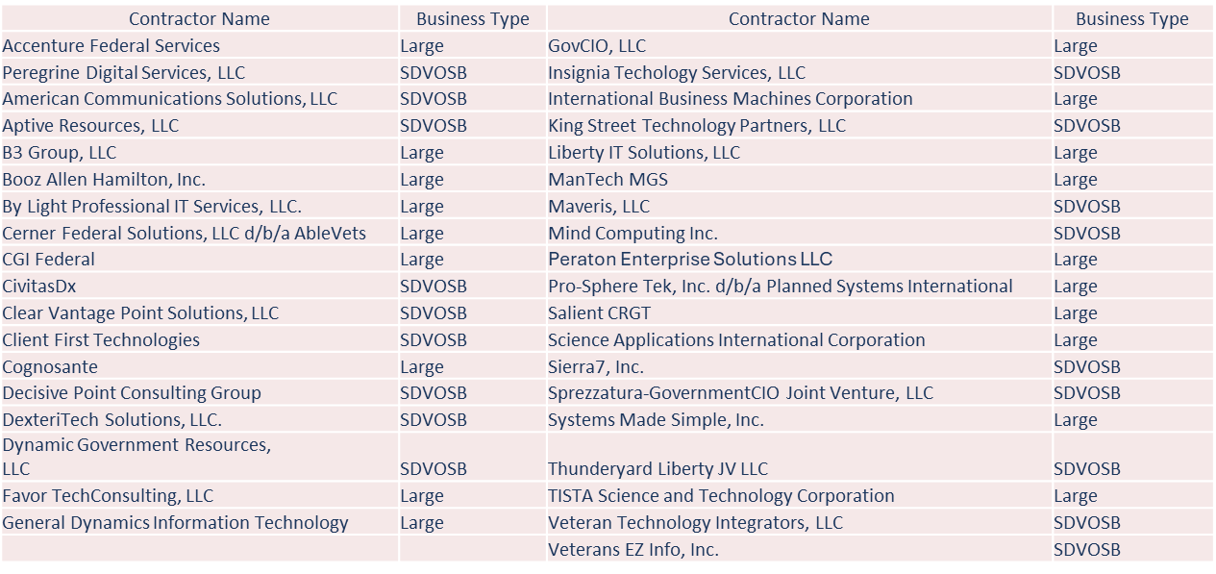
T4NG Update
Ordering period runs through March 6, 2026
Remaining Ceiling (as of May 13, 2024): $310.5M ($12.5M when factoring work in progress)
Veterans Employment: Increase of 42,094 Veterans employed since T4NG award employed since T4NG award

Slide 20
Technology Acquisition Center
Transformation Twenty-One
Total Technology – Next
Generation (T4NG2) Update

Slide 21
T4NG2

Slide 22
Technology Acquisition Center
CUSTOMER EXPERIENCE, DEVOPS,
AGILE RELEASES (cedar)

Slide 23
CEDAR
Period of Performance runs through March 28, 2026
Remaining Ceiling (as of May 13, 2023): $32.9M ($20.1M when factoring work in progress)
SDVOSB set-aside, IDIQ Vehicle

Slide 24
Technology Acquisition Center
Secure, performant, reliable, and user-centered experiences (spruce)
update

Slide 25
SPRUCE
This is a competitive acquisition for award of an IDIQ contract, with a five (5) year ordering period for the basic contracts. The resultant orders will be issued on a Firm-Fixed-Price (FFP) and Time-and-Material/Labor-Hour basis.
The Government intends to award eight (8) contracts but reserves the right to make fewer or additional awards if determined in its best interest.
This effort was solicited on November 29, 2023, as a 100% Service-Disabled Veteran-owned Small Business (SDVOSB) set-aside. Awards are projected for late 3QFY24/early 4QFY24.
The Highest Rated Offerors with a Fair and Reasonable Price will determine the best value basis for the award of contracts under this solicitation.
Maximum Overall Value of the SPRUCE IDIQ contracts is $2,442,037,228.80.

Slide 26
Technology Acquisition Center
Tips to build partnerships as a subcontractor

Slide 27
Tips to Build Partnerships
Do your homework:
There’s a lot of competition – Generic marketing materials are not likely to get much attention.
Know the VA mission, the customer and where you add value.
Know the prime contractor and how your capabilities can fill capability gaps of the prime.
Do not say you can do everything or anything the prime wants; understand and convey your specific preferences and skills to contribute.
If affordable and through the most cost-effective manner, companies should find a way to effectively tailor their capabilities to areas that are relative to opportunities - or at a minimum - tailor them to how you will fit within a specific swim lane or swim lanes that you are trying to sell/present.
For specific contracts or orders, show that you understand the problem and have low risk, highly feasible solutions.
Be able to show relevant domain knowledge and technical expertise mapped to specific requirements within the performance work statement.

Slide 28
Tips to Build Partnerships
Time with a Prime is limited. In that short time be able to convey:
Experience: What is the relevancy, depth and with which Agencies?
Reputation/Past Performance: How well have you performed these services?
Accountability/Responsibility: Do you have the necessary resources or the ability to obtain the necessary resources (i.e. staff, equipment, etc.)?
Processes/Systems: What processes or systems do you have for accounting, contracts, HR, security, etc. and what relevant certifications do you have?

Slide 29
Tips to Build Partnerships
Don’t come empty handed - Offer something of value to primes!
Examples include:
Writing assistance on proposals.
Relationship with the end customer.
Qualify for more than one socio-economic category as a small business.
Technologies that support the solution.
Innovative technologies that enhance the solution.
Depth/breadth of experience that improves Veteran and VA employee experience.

Slide 30
Technology Acquisition Center
Questions?
Notes:
Industry Visits: As a reminder, if you’d like to request an industry visit with the TAC, please send your requests to VA.TAC@va.gov

Slide 31
Technology Acquisition Center
Thank you for attending
today’s session!
Notes:
Thank you again for your attendance and continued support. VA could not perform its mission without our industry partners.

Slide 32
Doing business with OIT
Kurt DelBene
Assistant Secretary for Information and Technology
Office of Information and Technology
Advanced Planning Brief to Industry
June 26, 2024

Slide 33
VA is Complex – Both from Organizational and IT Perspective
Largest integrated U.S. healthcare provider supporting 9 million+ Veterans
Over 3,000 locations, including 132 large hospitals
5.8 million Veterans receiving disability compensation
2.7 million pieces of equipment including the largest medical devices inventory
Over 5.5 million life insurance policies administered
Over 904,000 computers and 193,000 mobile devices
Almost 4 million home loan participants
Over 1,000 IT systems

Slide 34
IT at VA Is Complex: Emerging Demands and Constraints
PACT Act creating record demand—1M claims over last year.
While $5.7B budget seems large, it’s half the discretionary spend of other organizations. FY25 budget is even more challenging.
Aging systems — must move to continuous modernization.
Conflicting objectives from stakeholders, Congress, and the Office of Management and Budget.
Huge IT complexity drives our #1 issue – security complexity.
Notes:
PACT Act causing huge demand influx
1MMth disability claim
Additional healthcare demand
Additional employees
How do you make sense of all this complexity?

Slide 35
Contractors and the IT Product Group
Our government employees and contractors operate as a single team.
We will balance acting as a team and holding contractors responsible for their work.
We work together to establish technical rigor and operational excellence.
Don’t sell us something that doesn’t comport with our priorities or for which we already have a solution.
Build systems that are security by nature.
Notes:
We share responsibility for direction taken and execution
Tell us what you think we should do
Contractors are expected to provide critical feedback
“This isn’t going as well, etc.”
We expect contractors to reduce, not add to our complexity
Build systems that are secure by nature, don’t assume the government can just put them in a secure container

Slide 36
How to Demonstrate Value
Help us move away from a “big bang” approach and to continuous modernization and MVP instead
Our partners should be capable of
Delivering high-quality products
Focusing relentlessly on operational and engineering excellence
Creating user experiences that customers love.
Delivering secure, accessible systems
We want projects with no surprises – rigorous execution and full transparency

Slide 37
www.digital.va.gov Twitter: @VA_CIO LinkedIn: @DigitalVA

Slide 38
Office of Information and Technology
Using the Software Factory Model to deliver products better, faster, and safer
Charles Worthington
Chief Technology Officer and Chief Artificial Intelligence Officer
Advanced Planning Brief to Industry
June 26, 2024
Notes:
Introduction Slide Notes

Slide 39
OIT Aspires to be the best product delivery team in government

Slide 40
Complex Enterprise
1,000
systems in use
Complex Enterprise

Slide 41
What is VA’s Software Factory (SWF) Model?
The software factory Model aims to streamline and systematize VA’s delivery methods, enabling better, faster, and safer product delivery.

Slide 42
What is SWF continued
The software factory Model aims to streamline and systematize VA’s delivery methods, enabling better, faster, and safer product delivery.

Slide 43
Three primary delivery methods - SaaS
Software as a Service (SaaS): Optimized for rapid deployment and scalability within the SWF, focusing on leveraging cloud efficiencies.

Slide 44
Three primary delivery methods - PaaS
Platform as a Service (PaaS): Facilitates innovation and development speed, providing a managed platform layer within the SWF.

Slide 45
Three primary delivery methods - Custom
Custom Development: Tailored for specific VA needs, ensuring flexibility and specificity in solutions developed under the SWF.

Slide 46
Software Factory Utilities
Supportive Infrastructure: Utilities are the underpinning that supports the SaaS, PaaS, and Custom software delivery models in VA's software factory approach.

Slide 47
Software Factory Utilities Tools and Services
Common Tools and Services: Streamlines operations and reduces complexity by offering shared resources essential for software development and maintenance.

Slide 48
Software Factory Utilities Efficiency
Efficiency and Scalability: Enables rapid scaling of applications and solutions.

Slide 49
Intake
Streamlined Operations: The intake process acts as the ‘front door’ to the Model for all software requests and ensures each request is assessed early and directed efficiently.

Slide 50
Intake
Streamlined Operations: The intake process acts as the ‘front door’ to the Model for all software requests and ensures each request is assessed early and directed efficiently.

Slide 51
Software Factory Intake
Resource Allocation: The Intake process identifies the best software development approach—SaaS, PaaS, or Custom which helps allocate resources efficiently.
Vendor Collaboration: Understanding the intake process helps vendors align their services with VA standards, boosting collaboration and integration.
Decision Framework: A structured decision-making framework guides the intake process to make informed play decisions.

Slide 52
Intake Process Play Decision Criteria

Slide 53
SaaS Software Factory
Learn more at: digital.va.gov/VAWay-Software-Factory
Vendors should review existing SaaS offerings and requirements on the SWF Model website before proposing new products.

Slide 54
SaaS Software Factory Benefits
Existing Catalog: Prioritizes the reuse of procured SaaS products available in VA’s existing marketplace.
Usage Standards: Enforces specific requirements and processes for using SaaS solutions that vendors must follow.
Systematic Approach: Aims to standardize the delivery of SaaS solutions using best practices for consistent and effective implementation.

Slide 55
PaaS Software Factory
Vendor Integration: Vendors are encouraged to understand and integrate with the VA’s specified PaaS platforms, preparing for potential collaborations.

Slide 56
PaaS Software Factory Benefits
Systematization: Efforts are underway to formalize the delivery of PaaS solutions using DevOps principles to ensure efficiency and quality.
Standardized Delivery:
VA utilizes a consistent approach and established contracts for deploying features across its designated PaaS platforms.
Designated PaaS Solutions: VA has approved three primary PaaS platforms: Salesforce, Pega, and Dynamics 365, to streamline processes and improve service delivery.

Slide 57
CustomDev Software Factory
Platform Reuse: These platforms are promoted for reuse to ensure consistency across development efforts and Vendors are encouraged to deliver specific features or functionalities within these established platforms.

Slide 58
CustomDev Software Factory Benefits
Systematization with DevOps: The VA Way seeks to systematize custom software delivery by integrating DevOps best practices.
Standardized Requirements: A common set of requirements for custom software development has been established, alongside four approved platforms.
Efficiency and Standardization: The aim is to enhance standardization and efficiency in VA’s custom software development processes.

Slide 59
SWF Utilities
Integration and Usage: Vendors can integrate these utilities into their projects, allowing for consistent, standardized functionality across different software solutions.

Slide 60
Software Factory Utilities Benefits
Utility Categories: SWF Utilities Categories include essential tools and services that standardize and streamline software development at VA.
Supportive Underpinning: The SWF Utilities act as the foundational support for the SWF Model, ensuring each segment of software development is bolstered by reliable, common utilities.
Standardization and Systematization: SWF Utilities enhance The VA Way with standardized tools for efficient software development.

Slide 61
CODE.va.gov

Slide 62
Code.VA.gov utilities list

Slide 63
Software Factory Survey
When Do We Take the Survey? For two weeks, starting in mid July, 2024.
Why are you running a survey? This survey will assess Developer Experience (DevEx), Product Manager Experience, and awareness, understanding, adoption, and feedback around the VA way of delivering software and the SWF Model.

Slide 64
SFW Survey
What will the survey change? We aim to gain an enhanced understanding of staff and contractor needs to help us target improvements to the model based on staff and contractor pain points and drive awareness and adoption through training around the VA Way, SWF Model, product delivery,, and DevEx.
Who will see what we say? This is an anonymous process.
Why is this survey different? Thought you were done with surveys? Not yet! This one's special—it dives deep into your role, giving you a real say in shaping the VA Way. Staff or contractor, your insights matter. Let’s make your voice count, the VA Way!

Slide 65
www.digital.va.gov/Software-Factory

Slide 66
VA IT BUSINESS PRIORITIES: EFFECTIVELY LEVERAGING BUSINESS RELATIONSHIP MANAGEMENT
Brad Houston
Deputy Chief Information Officer
Business Integration and Outcomes Service
VA Office of Information and Technology
June 26, 2024
Notes:
Introduction Slide Notes

Slide 67
Business Integration and Outcomes Service (BIOS)
Our Vision
To create the common vision for priorities within VA OIT to help VA deliver services to Veterans. This vision is translated into roadmaps which enable both business partners and OIT to know what the priority is at any given moment, and demonstrate the resources needed to support those roadmaps.
Our Mission
Deeply understand the processes, outcomes, challenges, and aspirations of our business partners. Understand and apply the products, services, and technical capabilities of VA OIT and our business partners. Use these insights to develop vision and outcome roadmaps for VA OIT products and services.
Our Roles
Capture the business-technology vision. Maintain 1-N prioritization. Triage new requests/demand management. Business partner service recovery.
Notes:
Our Values
Outcome driven
Customer biased
Positive mindset
Innovative spirit
Integrity

Slide 68
BIOS Business Partners and Service Lines

Slide 69
BIOS Leadership
Notes:
Need new org chart created to include those mentioned in Brad’s note. Here’s who I’ve identified as GS 15s in BIOS today according to May 2, 24 BIOS org chart.
Jarvis Newsome, COS, Business Operations
Patricia Craighill, Portfolio and Investment Management
Howard Green, Health
Shawn Faherty, Health
Cliff Sweney, Infrastructure and Network Support
Mark Wagner, Corporate
Thomas Verburght, Strategic Concepts Integration
Nicholas Lins, Benefits, Appeals, and Memorials
John Burke, Office of Technical Integration
Tammy Watson, Office of Technical Integration
Am I right? Who’s missing or should be changed? Need titles for each of them and please no acronyms so we can pass 508 quickly. We’ll have OC create a new org chart with these folks listed below their service line. I think Patty and Cliff are the only additions. Is that correct? What’s missing? What should be added?

Slide 70
BIOS Service Line Portfolios

Slide 71
BIOS Business Relationship Managers Deliver
Business Experts communicate with our partners to help provide the vision, identify needs, share and manage expectations and deliver results.
Outcome and Vision Experts identify and refine business desires into vision and outcome roadmaps.
Budget Experts support budget formulation, multi-year planning, and unplanned or shortfall (1:N).
OIT Expert and Task Managers are in charge of acquisitions, performance, communications, and security.

Slide 72
How BIOS Serves Our Customers
VA Business Partners identify Vision and Outcomes
BIOS gathers Vision and Outcomes and maps them to OIT delivery product areas
OIT delivers IT Products and Services needed to achieve Vision and Outcomes
Notes:
In BIOS, we are responsible for gathering our Business Partner’s visions and outcomes and mapping them to OIT products and services. BRMs play a critical role in helping shape that business demand by optimizing potential business value and aligning it with our business partners, and ultimately, the VA’s strategic vision.

Slide 73
Business Technical Vision Roadmap
A Business Technical Vision Roadmap tells us where a capability is going, why it’s required, the expected outcomes and success measures for each IT investment. This roadmap sets the vision for how a capability will benefit every Veteran or end-user.
Notes:
Industry is a VALUED AND REQUIRED PARTNER to ensure VA delivers the best customer service to Veterans. Close collaboration and coordination between Industry leaders, VA Administrations, and the Office of Information Technology (OIT) is essential to preserve CIO Accountability on issues such as security and Intellectual Property.
All IT products and services must be vetted by OIT. This requirement may add time to the delivery process and require modifications if requirements are not specified up front. If you are working with a VA organization other than OIT, please ask if the organization has coordinated with OIT. OIT is working with multiple acquisition areas to ensure appropriate requirements are included in acquisition documentation.
VA defines Business Led IT Services as products and services that are not under the direct control of OIT. These services can take several forms:
Managed Services
SaaS/PaaS not already part of OIT defined marketplace
Commercial Off the Shelf (COTS) not already part of TRM
Connected Devices
Web Applications/Portals

Slide 74
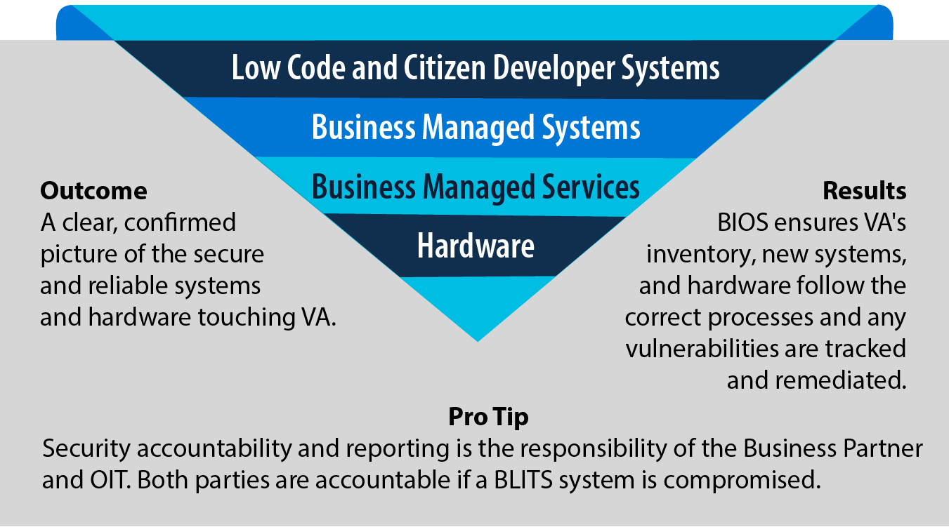
Business Led IT Services (BLITS)
Notes:
Regardless of the acquiring organization, VA IT products and services must comply with all legal requirements as well as with OIT policies and best practices to include:
System Security - comply with the security principles established by the Privacy Act, Federal Information Security Management Act, Heath Insurance Portability and Accountability Act, Federal Risk and Authorization Management Process, and other statutes.
IT Acquisition Compliance - comply with the CIO’s authority to oversee all VA IT investments pursuant to the Federal Information Technology Acquisition Reform Act.
Engineering and Architectural Compliance ensure that applications adhere to approved configuration baselines management standards, and architectural design patterns.
Hosting Requirements - All VA IT cloud applications must be hosted in the VA Enterprise Cloud (VAEC)environment to ensure consistent utilization and execution.
VA Intellectual Property (IP) and Data Retention to ensure VA can support the lifecycle of IT products independent of suppliers.

Slide 75
Why 1:N is Important to All of Us
Giving leadership and our workforce visibility into our priorities allows each of us to make informed decisions that are well coordinated with our partners in IT service lines, administration, and staff offices. It also helps us achieve:
Notes:
Giving leadership and our workforce visibility into our priorities allows each of us to make informed decisions that are well coordinated with our partners in IT service lines, administration, and staff offices. It also helps us achieve:
Generate a visible Budget level “cut line” that formulates the basis of the Unplanned/ Shortfall (UFR) view in the next FY cycle

Slide 76
BIOS Support Contracts (1 of 4)
Start Date | Amount | Product Line | Acquisition Title | Projected Exercise Optional Period Date | Projected Amount
Jul 9, 2022 | $5,584,217.09 | AMO Service Support | AMO Service Support (AMOSS) | Opt Period Two: Jul 09 2023 –Jul 8 2024 | $5,584,794.29
Jul 9, 2022 | $2,388,882.36 | AMO Service Support | AMOSS Optional Task 7 Portfolio Analysis Support | Opt Period Two: Jul 09 2023 –Jul 8 2024 | $2,897,623.15

Slide 77
BIOS Support Contracts (2 of 4)
Start Date | Amount | Product Line | Acquisition Title | Projected Optional Period Date | Projected Amount
Jan 30, 2023 | $385,898.66 | AMO Service Support | AMOSS Optional Task 4 VHA Appeals/Benefits Modernization. Task end May 29, 2023 | This task can be exercised multiple times, this task PoP is 90 days | $385,898.66 (funded amount $11,576,959.80)
Jul 9, 2022 | $771,797.32 | AMO Service Support | AMOSS Optional Task 1, Additional Portfolio Visualization Engineering Analysis Current State | Opt Period Two: Jul 9 2023 –Jul 8 2024 | $771,797.32

Slide 78
BIOS Support Contracts (3 of 4)
Start Date | Amount | Product Line | Acquisition Title | Projected Optional Period Date | Projected Amount
Jul 9, 2022 | $385,898.66 | AMO Service Support | AMOSS Optional Task 2, Additional Portfolio Visualization Engineering Analysis Target State | Opt Period Two: Jul 09 2023 –Jul 8 2024 | $385,898.66
Jul 9, 2022 | $434,355.03 | AMO Service Support | AMOSS Optional Task 6, Intake Management Support | Opt Period Two: Jul 09 2023 –Jul 8 2024 | $434,355.03

Slide 79
BIOS Technical Services Contracts (1 of 3)
Start Date | Amount | Primary Product Line | Acquisition Title | Projected Exercise Optional Period Date | Projected Amount
Sep 20, 2022 | $2,853,294.90 | AMO Service Support | IT Account Management (ITAM) Technical Services | Opt Period Two: Jul 09 2023 –Jul 8 2024 | $2,897,623.15
Sep 20, 2022 | $128,827.92 | Not Applicable | ITAM Technical Services Optional Task 1: Admin Surge Capability | Opt Period 1 Sep 20,2023 – Sep 19, 2024 | $128,827.92

Slide 80
BIOS Technical Services Contracts (2 of 3)
Start Date | Amount | Primary Product Line | Acquisition Title | Projected Exercise Optional Period Date | Projected Amount
Sep 20, 2022 | $216,660.00 | AMO/BIOS | ITAM Technical Services Optional Task 2:Account Group Surge Capability | Opt Period 1:Sep 20,2023 – Sep 19, 2024 | $216,660.00
Sep 20, 2022 | $216,660.0 | AMO/BIOS | ITAMS Optional Task 3: AMO Pillar Surge Capability | Opt Period 1: Sep 20,2023 – Sep 19, 2024 | $216,660.00

Slide 81
BIOS Technical Services Contracts (3 of 3)
Start Date | Amount | Primary Product Line | Acquisition Title | Projected Exercise Optional Period Date | Projected Amount
Sep 30, 2024 | $2,298,503.52 | BIOS | BIOS Technical Support Services | Opt Period 1: Sep 28, 2024 – Sep 27, 2025 | $2,3332,873.44

Slide 82
Contact Us
OIT Website Twitter: @VA_CIO LinkedIn: @DigitalVA

Slide 83
Office of Information Security: Embracing a Zero Trust Mindset
Lynette Sherrill
Deputy Assistant Secretary for Information Security and Chief Information Security Officer
Advanced Planning Brief to Industry
June 26, 2024
Notes:
Introduction Slide Notes

Slide 84
Agenda
Office of Information Security (OIS) Organization Chart and Services
OIS Mission and Vision
Department of Veterans Affairs (VA) Cybersecurity Priorities
Zero Trust (ZT) First, The North Star
Summary of VA’s ZT Status
Accomplishments
Initiatives
Disclaimer: Acquisitions and contractual commitments can only be made by government officials having expressed authority to enter into such agreements on behalf of the United States Government. The only Government officials with such authority are Warranted Contracting Officials. Any discussions of procurement requirements do not constitute contractual direction or authorization of any kind. Future contractual directions, if any, shall only come from the cognizant Department of Veterans Affairs Warranted Contracting Officer.

Slide 85
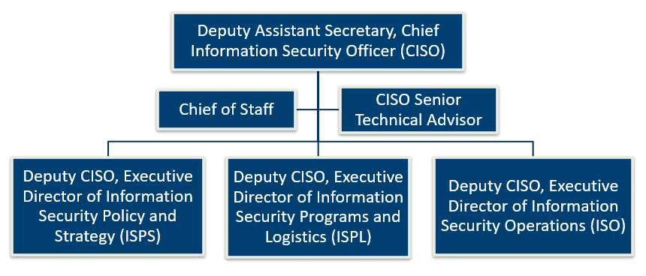
OIS Organization Chart and Services
Individual Directorates are listed on the following slide.

Slide 86
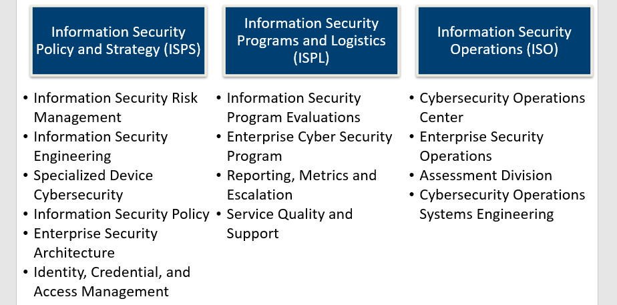
OIS Organization Chart and Services (Continued)

Slide 87
Our Mission and Vision
Mission Statement
OIS provides an Enterprise information security program that strengthens security strategy, risk management, engineering ​excellence, policy, budgeting, and operations services to over ​25 million Veterans and their families, caregivers, and survivors.
Vision
To advance cybersecurity through a secure infrastructure that exploits technical innovation, promotes the effective use of government resources, and fortifies the VA Cybersecurity Strategy, Zero Trust First.

Slide 88
Cybersecurity Priorities
Secure the Perimeter
Assure there are no unsecured points of access around our perimeter.
Increase Rigor in Access Management
Remove end-user access more quickly when someone leaves VA.
Strengthen Our Cyber Posture on Critical Systems
Strengthen our most critical systems through improvements to the Assessment and Authorization Process.
Establish Technical Information System Security Officers (ISSO)
Develop technical ISSOs for our most critical systems and prepare them to identify, contain, recover, and protect sensitive data.
Secure Critical Infrastructure
Isolate the most critical systems containing sensitive data with multiple layers of protection to prevent the compromise of Veteran information.
Institute a Culture of Continuous Development
Establish a strategic talent pipeline that attracts and retains the best cyber professionals. Celebrate our diverse and inclusive workforce.​

Slide 89
Summary of VA’s Zero Trust Status
VA incorporated ZT principles and best practices into its cybersecurity strategy, policies, reporting processes, and decision-making.
Key takeaways:
VA surpassed the traditional level of ZT maturity across all five pillars.
The identity and device pillars are VA’s most mature areas within the initial journey, including progress towards advanced ZT maturity.
Matured Executive Order and ZT Program Management Office with dedicated ZT acceleration support (October 2023), converged point for communications, internal and external collaboration, escalation of risks, issues, and decisions.
Exceeded CY23 targets for APNSA Implementation on Multifactor Authentication (MFA), Data at Rest (DAR), Data in Transit (DIT), Endpoint Detection and Response (EDR), and Skilled Workforce.
Initiatives are in place to continue expanding on FY23 accomplishments and comply with ZT and data logging requirements.
VA is providing traceability for all Cyber spend according to the Cybersecurity Framework (CSF) per the OMB Budget Data Request (BDR).

Slide 90
Notable Zero Trust Accomplishments (1 of 2)
VA has accelerated ZT efforts and strengthened its cybersecurity posture.
Transitioned to a unified EDR program to enhance VA’s threat detection:
Consolidated EDR capabilities using Microsoft Defender for Endpoint (MDE).
EDR consolidation reduced overhead, decreased the number of external tools and licenses in use, and enhanced data collection and integration.
VA is anticipating the Microsoft Persistent Access Capability (PAC) roll out to share EDR data with CISA.
Achieved 97% MFA at the boundary level to secure VA systems and operations:
VA is exceeding the 90% goal for MFA.
Plans are in place to achieve 100% by the end of 2024.
Over 95% of network access occurs with MFA.
Strong alternatives to PIV exemptions are being tested.

Slide 91
Notable Zero Trust Accomplishments (2 of 2)
Encryption deployed to safeguard VA systems and data:
DAR encryption is deployed 99% VA-wide.
DIT encryption is deployed 98% VA-wide.
Working to move all possible applications and APIs to secure connections and provide ZT-enabled protections for systems that cannot accept encrypted connections.
Instituted a comprehensive phishing prevention program to help secure VA users against threat actors:
Number of phishing assessment emails sent from FY22 through FY24 has climbed dramatically:
FY23 up 190% from FY22: As of May 15, 2024, up 135% from FY23.
Education and testing materials have vastly improved:
Incorporated videos and screenshots of dangerous areas within a phish for compromised users to review.
Developed more phishing training fliers and distributed to end-users.
Over 95% of VA’s users now use phishing-resistant MFA.

Slide 92
OIS FY24 Accomplishments by Division (1 of 2)
OIS continues to advance efforts to strengthen VA’s cybersecurity posture across three (3) organizational pillars. The highlighted accomplishments contribute to a collaborative culture across OIS and establish a more cohesive framework to keep VA ahead of the ever-evolving technological landscape.
Organizational Pillar | Accomplishments
Information Security Programs and Logistics (ISPL) | Improved the visibility of all OIT Cyber spending through a new implementation strategy. Developed OIS Service Catalog describing all the services OIS provides to its customers. Leveraged Internal Security Maturity Assessment to evaluate the effectiveness and maturity of OIS services.

Slide 93
OIS FY24 Accomplishments by Division (2 of 2)
Organizational Pillar | Accomplishments
Information Security Operations (ISO) | Performed Vulnerability Scanning for VA Critical Systems (15,000 assets). Completed 150 Phishing Assessments. Increased POA and M tracking through the POA and M Vulnerability Portal. Reached 99% compliance in remediating identified vulnerabilities on internet-facing systems within 14 days.
Information Security Policy and Strategy (ISPS) | Launched the Enterprise Audit Readiness Program (EARP) to mature VA’s audit readiness through proactive remediation efforts and robust governance and accountability mechanisms. Integrating Risk Scores, Continuous Monitoring (ConMon), and Ongoing Authorization (OA) to provide near-real-time security-related information to inform risk acceptance decisions for systems with an OA.

Slide 94
Active and Planned Zero Trust Initiatives (1 of 2)
As of May 2024, VA has traditional and some initial maturity level for the five ZT pillars and three supporting capabilities. Recent accomplishments and ongoing initiatives are helping VA progress towards the advanced maturity level.
Critical systems isolation:
Using M-21-30 results in categorizing VA’s Critical and Bedrock systems, VA selected three critical systems to create minimum requirements for isolating ZT Architecture (ZTA) use-case for applications, targeted for December 2024.
Currently working through the baseline efforts of the identified systems and planning implementation.
This isolation architecture will be application-centric and enabled by a centrally-managed Independent Computing Architecture (ICA) and other ZTA capabilities such as device posture, network segmentation, and micro-segmentation.
Updated an ongoing ZT maturity assessment to inform VA’s ZTA strategy:
Developed a framework and ongoing assessment to evaluate VA’s ZT maturity and capability gaps, current implementations, and recent White House and Federal guidance, resulting in an updated agile roadmap and timeline.
Based on the assessment, VA projects ZT implementation through FY27.

Slide 95
Active and Planned Zero Trust Initiatives (2 of 2)
Ongoing M-21-31 event long management implementation:
Transitioned to a prioritized, risk-based approach to implementation, per CISA’s December 2022 guidance.
Focus is on Critical and Bedrock Systems with automated comparison of GRC data with data warehouse logs to determine compliance.
Currently working towards a hybrid solution; phased approach estimated to complete EL3 in December 2026.
Ongoing Federal Information System Controls Audit Manual (FISMA) Containerization to Asset Boundary (FCAB) project:
FCAB aligns assets within VA’s enterprise with their respective ATO boundary.
Aligned 93% of VA’s IP addressable assets to FISMA security boundaries.
Completed the alignment for 91% of VA’s systems.
As a result of FCAB, VA Vulnerability Management maintained 95% compliance since December 2023 of aligned, OIT-managed Known Exploited Vulnerabilities and OIT-managed Aged Vulnerabilities that are past SLA every month (continuous monitoring).

Slide 96
Contact Us OIT Website Twitter: @VA_CIO LinkedIn: @DigitalVA

Slide 97
Office of Information and Technology
Product Engineering Service Overview
Carrie Lee
Deputy Chief Information Officer Advanced Planning Brief to Industry
June 26, 2024

Slide 98
PES Vision and Mission
Vision: Veterans receive seamless access to benefits and proactive care using our modern digital solutions.
Mission: To bring together the talents of our team to deliver digital solutions that enable exceptional Veteran outcomes.

Slide 99
Who We Are
We deliver IT capabilities to serve the needs of our Veterans and those who care for them

Slide 100
What We Do
Data and Analytics: Delivers the tools and practices to manage VA’s data as a Strategic Asset and ensures VA’s data infrastructure is AI ready
Big Projects and Programs:
Summit Data Platform
VA Profile
Corporate Data Warehouse
Digital Transformation Center: Accelerates the IT delivery process by enabling VA to leverage Software as a Service (SaaS) and Platform as a Service (PaaS) technologies
Big Projects and Programs:
DTC Product Marketplace
LC-NC Center of Excellence
Identity, Credential, and Access Mgmt.: Launching the Next Generation of Identity, Credential, and Access Mgmt. solutions for VA
Big Projects and Programs:
NextGen enterprise SSO and enterprise IGA
ICAM Modernization Roadmap
Lighthouse Improves the developer experience by managing a Veteran-centered platform to improve application and API development, security, and quality
Big Projects and Programs:
CODEVA developer portal
Public API Platform (developer.va.gov)
Lighthouse Delivery Infrastructure
Veterans Experience Services: Builds resilient, event-driven systems with extensible, pluggable architectures to better anticipate and respond to customer needs
Big Projects and Programs:
Healthcare Eligibility and Enrollment
Contact Center CRMs including VAHC
Transition Experience
Benefits Discovery Service
Big Projects and Programs:
DA
Delivers the tools and practices to manage VA’s data as a Strategic Asset and ensures VA’s data infrastructure is ready for artificial intelligence (AI).
Summit Data Platform
VA Profile
Corporate Data Warehouse
DTC
Accelerates the IT delivery process by enabling VA to leverage Software as a Service (SaaS) and Platform as a Service (PaaS) technologies
Big Projects and Programs:
DTC Product Marketplace
Low Code-No Code (NC/LC) Center of Excellence
ICAM
Big Projects and Programs:
Delivering the Next Generation of Identity, Credential, and Access Management solutions for VA
NextGen enterprise single sign-on (SSO) and enterprise IGA
ICAM Modernization Roadmap
LDX
Improves the developer experience by managing a Veteran-centered platform to improve application and API development, security, and quality
Big Projects and Programs:
CODEVA developer portal
Public Application Program Interface (API) Platform (developer.va.gov)
Lighthouse Delivery Infrastructure
VES
Builds resilient, event-driven systems with extensible, pluggable architectures to better anticipate and respond to customer needs
Big Projects and Programs:
Healthcare Eligibility and Enrollment
Contact Center CRMs including VAHC
Transition Experience
Benefits Discovery Service

Slide 101
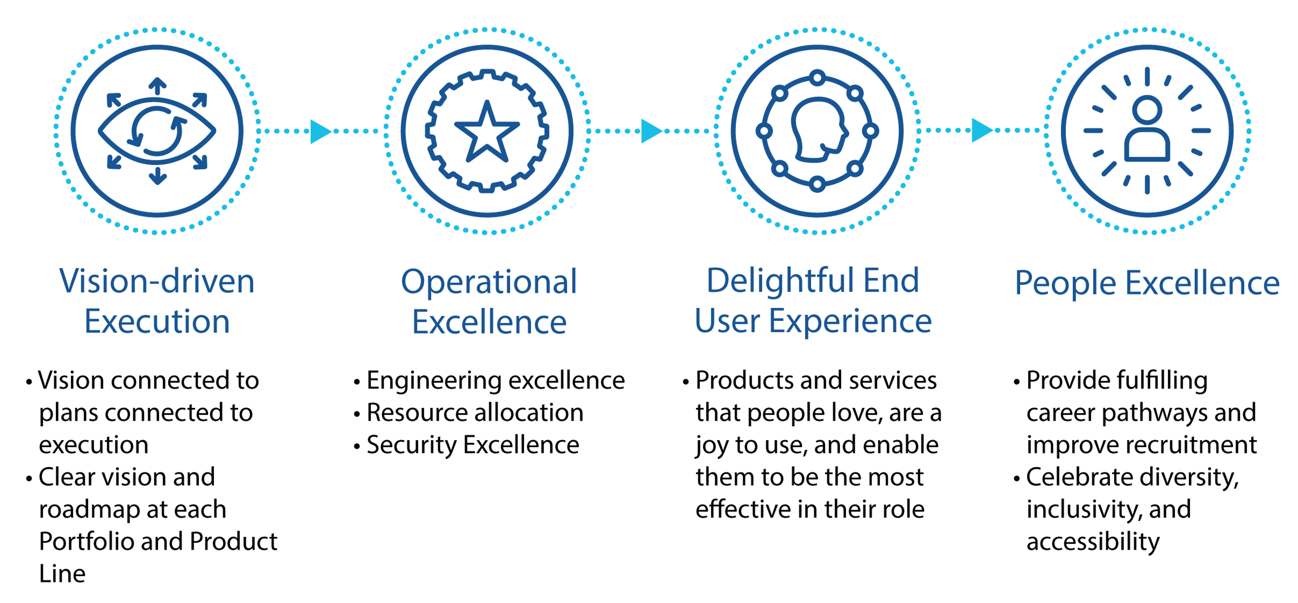
PES Goals Align with the CIO’s Vision
Vision Driven Execution → PES Strategic Goal 1: Use vision driven product roadmaps that support the Administration’s and VA’s purpose and direction
Operational Excellence → PES Strategic Goal 2: Provide enabling IT services to product teams
Delightful End User Experience → PES Strategic Goal 3: Providing personalized, seamless, relevant, and timely IT products to meet the needs of Veterans and those who serve them
People Excellence → PES Strategic Goal 4: Create the best product delivery organization in government
Strategic Goal 1:
Use vision-driven product roadmaps that support the Administration’s and VA’s purpose and direction
Strategic Goal 2:
Provide enabling IT services to product teams
Strategic Goal 3:
Provide seamless, personalized, relevant, and timely IT products to meet the needs of Veterans and those who serve them
Strategic Goal 4:
Create the best product delivery organization in government

Slide 102
What We Need from Industry
Skills and Technologies:
Data and Analytics
Artificial Intelligence
Security
Customer Experience (CX) Delivery
Development
Platform Creation
Low Code or No Code (LC/NC)
Center of Excellence Tools or Workflows
Improved Resiliency
Methodologies:
Technology and Platform Centers of Excellence
Human Centered Design
DevSecOps
Software Factory
Product Management
PACT Act:
Increased demand in Product and Service Delivery
Skills and Technologies
Methodologies
PACT Act
Data and Analytics
Artificial Intelligence
Security
Customer Experience (CX) Delivery
Development
Platform Creation
Low Code No Code
Center of Excellence Tools or Workflows
Improved Resiliency
Technology and Platform Centers of Excellence
Human Centered Design
DevSecOps
Software Factory
Product Management
Increased demand for Product and Service Delivery

Slide 103
Current PES Enterprise Level Task Orders (1 of 4)
Digital Transformation Center (DTC)
Enables a service delivery program designed to accelerate the IT delivery process and quality by enabling VA to leverage SaaS, PaaS, and Emerging Technologies for digital modernization and business transformation.
Product and Technology Ecosystem and Management Services (PTEMS)
Enables the delivery of technology-agnostic capabilities across a broad range of solutions for business transformation and digital modernization while mitigating technology debt from developing and maintaining stove-piped and or monolithic systems.
Enterprise SaaS Collaboration Tool (Box.com)
Subscriptions and professional services enable VA to easily and securely interact with their content and collaborate internally and externally.

Slide 104
Current PES Enterprise Level Task Orders Continued (2 of 4)
Technology Incubation Services (TIS)
Advisory services ensure a streamlined and cohesive experience for both business requirements and IT services to ensure low code, no code and other emerging technologies are using an open-source methodology and account for the full product lifecycle management.
Salesforce Subscription Licences, Maintenance, and Support
Provides access to the Salesforce Application Suite, AppExchange, and MuleSoft Applications and allows uninterrupted support for all Salesforce and MuleSoft licensing in use at VA.
Enterprise Services Integrated Platform (ESIP)
Provides production and non-production support services, Operations and Maintenance (O&M) support, project management and reporting, software and web service development, partner and system coordination, software integration, testing, release management, technical support, training and content management, systems engineering, development and enhancements and modernization, and documentation to support the VA OIT processes and Veterans Focused Integrated Process (VIP) and or DevOps methodology, in accordance with the Agile Process.

Slide 105
Current PES Enterprise Level Task Orders Continued (3 of 4)
Veteran Experience Technical Platform (VETPS)
Provides product management support for product and sustainment activities. Major work areas include administrative and meeting support, capital planning and investment, communications, technical writing, configuration management, onboarding, functional analysis, testing, implementation management, release management, schedule support, strategic analysis, and engineering and technical support.
Veteran Enterprise Module and System Integration Services (VEMSIS)
The VEMSIS solution utilizes a platform-agnostic approach to provide VA with modern solutions to support lower complexity, modular low-code and no-code solutions that enable an innovative reusable service-focused software component architecture including Platform as a Service (PaaS) functions and capabilities, Software as a Service (SaaS) integrations, Application Programming Interfaces (APIs), and Digital modernization and emerging technology support making configuring and customizing DTC PaaS and SaaS solutions easier to scale and faster to create, enabling innovation and accelerating time-to-market for new features.

Slide 106
Current PES Enterprise Level Task Orders Continued (4 of 4)
Enterprise Measurement and Configuration Services (EMACS)
Specializing in measurement services including organizational customer and employee measurement strategy, data strategy, user research, product management, SaaS configuration, software integration, and or survey design and dissemination. Leverage customer experience data, tools, technology, and engagement to enable VA to be the leading CX organization in government, so service members, Veterans, their families, caregivers, and survivors choose VA.

Slide 107
Office of Information and Technology
Product Engineering Service Overview
Carrie Lee
Deputy Chief Information Officer Advanced Planning Brief to Industry
June 26, 2024

Slide 108
PES Vision and Mission
Vision: Veterans receive seamless access to benefits and proactive care using our modern digital solutions.
Mission: To bring together the talents of our team to deliver digital solutions that enable exceptional Veteran outcomes.

Slide 109
Who We Are
We deliver IT capabilities to serve the needs of our Veterans and those who care for them

Slide 110
What We Do
Data and Analytics: Delivers the tools and practices to manage VA’s data as a Strategic Asset and ensures VA’s data infrastructure is AI ready
Big Projects and Programs:
Summit Data Platform
VA Profile
Corporate Data Warehouse
Digital Transformation Center: Accelerates the IT delivery process by enabling VA to leverage Software as a Service (SaaS) and Platform as a Service (PaaS) technologies
Big Projects and Programs:
DTC Product Marketplace
LC-NC Center of Excellence
Identity, Credential, and Access Mgmt.: Launching the Next Generation of Identity, Credential, and Access Mgmt. solutions for VA
Big Projects and Programs:
NextGen enterprise SSO and enterprise IGA
ICAM Modernization Roadmap
Lighthouse Improves the developer experience by managing a Veteran-centered platform to improve application and API development, security, and quality
Big Projects and Programs:
CODEVA developer portal
Public API Platform (developer.va.gov)
Lighthouse Delivery Infrastructure
Veterans Experience Services: Builds resilient, event-driven systems with extensible, pluggable architectures to better anticipate and respond to customer needs
Big Projects and Programs:
Healthcare Eligibility and Enrollment
Contact Center CRMs including VAHC
Transition Experience
Benefits Discovery Service
Big Projects and Programs:
DA
Delivers the tools and practices to manage VA’s data as a Strategic Asset and ensures VA’s data infrastructure is ready for artificial intelligence (AI).
Summit Data Platform
VA Profile
Corporate Data Warehouse
DTC
Accelerates the IT delivery process by enabling VA to leverage Software as a Service (SaaS) and Platform as a Service (PaaS) technologies
Big Projects and Programs:
DTC Product Marketplace
Low Code-No Code (NC/LC) Center of Excellence
ICAM
Big Projects and Programs:
Delivering the Next Generation of Identity, Credential, and Access Management solutions for VA
NextGen enterprise single sign-on (SSO) and enterprise IGA
ICAM Modernization Roadmap
LDX
Improves the developer experience by managing a Veteran-centered platform to improve application and API development, security, and quality
Big Projects and Programs:
CODEVA developer portal
Public Application Program Interface (API) Platform (developer.va.gov)
Lighthouse Delivery Infrastructure
VES
Builds resilient, event-driven systems with extensible, pluggable architectures to better anticipate and respond to customer needs
Big Projects and Programs:
Healthcare Eligibility and Enrollment
Contact Center CRMs including VAHC
Transition Experience
Benefits Discovery Service

Slide 111
PES Goals Align with the CIO’s Vision
Vision Driven Execution → PES Strategic Goal 1: Use vision driven product roadmaps that support the Administration’s and VA’s purpose and direction
Operational Excellence → PES Strategic Goal 2: Provide enabling IT services to product teams
Delightful End User Experience → PES Strategic Goal 3: Providing personalized, seamless, relevant, and timely IT products to meet the needs of Veterans and those who serve them
People Excellence → PES Strategic Goal 4: Create the best product delivery organization in government
Strategic Goal 1:
Use vision-driven product roadmaps that support the Administration’s and VA’s purpose and direction
Strategic Goal 2:
Provide enabling IT services to product teams
Strategic Goal 3:
Provide seamless, personalized, relevant, and timely IT products to meet the needs of Veterans and those who serve them
Strategic Goal 4:
Create the best product delivery organization in government

Slide 112
What We Need from Industry
Skills and Technologies:
Data and Analytics
Artificial Intelligence
Security
Customer Experience (CX) Delivery
Development
Platform Creation
Low Code or No Code (LC/NC)
Center of Excellence Tools or Workflows
Improved Resiliency
Methodologies:
Technology and Platform Centers of Excellence
Human Centered Design
DevSecOps
Software Factory
Product Management
PACT Act:
Increased demand in Product and Service Delivery
Skills and Technologies
Methodologies
PACT Act
Data and Analytics
Artificial Intelligence
Security
Customer Experience (CX) Delivery
Development
Platform Creation
Low Code No Code
Center of Excellence Tools or Workflows
Improved Resiliency
Technology and Platform Centers of Excellence
Human Centered Design
DevSecOps
Software Factory
Product Management
Increased demand for Product and Service Delivery

Slide 113
Current PES Enterprise Level Task Orders (1 of 4)
Digital Transformation Center (DTC)
Enables a service delivery program designed to accelerate the IT delivery process and quality by enabling VA to leverage SaaS, PaaS, and Emerging Technologies for digital modernization and business transformation.
Product and Technology Ecosystem and Management Services (PTEMS)
Enables the delivery of technology-agnostic capabilities across a broad range of solutions for business transformation and digital modernization while mitigating technology debt from developing and maintaining stove-piped and or monolithic systems.
Enterprise SaaS Collaboration Tool (Box.com)
Subscriptions and professional services enable VA to easily and securely interact with their content and collaborate internally and externally.

Slide 114
Current PES Enterprise Level Task Orders Continued (2 of 4)
Technology Incubation Services (TIS)
Advisory services ensure a streamlined and cohesive experience for both business requirements and IT services to ensure low code, no code and other emerging technologies are using an open-source methodology and account for the full product lifecycle management.
Salesforce Subscription Licences, Maintenance, and Support
Provides access to the Salesforce Application Suite, AppExchange, and MuleSoft Applications and allows uninterrupted support for all Salesforce and MuleSoft licensing in use at VA.
Enterprise Services Integrated Platform (ESIP)
Provides production and non-production support services, Operations and Maintenance (O&M) support, project management and reporting, software and web service development, partner and system coordination, software integration, testing, release management, technical support, training and content management, systems engineering, development and enhancements and modernization, and documentation to support the VA OIT processes and Veterans Focused Integrated Process (VIP) and or DevOps methodology, in accordance with the Agile Process.

Slide 115
Current PES Enterprise Level Task Orders Continued (3 of 4)
Veteran Experience Technical Platform (VETPS)
Provides product management support for product and sustainment activities. Major work areas include administrative and meeting support, capital planning and investment, communications, technical writing, configuration management, onboarding, functional analysis, testing, implementation management, release management, schedule support, strategic analysis, and engineering and technical support.
Veteran Enterprise Module and System Integration Services (VEMSIS)
The VEMSIS solution utilizes a platform-agnostic approach to provide VA with modern solutions to support lower complexity, modular low-code and no-code solutions that enable an innovative reusable service-focused software component architecture including Platform as a Service (PaaS) functions and capabilities, Software as a Service (SaaS) integrations, Application Programming Interfaces (APIs), and Digital modernization and emerging technology support making configuring and customizing DTC PaaS and SaaS solutions easier to scale and faster to create, enabling innovation and accelerating time-to-market for new features.

Slide 116
Current PES Enterprise Level Task Orders Continued (4 of 4)
Enterprise Measurement and Configuration Services (EMACS)
Specializing in measurement services including organizational customer and employee measurement strategy, data strategy, user research, product management, SaaS configuration, software integration, and or survey design and dissemination. Leverage customer experience data, tools, technology, and engagement to enable VA to be the leading CX organization in government, so service members, Veterans, their families, caregivers, and survivors choose VA.

Slide 117
Future or Upcoming PES Requirements (1 of 3)
Onboarding, Management, Engineering, Governance, and Assurance Services (OMEGA)
OMEGA enables a service delivery program designed to accelerate the IT delivery process and quality by enabling VA to leverage SaaS, PaaS, and Emerging Technologies for digital modernization and business transformation.​ This includes Cybersecurity Support, Platform Management, License Management​, End User Support, Infrastructure Improvement, and O&M Sustainment. (Estimated Need Date FY24 Q3)
Product and Technology Ecosystem Management Services (PTEMS) 2.0
PTEMS enables the delivery of technology-agnostic capabilities across a broad range of solutions for business transformation and digital modernization while mitigating technology debt from developing and maintaining stove-piped and or monolithic systems.​ This includes SaaS, PaaS, and Emerging Technology Implementation​, Lifecycle Management and Delivery, Systems and software engineering, web services development, and software release and change management services​, Data Migration and Integration including API Development, Configuration and Development​, and O&M Support​. (Estimated Need Date FY24 Q3/4)

Slide 118
Future or Upcoming PES Requirements (2 of 3)
Technology Incubation Services (TIS) 2.0
TIS advisory services ensure a streamlined and cohesive experience for both business requirements and IT services to ensure LCNC and other emerging technologies use an open-source methodology and account for the full product lifecycle management. ​This includes Ideation and Discovery​, Minimum Viable Product, Voice of the Customer​, Business Process Reengineering and Transformation, Emerging Business Practices – Technology Support​, and Strategy and Advisory work to research user-centered design and experience while optimizing and reinventing business processes. (Estimated Need Date FY24 Q3/4)
Pega Platform as a Service (PaaS) and Software as a Service (SaaS)
Pega PaaS supports the Financial Services Center Cloud modernization initiative, which allows VHA Community Care to modernize its legacy business applications. Pega provides PaaS and SaaS cloud where DTC subscribers can assess the tool’s ability to support rapid LCNC configuration to enable DTC to more quickly respond to emerging customer business needs. ​ The VHA Community Care Product Line requires this service to modernize their legacy business applications as well as for VA existing Pega business products and services that are configured and operating through use of Pega Systems or equal commercial-off-the-shelf development platforms. ​(Estimated Need Date FY24 Q4)

Slide 119
Future or Upcoming PES Requirements (3 of 3)
Veteran Experience Technical Platform (VETPS) 2.0
Provides product management support for product and sustainment activities. Major work areas include administrative support, meeting support, capital planning and investment, communications, technical writing, configuration management, onboarding, functional analysis, testing, implementation management, release management, schedule support, strategic analysis, engineering and technical support. (Estimated Need Date FY24 Q4)
Data and Analytics Integrated Modernization and Operations (DAIMO)
Provides O&M, enhancement, and modernization services primarily to Data and Analytics products (Cloud hosting support, software development, and security support). Includes coverage for data analysis and data science efforts, AI/ML, and data visualization. (Estimated Need Date FY24 Q4)

Slide 120
Contract Outlook
TIS 2.0 – Recompete – Project start date: FY24 Q3/4 – Primary Product Line: PES
PTEMS 2.0 – Recompete – Project start date: FY24 Q3/4 – Primary Product Line: DTC
OMEGA – Recompete – Project start date: FY24 Q3 – Primary Product Line: DTC
DAIMO – Recompete – Project start date: FY24 Q4 – Primary Product Line: DA
Pega PaaS/SaaS Subscriptions – Recompete – Project start date: FY24 Q4 – Primary Product Line: DTC
VETPS 2.0 – Recompete – Project start date: FY24 Q4 – Primary Product Line - DA
Recompete or New | Project Start Date | Primary Product Line (if applicable) | Acquisition Title
Recompete | FY24 Q3/4 | PES | TIS 2.0
Recompete | FY24 Q3/4 | DTC | PTEMS 2.0
Recompete | FY24 Q3 | DTC | OMEGA
Recompete | FY24 Q4 | DA | DAIMO
Recompete | FY24 Q4 | DTC | Pega PaaS/SaaS Subscriptions
Recompete | FY24 Q4 | DA | VETPS 2.0

Slide 121
Contact Us
www.digital.va.gov
Twitter: @VA_CIO
LinkedIn: @DigitalVA

Slide 122
Office of Information and Technology
Software Product Management Service Overview
Carrie Lee
Deputy Chief Information Officer Advanced Planning Brief to Industry
June 26, 2024

Slide 123
SPM Vision and Mission
Vision: We are the best government product delivery organization.
Mission: Design, deliver, and maintain software efficiently so we maximize positive impact to Veteran's health, dignity, and resources.

Slide 124
Who We Are
We deliver IT capabilities to serve the needs of our Veterans and those who care for them

Slide 125
What We Do
Health Portfolio - Healthcare software products for Veterans Health Administration and community care doctors, nurses, and other healthcare providers
Big projects and programs:
Supply Chain Services
Community Care Referral and Authorization System
Veterans Data Integration and Federation
Corporate Portfolio - Software products for VA administration areas such as HR, finance, acquisition, capital improvements, and policy oversight
Big projects and programs:
VA Centralized Adjudication Background Investigation System
HRIS/HR Smart
Benefits and Memorial Services- Benefits software products for Veterans Benefits Administration, National Cemetery Administration, and Board of Veterans’ Appeals.
Big projects and programs:
Benefits Integration Platform
Caseflow
Digital GI Bill
Memorial Benefits Management System
Financial Technology Service - Financial software products for the administrations using Franchise Funds . Includes data center operations
Big projects and programs:
Financial Management Business Transformation (Integrated Financial and Acquisition Management System)
Engineering Trust
Portfolio Integration - Orchestrate cross-portfolio efforts such as Social Security Number Reduction, End of Life Commercial-Off-the-Shelf Software (COTS), United States Space Force, Problem Management Chapter, BAM Jira/Jira Align Pilot, SPM Continuous Integration/Continuous Delivery (CI/CD) Tool Chain
Health
Healthcare software products for Veterans Health Administration and community care doctors, nurses, and other healthcare providers
Big Projects and Programs:
Supply Chain Modernization
Scheduling
VistA / CPRS Modernization
Corp
Software products for VA administration areas such as Human Resources (HR), finance, acquisition, capital improvements, and policy oversight
Big Projects and Programs:
VA Centralized Adjudication Background Investigation System
HR Modernization
BAM
Benefits software products for Veterans Benefits Administration (VBA), National Cemetery Administration (NCA), and Board of Veterans’ Appeals
Big Projects and Programs:
Veterans Benefits and Memorial Services
Caseflow
Digital GI Bill
Memorial Benefits Management System
FTS
Big Projects and Programs:
Financial Management Business Transformation (Integrated Financial and Acquisition Management System)
WebTA
Financial software products for the administrations using Franchise Funds. Includes data center operations
PI
Orchestrate cross-portfolio efforts such as Social Security Number Reduction, End of Life Commercial-Off-the-Shelf Software (COTS), BAM Jira/Jira Align Pilot, 508 Compliance

Slide 126
SPM Goals Align with the CIO’s Vision
Vision Driven Execution → Strategic Goal 1: Use vision-driven product roadmaps that support the Administration’s and VA’s purpose and direction
Operational Excellence → Strategic Goal 2: Provide enabling IT services to product teams
Delightful End User Experience → Strategic Goal 3: Provide seamless, personalized, relevant, and timely products to meet the needs of Veterans and those who serve them
People Excellence → Strategic Goal 4: Create the best product delivery organization in government
Strategic Goal 1:
Use vision-driven product roadmaps that support the Administration’s and VA’s purpose and direction
Strategic Goal 2:
Provide enabling IT services to product teams
Strategic Goal 3:
Provide seamless, personalized, relevant, and timely products to meet the needs of Veterans and those who serve them
Strategic Goal 4:
Create the best product delivery organization in government

Slide 127
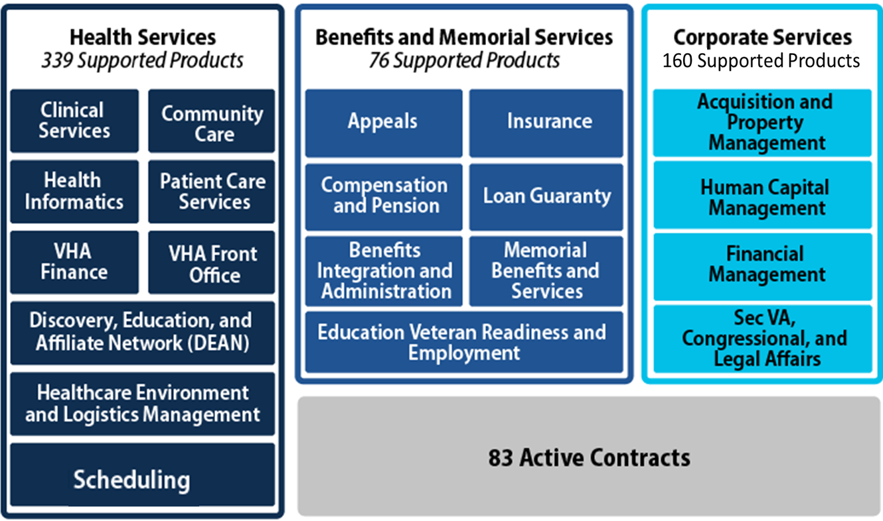
How We Steward VA’s Software Products
Business-Facing Product Lines by Portfolio
3 Portfolios – 20 Product Lines – Over 570 Systems and Applications
Health Services – 339 Supported Products:
Clinical Services
Community Care
Health Informatics
Patient Care Services
VHA Finance
VHA Front Office
Discovery, Education and Affiliate Network (DEAN)
Healthcare Environment and Logistics Management
Scheduling
Benefits and Memorial Services – 76 Supported Products
Appeals
Insurance
Compensation and Pension
Laon Guaranty
Benefits Integration and Administration
Memorial Benefits and Services
Education Veteran Readiness and Employment
Corporate Services – 160 Supported Products
Acquisition and Property Management
Human Capital Management
Financial Management
Sec VA, Congressional, and Legal Affairs
83 Active Contracts
Business-Facing Product Lines by Portfolio
3 Portfolios – 20 Product Lines – Over 570 Systems and Applications

Slide 128
What We Need from Industry
Skills and Technologies:
Cloud Modernization of on-premise software
Artificial Intelligence and Machine Learning
Multivariate testing
Low-code and no-code platforms
DevEx to attract world-class talent
Convert Legacy software to Modern Software
Methodologies:
Zero Trust
Move from Technical Debt to Technical Wellness
Engineering Excellence
Product Management
SPM Focus Areas
PACT Act Implementation
HR Modernization
Supply Chain Modernization
Open Data Publishing
Skills and Technologies
Methodologies
SPM Priority Initiatives
Cloud Modernization of on-premise software
Artificial Intelligence and Machine Learning
Multivariate testing
LC/NC platforms
DevEx to attract world-class talent
Convert Legacy software to Modern Software
Zero Trust
Move from Technical Debt to Technical Wellness
Engineering Excellence
Product Management
PACT Act Implementation
HR Modernization
Supply Chain Modernization
Open Data Publishing

Slide 129
SPM Front Office Service Contracts (6-24 Months)
SPM Product Operations and Technical Management Support – Recompete – Project Start Dat: Q3 FY24 – Primary Product Line: N/A
Recompete or New | Project Start Date | Primary Product Line | Acquisition Title
New | Q3 FY24 | Not Applicable | SPM Product Operations and Technical Management Support

Slide 130
Health Portfolio Service Contracts (6-24 Months)
Community Care DevSecOps – Recompete – Project Start Date: Q3 FY24 – Primary Product Line: Health-CC
Community Living Centers Resident Assessment Instrument – Recompete – Project Start Date: Q3 FY24 – Primary Product Line: Health-PCS
Teamtrack to Microfocus Solutions Business Manager (SBM) Migration – Recompete – Project Start Date: Q3 FY24 – Primary Product Line: Health-CC
Embarcadero Delphi Pro & Rapid Application Development Studio Concurrent Software Licenses and maintenance – Recompete – Project Start Date: Q3 FY24 – Primary Product Line: Health-CS
Cloud-Based Signature Informed Consent for Clinical Treatments and Procedures Enterprise Solution – Recompete – Project Start Date: Q4 FY24 – Primary Product Line: Health-VHA-FO
Docker Desktop Licenses –Recompete – Project Start Date: Q4 FY24 – Primary Product Line: Health-Scheduling
Health Agile Development Services – Recompete – Project Start Date: Q2 FY25 – Primary Product Line: Multiple
Recompete or New | Project Start Date | Primary Product Line | Acquisition Title
Recompete | Q3 FY24 | Health-CC | Community Care DevSecOps
Recompete | Q3 FY24 | Health-PCS | Community Living Centers Resident Assessment Instrument
Recompete | Q3 FY24 | Health-CC | Teamtrack to Microfocus Solutions Business Manager (SBM) Migration
Recompete | Q3 FY24 | Health-CS | Embarcadero Delphi Pro and Rapid Application Development Studio Concurrent Software Licenses and Maintenance
Recompete | Q4 FY24 | Health-VHA-FO | Cloud-Based Signature Informed Consent for Clinical Treatments and Procedures Enterprise Solution
Recompete | Q4 FY24 | Health-Scheduling | Docker Desktop Licenses
Recompete | Q2 FY25 | Multiple | Health Agile Development Services

Slide 131
BAM Portfolio Service Contracts (6-24 Months)
LGY SAH/SHA Modernization - Recompete – Project Start Date: Q1 FY25 – Primary Product Line: BAM-Loan Guaranty (LGY) and Special Adaptive House (SAH/SHA)
Benefits Integrated Delivery Next Generation – Recompete – Project Start Date: Q2 FY25 – Primary Product Line: BAM Multiple
Quality Assurance (QA) Web Application Sustainment Support – Recompete – Project Start Date: Q2 FY25 – Primary Product Line: BAM-Education Veteran Readiness and Employment (EVRE)
Recompete or New | Project Start Date | Primary Product Line | Acquisition Title
Recompete | Q1 FY25 | BAM-Loan Guaranty (LGY) and Special Adaptive House (SAH/SHA) | LGY SAH/SHA Modernization
Recompete | Q2 FY25 | BAM - Multiple | Benefits Integrated Delivery Next Generation
Recompete | Q2 FY25 | BAM-Education Veteran Readiness and Employment (EVRE) | Quality Assurance (QA) Web Application Sustainment Support

Slide 132
Corp Portfolio Service Contracts (6-24 Months)
Recompete or New | Project Start Date | Primary Product Line | Acquisition Title
Recompete | Q4 FY24 | Multiple | CORP Technical Management Support Services (TMSS)
New | Q4 FY24 | Financial Management | Financial Management System Support
New | Q4 FY24 | SecVA Congressional Legal Affairs | General Counsel Agile Modernization (GCAM)
Recompete | Q3 FY25 | Multiple | Consolidated Corporate Support Services (CCSS)
CORP Technical Management Support Services (TMSS) - Recompete – Project Start Date: Q4 FY24 – Primary Product Line: Multiple
Financial Management System Support – New – Project Start Date: Q4 FY24 – Primary Product Line: Financial Management
General Counsel Agile Modernization (GCAM) - New – Project Start Date: Q4 FY24 – Primary Product Line: SecVA Congressional Legal Affairs
Consolidated Corporate Support Services (CCSS) – Recompete – Project Start Date: Q3 FY25 – Primary Product Line: Multiple

Slide 133
FTS Portfolio Service Contracts (6-24 Months)
Recompete or New | Project Start Date | Primary Product Line | Acquisition Title
Recompete | Q4 FY24 | FTS - IT Maintenance and Support | Financial Services Center (FSC) Information Technology Operations Support
Recompete | Q4 FY24 | FPS – Business Sustaining | Veteran Affairs Time and Attendance System (VATAS) Support
Recompete | Q1 FY25 | FTS - Financial Management Business Transformation (FMBT) | FMBT System Integration Support
Recompete | Q2 FY25 | FTS - PMO Support Services | Software Development Support
Recompete | Q4 FY26 | FTS - FMBT | FMBT Interface and Data Conversion Development Support
Financial Services Center (FSC) Information Technology Operations Support - Recompete – Project Start Date: Q4 FY24 – Primary Product Line: FTS - IT Maintenance
Veteran Affairs Time and Attendance System (VATAS) Support - Recompete – Project Start Date: Q4 FY24 – Primary Product Line: FPS – Business Sustaining
FMBT System Integration Support - Recompete – Project Start Date: Q1 FY25 – Primary Product Line: FTS - Financial Management Business Transformation (FMBT)
Software Development Support – Recompete - Project Start Date: Q2 FY25 – Primary Product Line – PMO Support Services
FMBT Interface and Data Conversion Development Support – Recompete - Project Start Date: Q4 FY26 – Primary Product Line: FTS-Financial Management Business Transformation (FMBT)

Slide 134
Contact Us
www.digital.va.gov
Twitter: @VA_CIO
LinkedIn: @DigitalVA

Slide 135
Advanced Planning Brief to Industry
Electronic Health Record Modernization – Integration Office
Ms. Linda Ennis
Director, Solutions Management
Advanced Planning Brief to Industry
June 26, 2023
Notes:
Introduction Slide Notes

Slide 136
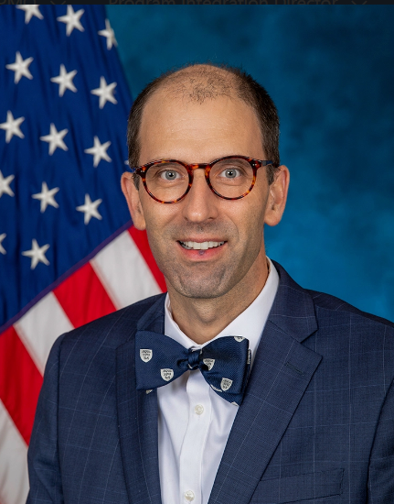
Electronic Health Record Modernization – Integration Office
The Department of Veterans Affairs (VA) is committed to providing seamless care for Veterans, including access to a complete electronic health record and shared, transparent care pathways.
—Dr. Neil Evans, EHRM-IO Acting Program Executive Director
There are currently 3 main pillars within EHRM-IO:
Office of the Functional Champion (OFC)
Program Management Office (PMO)
Office of the Deputy Chief Information Officer (ODCIO)

Slide 137
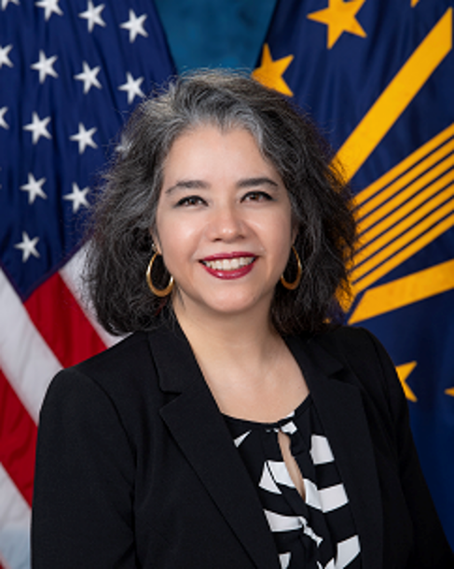
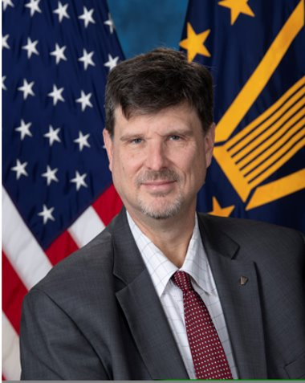
ODCIO Leadership and Teams
Dr. Laura Prietula
EHRM-IO Deputy Chief Information Officer
Mr. Jim Bates
EHRM-IO Assistant Deputy Chief Information Officer
Interagency Office: Conducts all policy related activities, privacy, interagency collaboration, federal standards, and establishing new standards of work.
Deployment Readiness: Leads infrastructure and network capabilities, coordinates deployment activities, IT training, and site prep for implementation.
Enterprise Services: Ensures system operations and security. Manages data migration and syndication processes. Manages requirements and access to all environments.
Solution Management: Manages products end-to-end, EHR system standardization, transition management, and system recovery and monitoring.
Notes:
Talk about what you don’t see (Architecture , engineering etc)
Those components are seamlessly integrated into these pillars
Across each sub-pillar
Not just deployment but sustainment
Make more conversational

Slide 138
EHRM-IO ODCIO
ODCIO Vision
Provide electronic health record technologies that VA customers love.
ODCIO Mission
Seamlessly transition VA’s electronic health record into a modernized platform that is safe to use and easy to embrace.
ODCIO Principles
Continuous enablement of safe and secure health care
Do the right thing, the right way, with integrity and honesty
Sustainable technical excellence every day
Notes:
Need to include in voiceover the alignment to the OIT goals
OIT’s Vision: Drive Exceptional Digital Experiences and Power World-Class Veteran Health Care and Benefits Through Technology
OIT’s Mission: Deliver World-Class IT Products and Services to VA and the Nation’s Veterans
One of OIT’s Priorities: Delightful End User Experience
One of OIT’s Partnership Strategies: Deliver a Seamless Digital Health Experience
And EHRM Mission and Vision / Overall VHA
Love is something that makes people uncomfortable
Intentional
Accept its faults
May not like everything about it, but support the whole

Slide 139
High Level Technical EHRM Overview
VA Facilities
5 VA Medical Centers using the Federal EHR
VA clinics
Health Information Exchange
Consolidated Patient Account Centers (CPAC)
Federal Enclave
Shared enclave managed by DoD
Federal Partners
Federal Electronic Health Record Modernization Program Office (FEHRM)
Department of Defense (DoD)
Department of Homeland Security’s U.S. Coast Guard (USCG)
Department of Commerce's National Oceanic and Atmospheric Administration (NOAA)
Joint VA and DoD Facility
Captain James A. Lovell Federal Health Care Center
(Lovell FHCC is also a VAMC)
Collaboratively Developed EHR
Notes:
Starting from the center overview the Enclave and then talk about the facilities
Talk about the ecosystem
Digital Version of patient record which we share
Security shared between
Secured enclave that provides all agencies standardization of security

Slide 140
Evolving EHRM Standardization
The enterprise IT system solution is a list of platforms, capabilities, and integrations planned for deployment across the VA Enterprise.
Platforms are underlying technology for the capabilities, workflows, and integrations.
Capabilities are modules, features, services, or software which support overall clinical and administration practices.
Integrations are semi-automated interactions between a platform and another VA system.
VA-specific Solutions are customized products, enhancements, or additions to the EHR.
Notes:
Connect to the baseline
Need help to standardize, not to change. Mandate compatible technologies and processes
Describe performance
Use an example
Standards based standards- like API’s
Enable secure and seamless data exchange
Promote interoperability
Standardized, Enterprise, and Sustainable
Outside – In
Thinking about what we are doing with standardization in mind. Helps us with costs, complexity etc. We need to think about long term sustainability.

Slide 141
What We Need from Industry
Patient-first mindset and Veteran-focused design
Focus products on capabilities while using standardized interfaces
Health care industry standards (Health Level 7, Fast Healthcare Interoperability Resources, etc.)
Oracle Health integration and experience
Health care IT (biomedical device integration, application programming interface)
Innovation for the end user or point of care
Make it better for Veterans and VA employees
Notes:
make it better by how the system is used. Don’t mess with standards. Changing standards is not good, leave the data streams alone.
mention the path patterns and middleware layer patterns
Leverage use cases to see who else can benefit
Innovative solutions, need to eliminate the disruptions to the user experience.
External solutions
Flexible framework for scalability

Slide 142
Common Types of Contracts in EHRM-IO
Oracle Health
Care Aware integrations (Care Aware Validation Link)
Interagency agreements (e.g., Defense Health Agency)
Use of existing OIT contracts
Hardware and software
Common vehicles like National Aeronautics and Space Administration (NASA) Solutions for Enterprise-Wide Procurement (SEWP)
Managed services
Notes:
Asking for innovative ideas, these are contracts that we use which we think are beneficial to VA
What does this really mean
Help us seek innovative ideas
Need to consider studies, future efforts should talk about general saving expectations

Slide 143
Contact Us
ehrmquestions@va.gov

Slide 144
2024 Small Business Update
(OSDBU)
Small Business Resources for Success at VA
Advanced Planning Briefing to Industry
June 26, 2024
Kimberly Osborne
Acting Executive Director, OSDBU

Slide 145
Agenda
Background on VA OSDBU
Benefits of working with OSDBU
VA’s top IT Spend Areas
Tips for success
Small business updates
Resources

Slide 146
Background On VA OSDBU
The head of each agency is responsible for effectively implementing the small business programs within their organization.
The Veterans First Contracting Program provides the Department of Veterans Affairs (VA) the unique authority to award set-aside and sole source contracting opportunities to Service-Disabled Veteran-Owned Small Businesses (SDVOSB) and Veteran-Owned Small Businesses (VOSB).
OSDBU Mission: To support the Secretary’s priorities by enabling Veterans to gain access to economic opportunities by developing policies and programs, informed by customer feedback, that improve market research, increase direct access, and maximize the participation of procurement-ready VOSBs and SDVOSBs in Federal contracting.

Slide 147
About OSDBU
Support the Secretary’s priorities by enabling Veterans to gain access to economic opportunities by developing policies and programs, informed by customer feedback, that improve market research, increase direct access and maximize the participation of procurement-ready Service-Disabled Veteran-Owned Small Businesses (SDVOSBs) and Veteran-Owned Small Businesses (VOSBs) in Federal contracting.
Fiscal Year (FY) 2023
$12.8 Billion spent on small businesses

Slide 148
Benefits of Working with OSDBU
Provides procurement readiness education and small business training resources
Creates opportunities to connect with Procurement Decision Makers (PDMs)

Slide 149
VA’s Top IT NAICS
NAICS | NAICS Description | VA Spend (Million) | Small Business Contract Value (Million) | Percentage of contracts awarded to Small Business
541512 | Computer Systems Design Services | $3993 | $664 | 16.6%
541519 | Other Computer Related Services | $2307 | $1917 | 83.1%
334510 | Electromedical and Electrotherapeutic Apparatus Manufacturing | $643 | $122 | 19.1%
511210 | Software Publishers | $611 | $25.3 | 4.1%
518210 | Computing Infrastructure Providers, Data Processing, Web Hosting, and Related Services | $546 | $105 | 19.4%
334517 | Irradiation Apparatus Manufacturing | $474 | $20 | 4.3%
541511 | Custom Computer Program Services | $363 | $207 | 57.2%
334111 | Electronic Computer Manufacturing | $309 | $59 | 19.3%
*Figures reflect data in FPDS for October 1, 2022 – September 30, 2023

Slide 150
Tips For Success
Where to start?
Do your market research
Use VA’s Pathfinder Tool
Respond to Sources Sought and Requests for Information (RFI)
Partner and subcontract
Become certified in multiple socioeconomic categories
Meet with Procurement Decision Makers
Take advantage of OSDBU resources

Slide 151
What’s New For Small Businesses At VA?
Record-high contracting spend on small businesses in FY 2023
Records for VOSB, VOSB, HubZone, and Small and Disadvantaged Business
Women-Owned Small Business (WOSB) Set-Aside to Tier 3
Pending legislation to make WOSB on par with HUBZone and 8(a)
Revamped Forecast of Contracting Opportunities
Ease of Navigation
Advance notice of requirements

Slide 152
Useful Resources
VA OSDBU Website: https://www.va.gov/osdbu/
OSDBU Help Desk Phone: 1-866-584-2344
Strategic Outreach and Communications (SOC) email: OSDBUStratComm@va.gov
~~~
Doing Business with VA Resources
http://www.va.gov/osdbu/library/dbwva.asp
Education and Training
https://www.va.gov/osdbu/outreach/soc/training.asp
Direct Access Program Events
https://www.vetbiz.va.gov/events/
Pathfinder Vendor Tool
https://pathfinder.va.gov/
VA Forecast of Contracting Opportunities
https://www.vendorportal.ecms.va.gov/eVP/fco/EntireVA.aspx?Type=Complete

Slide 153
Stay Connected with OSDBU
OSDBU Help Desk:
Phone: 866–584–2344
Email: vip@va.gov
OSDBU Website: https://www.va.gov/osdbu
Social Media:
X:
https://twitter.com/VAVetBiz
YouTube:
https://www.youtube.com/c/VAOSDBU

Slide 154
PATHFINDER FOR VENDORS
OPENING THE FRONT DOOR OF VA
Presented by: Ashley Hammond
Category Management Support Office
Notes:
“Pathfinder for vendors serves as the front door of VA”

Slide 155
WHAT IS PATHFINDER?
Pathfinder provides a tailored experience that helps vendors:
LEARN
SUBMIT
ENGAGE
Navigate opportunities and find tailored ﻿resources about how to sell to and innovate with VA
Send in your ideas, products and services for VA’s awareness using the Pathfinder survey portal
Connect with relevant VA staff members who can provide feedback on your product or service
WWW.PATHFINDER.VA.GOV
Notes:
VA Pathfinder is a digital concierge that provides each user with a tailored experience based on how the user answers questions as they move through their user journey.
Users who are interested in selling to VA have the opportunity to learn about how VA buys, submit their product or services to VA, and engage with relevant VA staff members.
Learn by navigating opportunities and finding tailored resources about how to sell to VA.
After you've completed your learning journey, submit your products and services for VA's awareness through the Pathfinder survey submission portal.
Relevant VA staff members will engage with your submission through the course of a triage process that every vendor submission goes through.

Slide 156
BENEFITS OF WORKING WITH VA
Reach a New Market
Create opportunities for introducing your product or service into VA's broad infrastructure that supports over 1,200 medical centers and clinics
Spark Opportunity
The Veterans Health Administration serves over 6 million beneficiaries supported by an annual healthcare budget of approximately $110 billion
Support VA Clinicians
Your product or service will not only impact Veterans' lives but also the working lives of the largest healthcare workforce in the country
Notes:
Reach a new (and massive!) marketplace - the Veterans Health Administration serves over 6 million beneficiaries with an annual healthcare budget of around 110 billion dollars. It's a very large organization carrying lots of potential for acquisition of your products and services.
Spark opportunity - with 170 VA Medical Centers and 1100 outpatient clinics, there are countless opportunities for your products and services to be utilized in a clinical setting.
Support clinicians - in addition to its mission of providing care to our Nation’s Veterans, VA also has the nation’s largest healthcare workforce with over 340,000 employees. Your products and services could help make their working lives easier.

Slide 157
BENEFITS OF USING PATHFINDER
Understand How to Sell to VA
Build Connections with VA
Improve Veteran Outcomes
Pathfinder provides an improved user experience with clear step-by-step learning pathways to build your understanding about selling to VA
After you submit to Pathfinder, your product or service goes directly to VA for awareness and engagement through the Pathfinder market research database
You can help improve Veteran access to the best care through state-of-the-art products, services, and innovations provided by vendors like you!
Notes:
Pathfinder offers several benefits to vendors who want to sell to VA
An improved user experience cuts through the red tape often associated with working with VA. We have received feedback from vendors that working with VA is not always the easiest and most transparent process, and Pathfinder helps solve that challenge.
You can build better connections within VA. Every Pathfinder submission goes to VA CMSO staff for review and is then shared with all VA staff for awareness through the Pathfinder market research database.
Finally, your product or service can improve Veterans lives by offering state-of-the-art private sector products and innovations

Slide 158
VENDORS LEARN HOW TO DO BUSINESS WITH VA
Learn
LEARN WHAT VA BUYS
SEE WHO VA WORKS WITH
Products or services within the 10 categories identified by the Office of Management and Budget (OMB)
Domestic products sourced and manufactured in the United States consistent with the requirements of the Buy American Act
Vendors with market-ready solutions that can solve problems for Veterans, caregivers, survivors, families, and active-duty service members
VA gives priority to Veteran-Owned Small Businesses (VOSBs) and Service-Disabled Veteran-Owned Small Businesses (SDVOSBs)
Submit
Engage
Learn More at www.pathfinder.va.gov
Notes:
Pathfinder helps vendors get ready to sell to VA
It provides them with critical information on becoming qualified to provide products and services to a federal agency.
Visit www.pathfinder.va.gov/sell to learn more about what VA buys and who VA works with, including information about:
The 10 OMB categories
The Buy American Act
VA policies regarding Veteran-Owned Small Business and Service-Disabled Veteran-Owned Small Businesses
And more!

Slide 159
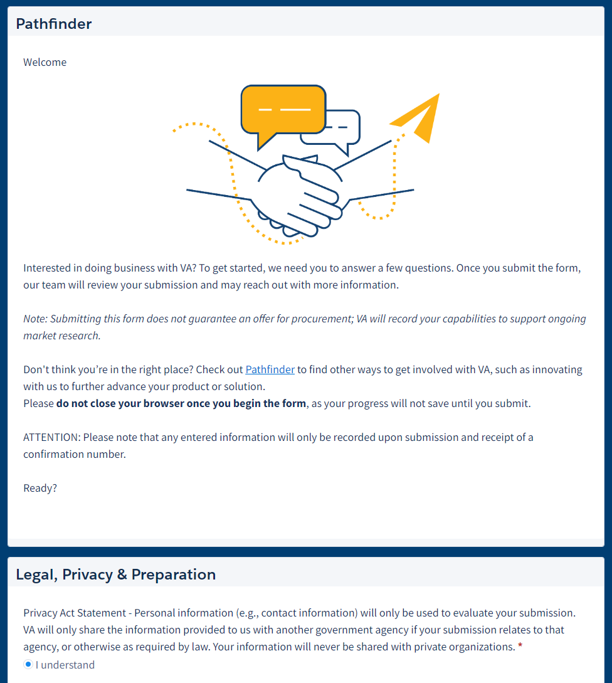
VENDORS CAN SUBMIT THEIR PRODUCTS OR SERVICES TO VA
Pathfinder Survey Form
Learn
Works as a templatized capability statement that provides key information to VA staff about your product or service
The form offers response options as selection or free text to make it easy to share your information
Clearly captures and identifies socio-economic status of potential innovators and vendors
Submit
Engage
Notes:
Vendors can submit their products or services to VA through the Pathfinder survey form, which users will find at the end of their learning journey.
The Pathfinder survey form includes questions about your company, your product or service, your prior experience working with VA (if any), and your business’ socioeconomic status
Response options include multiple choice selections and free text responses, so you can easily and effectively communicate your information.

Slide 160
VENDORS RECEIVE AN EMAIL CONFIRMATION WITH A SUBMISSION NUMBER
Hello, Your Submission ID is: S-#### Thank you for your interest in VA and sharing your product or service with us! Our Pathfinder team will read your submission, and reach out if it looks like you need any support getting ready to do business with VA, or if additional information about your submission is required. Your product or service will then be added to Pathfinder's Market Research Database. We will also share this submission with relevant VA National Program Offices. Having your submission in the database allows VA employees to easily access your information. VA staff will be able to view your submission for relevancy to needs, feasibility, and alignment with strategic priorities. If your submission aligns to existing needs within VA, you maybe contacted by VA staff as they conduct Market Research and shape their requirements. Thank you, Veterans Affairs Pathfinder
Learn
Submit
Engage
Notes:
You’ll know that VA has received your Pathfinder survey submission because you will get a confirmation email with a submission number and some key information about the Pathfinder market research database.

Slide 161
WHAT HAPPENS WITH PATHFINDER VENDOR SURVEY SUBMISSIONS?
VA’s Category Management Support Office (CMSO) acknowledges vendor submissions and makes sure vendors are ready to enter the Pathfinder market research database
Readiness Assessment
Small business support staff help small businesses with registration, certifications, and opportunities while CMSO shares submissions with VA National Program Offices
Vendor Support
Participating VA staff can browse to find new products and services or engage directly with vendors
Market Research Database Entry
The Pathfinder team shares submissions with relevant National Program Offices throughout VA for their awareness. VA staff can engage with their acquisitions team if interested
Connection with VA Staff
Notes:
On the VA side, a triage process is triggered when a vendor sends in a Pathfinder survey submission.
First, CMSO acknowledges the submission and coordinates with the vendor to make sure your product or service is ready to be entered into the Pathfinder market research database. Small business support staff are also mobilized as needed to support small businesses with their submissions.
Second, CMSO shares relevant submissions with National Program Offices across VA as they are entered into the Pathfinder market research database.
Finally, staff across VA can review and engage with their acquisitions teams if they are interested in a particular product or service they found in this Pathfinder market research database.

Slide 162
PATHFINDER IS ENGAGING VENDORS WITH A FOCUS ON SMALL BUSINESS
200K+
Website Visits
1700+
Vendor Submissions
20%
of Pathfinder submissions are from Women-Owned Small Businesses (WOSBs)
50%
of Pathfinder submissions are from Veteran-Owned Small Businesses (VOSBs) & Service-Disabled Veteran-Owned Small Businesses (SDVOSBs)
Notes:
VA is making an effort to work with more small businesses, and Pathfinder is helping the agency achieve this goal.
In just over one year, Pathfinder has attracted over 200,000 website visitors and nearly 1700 submissions from vendors with products or services they want to sell to VA.
A meaningful proportion of these submissions are coming from WOSBs, VOSBs, and SDVOSBs.

Slide 163
ENGAGE WITH PATHFINDER IN ONE OF THREE WAYS:
1
2
3
Learn How to Sell to VA
Submit Your Information
Refer Your Colleagues
Learn what you need to know to be prepared to sell to VA at the Pathfinder website
Use Pathfinder to make VA aware of your commercially-available product or service by submitting a survey
Tell others about Pathfinder if they have products and services that can help VA meet its mission
www.pathfinder.va.gov
Notes:
Here is how YOU can use Pathfinder! Go to the website pathfinder.va.gov to:
get ready to sell to VA by accessing learning and support resources, then
submit your product or service directly to VA through the Pathfinder survey portal
Additionally, help spread the word about Pathfinder by referring other potential vendors to the website if they have a product or service that might be right for VA

Slide 164
Thank You!
VAPathfinderSupport@va.gov
PRE-DECISIONAL / FOR DISCUSSION ONLY / VA
Notes:
Visit Pathfinder on the web at www.pathfinder.va.gov or scan the QR code here to access directly.
Reach out to VAPathfinderSupport@va.gov with any questions.
Thank you!

Slide 165
Wrap Up – Thank You!
Participant Surveys will be sent to all registered attendees following the event via an email from EventBrite.
Parking Reminder: Please pay at the two foot-stations on Levels 2 and 3 before heading to your vehicles. Simply scan your QR code and pay via MasterCard or Visa. This will help lead to an efficient exit.
We hope to see you next year!
165

