Slide 1
Advanced Planning Brief to Industry (APBI)
Robert L. Capers Jr.,
Director AE & Construction Policy
Office of Construction & Facilities Management (CFM) November 5 & 6, 2013

Slide 2
Agenda
Background
Major Program(s) Summary
Upcoming Acquisition/Opportunities
Questions

Slide 3
Background
The Office of Construction & Facilities Management (CFM) is responsible for the planning, design, and construction of all major construction projects greater than $10 million. In addition, CFM acquires real property for use by VA elements through the purchase of land and buildings, as well as long-term lease acquisitions. Through the construction and real property programs, CFM delivers to Veterans, high quality buildings, additions, large scale renovations, and structural enhancements. CFM also manages facility sustainability, seismic corrections, physical security, and historic preservation of VA's facilities.

Slide 4
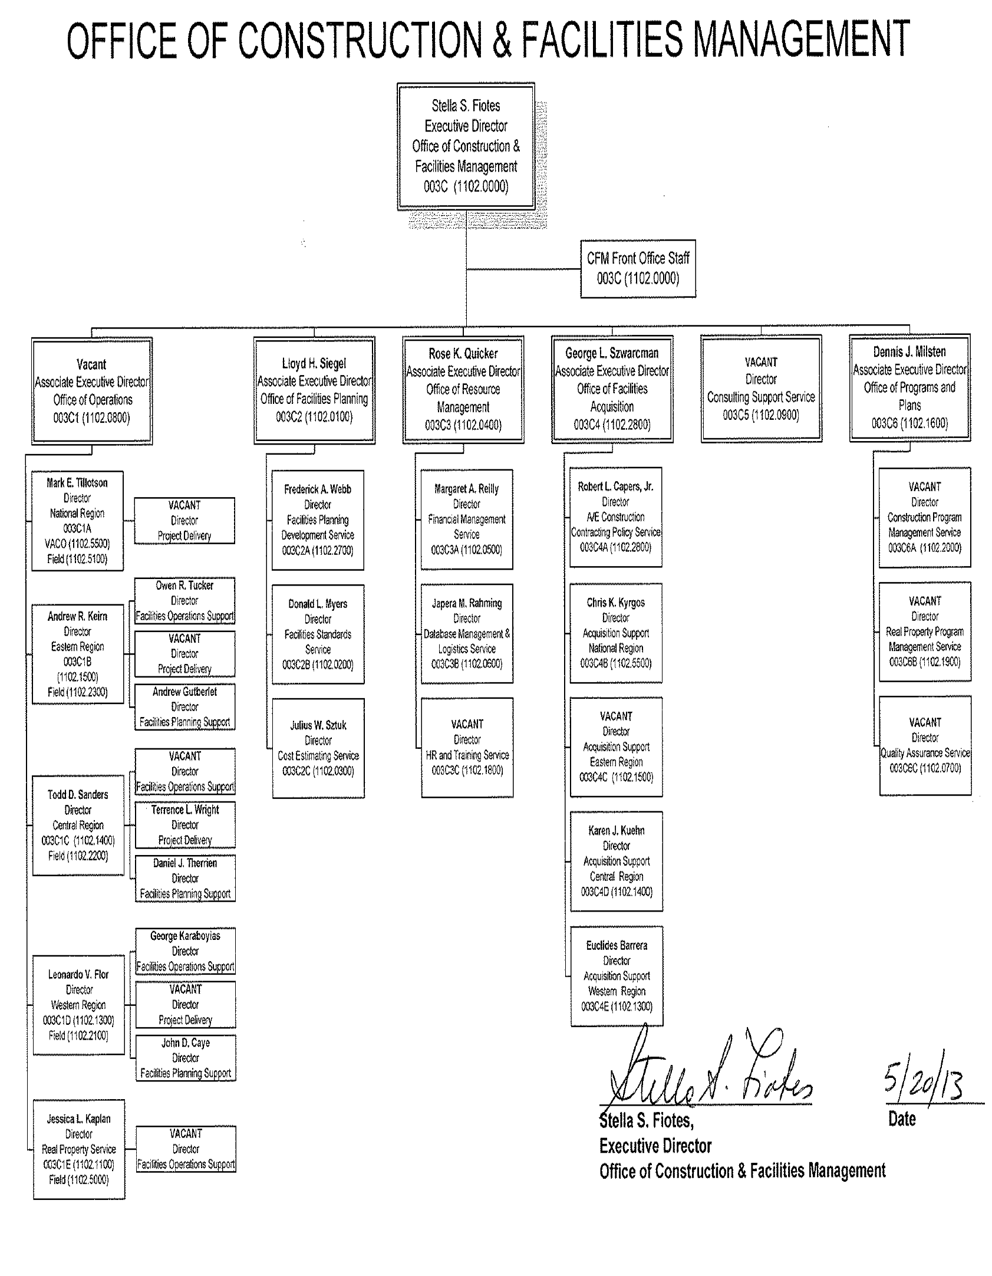
Background

Slide 5
Major Programs
Major Construction
Projects with a cost greater than $10 Million
Requires a line item appropriation by Congress
Also requires a specific authorizing legislation for medical projects
Typically designed by an Architectural/Engineering Firm and constructed by a general contractor selected based on a combination of quality and price

Slide 6
Major Programs
Construction Funding

Slide 7
Major Programs
Architect-Engineering Services
Contract for Pre-Design, Schematic Design, Design Development, and Construction Documents for Major VA New Facilities, Major Additions, & Major Renovations for Medical Center Projects

Slide 8
Major Programs
Leasing Acquisition
Many VA facilities are leased – particularly CBOCs
Varying approvals required based on space and rent levels
Congressional approvals if rent is greater than $1 million
CFM’s Real Property Service manages the acquisition of large leases
Local or VISN personnel manage smaller leases
18 million leased square feet (12.7% of VA Inventory)

Slide 9
Upcoming Acquisition/Opportunities
2014 FORECAST OPPORTUNITIES
Station Name | Project Number | Project Description | Proposed Large | Proposed Small | Proposed Qtr. FY 14
VHA Majors - Schematic/Design Development Awards
Manhattan, NY |  | Ground Floor Phase 2B | ü |  | 1st
Manhattan, NY |  | Flood Reinforcement | ü |  | 1st
West Los Angeles, CA |  | Seismic Corrections Various Bldgs (B156/B157/B258) | ü |  | 3rd
Tampa, FL |  | New Bed Tower Schematic & DDs | ü |  | 3rd
West Los Angeles, CA |  | New Tower & B500 Seismic Corrections | ü |  | 4th
NCA Majors - Schematic/Design Development Awards
Ft Sam Houston (NC), TX |  | Expansion | ü |  | 2nd
Southern Colorado, CO | 933-002 | New Cemetery |  | ü | 1st
Sacramento Valley, CA | 921-002 | Phase 2 Expansion | ü |  | 2nd
Ohio Western Reserve |  | Expansion | ü |  | 2nd
Bayamon, PR (Morovis) |  | New Expansion? |  | ü | 3rd
Pensacola, FL (Barrancas) (NC) | 828 | Expansion Phase II |  | ü | 2nd
Jacksonville (NC), FL | 928 | Expansion Phase II |  | ü | 2nd
Miami, South FL (NC) | 924 | Expansion Phase II |  | ü | 3rd
Willamette, OR (NC) | 907 | Expansion |  | ü | 3rd
Western, NY | 936-002 | New National Cemetery - Phase 1 Develop |  | ü | 2nd

Slide 10
Upcoming Acquisition/Opportunities
VHA Majors - Construction
Palo Alto, CA | 640-424 | Phase II Demolition Building 2 | ü |  | 1st
Palo Alto, CA | 640-424 | Radiology Consolidation, Parking, Site Utilities & Loop Rd | ü |  | 2nd
Manhattan, NY |  | Ground Floor Renovation Phase 1A | ü |  | 2nd
Manhattan, NY |  | 9th Floor OPC | ü |  | 2nd
Manhattan, NY |  | Utility/MRI Relocation | ü |  | 2nd
Manhattan, NY |  | Flood Wall Construction | ü |  | 2nd
New Orleans, LA |  | WP-08 Campus Buildout | ü |  | 1st
New Orleans, LA |  | WP-09 Research Building | ü |  | 1st
Orlando, FL |  | Phase V SimLearn Center | ü |  | 2nd
Manhattan, NY |  | Ground Floor Renovation Phase 1B | ü |  | 2nd
Manhattan, NY |  | Ground Floor Renovation Phase 2A | ü |  | 2nd
Manhattan, NY |  | Utility/MRI Relocation Phase 2A | ü |  | 2nd
Manhattan, NY |  | Utility/MRI Relocation Phase 2B | ü |  | 2nd
Manhattan, NY |  | Inpatient Privacy Renovations Phase 1 | ü |  | 2nd
Biloxi, MS |  | Renovations | ü |  | 3rd
Manhattan, NY |  | Ground Floor Renovation Phase 2B | ü |  | 4th
Manhattan, NY |  | Flood Reinforcement | ü |  | 4th
Pittsburgh, PA |  | ROB Connector |  | ü | 4th
Long Beach, CA |  | Seismic Correction PH-2 Demo 2 |  | ü | 3rd
Seattle, WA |  | B101 MHR Facility - Phase 2 | ü |  | 4th
Walla Walla, WA |  | Phase II Renovations Bldg 86 |  | ü | 4th
Bay Pines, FL |  | Phase III Wards 3D and 5D Renovations | ü |  | 4th
Manhattan, NY |  | Interim/Long Term OPC | ü |  | 4th

Slide 11
Upcoming Acquisition/Opportunities

Slide 12
Upcoming Acquisition/Opportunities
2014 FORECAST OPPORTUNITIES - LEASES
Description | New or Renewal | NUSF | LEASE TERM | Proposed Qtr. FY 14
Binghamton, NY | Renewal | 24,888 | 20 | 4th
TOTAL - VISN 2
Savannah, GA | New | 55,193 | 20 | 3rd
Mobile, AL --Award | New | 65,125 | 20 | 3rd
TOTAL - VISN 7 |  | 120,318
St. Augustine, FL | New | 16,595 | 20 | 4th
TOTAL - VISN 8
S. Bend, IN | New | 71,403 | 20 | 1st
TOTAL - VISN 11
Springfield, MO | New | 68,000 | 20 | 4th
TOTAL - VISN 16
East Portland, OR | Renewal | 26,000 | 20 | 2nd
TOTAL - VISN 20
San Jose, CA | Renewal | 72,000 | 20 | 3rd
TOTAL - VISN 21
Knoxville, IA | New | 12,835 | 20 | 2nd
TOTAL - VISN 23

Slide 13
Thank You & Questions
Available Resources
CFM Web Site: www.cfm.va.gov
VA FY 2013 Budget & Capital Plan:
www.va.gov/budget/products.asp

