Slide 1
Strategic Sourcing OVERVIEW
Annette Gibbs-Skervin, PhD, MBA, PMP
Executive Director Strategic Sourcing Transformation Management
Technology Acquisition Center Industry Engagement
June 20, 2017

Slide 2
Agenda
Department of Veterans Affairs (VA) Office of Information and Technology (OI&T) Transformation Background
What Is Strategic Sourcing?
How Does Strategic Sourcing Drive Transformation?
Q&A

Slide 3
Acquisitions and Contractual Authority Disclaimer
Acquisitions and contractual commitments can only be made by Government officials having expressed authority to enter into such agreements on behalf of the United States Government. The only Government officials with such authority are Warranted Contracting Officials. Any discussions of procurement requirements do not constitute contractual direction or authorization of any kind. Future contractual directions, If any, shall only come from the cognizant Department of Veterans Affairs Warranted Contracting Officer.

Slide 4
OI&T Transformation Background

Slide 5
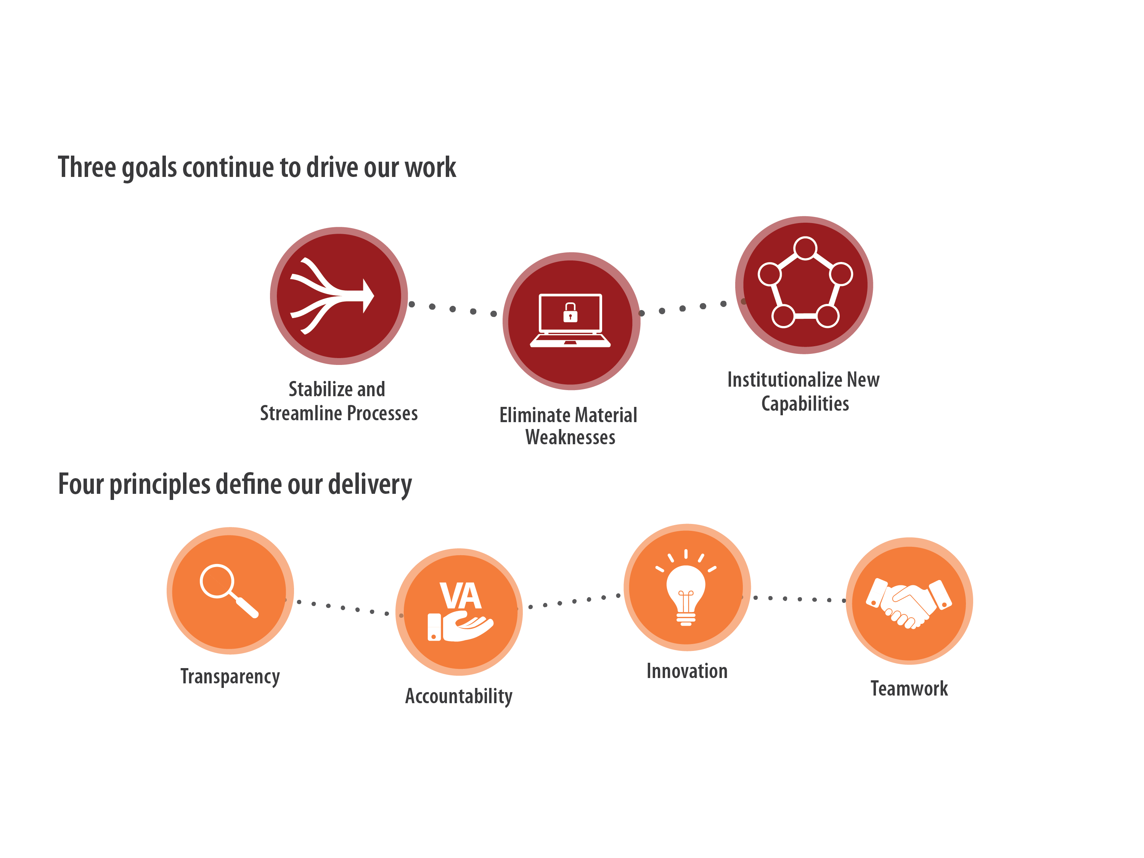
2017 Transformation Strategy

Slide 6
2017 Transformation Strategy (cont’d)

Slide 7
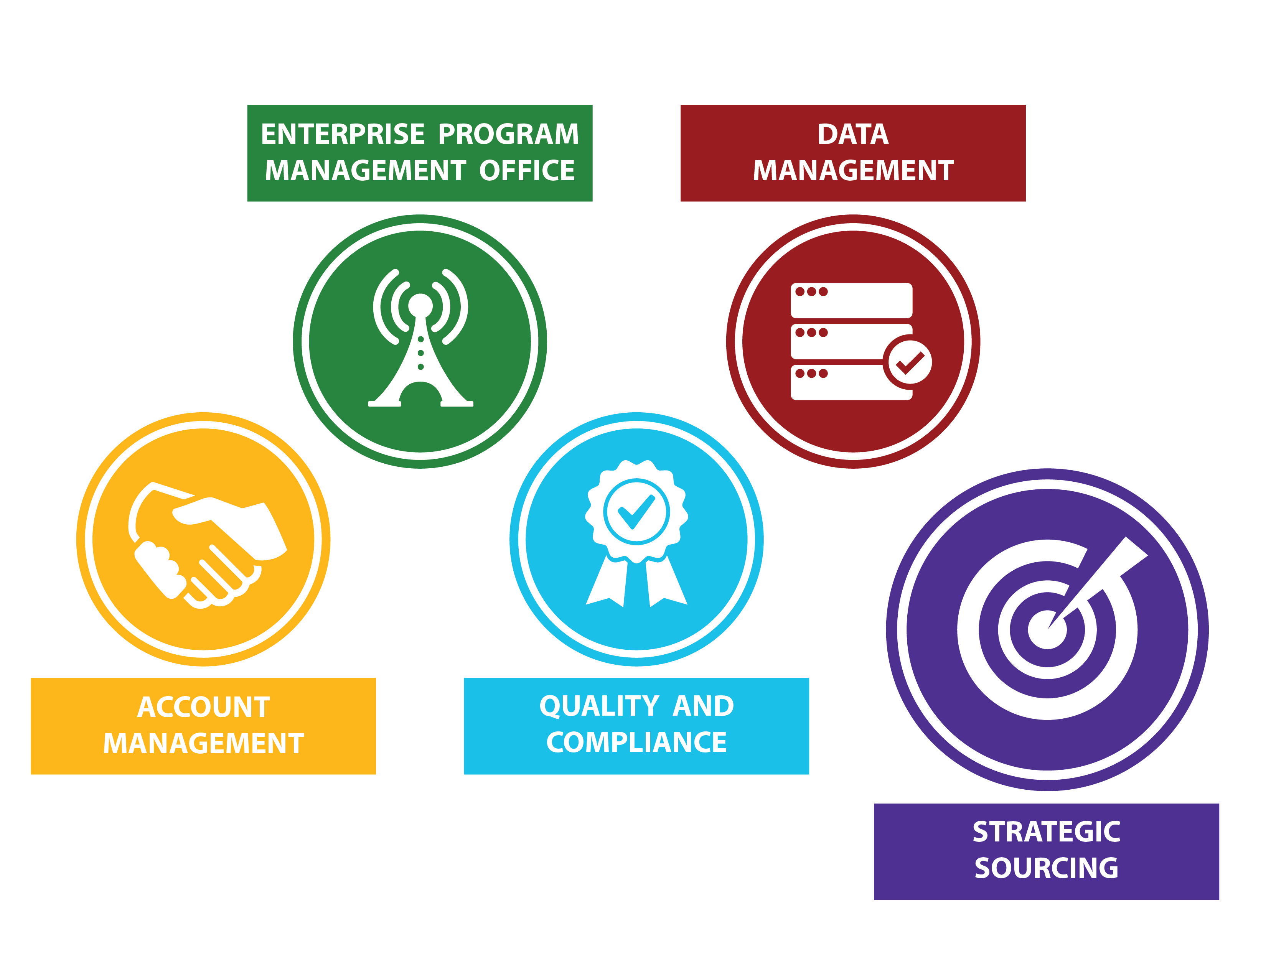
Strategic Sourcing: A New VA OI&T Critical Function

Slide 8
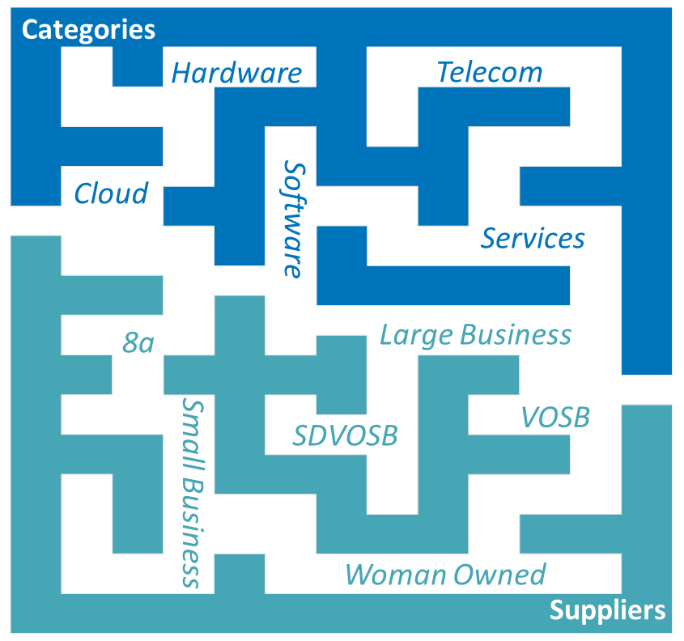
The Strategic Sourcing Opportunity
>$3.1B Spending / year
>3,000 Acquisitions/ YEAR
Access to innovation
cotS, Cloud, buy-first focus

Slide 9
State of VA Before Strategic Sourcing
Complex, multi-sourcing environment
Governance, sourcing, service delivery, and collaboration issues
Vague delineation between VA and supplier responsibilities
Fragmented approach to supplier risk mitigation and issue escalation
Poorly managed product delivery and service level tracking
Low FITARA assessment score
Before Strategic Sourcing
With Strategic Sourcing
SP = Service Provider

Slide 10
What Is Strategic Sourcing?

Slide 11
Strategic Sourcing = VETERAN ACCOUNTABILITY
Strategic Sourcing ensures that the VA consistently receives innovative, best-in-class products and services from suppliers at the best price! This allows the VA to deliver outcomes that improve the Veteran experience.
STRATEGIC SOURCING

Slide 12
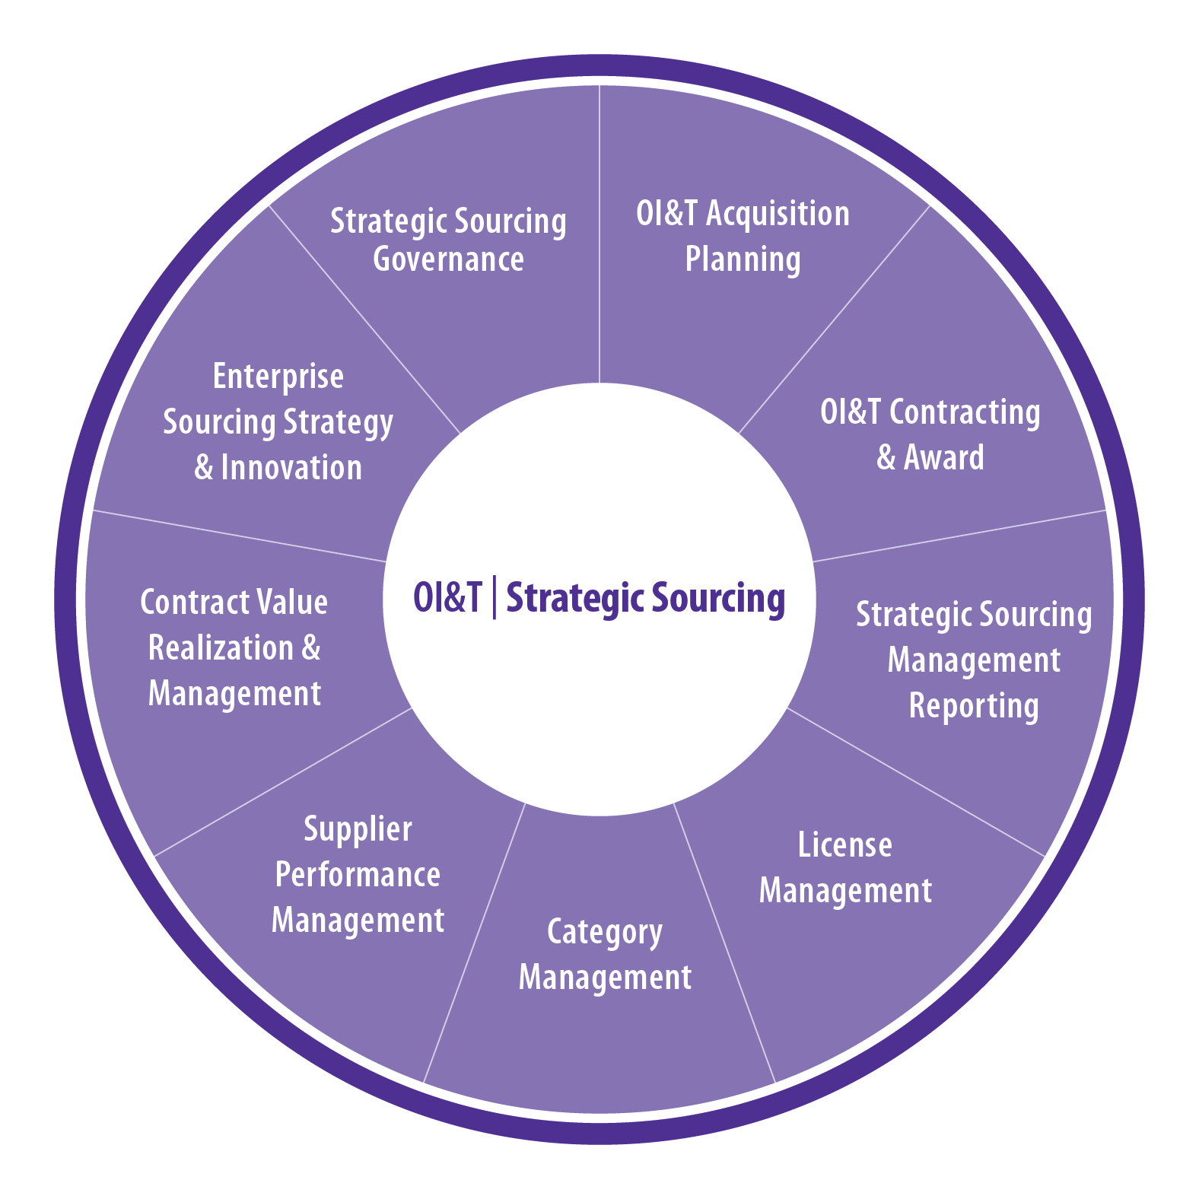
Strategic Sourcing = SUPPLIER VALUE

Slide 13
Strategic Sourcing = SUPPLIER GOVERNANCE
VA OI&T is implementing a standardized governance committee framework across the supplier base to support improved contract performance and oversight
Each layer of ascending governance has important relationship, issue management, and decision making roles
The Strategic Sourcing Governance Board sets the governance standards and provides input from the organization
Escalation of Decisions
 | Executive Team | Management Team | Service Delivery Team
Purpose | Quarterly/bi-annual review provides a strategic overview of sourcing relationship and executive escalations requiring attention | Monthly/quarterly review provides a summary level rollup of project or service delivery metrics/data, and business escalations, using a standard reporting template | Weekly/monthly review addresses escalated operational activities, project deliverables, service delivery metrics, and issues
Strategic Sourcing Governance Board

Slide 14
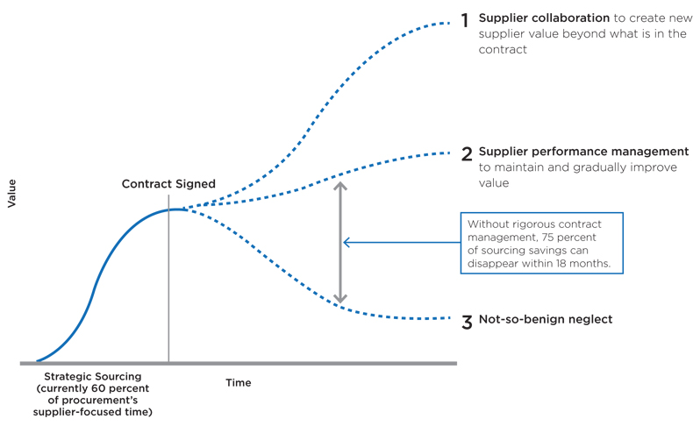
Strategic Sourcing = SUPPLIER PERFORMANCE MANAGEMENT
VA OI&T is changing how we do business with our vendors/suppliers, ensuring that we deliver value to our Veterans through continuous monitoring of our contract and supplier performance
Source: CEB Procurement Leadership Council

Slide 15
Strategic Sourcing = PROCESS CONSISTENCY
As part of Strategic Sourcing, VA OI&T will deploy the Service Integration and Management (SIAM) processes in phases
The rollout will align with the implementation/maturity of the related Information Technology Infrastructure Library (ITILv3) processes.
Demand Management
Delivery Management
Supplier Management
HOW you work with customers or constituents
Drives the priority of WHAT requirements need to be delivered
HOW you deliver, including HOW you meet demand needs and HOW well you do so
Managing the delivery of WHAT is supplied by external suppliers, including managing to contractual commitments

Slide 16
Strategic Sourcing = CATEGORY MANAGEMENT
Develops sourcing strategy aligned to the OI&T Strategy and Portfolio
Applies structured analysis of spend, supplier, market, and business information to determine opportunities
Establishes multi-year category plans, prioritizes category activities, tracks progress, and ensures stakeholder support
Builds process discipline on category strategy development and execution
Highlights results of Strategic Sourcing contribution to VA and OI&T objectives
Categories
Hardware
Software
Telecom
Cloud
Service

Slide 17
How Does Strategic Sourcing Drive Transformation?

Slide 18
How Strategic Sourcing Drives Transformation
Prioritizes Value Over Cost
Continuous Improvement
Optimization and stewardship of taxpayer dollars through best value decisions
Identifies suppliers who demonstrate ability to deliver products and services
Supports continuous improvement and innovation
Directly Ties Vendor Performance to Value
Centralizes ownership and accountability of IT acquisition decisions under the CIO
Supports execution of FITARA
Monitors supplier performance and holds them accountable
Cuts Through Bureaucratic Red Tape
Uses outcome-driven requirements approach, aligning to OI&T strategic direction
Reduces acquisition package fragmentation by aligning OI&T-wide sourcing strategy with portfolio
Facilitates Quick and Efficient Solutions
Supports VA’s Cloud-First, COTS-First, Buy-First Strategy
Improves speed to market, delivering solutions to Veterans faster
Identifies solutions that meet business and Veteran needs

Slide 19
Key Strategic Sourcing Benefits
With consolidated IT award accountability and responsibility, OI&T will:
Manage the sourcing lifecycle versus creating acquisition packages
Select best value awards versus lowest cost awards
Hold suppliers accountable for performance and results versus simply managing supplier activity
Monitor OI&T supplier performance reports and driving improvements versus tracking contract issues
Transform our environment to a managed services, cloud services (“as-a-service”), COTS solutions versus building-to-order
Identify cost avoidance dollars to reinvest in transforming OI&T legacy infrastructure and systems

Slide 20
QUESTIONS?

