Slide 1
Advanced Planning Brief to Industry (APBI)
Rick Lemmon
Acting VHA Chief Procurement & Logistics Officer December 20, 2015

Slide 2
Agenda
VA Overview
VHA Procurement and Logistics Overview
Office of Procurement Overview
Network Contracting Office Structure

Slide 3
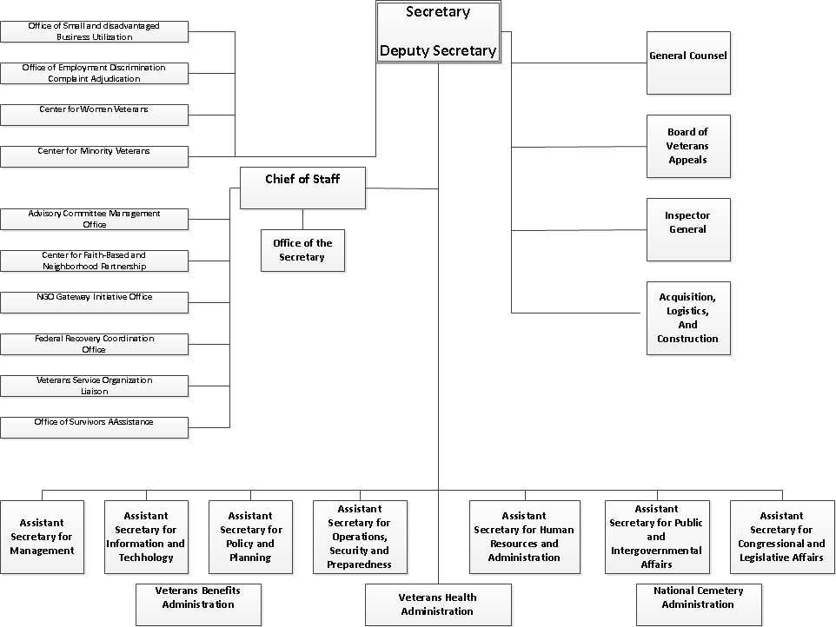
VA Overview

Slide 4
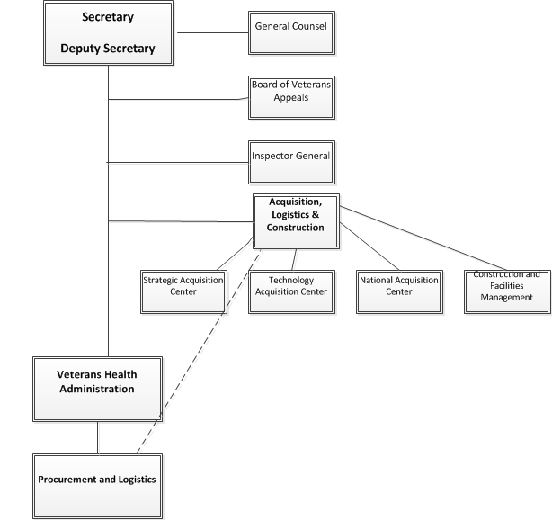
Procurement and Logistics Relationship to OALC

Slide 5
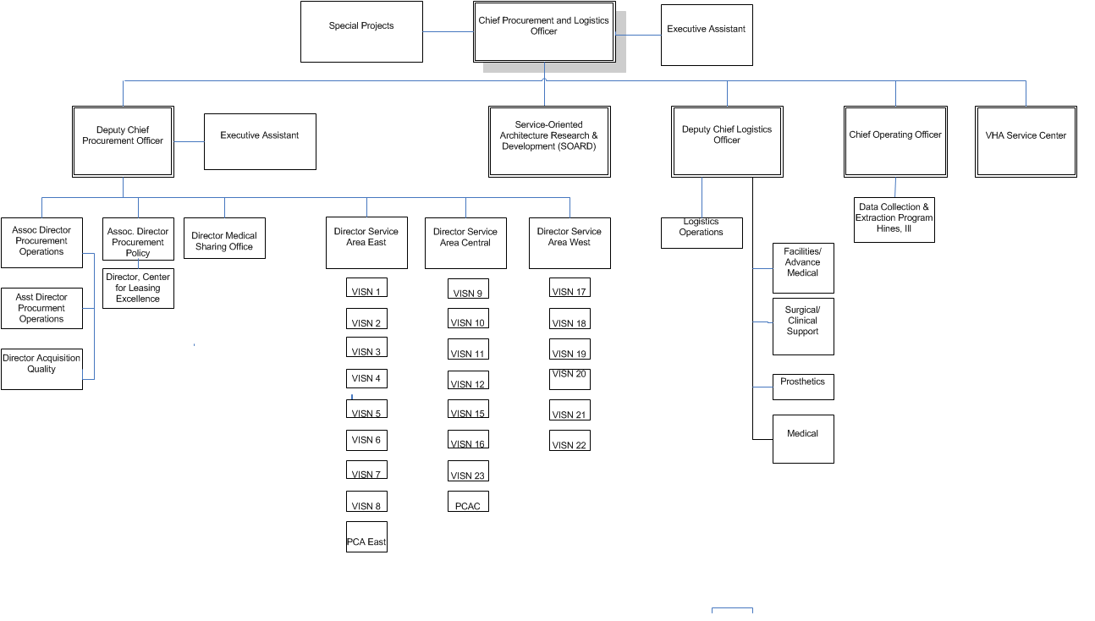
Office of Procurement and Logistics Overview

Slide 6
SAO West/Central/East Network XX Contracting Office

Slide 7
SAO West/Central/East Network XX Contracting Office

Slide 8
SAO West/Central/East Network XX Contracting Office

Slide 9
What We Buy
Construction –
Minor
Non-recurring Maintenance
$1.5B in FY 15
Supply –
Medical/Surgical
Products to keep facilities running
$2.7B in FY 15
Services –
Keep facilities running
$2.5B in FY 15
Notes:
Construction – VHA FPDS PSC Y & Z for FY15
Supply – VHA FPDS All PSC Product Codes minus 6505-Drugs and Biologicals for FY15
Services – VHA FPDS all PSC Service Codes minus X-Leases, Y/Z-Construction, and Medical Sharing for FY15

Slide 10
What We Buy (continued)
Medical Sharing –
Non-VA Medical Care (University Partners)
$1.3B in FY 145
Specialized –
Prosthetics
Leases
$1.6B in FY 15
Notes:
Medical Sharing – From MSO
Specialized - PSAS GUI >3k for FY15 = 1B
- Leases eCMS PSC X for FY15 = 617M

Slide 11
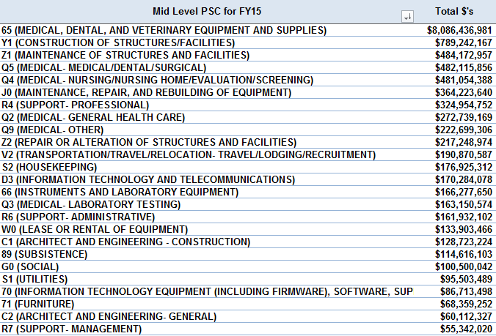
What We Buy (continued)
Notes:
Construction – VHA FPDS PSC Y & Z for FY15
Supply – VHA FPDS All PSC Product Codes minus 6505-Drugs and Biologicals for FY15
Services – VHA FPDS all PSC Service Codes minus X-Leases, Y/Z-Construction, and Medical Sharing for FY15

Slide 12
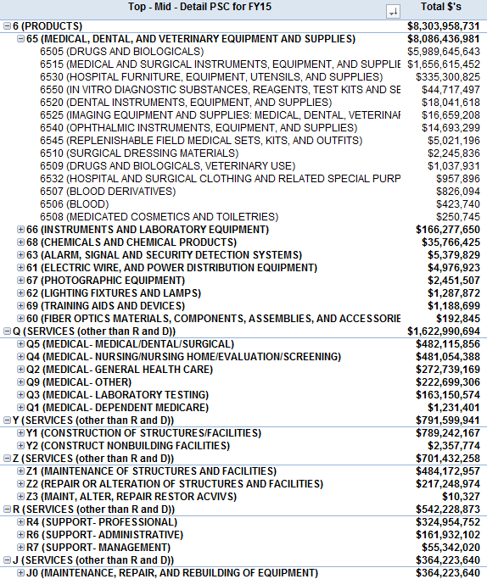
What We Buy (continued)
Notes:
Construction – VHA FPDS PSC Y & Z for FY15
Supply – VHA FPDS All PSC Product Codes minus 6505-Drugs and Biologicals for FY15
Services – VHA FPDS all PSC Service Codes minus X-Leases, Y/Z-Construction, and Medical Sharing for FY15

Slide 13
Questions
?

