Slide 1
OFFICE OF INFORMATION AND TECHNOLOGY
Medical Appointment Scheduling System (MASS)
MASS Conceptual Architecture
18 JUNE 2014
Seal of the U.S. Department of Veterans Affairs
Office of Information and Technology

Slide 2
Agenda
As-Is System Integration View
Business Process Framework
High-level Sequencing Priorities
Key Capabilities
Supporting
Enabled
VistA Scheduling Integration
Other Scheduling Integrations
Other Architecture Considerations

Slide 3
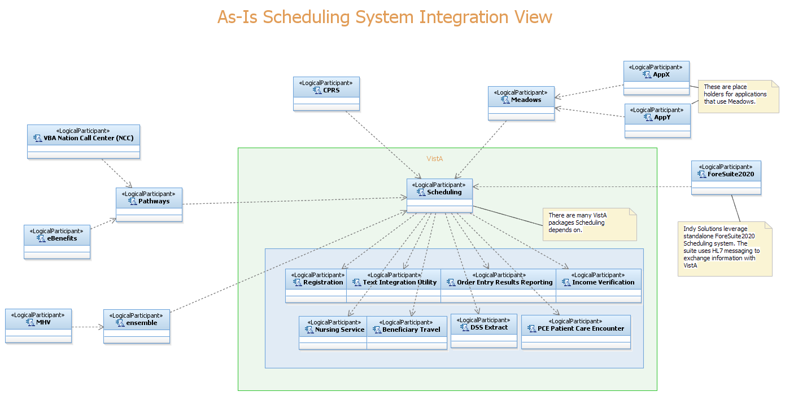
Scheduling As-Is Architecture View

Slide 4
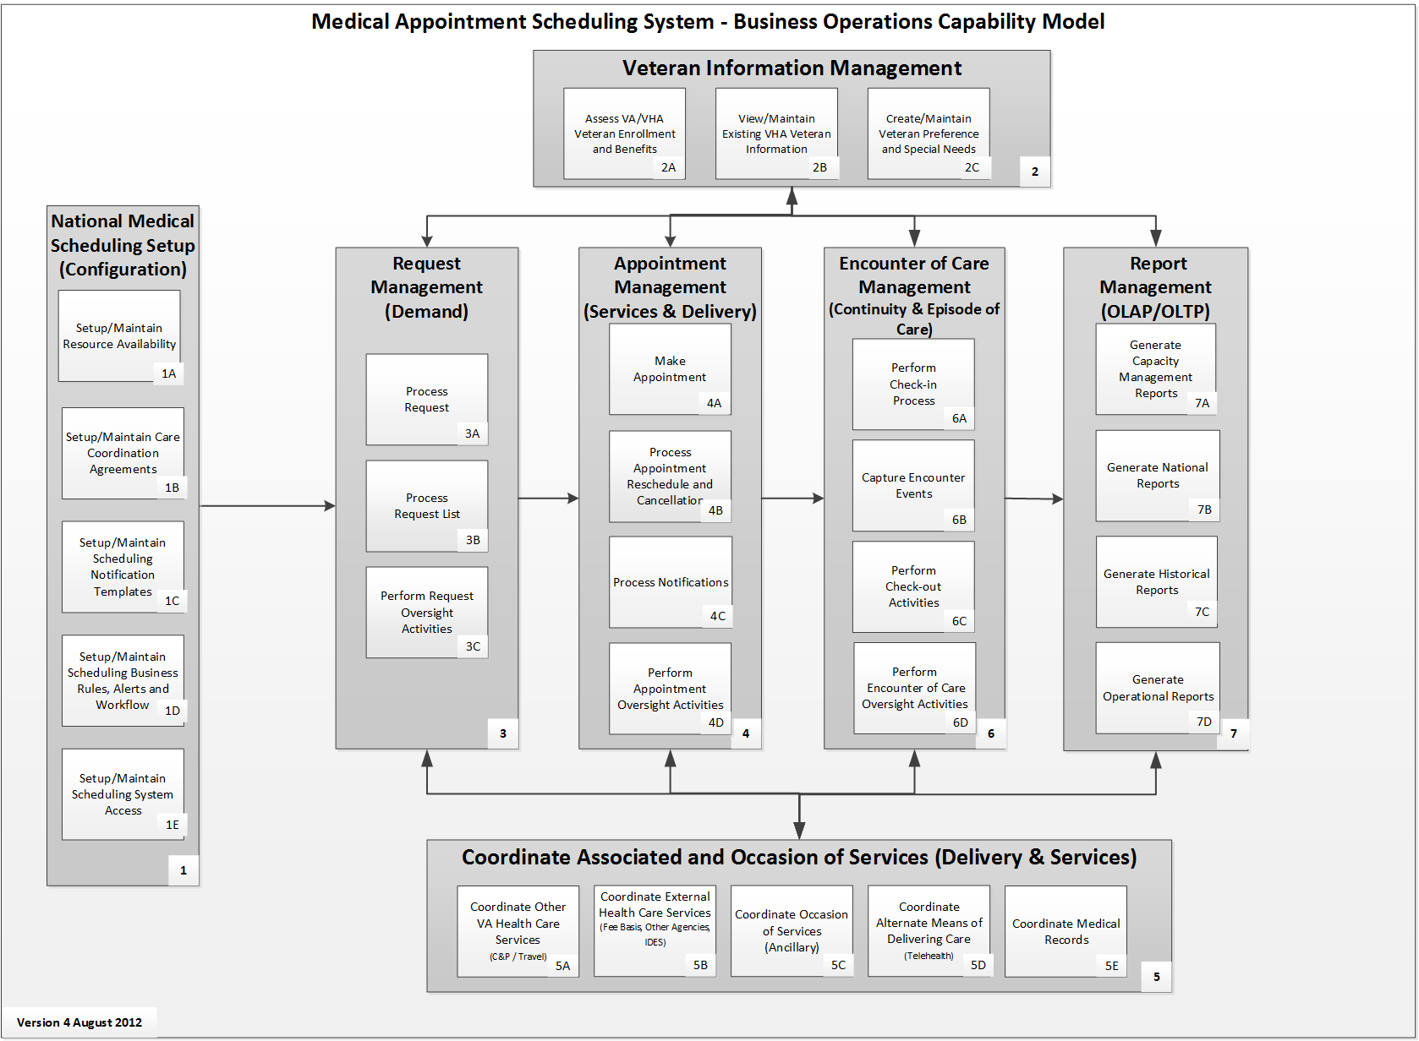
Business Process Framework

Slide 5
High Level Integration Priorities
VistA Scheduling Adapter
Clinical Video Tele-conferencing (CVT)
Medical Appointment Scheduling System (Phase 1B)
Priority VA Integrations (concurrent development)
Disability Evaluation Assessment Program (DEAP)
Burn Pit
Customer Channel Integrations
Self Service
Call Centers
Case Management
External Partner Integrations
DoD, NwHealth Informaiton Network (NwHIN), potentially any healthcare provider
Legacy Interface Migration
External Consumer Integrations
VistA Integrations

Slide 6
Key Supporting Capabilities Unique to the VA’s Environment
Push Appointments into VistA
VistA Scheduling Adapter
Read Data from VistA
VistA Adapters (such as: Primary Care Management Module (PCMM), TIU, Registration, Beneficiary Travel)
Read Health Enrollment Information
Enrollment & Eligibility Service
Enterprise Person/Customer Services
Identity Management
Military Service Information
Demographic Information
Contact Information
Preferences
User Provisioning
IAM and VistA Kernel Integration
Correspondence
Correspondence Templates
Correspondence Rules
PDF Generation
Document Archiving

Slide 7
Key Supporting Capabilities Unique to VA’s Environment
External Partner Integration
eHealth Gateway
Virtual Lifetime Electronic Record (VLER) Gateway
Partner Façade(s)
Request/Cancel/View Appointments
Enterprise Infrastructure
eMI – Messaging
VSA – VistA Service Assembler (Federating Platform)
CDW – Data Warehouse
VLER DAS – Persistence as a Service

Slide 8
Key Capabilities Enabled
Veteran Facing Applications
Portal Integration (My HealtheVet, eBenefits, StakeHolder Portal)
Kiosk Integration
Mobile Apps
Call Center / Case Management Integration
Veteran Facing Capabilities
Check-in/Checkout (Encounter of Care Management)
Contact Info Management
Preferences Management
Request/Cancel/View Appointments

Slide 9
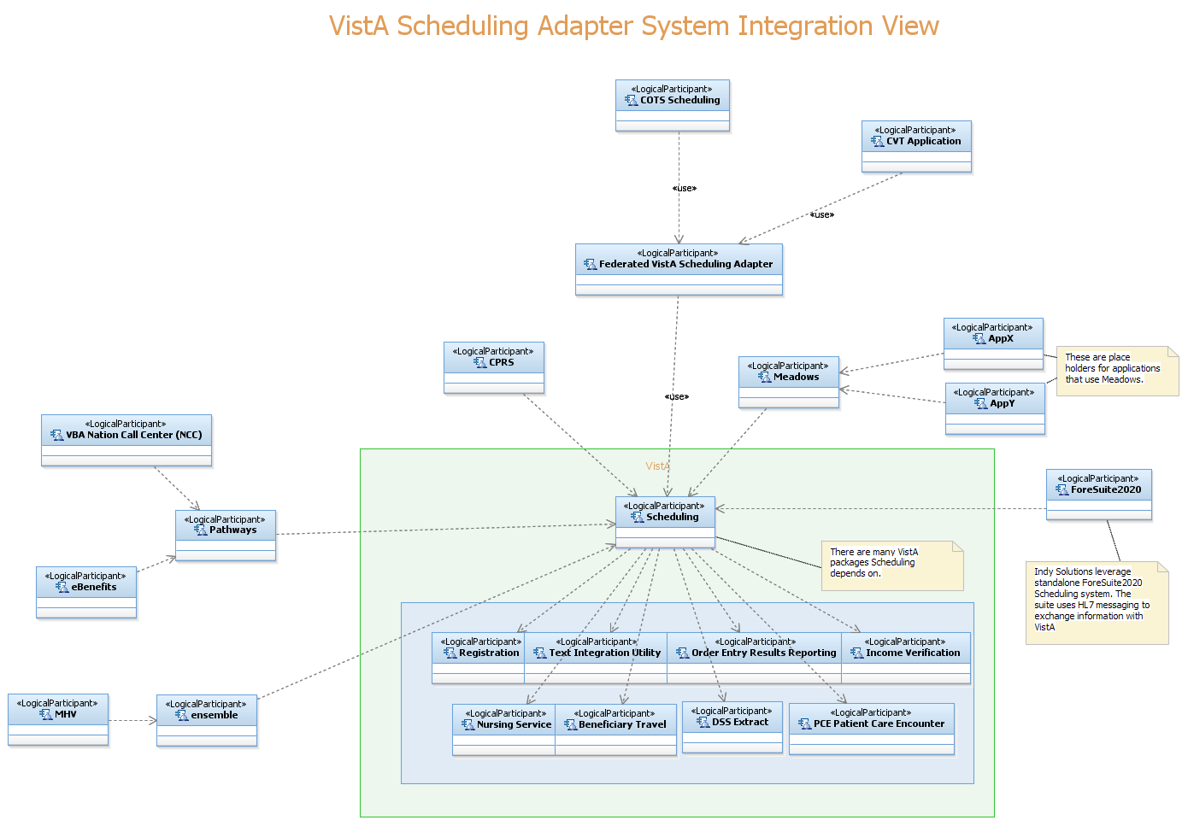
Scheduling Phase 1 VistA Integration

Slide 10
Support for other VistA applications using VistA scheduling
There are numerous integration points between VistA Scheduling and other Legacy VistA applications.
Implementation of these same integration points with the MASS scheduling application would result in significant risk and cost and time to deliver.
The approach to address these integration points is to implement a mechanism to push appointment data from the new scheduling application into the VistA Scheduling application. This concept has been proven at Indianapolis VAMC, however there are further analysis and requirements needed to define the specifics for a national implementation.

Slide 11
Support for non-VistA applications using VistA scheduling
There are a number of integration points between Vista Scheduling and non-VistA applications.
These applications are known to use CDS\Pathways, MDWS, Ensemble, and potentially other interfaces to read appointment data.
In the short run, these applications will continue to operate as they are.
In the longer term, these applications will migrate to use services provided by MASS scheduling.

Slide 12
Support for MASS scheduling use of legacy VistA applications
There are several integration points needed between MASS scheduling and legacy VistA applications.
These integration points will be addressed long term by business tier ESS services.
Where interim measures are needed (most cases), these integration points will be addressed by package specific adapters that comply with ESS service interface guidelines.

Slide 13
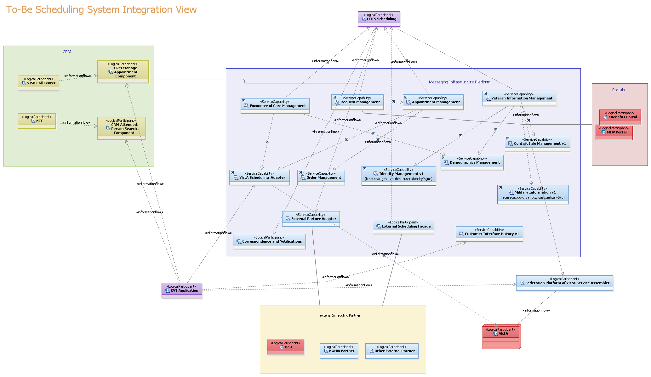
Support for MASS scheduling use of legacy VistA applications

Slide 14
Clinical Video Teleconferencing (CVT) Integration
First consumer of the VistA Scheduling Adapter
Clinical Video Teleconferencing requirements are part of the MASS Business Requirements Document (BRD_
CVT is slated for delivery before MASS
Like MASS, CVT has a need to push appointment data into the VistA scheduling application
The ability to push appointments into VistA must be delivered early.

Slide 15
Other Integrations: User Provisioning Integration
The long term vision is that MASS scheduling user provisioning will be provided by IAM enterprise provisioning. What this means exactly may vary depending on the product selected for MASS scheduling.
In the interim, when schedulers are provisioned or deprovisioned in VistA, a similar action needs to occur in MASS scheduling.
Given the number of staff (over 50,000), and the decentralized process (users are provisioned at each local site), VistA Kernel will be used for some time.
The integration of VistA provisioning (Kernel A&A, menus, options, and security keys) with IAM is underway, but will take some time to fully realize.
The planned approach is to modify Kernel to notify IAM provisioning of these changes, and IAM provisioning will then make the enterprise level change.
This approach leverages the work already in progress with IAM and Kernel, and any work delivered by MASS will also support the long term realization of enterprise provisioning.

Slide 16
Correspondence and Notification Integration
MASS scheduling requirements related to correspondence and notifications are supported by enterprise correspondence requirements.
The enterprise Correspondence Engine and Notifications effort (CEN) can provide the functionality needed by MASS scheduling, and the first VHA focused implementation is likely to be in production well ahead of MASS timelines.
Any portion of CEN needed by MASS, but not in the first CEN iteration could be delivered by MASS, and re-used by the rest of the enterprise.
MASS specific rules and templates can be supported by CEN.
MASS specific processes would have to be developed by MASS.

Slide 17
Veteran Facing Systems Integration
There is a need to support the ability to request appointments through a variety of Veteran facing systems.
Requests are expected to come through a variety of channels, including mobile, web self service, kiosk, and call centers.
Rather than have each of these systems integrate with scheduling separately, a few service capabilities should be built that can be reused by many.

Slide 18
Veteran Facing Systems Integration
Portal Integration
My HealtheVet, eBenefits, SEP, Kiosk, and mobile apps all have current requirements to view and request/reschedule/cancel appointments.
Most already have some limited ability to view appointments.
EVSS and Connected Health both have objectives to provide a consistent user experience, which can be provided by shared presentation tier services.
Call Center and Case Management Integration
HRC, NCC, VISN and VAMC call centers support calls related to appointments.
Customer service representatives need to view appointment information and need to be able to view and request/reschedule/cancel appointments.
CRME can provide a common application component that can be used like a plug in for all call centers and case management systems built on MS Dynamics.

Slide 19
External Partners Integration
The ability to request/reschedule/cancel appointments with external partners is needed.
The ability for external partners to request/reschedule/cancel appointments with VA is needed.
This capability should be provided through NwHIN/VLER eHealth Gateway
We are exploring other scheduling standards and service offerings for exchanging scheduling data

Slide 20
Reporting Integration
The Commercial off the Shelf (COTS) scheduling product handles workflow and operational related reports.
VA needs the ability to produce performance reports and national level reports; Expectation is COTS can export necessary information
Handled via VHA’s Corporate Data Warehouse (CDW)
Ability to write real-time updates to CDW
Ability to write periodic updates thru ETL processes/tools, via COTS product
Use existing Business Intelligence tools
VA is currently reviewing best practices for data warehouse reporting and its processes for using CDW

Slide 21
Other Architecture Considerations
Available Now
Enterprise Technical Architecture
Published/Regular updates
Enterprise Shared Services Guidance
Published as part of the Enterprise Technical Architecture
Underway
SOA Center of Excellence
Enterprise Registry/Repository
Enterprise Messaging Infrastructure

