Slide 1
The Women-Owned Small Business (WOSB)
Federal Contract Program
www.sba.gov/wosb
Amy Kim, Program Manager
WOSB Federal Contract Program
Office of Government Contracting

Slide 2
Topics to Be Discussed
WOSB Program Overview
WOSB Eligibility Requirements
WOSB Status Certification
WOSB Set-asides and Sole Source Awards
Certify.SBA.gov Overview
WOSB Eligibility Examinations and Protests
Resources

Slide 3
Overview of the WOSB Federal Contract Program
The WOSB Federal Contract Program allows Contracting Officers (COs) to set aside contracts for WOSBs (including EDWOSBs) under certain conditions
As of December 2015, it also allows COs to make sole source awards to WOSBs (including EDWOSBs) under specific circumstances

Slide 4
History of the WOSB Program
Time | Event
December 2000 | Public Law 106-554 establishes a women's procurement program to assist the government in meeting its 5% women-owned small business (WOSB) contracting goal.
April 2011 | New Federal Acquisitions Regulation (FAR) implements WOSB Program. Eligible industries limited to 83 based on the RAND report
December 2014 | NDAA 2015 provides sole source authority to the program, ended self-certification option. Certification process currently under review.
December 2015 | Sole Source process implemented by new FAR.
March 2016 | Eligible Industries revised and expanded to 113 based on the new Department of Commerce Study.
October 2017 | Eligible industries revised to 112 as a result of NAICS 2017 implementation.

Slide 5
WOSB eligibility requirements
13 CFR § 127 Subpart B

Slide 6
WOSB and EDWOSB
WOSB
EDWOSB
WOSB: Women-Owned Small Business
EDWOSB: Economically Disadvantaged Women-Owned Small Business; WOSBs whose owner and/or manager claims economic disadvantage
EDWOSB is a subset of WOSB. As such, if you qualify as an EDWOSB, you automatically qualify as a WOSB.

Slide 7
Eligibility Requirements for WOSBs
To qualify as a WOSB, a business must meet the following requirements:
Meet small business size standard for primary NAICS code and contract
Ownership: At least 51% unconditionally and directly owned by one or more women who are U.S. citizens
Control: Management must be controlled by women who are U.S. citizens.
A woman must manage the daily business operations in the company.
A woman must hold the highest officer position within the company.
The woman holding the highest officer position must have managerial experience required to run the company.
The woman holding the highest officer position must devote her full-time attention to the company during normal working hours.
One or more women must make the long-term decisions for the business.
No minimum amount of time for the business to be operational.

Slide 8
Eligibility Requirements for EDWOSBs
To qualify as an EDWOSB, a business must meet all the requirements for a WOSB, as well as the following requirements:
Personal net worth (assets minus liabilities) is less than $750,000 excluding:
Equity in business and primary personal residence
Income from LLC or S Corp that was reinvested or used to pay taxes of business
Funds invested in official retirement accounts if unavailable until retirement w/o significant penalty
Adjusted gross income averaged over three years is $350,000 or less excluding:
Income from LLC or S Corp reinvested or used to pay taxes of business if documentary evidence is provided.
Fair market value of all assets is $6 million or less excluding:
Funds invested in official retirement accounts if unavailable until retirement w/o significant penalty
Note: SBA will look at spouse’s finances if the spouse has a role in the WOSB/EDWOSB, has lent money to or provided financial support (including credit or guarantee of loan) to the business. SBA may also look at spouse’s finances if both spouses are in same or similar line of business and businesses share names, websites, equipment and employees.

Slide 9
Eligibility Requirements for Joint Ventures
A WOSB/EDWOSB may submit an offer as a joint venture with another business
if the following requirements are met
Size: each concern is small under applicable size standard unless an SBA-approved MP JV;
EDWOSB/WOSB must manage the joint venture;
EDWOSB/WOSB employee must be project manager responsible for contract performance;
EDWOSB/WOSB must own 51% of the JV;
EDWOSB/WOSB must receive JV profits commensurate with work performed (at least 40%);
Must have a special bank account in JV’s name;
Itemize all major equipment and facilities furnished by each party;
Specify the responsibilities of the parties;
Obligate all parties to ensure performance on the contract;
Original records must be retained by the EDWOSB/WOSB managing venturer;
Quarterly financial statements and final profit and loss statement must be submitted to SBA
Note: JV agreement must be submitted to CO.
SBA does not approve JV agreement but will adjudicate any protests!

Slide 10
WOSB STATUS CERTIFICATION
13 CFR § 127 Subpart C
Certify.SBA.gov

Slide 11
Ways to Qualify as WOSB or EDWOSB
Self Certification
with Supporting Docs
Compile and provide documents to WOSB Repository
Third-Party Certification
with Supporting Docs
Register in SAM
Register in SAM
8(a) Certification
with Supporting Docs
Register in SAM
Represent status as WOSB or EDWOSB in SAM
Obtain certification from SBA-approved TPC
Provide TPC certification to WOSB Repository
Represent status as WOSB or EDWOSB in SAM
Obtain 8(a) certification from SBA
Provide 8(a) certification to WOSB Repository
Represent status as WOSB or EDWOSB in SAM

Slide 12
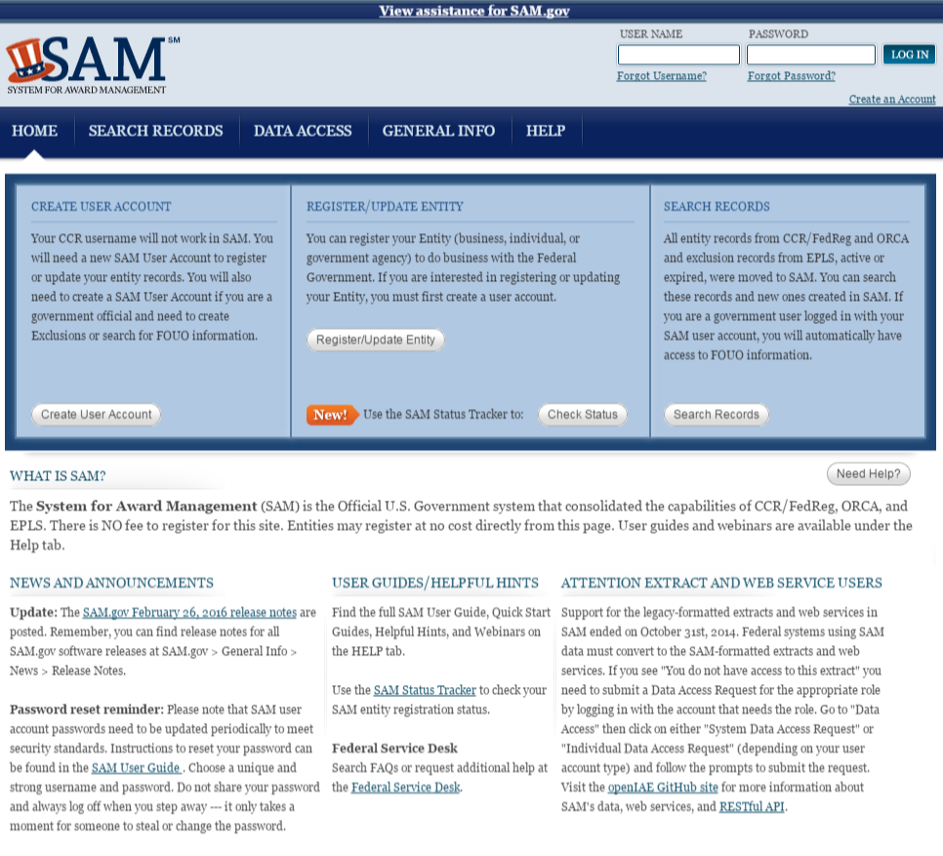
Step 1: Register in SAM
The System for Award Management (SAM) is a registration system owned by GSA and located at www.SAM.gov
SAM is where companies represent their eligibility for federal contracts (representations and certifications)
In order to begin the process of certifying as a WOSB or EDWOSB, you must first establish a user account on the SAM site, and then register your entity in SAM.
Note: DO NOT represent as a WOSB or EDWOSB at this stage

Slide 13
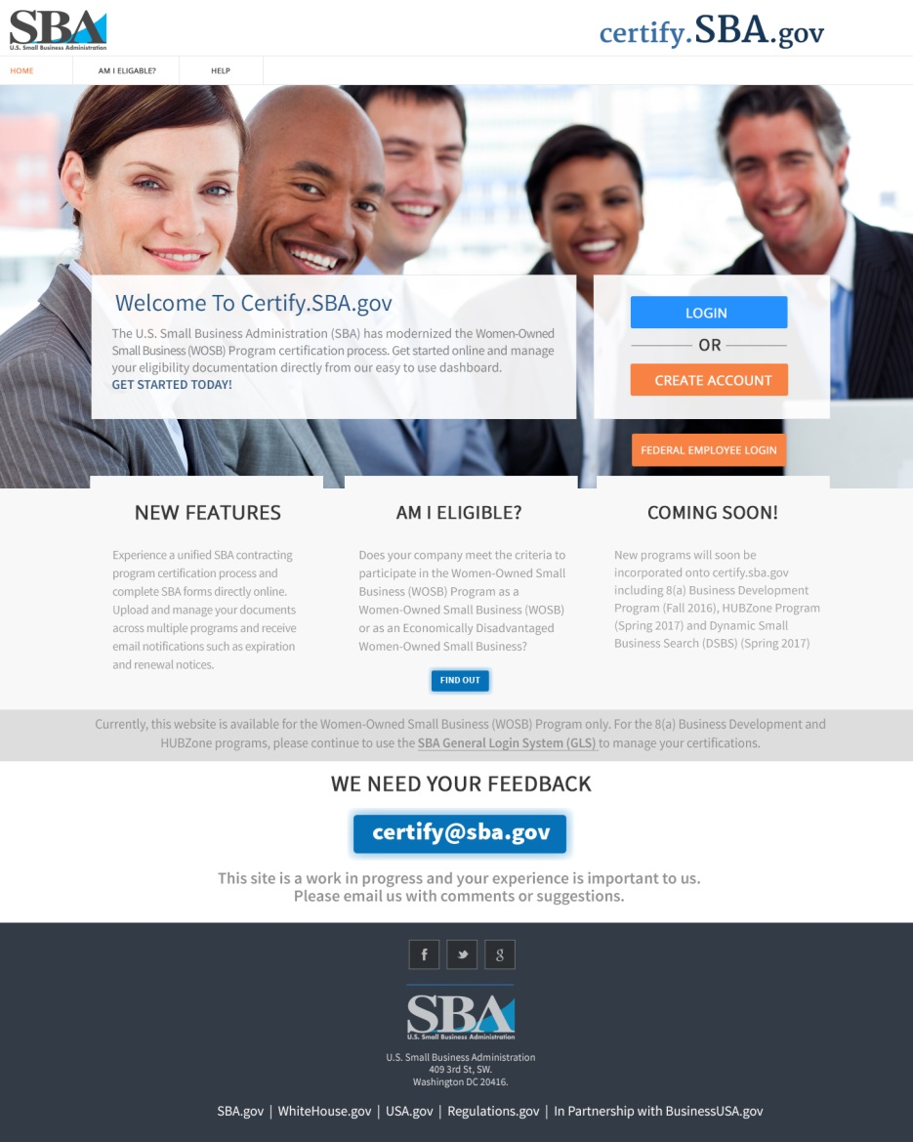
Step 2: Provide documents to Certify.SBA.gov
Next, navigate to certify.SBA.gov and create an account in the new system
Once you have created an account, associate this account with your business information in SAM by providing the following information:
Your primary DUNS number
Your Marketing Partner ID Number (MPIN) number (created in SAM)
Your Taxpayer Identification Number (TIN) number
Then, complete any necessary forms and upload these documents to the new repository

Slide 14
Self-Certified – Documents (WOSB)
Corporation | LLC | Partnership | Sole Proprietorship
Birth certificate, naturalization paper or unexpired passport of women who own and control the firm
WOSB Program Certification (Completed online – equivalent to SBA Form 2413)
Articles of incorporation | Articles of organization | Partnership agreement | DBA name certificate
By-laws | Operating agreement
Stock certificates
Stock ledger
Voting agreements, if any
DBA name certificate, if applicable
Joint venture agreement, if applicable

Slide 15
Self-Certified – Documents (EDWOSB)
Corporation | LLC | Partnership | Sole Proprietorship
Birth certificate, naturalization paper or unexpired passport of women who own and control the firm
EDWOSB Program Certification (Completed online – equivalent to SBA Form 2414)
Personal financial statement (Completed online – equivalent to SBA Form 413)
Articles of incorporation | Articles of organization | Partnership agreement | DBA name certificate
By-laws | Operating agreement
Stock certificates
Stock ledger
Voting agreements, if any
DBA name certificate, if applicable
Joint venture agreement, if applicable

Slide 16
Third-Party Certified - Documents
Corporation | LLC | Partnership | Sole Proprietorship
WOSB or EDWOSB Program Certification (Completed online in Certify.SBA.gov)
Current TPC Certification
SBA accepts WOSB or EDWOSB certifications only from the following four entities:
El Paso Hispanic Chamber of Commerce
National Women Business Owners Corporation
US Women’s Chamber of Commerce
Women’s Business Enterprise National Council: WOSB only
No USDOT DBE or State certifications are accepted.

Slide 17
8(a) Certified - Documents
Corporation | LLC | Partnership | Sole Proprietorship
EDWOSB Program Certification (Completed online in Certify.SBA.gov)
Initial 8(a) Approval Letter
Most Recent Annual Review Letter from SBA
Certifications of eligibility in the 8(a) BD Program also satisfy eligibility requirements for the WOSB Program and need no further clarifications.

Slide 18
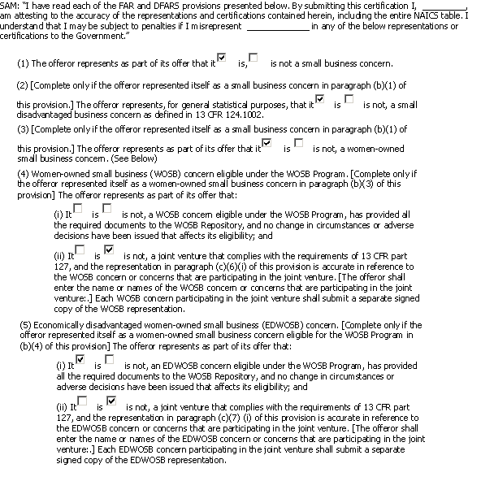
Step 3: Represent Status in SAM
Once you have uploaded all necessary documents on certify.SBA.gov, you will be able to represent your status as a WOSB/EDWOSB on the SAM site
Check the boxes as appropriate to indicate your status as a WOSB and/or EDWOSB (please note that all EDWOSBs are also WOSBs)
NOTE: All required documents must be uploaded before representing as a WOSB or EDWOSB – penalties for false representation are steep.
Check these boxes as appropriate to indicate WOSB/EDWOSB status
EDWOSBs should check both boxes, since all EDWOSBs are also WOSBs

Slide 19
WOSB Set-Asides and sole source awards
13 CFR § 127 Subpart E

Slide 20
Requirements for WOSB and EDWOSB Set-Aside Contracts
 | WOSB | EDWOSB
Industries | NAICS code assigned to contract solicitation is in an industry in which WOSBs are substantially underrepresented (364 NAICS Codes) | NAICS code assigned to contract solicitation is in an industry in which WOSBs are underrepresented (80 NAICS Codes)
Rule of two | Contracting officer has reasonable expectation that 2 or more WOSBs will submit an offer
Award price | Contract must be awarded at fair market price
A complete list of applicable NAICS codes can be found at:
www.sba.gov/wosb
EDWOSB is a subset of WOSB. As such, all EDWOSBs are allowed to compete for WOSB set-asides but not vice versa.

Slide 21
Requirements for WOSB and EDWOSB Sole-Source Authority Contracts
In order to make sole source award to a WOSB or EDWOSB, the following conditions must be met:
Is the contract in a WOSB/EDWOSB eligible NAICS code?
Is the contract (including options) valued at $6.5 million or less for manufacturing contracts or $4 million or less for all other contracts?
Can the contract be awarded to the WOSB/EDWOSB at a fair and reasonable price?
In the determination of the contracting officer, is there a reasonable expectation that there is only one WOSB/EDWOSB that can perform?
WOSB Program is NOT a business development program. As such, there is no statutory authority to make a direct award. Agencies are required to prepare and approve J&A.

Slide 22
Certify.Sba.gov – SBA Certification Portal

Slide 23
Certify.SBA.gov
SBA’s new certification portal where businesses can submit documents to seek SBA certifications
WOSB Repository was migrated from GLS to Certify.SBA.gov in March 2016. GLS was disabled.
All existing WOSBs/EDWOSBs in the WOSB Repository that have updated their content since 1 October 2014 have had their information migrated to new Repository
Any firms that did not update after Oct 2014 will need to resubmit as if new
Pulls business information from SAM.gov
SBA plans to add other certification programs to certify.SBA.gov in the future

Slide 24
Certify.SBA.gov – WOSB
Forms are completed online - No longer required to upload WOSB Program Certifications (SBA Forms 2413 and 2414) and Personal Financial Statement (SBA Form 413)
Certification questions are filtered by business organization
Must complete WOSB or EDWOSB certification questionnaire (or application) and add documents to the question when prompted – To be reviewed by CO when in line for award
Only owner/officer authorized to certify on behalf of company should create account

Slide 25
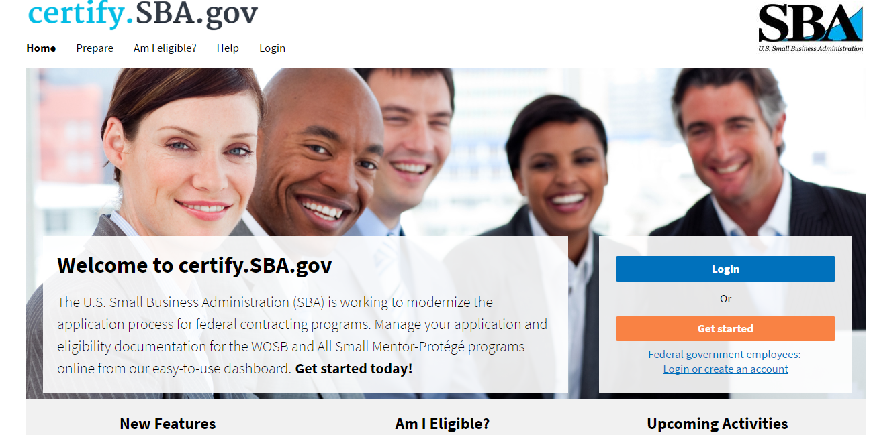
Certify – Home Page
View required documents
Take a quiz to identify your eligibility for SBA certification programs
Click here to log in after business is associated with SAM
Click here to associate business with SAM

Slide 26
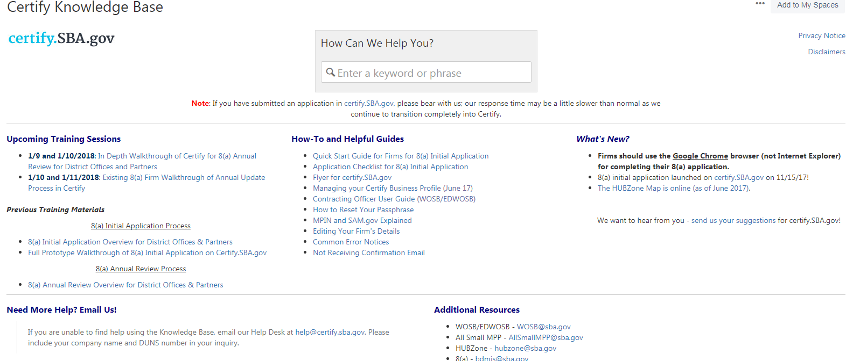
Certify – Help Page
WOSB Certify User Guide

Slide 27
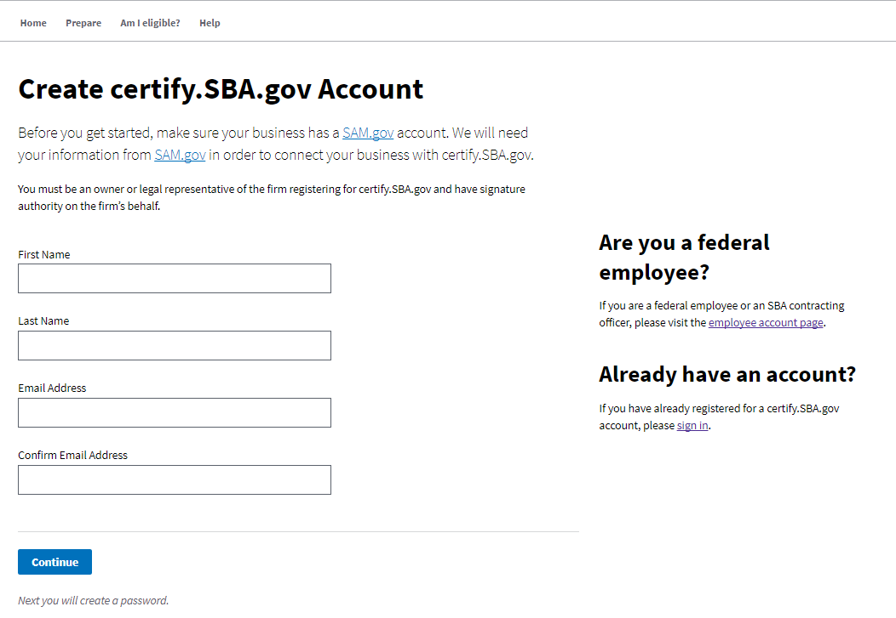
Certify – Creating Account

Slide 28
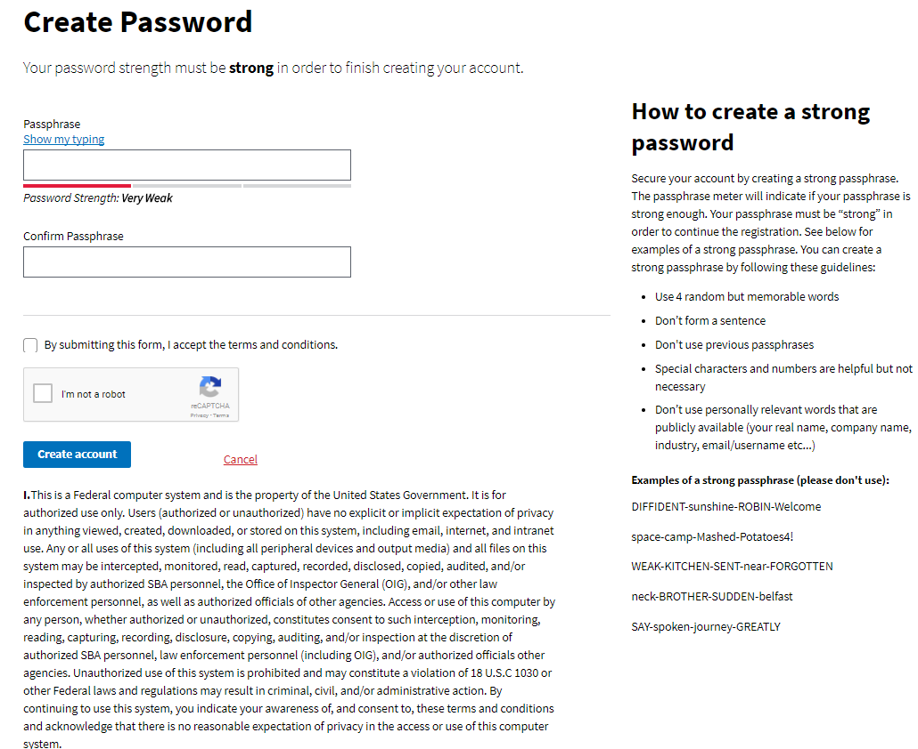
Certify – Creating Password

Slide 29
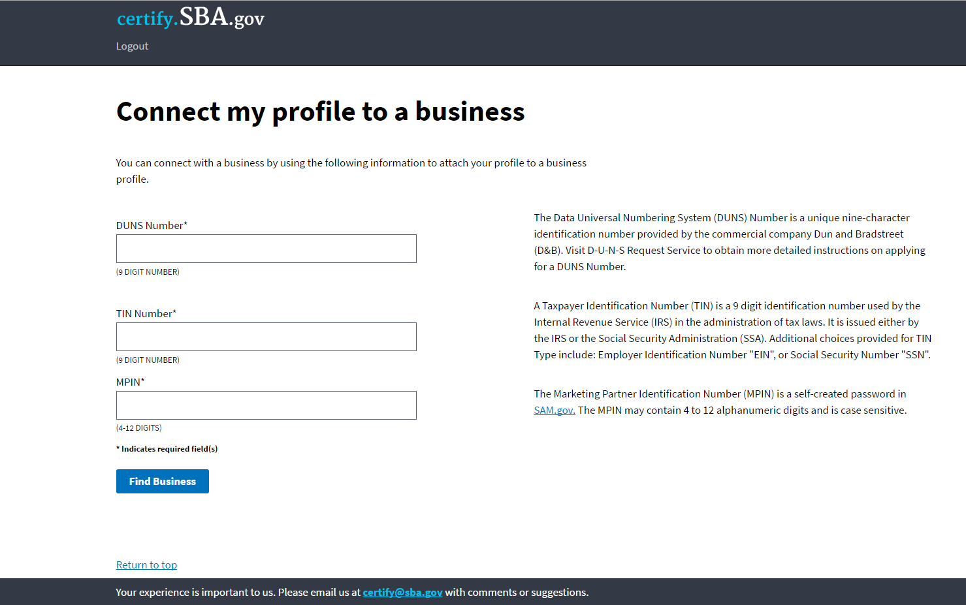
Certify – Connecting Business Profile

Slide 30
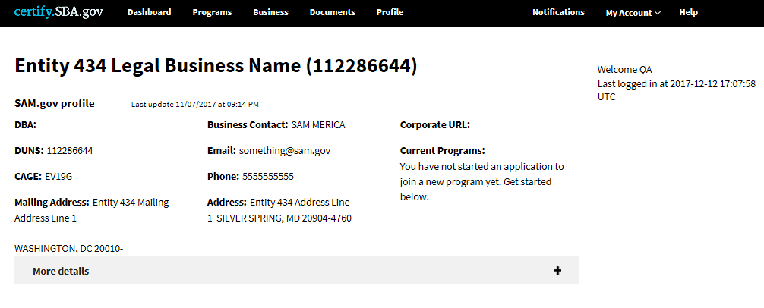
Certify Dashboard
To approve or deny CO request
To change your passphrase
To start self-certifications
To store and maintain documents
To view helpful info & user guides

Slide 31
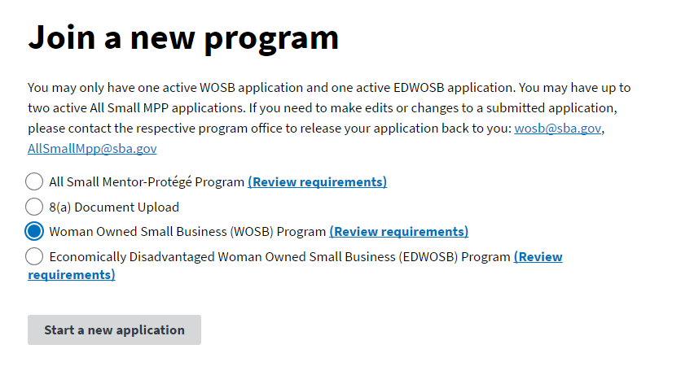
Certify - Programs
Click here to complete certification questionnaire

Slide 32
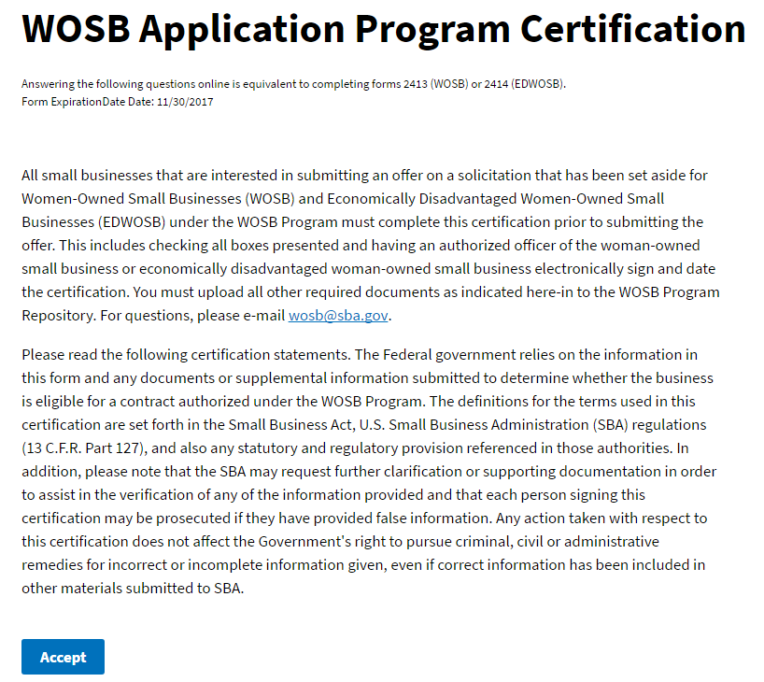
Certify - Programs
Click here to continue.

Slide 33
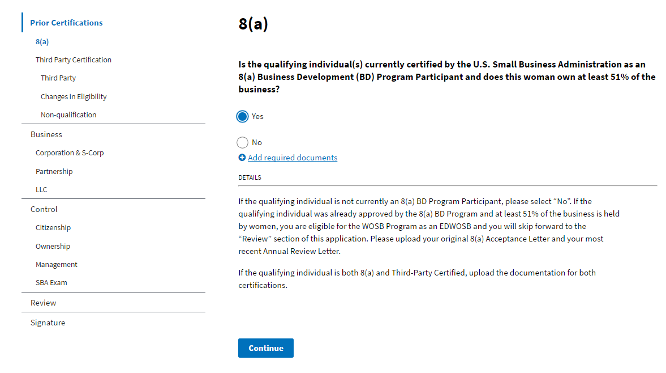
Certify - Programs
Click on the active link to add documents.

Slide 34
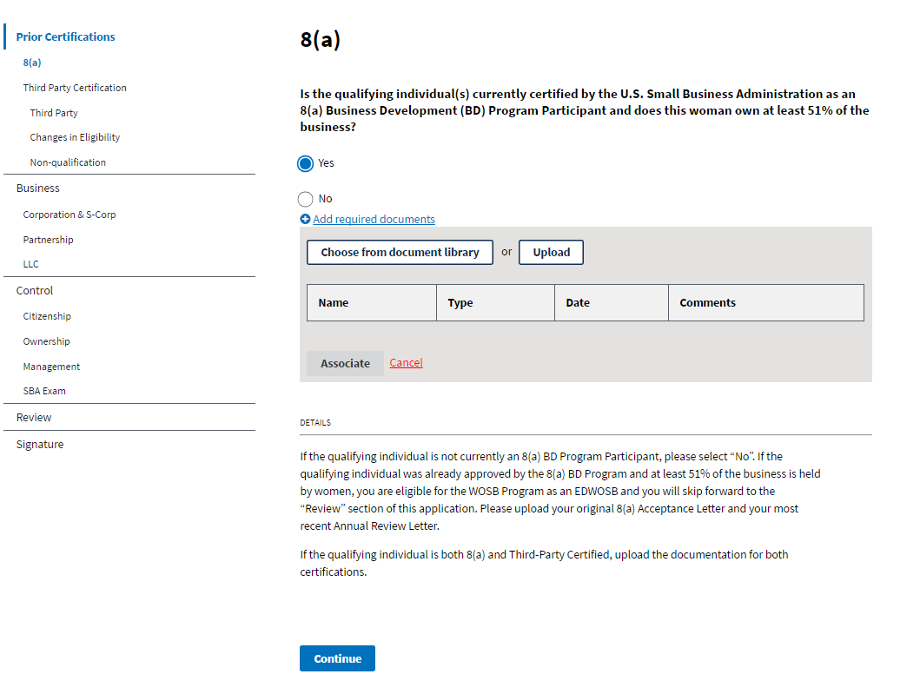
Certify - Programs
You may add documents by clicking either button.

Slide 35
Certify - Documents
To store & maintain your documents but CO has no visibility of the documents

Slide 36
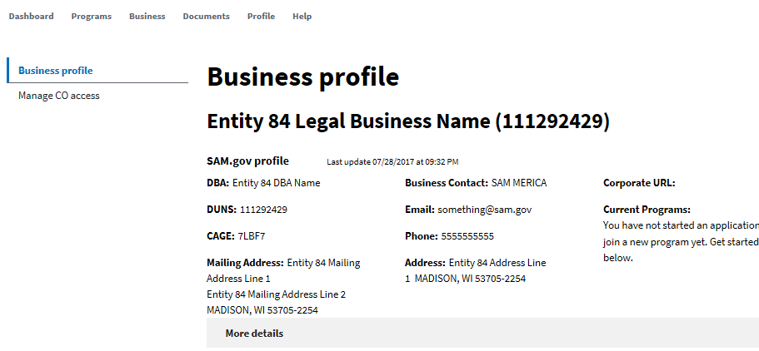
Certify - Business
To view & approve/reject CO account access request

Slide 37
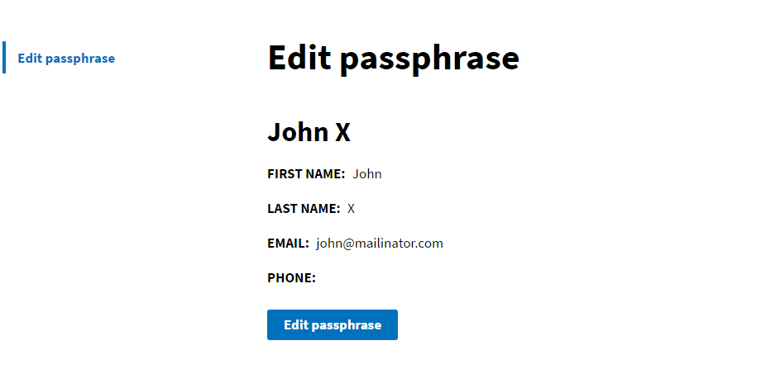
Certify - Profile

Slide 38
WOSB eligibility examinations and protests
13 CFR § 127 Subparts D, F &G

Slide 39
Eligibility Exams and Protests
SBA is committed to ensuring only eligible WOSBs benefit from the WOSB Federal Contract Program. The following tools ensure compliance with Program requirements:
Eligibility Examinations
Protests
SBA will conduct regular reviews of firms who have self-certified and obtained third party certification
A review will involve evaluation of documents uploaded in the repository and SBA may request additional documents and perform a site visit
SBA may investigate the accuracy of any certification or representation made as it relates to a specific WOSB/EDWOSB contract
Only an interested party, SBA or a contracting officer may submit a protest
A protest must be submitted to the contracting officer within certain timeframes
Can only protest the ownership, control and economic disadvantage requirements
Size protests are handled under 13 C.F.R. part 121
SBA reviews each protest and makes a final decision, which may be appealed to the Office of Hearings and Appeals.
Any WOSB/EDWOSB found to be ineligible must remove designation in SAM; CO shall not award the contract

Slide 40
Contact US
Visit the SBA’s website: www.sba.gov/wosb
For questions on the WOSB program, email wosb@sba.gov
For technical questions on the WOSB Program Repository, please email help@certify.sba.gov

Slide 41
Resources and Q&A
There are a number of resources available to help answer questions about the WOSB Program:
Visit a local resource:
Procurement Center Representative (PCR) Directory
Find your local PCR at: https://www.sba.gov/contracting/resources-small-businesses/pcr-directory
Small Business Administration District Offices
Find your local office at: https://www.sba.gov/tools/local-assistance/districtoffices
Women’s Business Centers
Find your local center at: https://www.sba.gov/tools/local-assistance/wbc
Procurement Technical Assistance Centers
Find your local center at: http://www.aptac-us.org
Small Business Development Centers
Find your local center at: http://americassbdc.org/home/find-your-sbdc/
SCORE (Service Corps of Retired Executives)
Find your SCORE office at: https://www.score.org/
Call the SBA Answer Desk: 1-800-U-ASK-SBA (1-800-827-5722)
Questions?

