Slide 1
VA Office of Small and Disadvantaged Business Utilization (OSDBU) Overview
Presented by
Chanel Bankston-Carter
U.S. Department of Veterans Affairs WOSB Industry Day
March 28, 2018

Slide 2
Overview
OSDBU Mission and Vision
OSDBU Program Areas
VA Small Business Achievement FY 17
What VA Buys
VA Organizational Chart
Impact of Kingdomware Supreme Court Decision
Market Research Background
How a VOSB Can Benefit from performing Market Research
VA Resources for Veteran Entrepreneurs
Verification and VIP
Information Resources
Notes:
Today’s objective is to provide you a snapshot on how VA supports Veteran Entrepreneurship.

Slide 3
OSDBU Mission and Vision
Centered around our support for Veteran small business success
Mission:
Enable Veterans to gain access to economic opportunity by leveraging the federal procurement system and enabling participation of procurement ready small businesses.
Vision:
By 2019, OSDBU will transform how procurement ready small businesses gain access to economic opportunity through increased awareness, reduced risk, enhanced access, improved procurement mechanisms, and better performance in order to enable Veterans to gain access to economic opportunities.

Slide 4
OSDBU Program Areas
How we support Veteran small businesses
Verification
Direct Access
Market Research
Small Business Policy
Strategic Outreach and Communications
Notes:
Small Business Policy (SBP) Mission:
Ensure small businesses, and especially Veteran-owned small businesses, have the maximum practicable opportunity to benefit from VA contracting opportunities through appropriate policy, goals, and accountability mechanisms.
SBP -Why Important?
The Small Business Policy Program ensures that VA actively maintains and fulfils its responsibilities and obligations under Congressional and Legislative law. It works with VA and other Federal agencies to create policies that support VA interests. The program also works closely with the Office of the Secretary for Veterans Affairs (OSVA) and the Small Business Administration (SBA) to assist with the establishment of VA small business goals.
Verification Mission:
Enable eligible VOSBs to be verified for inclusion in the Veterans First Program
Verification- Why Important?
Verification is a pre-requisite to the Veterans First Contracting Program which facilitates SDVOSB and VOSB participation in VA contracting. VA is the only federal agency that verifies Veteran-Owned Small Businesses as a requirement for competing for Veteran set-aside procurement opportunities.
DAP Mission:
Enable VOSBs and other small businesses opportunities to gain direct access to Federal and Commercial Procurement Decision Makers (PDM)
DAP- Why Important?
Direct Access allows both the small business owner and PDM to build the business relationship essential to adding value to VA through access to procurement opportunities.
Market Research
Why Important?
Market Research is conducted by VA acquisition staff in order to develop effective acquisition strategies for small businesses.
Market research should not be used to evaluate specific firms pre-solicitation. The primary purpose of market research is to determine an acquisition strategy, so, you would be trying to determine if there are sufficient VOSB firms available to provide a response to a solicitation and provide a fair and reasonable price.
Strategic Outreach and Communications (SOC) Mission:
Provide communication, education, and the distribution of information to the stakeholder to promote awareness and understanding of VA small business programs.
Why Important?
SOC provides an avenue for OSDBU to inform all of its stakeholders about VA small business programs and resources, VA small business goals, and access opportunities.

Slide 5
VA Small Business Achievement- FY 2017
Committed to providing opportunities for small businesses
 | Federal Goal | VA Goal | VA Achievement | VA Dollars (billions)
 |  |  | 2017 | 2017
All small business | 23% | 28.5% | 29.4% | $7.617
SDVOSB | 3% | 10.0% | 19.6% | $5.093
VOSB | N/A | 12.0% | 20.8% | $5.388
Small Disadvantaged Business (SDB) – includes 8(a) | 5% | 5.0% | 7.2% | $1.865
Women-Owned Small Business (WOSB) | 5% | 5.0% | 2.7% | $0.709
Historically Underutilized Business Zone (HUBZone) | 3% | 3.0% | 2.2% | $0.558
Source: Federal Procurement Data System.
Data reported as of December 17, 2017.

Slide 6
What VA Buys
Pharmaceuticals and medical and surgical supplies
Equipment, supplies, and materials for facility operation
Maintenance and repair of medical and scientific equipment
Building construction, maintenance, and repair
Prosthetic and orthopedic aids
Non-IT enterprise-wide solutions
Enterprise-wide solutions in information and technology
Architect/Engineer services
Notes:
VA Buys
VA procures over $3 billion in goods each year from VOSB.
Because of our mission, and our SDVOSB and VOSB goals, VA has a key interest in doing business with Veterans.

Slide 7
VA Organizational Chart
Office of Employment Discrimination Complaint Adjudication
Secretary
Deputy Secretary
Senior Advisor to SECVA
Senior Advisor to DEPSECVA
Office of Small and Disadvantaged Business Utilization
Chief Technology Officer
Chief of Staff
Deputy
Chief of Staff

Slide 8
Impact of Kingdomware Supreme Court Decision
Expected increases in opportunities for procurement-ready VOSBs
Could potentially slow down some procurements due to increased work load
Emphasized need for comprehensive and robust Market Research to facilitate identification of procurement-ready VOSBs for VA requirements
VA has been actively engaging with Small Business Liaisons to work on Market Research process improvements
Expected increase in volume of Verification applications and increased significance of the Vendor Information Pages (VIP)

Slide 9
Market Research Background
Market Research is conducted by VA acquisition staff in order to develop effective acquisition strategies. It helps us:
Determine the extent of competition in a particular industry
Is there a sufficient number of VOSB that can provide us with the products and services that we are seeking?
Is there a sufficient number of firms that can offer fair and reasonable pricing?
Is the VOSB accessible?
Is the VOSB a high-risk or low-risk candidate?
Does the VOSB have a credible, positive performance history?
Can the VOSB meet deadlines?
Does the VOSB have enough staff to keep up with supply and demand?
Determine whether VA can meet the “Rule of Two” requirements per the Kingdomware decision
Notes:
Why VA makes a great business partner – There is a lot of business to be had at VA.
Second largest Federal department in the US with over 300,000 employees
Among the top 5 spenders of all Federal agencies
Over $21 billion dollars spent in FY 2017
Services cover:
140+ hospitals
1,230 outpatient clinics
300 Vet Centers
50+ Regional Offices
240 National, State or Tribal Cemeteries
Sizeable amount of potential customers

Slide 10
How A VOSB Can Benefit from Performing Market Research
You are encouraged to perform market research for your own benefit as it allows for you to:
Scope out the competition
Adjust your procurement strategy
Improve on current offerings of products and services
Facilitate innovation within your industry
Most Importantly:
STAY COMPETITIVE!

Slide 11
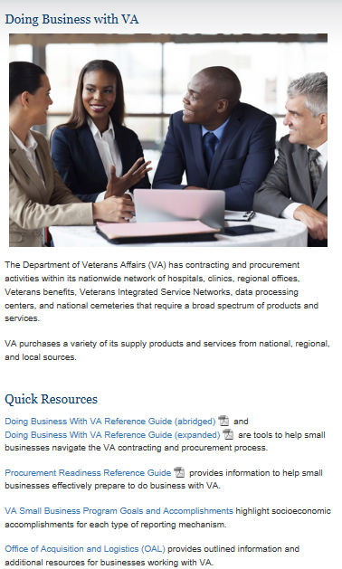
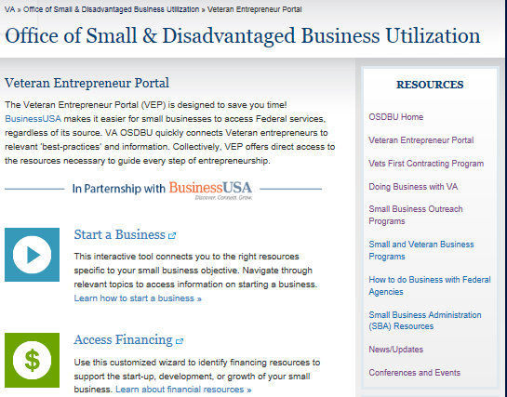
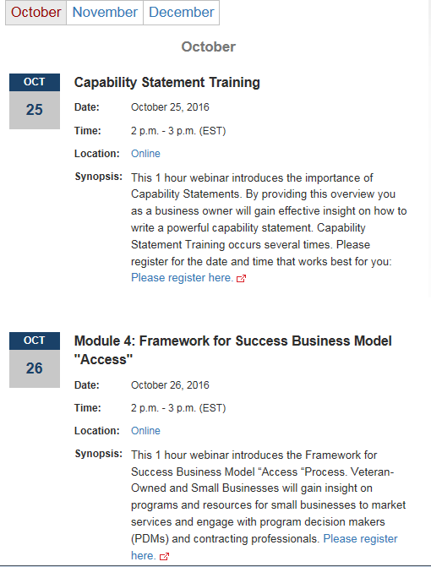
VA Resources for Veteran Entrepreneurs
Access to Information
2. Doing Business with VA & Procurement Readiness
1. Veteran Entrepreneur Portal (VEP)
3. Events Calendar
Notes:
VA Outreach Resources Available Include:
Veteran Entrepreneur Portal (VEP): a one-stop, online listing of small business resources provided to assist Veteran entrepreneurs with information and guidance through various steps of entrepreneurship.
Doing Business with VA Reference Guide: explains how to navigate through the VA contracting procurement process.
Procurement Readiness: Use this information to ensure your small business is prepared to effectively do business with VA.
Events Calendar: where small businesses can find upcoming events that center are creating opportunities for small business to add value to VA.

Slide 12
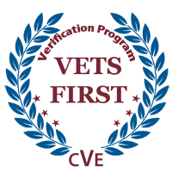
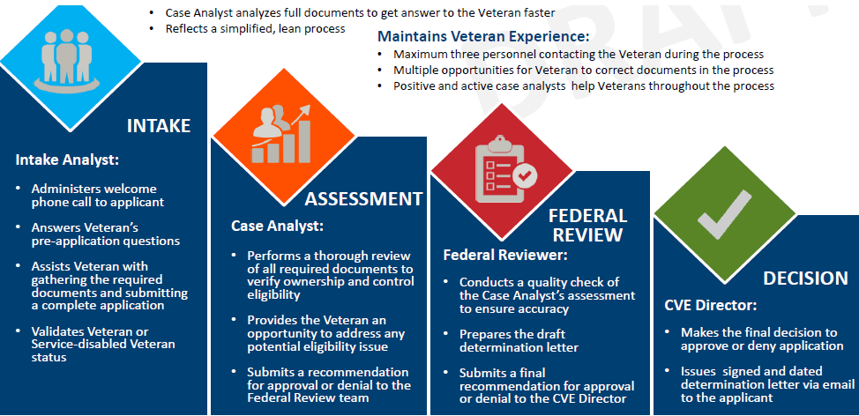
Verification and VIP
Making it easier for Program Offices to Perform Market Research
Center for Verification and Evaluation (CVE)
Primary Governing Regulation
Eligible Applicants
3 Core Tenets of the Verification Program
Vendor Information Pages (VIP)
https://www.vip.vetbiz.gov/
Priority Processing

Slide 13
VA OSDBU Help Desk
Phone
866–584–2344
Email
osdbu@va.gov

