Slide 1
Department of veterans affairs Office of information & technology
Mr. James Woodard
Supervisor, Vendor Management Office
Office of Strategic Sourcing
Advanced Planning Briefing to Industry,
June 6, 2019
FOR INTERNAL USE ONLY

Slide 2
OIT by the Numbers
An annual budget of $4.103 billion
6000+ approved tools in technical reference model
130+ instances of VistA
60 percent of 7,861 OIT employees are Veterans; workforce also includes 8,000 contractors
1,500+ active contracts to date
200 development projects, 194 of which were shared with the open source community since January 2016
274 data centers and 640 systems and applications
39 prioritized cybersecurity projects to mitigate vulnerabilities
Blocked 581,918,890 malware attempts in 2018
779+ million documents and 4 billion images in VBMS
1.5 million data elements exchanged between DoD and VA daily
361 Information System Security Officers

Slide 3
Secretary’s Top Priority - Customer Service - It Starts With Us
One of Secretary Wilkie’s top organizational priorities is improving customer service across the enterprise. “VA is about serving Veterans and my prime directive is customer service.”
It Starts With Us

Slide 4
OIT’s Top Priority: MISSION Act
The Maintaining Internal Systems and Strengthening Integrated Outside Networks (MISSION) Act of 2018 is legislation that improves Veterans’ access to community benefits and walk-in care as part of the umbrella of health care and benefit options that Department of Veterans Affairs (VA) makes available to our Nation’s Veterans.
“Implementing the MISSION Act, will fundamentally transform VA health care. It will consolidate community care into a single program that’s easier for Veterans, families, community providers, and all of you to navigate.” – Secretary Wilkie
Notes:
The Maintaining Internal Systems and Strengthening Integrated Outside Networks (MISSION) Act of 2018 is legislation that improves Veterans’ access to community benefits and walk-in care as part of the umbrella of health care and benefit options that Department of Veterans Affairs (VA) makes available to our Nation’s Veterans.
Although VA medical centers (VAMCs) are located nationwide and provide timely care for the unique needs of millions of Veterans, it may in certain circumstances be in the best interest of the Veteran to receive care from the community.
The MISSION Act expands community care eligibility criteria to include nearly 3.7 million Veterans and provides a streamlined process for determining eligibility and referring Veterans for community care services.
“Implementing the MISSION Act, will fundamentally transform VA health care. It will consolidate community care into a single program that’s easier for Veterans, families, community providers, and all of you to navigate.” – Secretary Wilkie

Slide 5
What is OIT’s Role in MISSION Act?
OIT is a critical partner of the Veterans Health Administration (VHA) for successful MISSION Act implementation.
OIT is developing and enhancing 11 key applications, including the Decision Support Tool (DST) which will help expedite community care decisions.
OIT also conducts user testing and training at IOC sites, develops requirements, and escalates issues to leadership.

Slide 6
Where we’re going
Mission
Collaborate with our business partners and staff to create the best experience for all Veterans
Vision
Become a world-class organization that provides a seamless, unified Veteran experience through state-of-the-art technology
Notes:
This is our roadmap to help us get there
Our mission is to align our business partners; needs with the right IT solutions and deploy state-of-the-art technology.
Our vision is a world-class organization that provides a seamless, unified Veteran experience.
Become a world-class organization that provides a seamless, unified Veteran experience through state-of-the-art technology

Slide 7
How we’ll get there – IT Modernization
Notes:
We are changing the way we procure services by taking a “buy first” approach to new systems, getting out of the business of building our own applications, and relying more
on cloud, managed and shared services, and commercial off-the-shelf (COTS) products.
Our five priorities are: (1) manage data, (2) migrate to the cloud, (3) improve cybersecurity, (4) digitize business processes, and (5) decommission legacy systems. I’ll explain each briefly.
Managing Data—We’re defining authoritative data sources and ensuring data is consistent and secure across VA so we can better leverage our vast data stores, improve data-driven decision making, and simplify the way Veterans interact with VA platforms such as Vet360 or MyHealtheVet
Migrating to the Cloud—We’re migrating infrastructure and applications to commercial cloud providers to reduce operational costs and increase flexibility, allowing us to deliver services to Veterans more quickly and consistently
Improving Cybersecurity—We’re developing an enterprise cybersecurity risk management framework, based on industry best practices, to stay at the forefront of protecting Veteran information from cyber threats.
Digitizing Business Processes—We’re upgrading VA’s customer-facing digital tools to give Veterans easier access to their care and benefits, and using new technologies and services to streamline our internal business processes. (Example: VA.Gov Launch on November 7)
Decommissioning Legacy Systems—We’re moving critical functions from outdated and difficult to sustain platforms, into more modern systems that operate at lower maintenance costs. This cost savings will be reinvested in projects to improve services for all Veterans.

Slide 8
What we’ve done
EHRM
Cloud
Strategic Sourcing/Managed Services
YourIT Services
Micro-Purchasing
Notes:
OIT is moving forward with many exciting projects.
Each of these initiatives will help us achieve Secretary Wilkie’s vision, and they map to OIT’s five priorities.
EHRM
VA’s adoption of the DoD’s Electronic Health Record (her) will fundamentally solve the problem of transitioning patient health record data between the Departments by having all patient data reside in a common system and eliminate the current need for moving data from one system to the other
» The size and scope of this project demonstrates VA’s commitment to providing Veterans with the modern services they expect and deserve
Benefits to Veterans:
When fully operational, patients will be able to access their entire medical history, and clinicians will be able to use real-time data from any VA or DoD medical facility, improving health care outcomes
Veterans won’t need to carry their Service records to their VA provider—it will be available to all DoD and VA providers electronically
Cloud
Many of the COTS solutions and managed services that we have been purchasing are cloud-based
The “cloud-first” move alone is expected to lead to approximately $11M potential cost avoidance annually, promoting better stewardship of taxpayer dollars.
We are requiring all new applications be hosted in the cloud, and are currently transitioning existing applications to the cloud
Moving to a cloud environment facilitates real-time updates across the entire Department and synchronizes our communication. This level of collaboration will speed up IT projects and improve VA’s customer service.
Benefits to Veterans:
Migrating to the cloud gives us the flexibility to scale applications up or down very quickly, based on Veteran demand
It promotes enhanced, leading-edge security of our systems and Veteran information
It potentially opens our trove of resources to industry partners who can help us bring greater value/services to Veterans
Strategic Sourcing & Managed Services
VA recently stood up the Office of Strategic Sourcing to leverage the best of both our VA staff’s expertise and the innovations of our external partners to deliver the best solutions for our Veterans, at the best value to the taxpayer.
Strategic sourcing improves our speed to market, ensures our compliance with Federal Information Technology Acquisition Reform Act (FITARA), and fosters the most responsible allocation of taxpayer resources.
We’ve already achieved an approximate $100M in cost savings by scrutinizing existing contracts and their value/impact to the Veteran and employee experience
Benefits to Veterans:
Implement industry best practices and supplier management strategies that drive improved outcomes
Identify cost avoidance to reinvest in the latest industry innovations and modernize OIT infrastructure and systems that deliver the solutions our VA business partners require
Purchase managed services to increase operational efficiency and free IT staff to focus on our core processes, on innovation, and on customer service
Your IT Services
VA’s new IT Service Management tool named “Your IT Services” allows VA employees to now submit and track IT support tickets, order equipment, and expedite staff onboarding in a streamlined online system
This kind of managed service solution puts VA at the forefront of IT service
Benefits to Veterans:
Better able to connect with the VA customers needing support
Better tool to expedite important requests
Single tool to collect our IT support knowledge
Enterprise-view of trending IT issues and topics so we can act immediately, and even anticipate VA business partner and Veterans needs
The ultimate benefit is that the solution creates a more efficient VA with employees better equipped to respond swiftly to Veterans’ needs.
Micro-purchasing
Micro-purchasing allows VA to award contracts for targeted requirements to micro-consultants or small businesses—it allows developers to bid on short-term projects so we can deploy solutions rapidly
Benefits to Veterans:
• Micro-purchasing allows VA to cut through bureaucratic red tape and award contracts quickly to micro-consultants or small businesses who may otherwise find it hard to work with VA—getting the Veteran the services they need now
• This will ultimately diversify the development ecosystem at VA

Slide 9
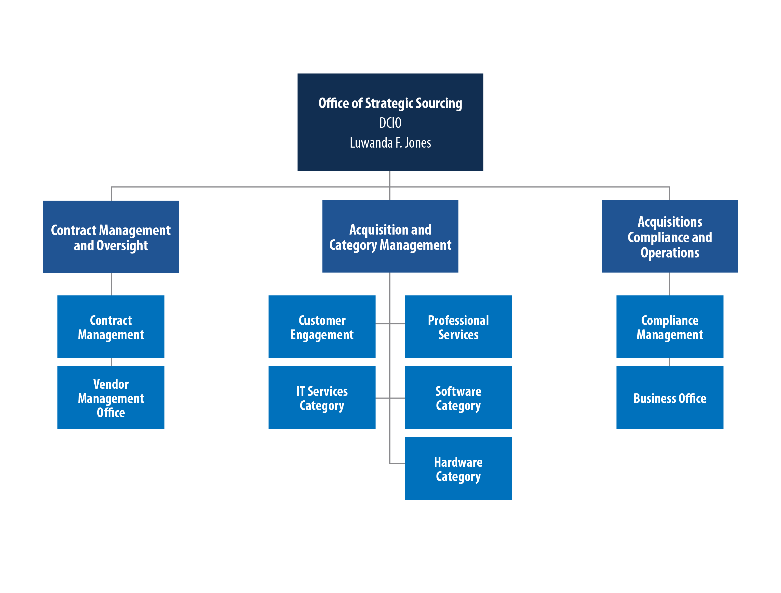
Office of Strategic Sourcing (OSS) Organizational Structure
Office of Strategic Sourcing: Deputy Chief Information Officer – Ms. Luwanda F. Jones
Sub-Office: Contract Management and Oversight
Contract Audit/Risk
Supplier Liaison
Data Management
Sub-Office: Acquisition and Category Management
Customer Engagement
Professional Services
IT Services Category
Software Category
Hardware Category
Sub-Office: Acquisitions Compliance and Operations
Quality Assurance and Oversight
Business Office
Compliance Management
Notes:
I approved our Strategic Sourcing organization structure.
This is a positive step toward easily working across the organization and ensuring VA is contracting with companies that bring the utmost value to the organization, the tax-payer, and the Veteran.
Strategic Sourcing is structured like this to more efficiently handle the amount of contracting issues that come to us from across OIT. This will help us provide our best strategic vision for how business contracting with OIT will help our modernizing organization and its workforce.

Slide 10
OSS Fiscal Year 2019 Priorities
Stabilize and operationalize the organization
Implement Acquisition and Category Management processes and procedures
Efficiencies and Effectiveness
Consolidated purchases
Transitioning from OPX to CAPX
Improve Vendor Management processes
Includes being in the discussions when IT vendors are visiting our business partners
Showing up differently: value propositions, industry solutions
Implement Contract Management processes and procedures
Assess value not just by past performance, working with contracting on vendor scorecard
Two way Scorecard
Build and improve our Federal Information Technology Acquisition Reform Act (FITARA) compliance and implementation
Notes:
. All of these priorities will help get us to a steady state where OIT can thrive in the ever-changing government and IT environments.

Slide 11
Where We’re Investing
MISSION Act
Electronic Health Records Modernization (EHRM)
Interface requirements
Communications closets
IT Aging Infrastructure
Defense Medical Logistics Standard Support (DMLSS)
Financial Management Business Transformation (FMBT)
Open API initiative
Need to curate our API store
Security must be baked in upfront
Service Now: Service Management capability and IT Asset Management Capability
DevOps: end to end processes/agile
Buy versus build
Managed Services
Cloud: actively rolling out and integrating capabilities in the cloud

Slide 12
Ways Industry can help us
Keeping client’s solutions at the forefront
Asking: how does this help the VA and improve Veterans access?
Industry best practices for transitioning from an OPX to CAPX
Enterprise Approach
Industry partnering with each other
Work with OSS as the focal point for all IT engagements

Slide 13
Key Success Factors
Customer service
Internal business partnerships
Improving the employee experience
Talent management
Financial management
Clear communication
Cross-agency collaboration
External partnerships

Slide 14
“We are absolutely committed to continuous IT Modernization in order to increase value and improve health outcomes for Veterans.”
Notes:
Over the past two years, VA has been working hard to transform the systems and services it provides to our business partners, and ultimately to our Veterans
Secretary Wilkie stated the overarching goal of these efforts is to improve customer service
We are working together across traditional barriers to unite efforts between VBA, VHA and NCA
Here in OIT, we are modernizing tools and services that help our Veterans access benefits and care
Our sweeping IT Modernization efforts will help us better collaborate with our business partners and fulfill our mission of creating the best experience for all Veterans.
Continuing to be a world-class organization that strives for a seamless, unified Veteran experience will require the sustained focus and dedication of everyone in OIT.
“We are absolutely committed to continuous IT Modernization in order to increase value and improve health outcomes for Veterans.”

Slide 15
QUESTIONS?
Office of Strategic Sourcing Points of Contacts
James Bryant, Director OIT Contract Management and Oversight
James Woodard, Supervisor OIT Vendor Management Office
IT Vendor Management Office, ITVMO@VA.GOV
VMO Phone number: 202-461-5600

