Slide 1
VA Lighthouse API program
Dave Mazik
IT Product Owner
OIT Project Special Forces
TAC Advanced Planning Briefing to Industry
June 6th, 2019

Slide 2
“I want … my doctor,PA,RN,LPN,certified physical therapist, caregiver, to access my medical records … w/o all the red tape …in my total control... immediately...” - Independent Veteran SW developer

Slide 3
Agenda
Why APIs?
What have we done?
What will we do?
What can you do?

Slide 4
Why APIs?

Slide 5
VA Mission
To fulfill President Lincoln's promise…
"To care for him who shall have borne the battle, and for his widow, and his orphan" by serving and honoring the men and women who are America's veterans.

Slide 6
VA Customers and Services Provided
6

Slide 7
VA Customers
21.4M Veterans
7

Slide 8
VA Customers
21.4M Veterans
26.7M family members and dependents potentially eligible for benefits
8

Slide 9
VA Customers
21.4M Veterans
26.7M family members and dependents potentially eligible for benefits
~60 Veteran Service Organizations
9

Slide 10
VA Customers
21.4M Veterans
26.7M family members and dependents potentially eligible for benefits
~60 Veteran Service Organizations
Community Care Providers
10

Slide 11
VA Customers
Services Provided
21.4M Veterans
26.7M family members and dependents potentially eligible for benefits
9.3M healthcare enrollees
~60 Veteran Service Organizations
Community Care Providers
Home Loan Providers
11

Slide 12
VA Customers
Services Provided
4.6M disabled veterans receiving compensation
21.4M Veterans
26.7M family members and dependents potentially eligible for benefits
9.3M healthcare enrollees
~60 Veteran Service Organizations
Community Care Providers
Home Loan Providers
12

Slide 13
VA Customers
Services Provided
4.6M disabled veterans receiving compensation
21.4M Veterans
2.6M active home loans
26.7M family members and dependents potentially eligible for benefits
9.3M healthcare enrollees
~60 Veteran Service Organizations
Community Care Providers
Home Loan Providers
13

Slide 14
VA Customers
Services Provided
4.6M disabled veterans receiving compensation
21.4M Veterans
2.6M active home loans
26.7M family members and dependents potentially eligible for benefits
9.3M healthcare enrollees
Life Insurance - 13th largest provider in U.S.
~60 Veteran Service Organizations
Community Care Providers
Home Loan Providers
14

Slide 15
VA Customers
Services Provided
4.6M disabled veterans receiving compensation
21.4M Veterans
2.6M active home loans
26.7M family members and dependents potentially eligible for benefits
9.3M healthcare enrollees
Life Insurance - 13th largest provider in U.S.
~60 Veteran Service Organizations
Community Care Providers
1M students receiving education assistance
Home Loan Providers
15

Slide 16
VA Customers
Services Provided
4.6M disabled veterans receiving compensation
21.4M Veterans
2.6M active home loans
26.7M family members and dependents potentially eligible for benefits
9.3M healthcare enrollees
Life Insurance - 13th largest provider in U.S.
~60 Veteran Service Organizations
Community Care Providers
1M students receiving education assistance
Largest national cemetery system
Home Loan Providers
16

Slide 17
Veteran Focused API Strategy
As a Veteran:
I have one answer for every question at VA
I can easily access and share my data securely when I want to
I know with whom and why I’m sharing my data and can revoke access to it
I have a consistent experience across interactions

Slide 18
Benefits APIs bring
Benefits for Veterans
Benefits for Innovators
Share their data with whom they want, when they want
Increase awareness of and accessibility to entitled services and benefits
Ensure consistent experience with all VA touchpoints
Access a more diverse and feature-rich application ecosystem
Gain access to provide services to a huge customer base
Self-service API’s accelerates product development cycle times
Enables new veteran empowered marketplace
Creates a new and growing technology ecosystem

Slide 19
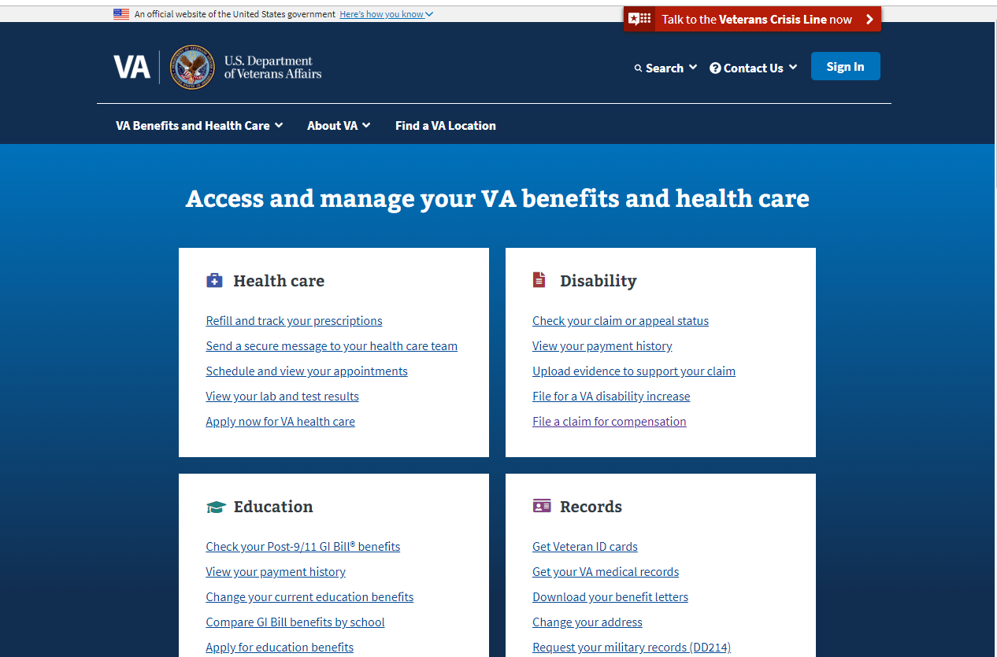
One Answer, Easy Access, Veteran Control
19

Slide 20
One Answer, Easy Access, Veteran Control
API Gateway

Slide 21
One Answer, Easy Access, Veteran Control
API Gateway

Slide 22
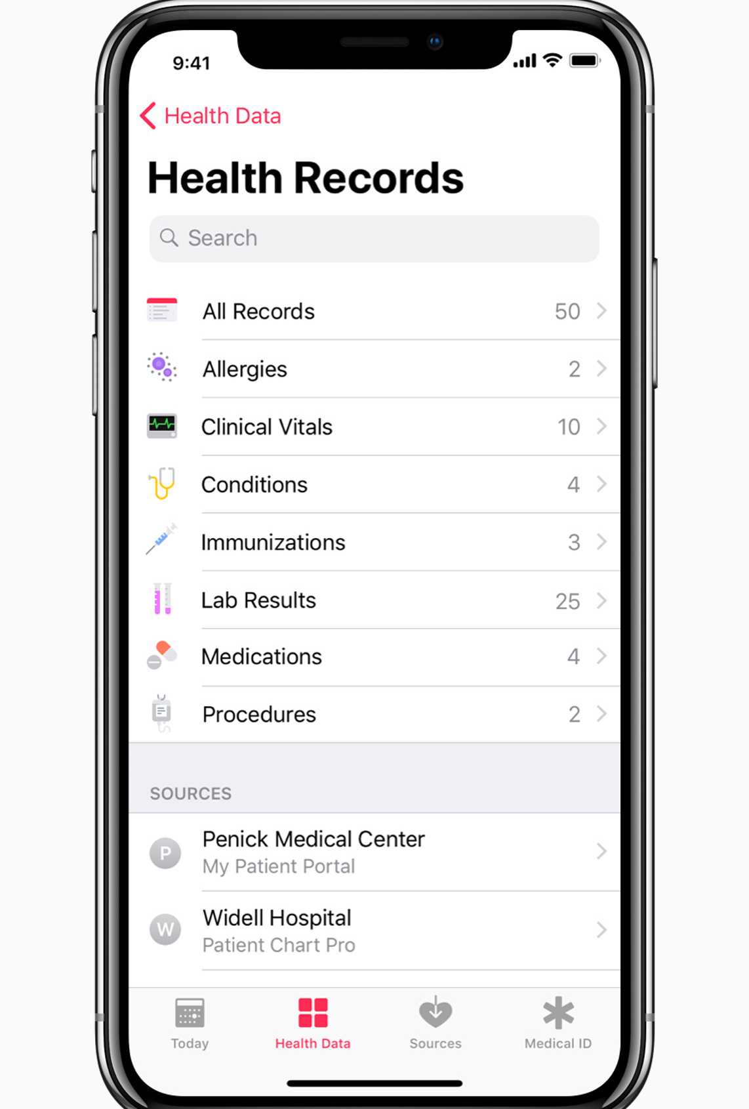
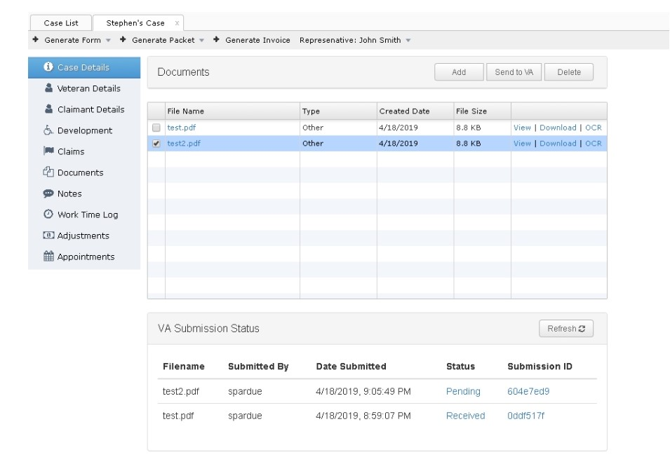
One Answer, Easy Access, Veteran Control
API Gateway

Slide 23
One Answer, Easy Access, Veteran Control
API Gateway
23

Slide 24
What have we done?

Slide 25
Milestones
25

Slide 26
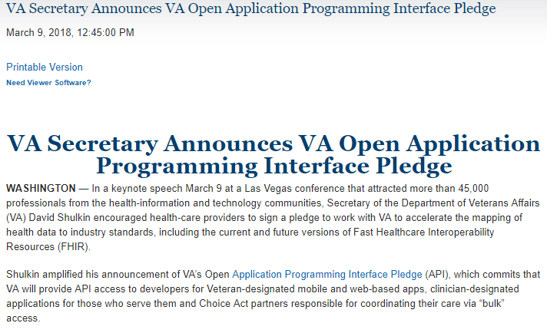
Milestones
VA Lighthouse Announced
Mar 2018
26

Slide 27
Milestones
VA Lighthouse Announced
Apr - 2018
Mar 2018
1st Benefits API
27

Slide 28
Milestones
First production app
VA Lighthouse Announced
Apr - 2018
Mar 2018
May - 2018
1st Benefits API
28

Slide 29
Milestones
First production app
VA Lighthouse Announced
Apr - 2018
Aug - 2018
Mar 2018
May - 2018
1st Benefits API
1st Facilities API
29

Slide 30
Milestones
First production app
First self-signup developer registration
VA Lighthouse Announced
Apr - 2018
Aug - 2018
Mar 2018
May - 2018
Oct - 2018
1st Benefits API
1st Facilities API
30

Slide 31
Milestones
First production app
First self-signup developer registration
VA Lighthouse Announced
Apr - 2018
Aug - 2018
Nov - 2018
Mar 2018
May - 2018
Oct - 2018
1st Benefits API
1st Facilities API
1st Veteran-Verification API
31

Slide 32
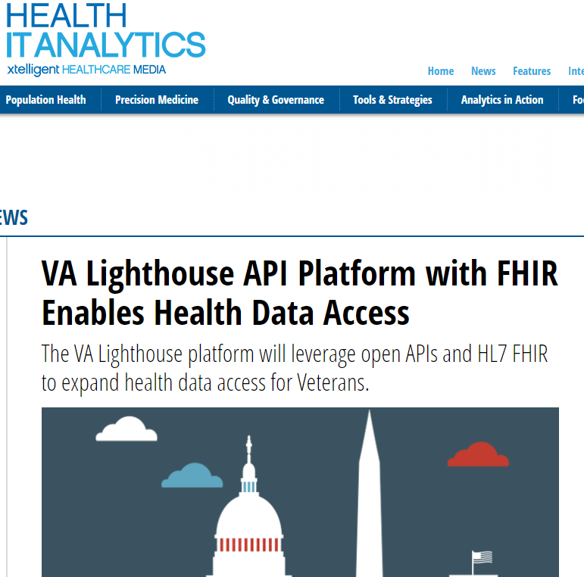
Milestones
1st Health API
First production app
First self-signup developer registration
VA Lighthouse Announced
Apr - 2018
Aug - 2018
Nov - 2018
Mar 2018
May - 2018
Oct - 2018
Dec - 2018
1st Benefits API
1st Facilities API
1st Veteran-Verification API
32

Slide 33
Milestones
1st Health API
First production app
First self-signup developer registration
VA Lighthouse Announced
Apr - 2018
Aug - 2018
Nov - 2018
Feb - 2019
Mar 2018
May - 2018
Oct - 2018
Dec - 2018
1st Benefits API
1st Facilities API
CDC Health Collaboration
1st Veteran-Verification API
33

Slide 34
Milestones
1st Health API
First self-signup developer registration
>900 Weekly benefits claims submissions
300th developer API key granted
12 Production Apps
First production app
VA Lighthouse Announced
Apr - 2018
Aug - 2018
Nov - 2018
Feb - 2019
Mar 2018
May - 2018
Oct - 2018
Dec - 2018
May - 2019
1st Benefits API
1st Facilities API
CDC Health Collaboration
1st Veteran-Verification API
34

Slide 35
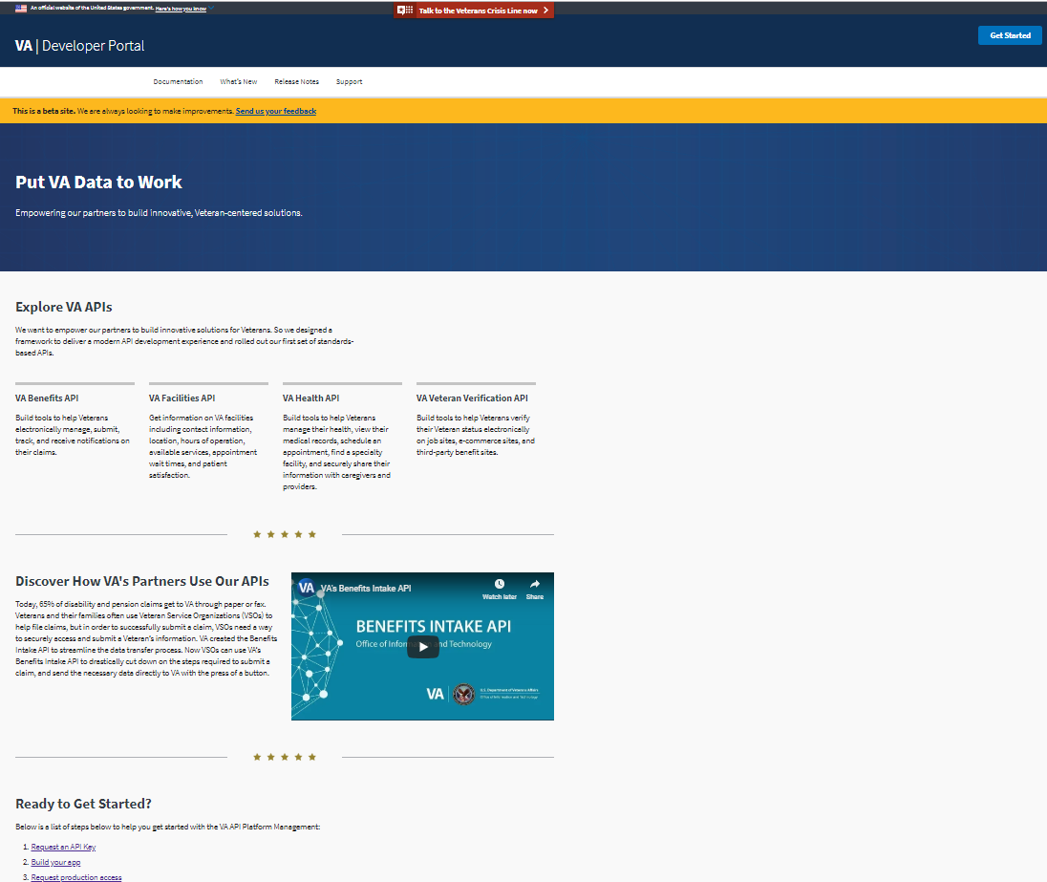
developer.va.gov
Developer Registration
Registration to access the development sandbox via developer.va.gov/apply
Common Terms of Service
Key Developer Resources
After registering , developers will gain access to:
Documentation
Servers
API Schema
Sample Applications
Support
Synthetic Veteran Data

Slide 36
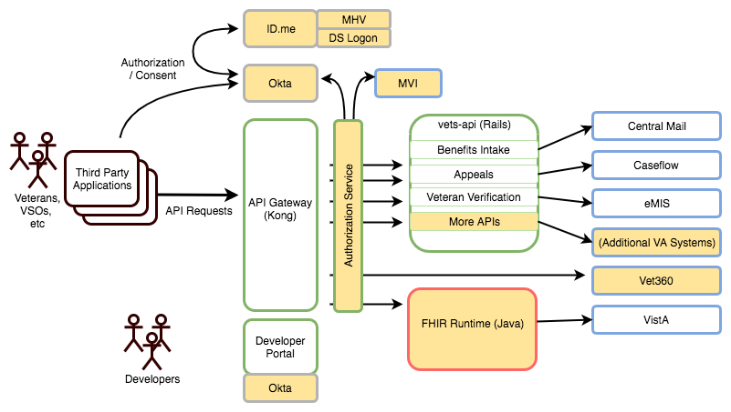
API Architecture
Agile
Devops
Modern SW And Tools
Cloud Native

Slide 37
Benefits Intake API

Slide 38
Benefits Intake API
900/week
May-2019

Slide 39
Health API
Use cases
Patient self-service digital access
Health record aggregation
FHIR-Compliant

Slide 40
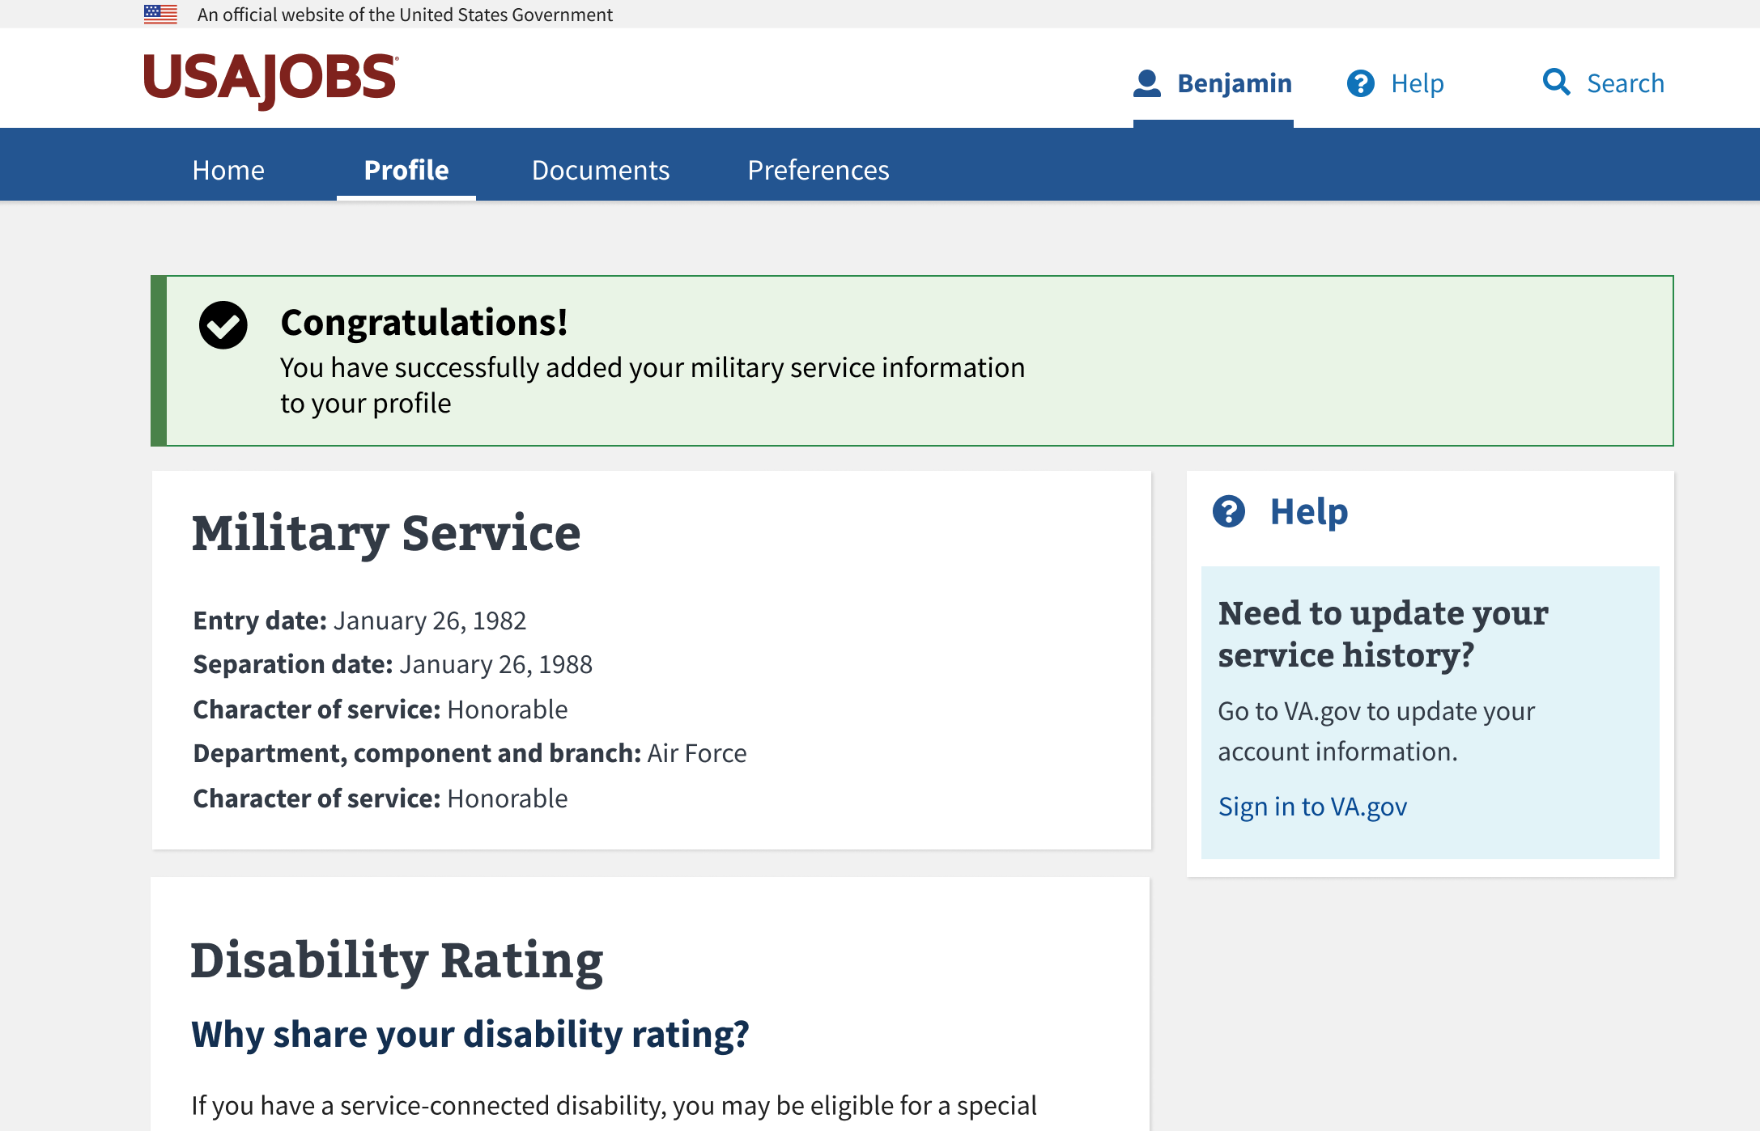
Veteran Verification API

Slide 41
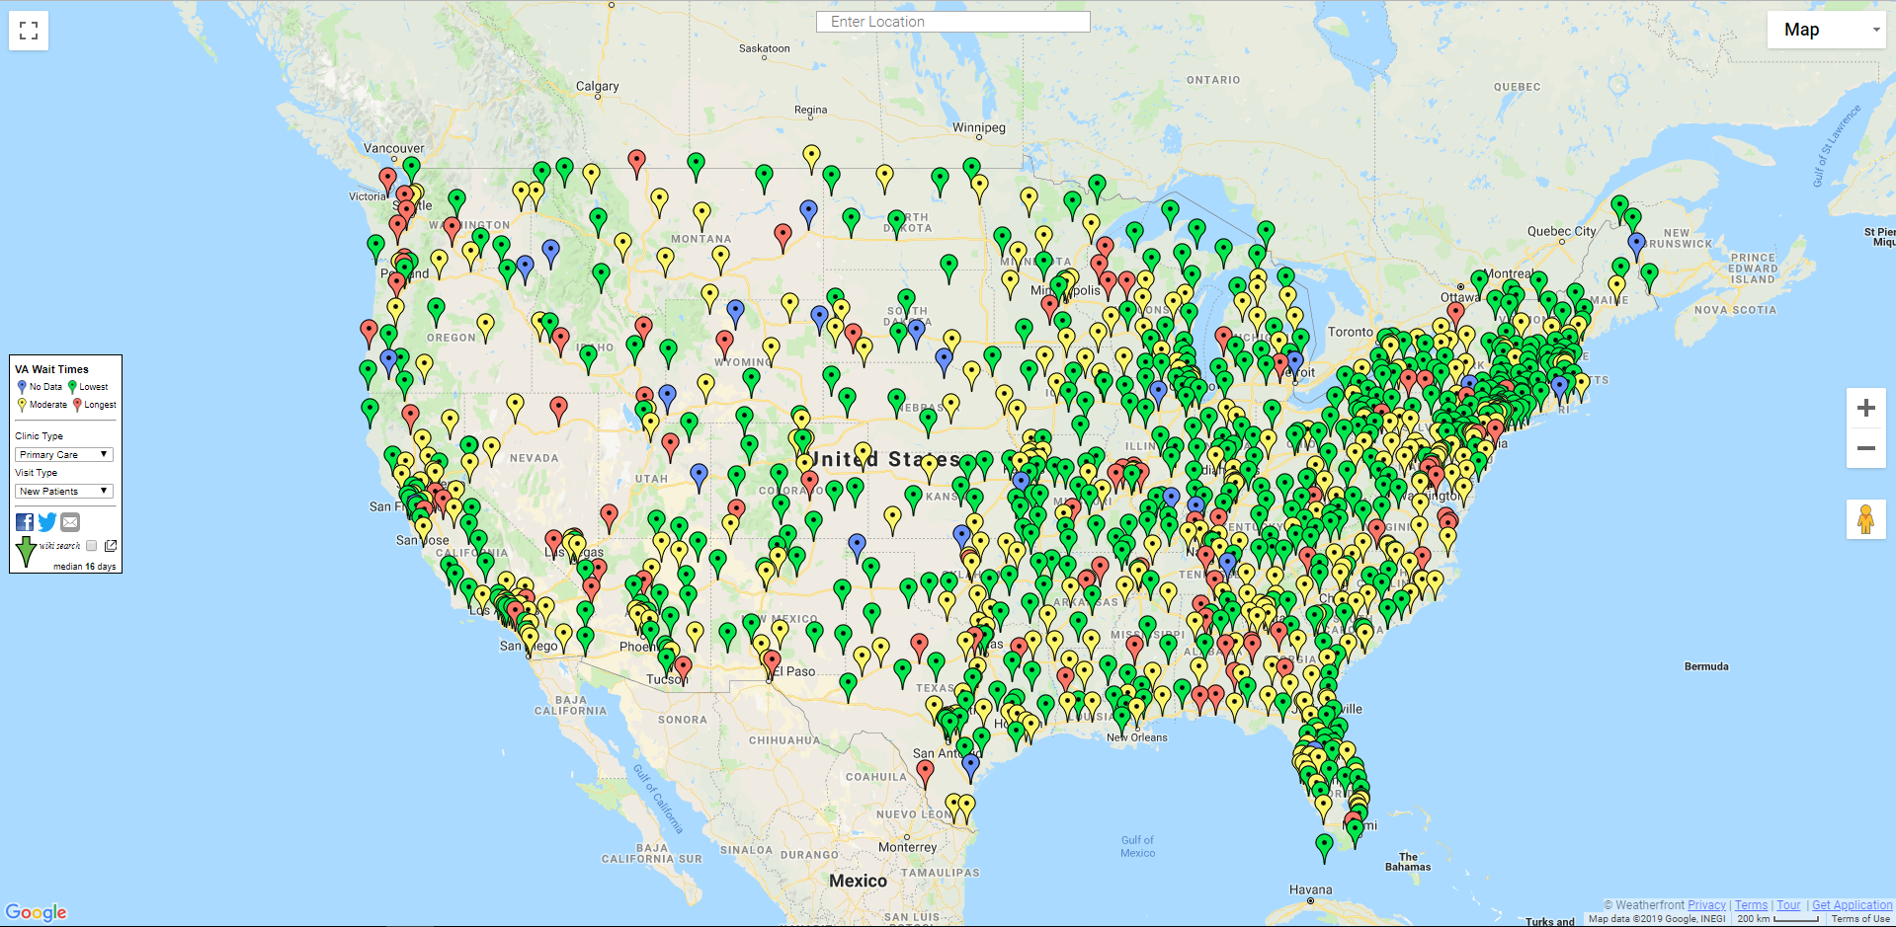
Facilities API
Benefits, Health, Cemetery, Vet Centers
Hours of Operation
Contact Info
Services Offered
Satisfaction Scores
Average Wait Times

Slide 42
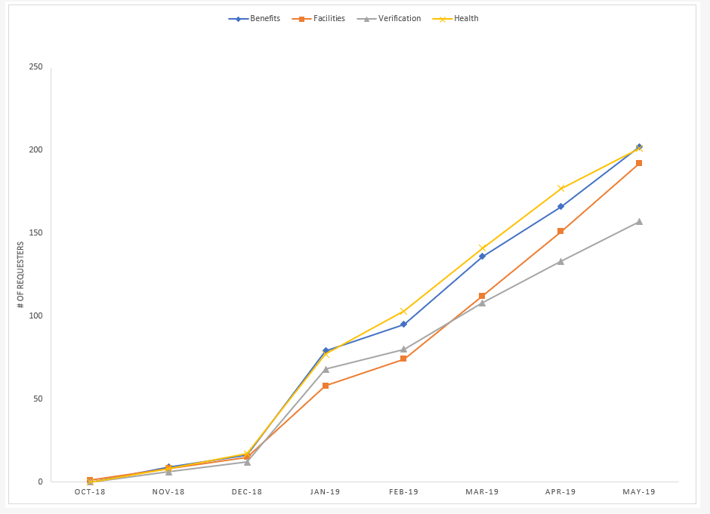
Developer
Registrations
Over 300 unique developer registrations
42

Slide 43
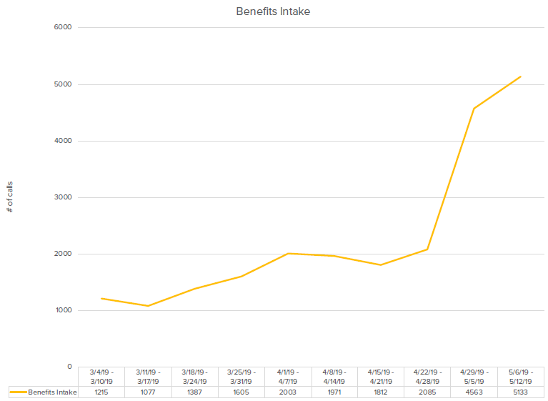
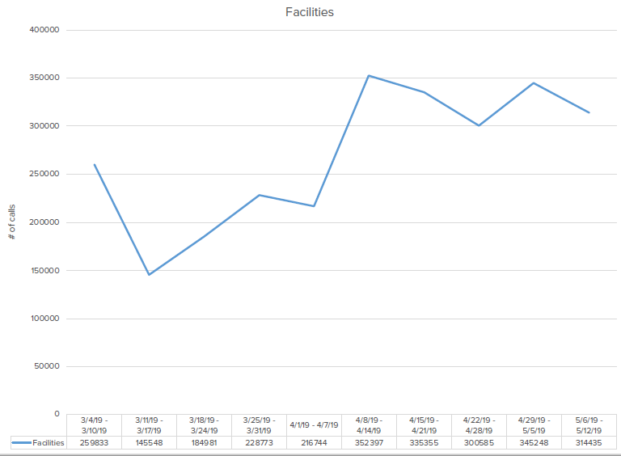
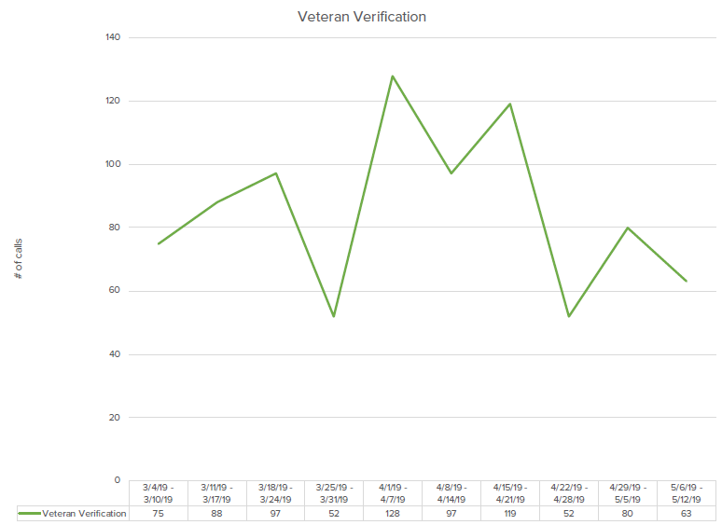
API Usage

Slide 44
What are developers saying…

Slide 45
What are developers saying…
“We see a benefit to include functionality in our connected wheelchair mobile application … to provide better support and guidance on how to use the wheelchair and create regimens for pressure relief exercises etc.” – Wheelchair Manufacturer

Slide 46
What are developers saying…
“We see a benefit to include functionality in our connected wheelchair mobile application … to provide better support and guidance on how to use the wheelchair and create regimens for pressure relief exercises etc.” – Wheelchair Manufacturer
“Our development team has said that your developer portal is better than many private sector portals they have encountered. […] Kudos to you for making government look so good." – Leadership from an identity authentication company commenting on developer.va.gov.

Slide 47
What are developers saying…
“We see a benefit to include functionality in our connected wheelchair mobile application … to provide better support and guidance on how to use the wheelchair and create regimens for pressure relief exercises etc.” – Wheelchair Manufacturer
“Our development team has said that your developer portal is better than many private sector portals they have encountered. […] Kudos to you for making government look so good." – Leadership from an identity authentication company commenting on developer.va.gov.
“We will use the APIs to allow veterans to create, edit, and view their advance directives, advance care plans, and related healthcare documents.” – SaaS SW Provider

Slide 48
What are developers saying…
“We see a benefit to include functionality in our connected wheelchair mobile application … to provide better support and guidance on how to use the wheelchair and create regimens for pressure relief exercises etc.” – Wheelchair Manufacturer
“Our development team has said that your developer portal is better than many private sector portals they have encountered. […] Kudos to you for making government look so good." – Leadership from an identity authentication company commenting on developer.va.gov.
“We will use the APIs to allow veterans to create, edit, and view their advance directives, advance care plans, and related healthcare documents.” – SaaS SW Provider
“The progress being made on multiple fronts is amazing. I clearly see a path forward that is going to revolutionize the claim process, increase speed to decision, and transparency for Veterans." – VSO SW Vendor

Slide 49
What are developers saying…
“We see a benefit to include functionality in our connected wheelchair mobile application … to provide better support and guidance on how to use the wheelchair and create regimens for pressure relief exercises etc.” – Wheelchair Manufacturer
“Our development team has said that your developer portal is better than many private sector portals they have encountered. […] Kudos to you for making government look so good." – Leadership from an identity authentication company commenting on developer.va.gov.
“We will use the APIs to allow veterans to create, edit, and view their advance directives, advance care plans, and related healthcare documents.” – SaaS SW Provider
“The progress being made on multiple fronts is amazing. I clearly see a path forward that is going to revolutionize the claim process, increase speed to decision, and transparency for Veterans." – VSO SW Vendor
“ I foresee using VA Facilities API for veterans and their families to get information related to VA facilities on voice-first devices such as Amazon Echo, Google Home, etc” – Independent Veteran SW Developer

Slide 50
What are developers saying…
“We see a benefit to include functionality in our connected wheelchair mobile application … to provide better support and guidance on how to use the wheelchair and create regimens for pressure relief exercises etc.” – Wheelchair Manufacturer
“Our development team has said that your developer portal is better than many private sector portals they have encountered. […] Kudos to you for making government look so good." – Leadership from an identity authentication company commenting on developer.va.gov.
“We will use the APIs to allow veterans to create, edit, and view their advance directives, advance care plans, and related healthcare documents.” – Saas SW Provider
“The progress being made on multiple fronts is amazing. I clearly see a path forward that is going to revolutionize the claim process, increase speed to decision, and transparency for Veterans." – VSO SW Vendor
“ I foresee using VA Facilities API for veterans and their families to get information related to VA facilities on voice-first devices such as Amazon Echo, Google Home, etc” – Independent Veteran SW Developer
“I want … my doctor,PA,RN,LPN,certified physical therapist, caregiver, to access my medical records … w/o all the red tape …in my total control... immediately...” - Independent Veteran SW developer

Slide 51
What will we do?

Slide 52
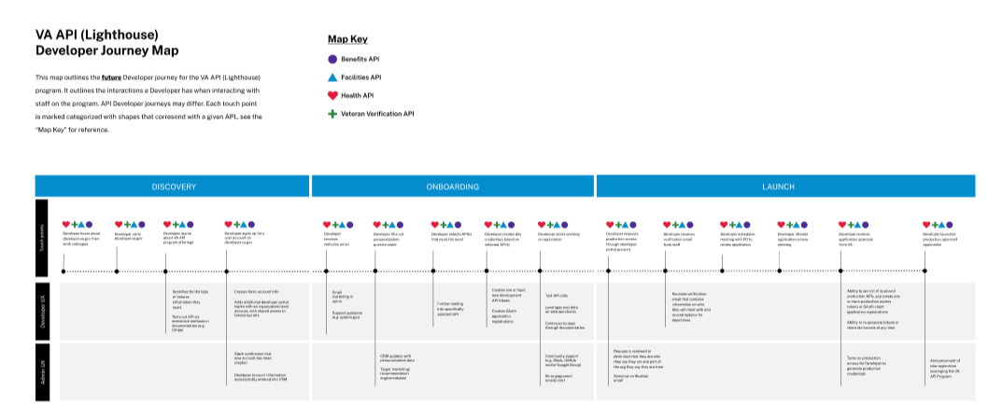
Grow API usage
Success is what gets used, not what’s built
Expand CRM and outreach
Register more developers
Coach developers on journey to production
Increase developer API usage
52

Slide 53
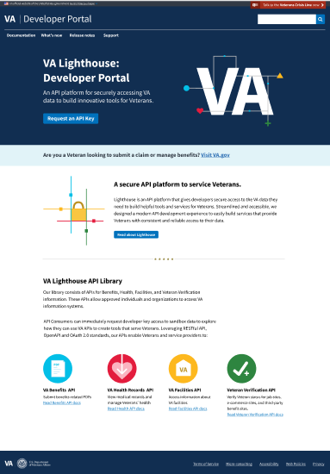
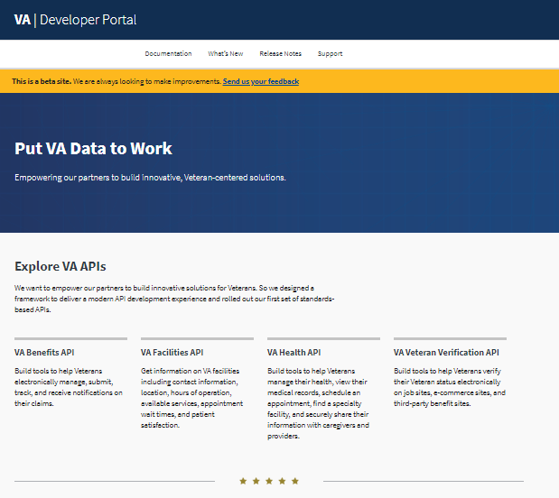
Design Evolution
UX and HCD
User Interviews
Information Architecture Analysis
Hallway Testing
Under development

Slide 54
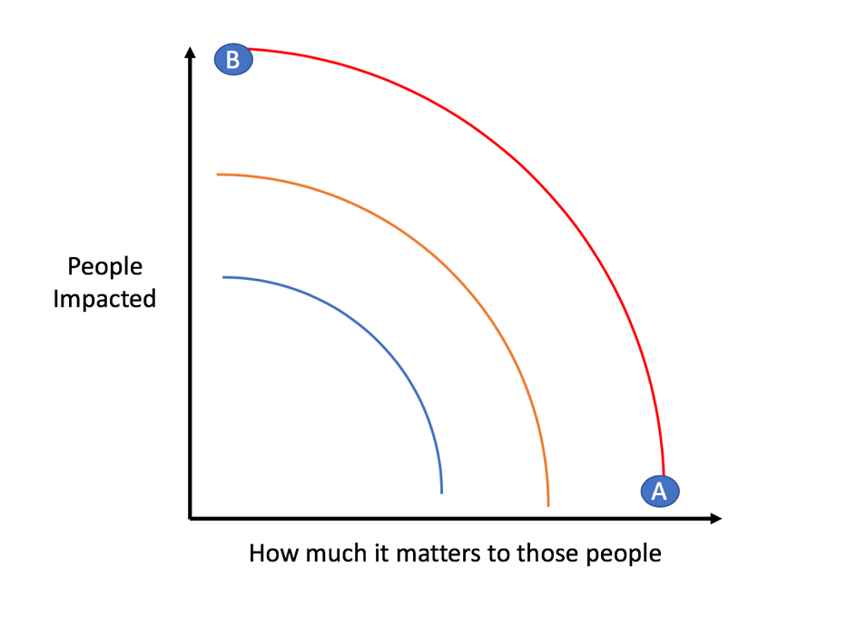
Identify new APIs and features
Maximize the impact on the most people
54

Slide 55
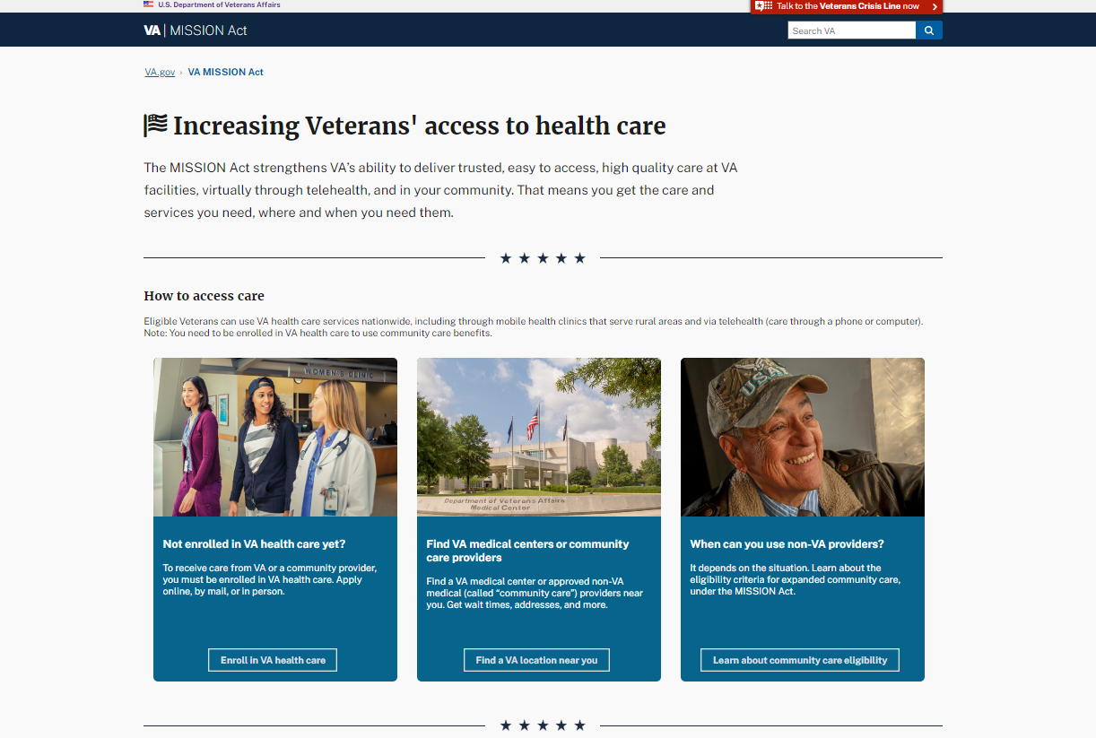
Mission Act
Help veterans assess eligibility
Enable more veterans to receive community care

Slide 56
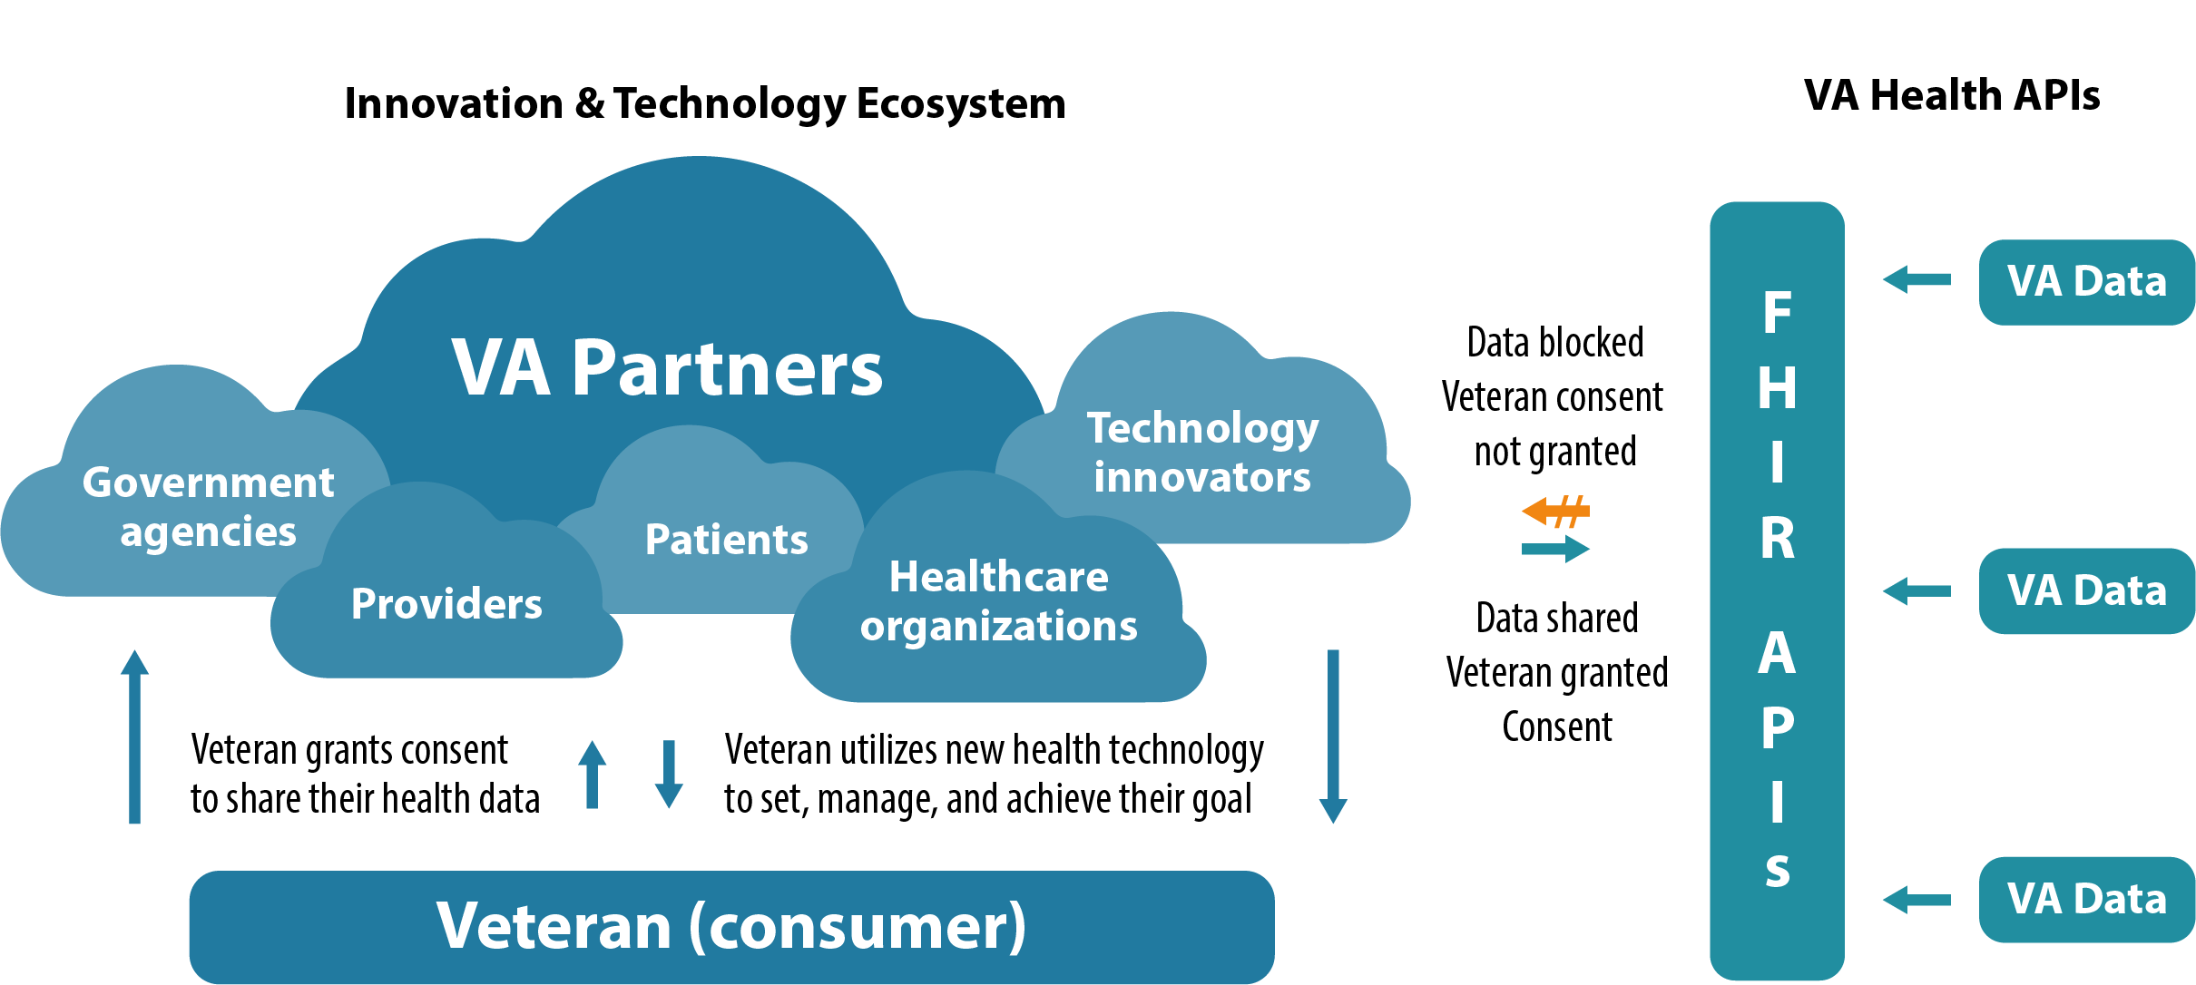
Health – Production Launch

Slide 57
Benefits - Auto CEST
Automatic Claims Establishment
Disability MVP
PoA Establishment
Additional Claim Types
A
B
2
C
1
3

Slide 58
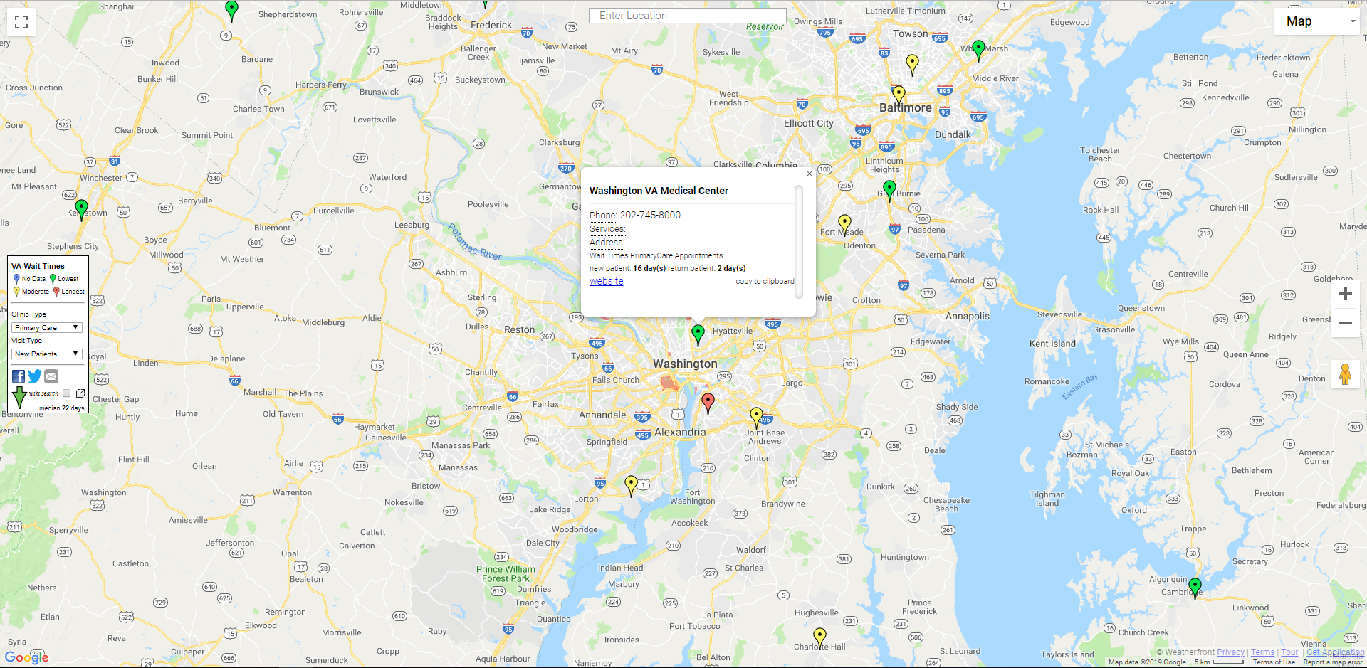
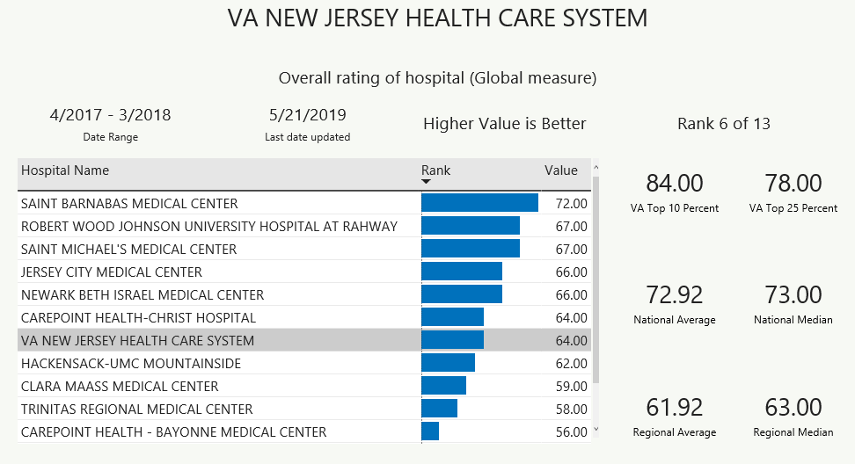
Facilities – More Data
Veteran<->Facility Drive Times
Quality of Care Data

Slide 59
Other
API Monitoring Status Page
Veteran Profile
Return to Active Duty

Slide 60
What can you do?

Slide 61
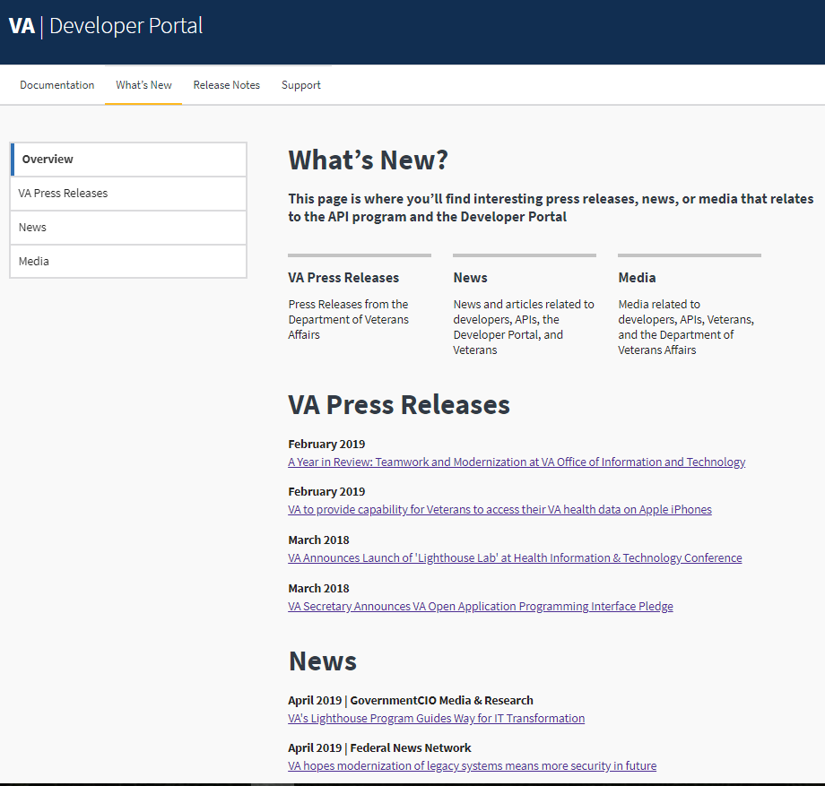
Call to Action
Explore https://developer.va.gov
Advance Lighthouse in 2019 and beyond
Product-focus
Cloud-Native technologies
Agile development
Devops release process
➔ Delivery is the strategy!
Leverage Lighthouse API’s as Authoritative Data Sources
Accelerate delivery of other VA products
Provide same source of truth to VA and veterans
Build new and exciting applications Simply agree to Terms of Service and go!

Slide 62
Thank You!

