Slide 1
Office of Procurement, Acquisition and Logistics
Advanced Planning Brief to Industry
June 11, 2025

Slide 2
Administrative Remarks
Questions may be answered as time permits following some of today’s presentations; alternatively, we ask that you hold your questions so they may be answered as part of the OIT Round Table discussion later this morning.
Information presented during today’s briefings is subject to change.
Government responses to today’s questions should be considered ADVISORY.

Slide 3
Administrative Remarks (Cont.)
The registration list, briefing charts, TAC future contracting opportunities list and the recording of the event will be available on https://www.voa.va.gov under the “Advanced Planning Brief to Industry 2025” library within a week of today’s event.

Slide 4
Office of Procurement, Acquisition and Logistics
Technology Acquisition Center (TAC) Update
for the
Advanced Planning Brief to Industry
Jeffrey C. Neill
Associate Executive Director
June 11, 2025

Slide 5
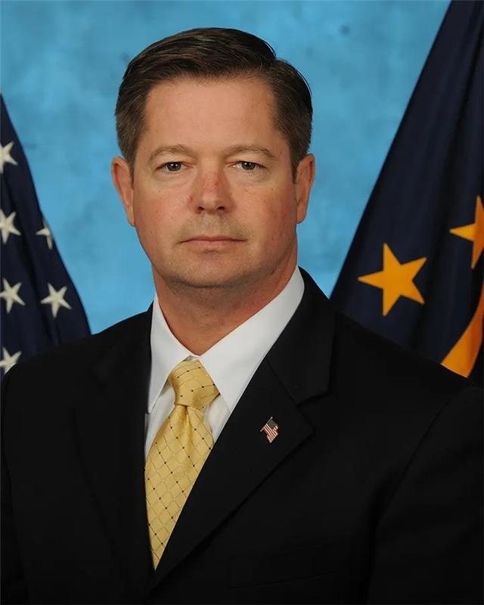
Office of Acquisition, Logistics and Construction
Advanced Planning Brief to Industry
Driving Innovation and Transformation in VA Acquisitions
Mr. Phillip Christy
Acting Principal Executive Director
Office of Acquisition, Logistics & Construction (OALC) and
Acting Chief Executive Officer

Slide 6
Future Direction of the Office of Information and Technology
Eddie Pool
Acting Assistant Secretary (AS) and Chief Information Officer (CIO)
Office of Information and Technology
Advanced Planning Brief to Industry
June 11, 2025

Slide 7
Our Mission

Slide 8
Where We Are
3,088
Sites and Facilities
Includes VA Care Sites, VA Outpatient Only Care Sites, VA Vet Centers, Veterans Benefits Administration (VBA) Regional Offices, and VA National Cemeteries in our total facilities supported by OIT.
Source: Veteran Data Pocket Card

Slide 9
VA at a Glance
17.92 million projected U.S. Veteran population
458,000+ full-time VA employees
9.26 million total enrollees in VA health care system
120,289 VA health care professional academic rotations in academic year 2023
$369.3 billion VA Fiscal Year (FY) 2025 budget
5.99 million Veterans receiving VA disability compensation

Slide 10
OIT Supports VA Across a Complex Enterprise
82 Customer Satisfaction Index – Above industry average of 73; must continue high satisfaction with operational improvements
$6.4 billion budget currently – Tightening in FY 2026; requires IT smarter spending, greater efficiency, and stronger industry partnerships
Blocked over 6.1 billion malware attempts in 2023
1.5 million data elements exchanged between DOD and VA daily
Supports more than 2.7 million pieces of equipment
Time to fix broken IT items 2.8 days

Slide 11
OIT Priorities
Exceptional customer and product experiences – We are committed to putting the Veteran first and seamlessly connecting Veterans with the health and benefits they have earned.
Relentless focus on IT fundamentals – We’re relentlessly focused on bringing more Veterans to VA, expanding capacity, improving timeliness, and increasing efficiency. Ensuring best-in-class IT capabilities that are highly available, efficient, and resilient.
Strengthening VA Cybersecurity – We’re dedicated to a risk-based, Zero Trust approach, so VA can consistently and rapidly identify and respond to security threats, strengthening the protection of critical VA and Veteran information. Key is a modernized, comprehensive, efficient, and adaptable cybersecurity environment.

Slide 12
VA’s Digital Transformation is much broader than investments in the cloud, in equipment, and in new services. It’s an acknowledgement that many Veterans are already accustomed to a digital experience and expect the same options from VA.

Slide 13
IT at VA Is Complex: Emerging Demands and Constraints
PACT Act creating record demand—1M claims over last year.
While a $6.4 billion budget may seem large, VA is the government’s largest civilian agency and operates the nation’s largest integrated health care system.
Aging systems — must move to continuous modernization.
Competing objectives from stakeholders, Congress, and the Office of Management and Budget.
Huge IT complexity drives our #1 issue – security complexity.

Slide 14
How to Demonstrate Value
Help us move away from a “big bang” approach and to continuous modernization and MVP instead.
Deliver “speed to value” – quickly deliver tangible benefits and results from investment.
Our partners should be capable of
Delivering high-quality products
Creating seamless user experiences that our customers expect
Delivering systems that are secure by nature.
We want projects with no surprises – rigorous execution and full transparency.

Slide 15
www.digital.va.gov

Slide 16
AI Expectations for Industry Partners: Build Faster, Smarter, and More Cost-Effectively for VA
Charles Worthington
Chief Artificial Intelligence Officer-Chief Technology Officer
Office of Information and Technology
Advance Planning Briefing for Industry
June 11, 2025

Slide 17
VA in Context

Slide 18
Storage and Retrieval
Inference

Slide 19
Deterministic Software
Probabilistic Software

Slide 20
AI Opportunity

Slide 21
AI Results

Slide 22
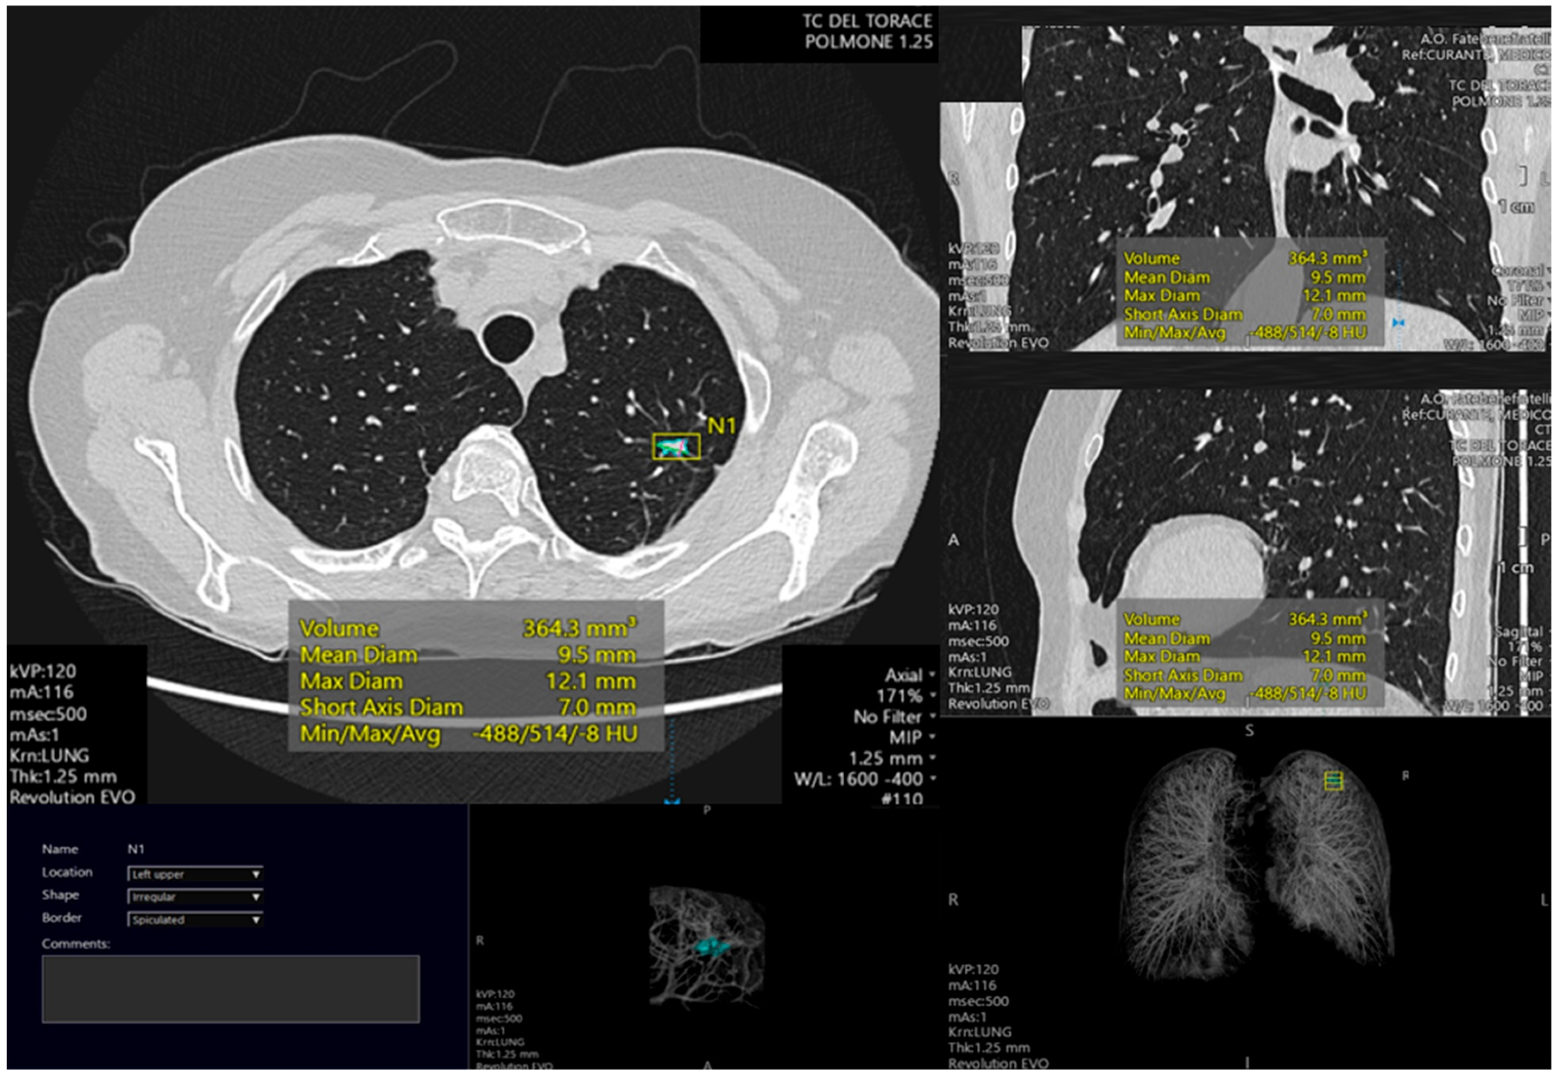

Slide 23
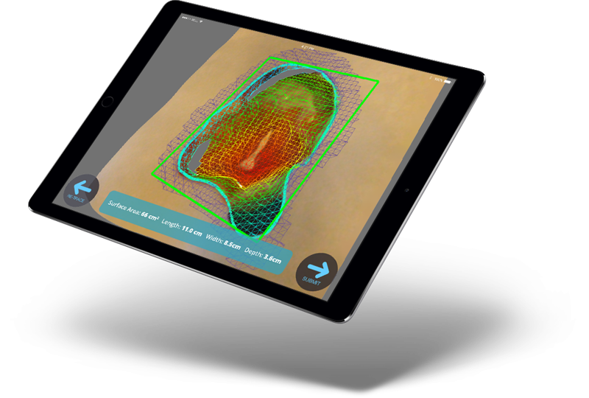

Slide 24
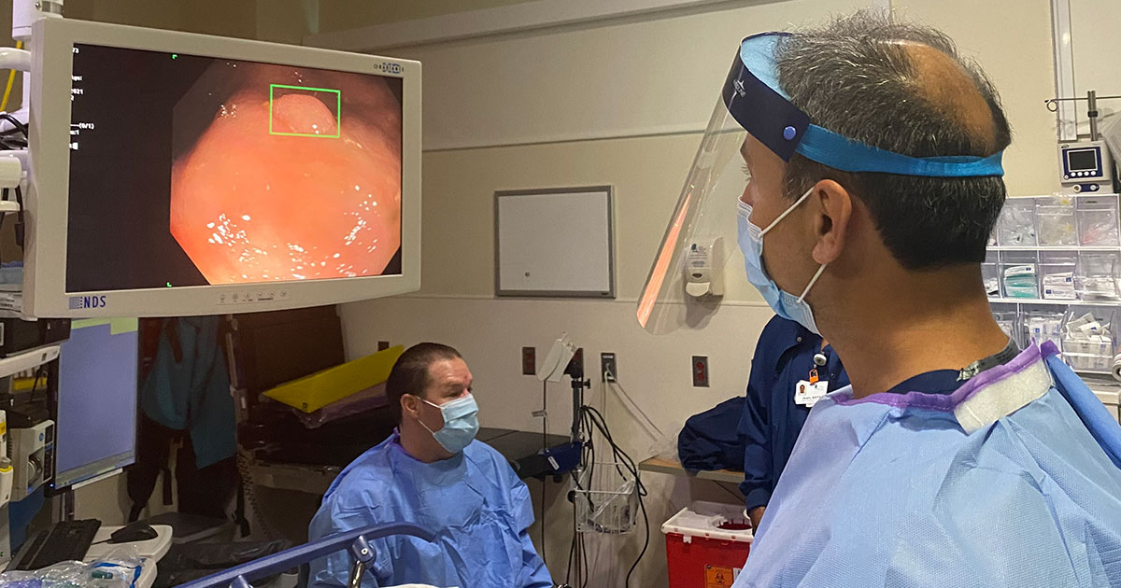

Slide 25
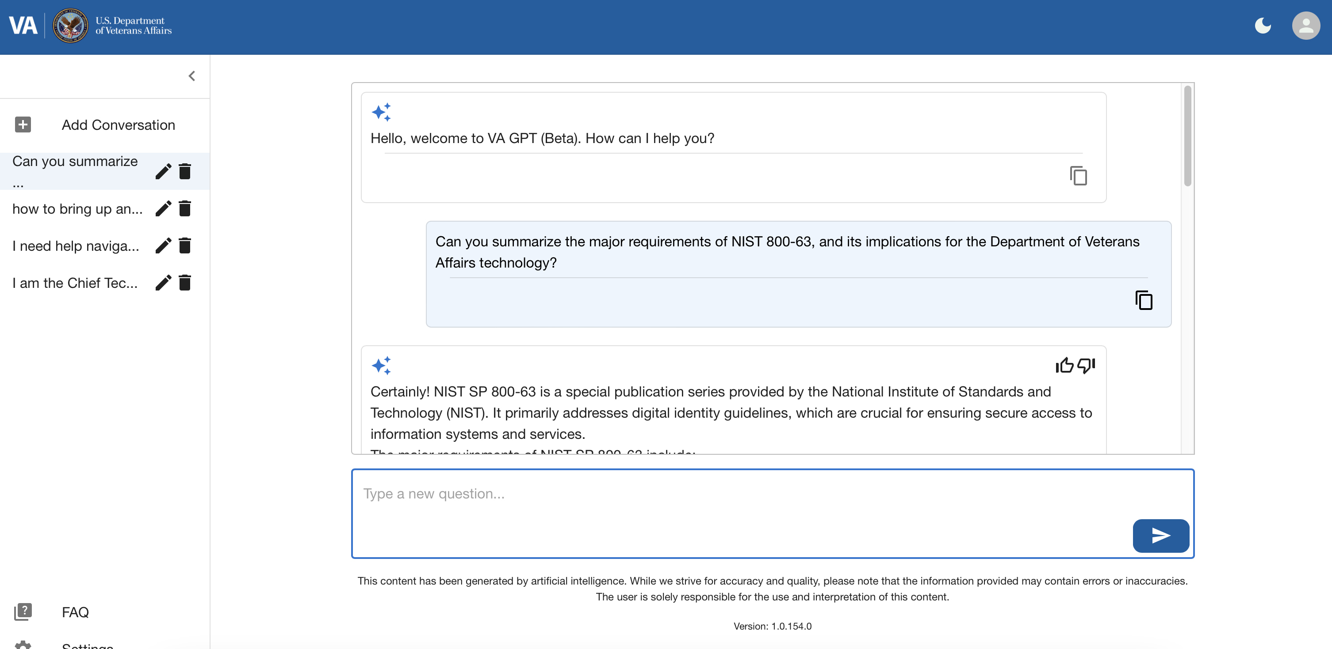

Slide 26
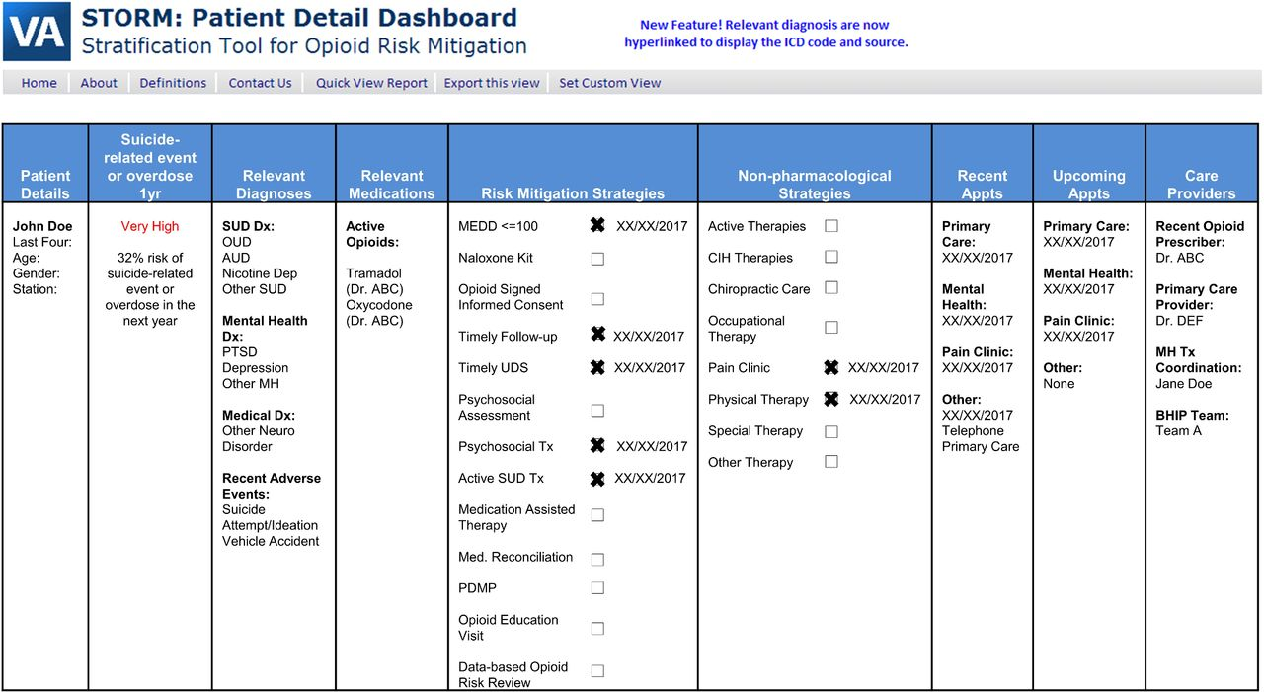

Slide 27
Building Solutions with AI
Building AI Solutions

Slide 28
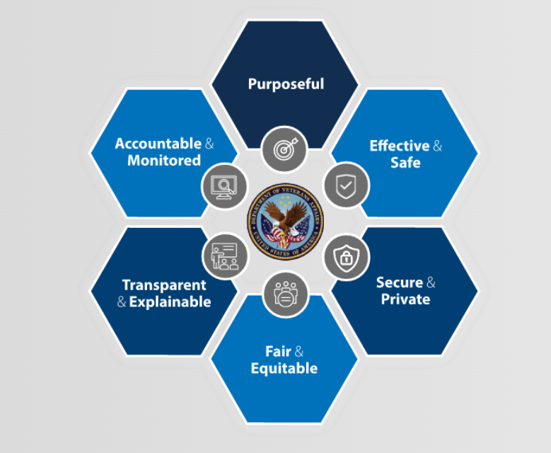
Our Standards: Trustworthy AI at VA

Slide 29
VA’s 2024 Use Case Inventory
Released December 16th, 2024
227 use cases, with 82% from Veterans Health Administration (VHA) followed by OIT, Veterans Benefits Administration (VBA), and Veterans Experience Office (VEO)
Common categories include productivity, clinical decision support, medical devices, and natural language processing
Positions VA as among most transparent healthcare systems in country related to AI

Slide 30
VA’s 2024 Use Case Inventory

Slide 31
USING AI IN YOUR WORK

Slide 32
Current Guidance on GenAI at VA
No web-based, publicly available generative AI service has been approved for use with VA sensitive information (see note).
When users enter information into these tools, VA loses control of the data. Some public LLM web services have terms of service allowing them to use this data for other purposes.
Examples include: OpenAI’s ChatGPT, Perplexity, Grok, Otter.ai. Some of these tools are blocked on the VA network. Current guidance on use of Generative AI at VA
Note: VA Sensitive Information is any information that has not been cleared for public release and has been collected, developed, received, transmitted, used, or stored by VA, or by a non-VA entity in support of an official VA activity.

Slide 33
Active Generative AI Tools at VA
VA GPT (Beta): VA’s new Generative-AI (Gen AI) assistant designed to make your job easier, faster, and more efficient, ultimately improving our service to Veterans.
GitHub Copilot: GitHub Copilot is an AI-powered tool that assists software developers in writing code. It analyzes the context in the file you are editing, as well as related files, and offers suggestions from within your IDE, GitHub.com web-interface, or CLI.
Azure OpenAI API: We are currently exploring possibilities and feasibility around offering GPT API access to VA innovators.

Slide 34
Building Solutions with AI
Building AI Solutions

Slide 35
Why This Matters Now
AI is changing how software is built
VA is moving from pilot projects to scaled solutions
We expect our industry partners to use AI tools responsibly on VA projects
These tools should lead to faster development, higher quality, and lower cost solutions

Slide 36
AI Assisted Software Development: GitHub Copilot
Definition:
An AI-powered coding assistant developed by GitHub, designed to assist developers by providing code suggestions, completions and chats in real-time.
Core Features:
Predicts and suggests code snippets based on context
Supports multiple programming languages
Integrates seamlessly with various development environments, including Visual Studio Code and Visual Studio
Pilot Group:
Fulltime and Contractors that develop code within github.com
Developers that have committed code 10+ times in the last 30 days have been enrolled to the program (~1,500, 2/19)

Slide 37
GitHub Copilot

Slide 38
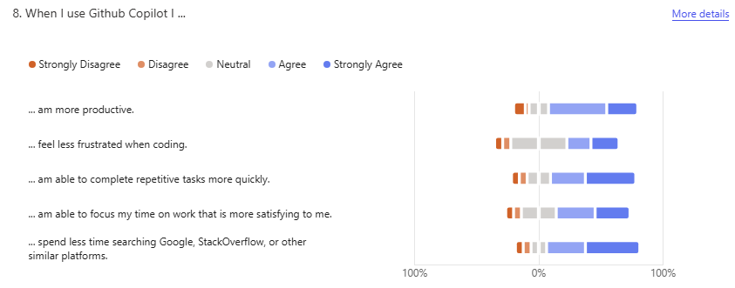
AI GitHub Copilot Survey: Impact
When I use GitHub Copilot I…
FOR INTERNAL USE ONLY • OFFICE OF INFORMATION AND TECHNOLOGY • PRE-DECISIONAL

Slide 39
What We Expect From Our Industry Partners
Use VA’s AI tools in your software development workflow (e.g., GitHub Copilot Agent Mode) and experiment with approved AI tools to accelerate all aspects of your delivery
Accelerate delivery timelines and reduce costs
Ensure all AI-assisted outputs are reviewed and validated by humans
Train staff on AI
Contact CAIOoffice@va.gov, with questions or compliance concerns

Slide 40
Questions?

Slide 41
Electronic Health Record Modernization – Integration Office (EHRM-IO)
Dr. Laura Prietula
Deputy Chief Information Officer
Electronic Health Record Modernization – Integration Office
Advanced Planning Brief to Industry
June 11, 2025

Slide 42
Agenda
EHRM Program Overview
Movement to the Cloud
Standardized Baseline
Vendor Agnostic Technical Specifications
API Strategy
Industry
Questions

Slide 43
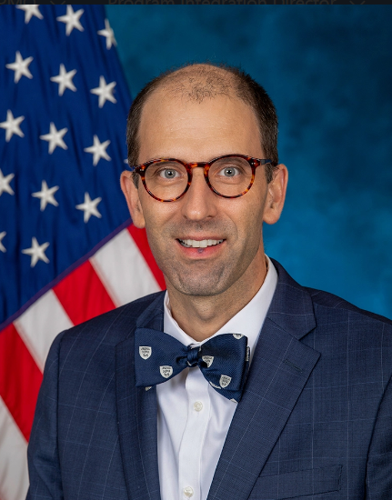
VA’s EHRM-IO Program
The Department of Veterans Affairs (VA) is committed to providing seamless care for Veterans, including access to a complete electronic health record and shared, transparent care pathways.
—Dr. Neil Evans
EHRM-IO Acting Program Executive Director

Slide 44
High Level Technical EHRM Overview
VA Facilities
5 VA Medical Centers using the Federal EHR
VA clinics
Health Information Exchange
Consolidated Patient Account Centers (CPACs)
Federal Enclave
Shared enclave; managed by DoD
Federal Partners
Federal Electronic Health Record Modernization Program Office (FEHRM)
Department of Defense (DoD)
Department of Homeland Security’s U.S. Coast Guard (USCG)
Department of Commerce's National Oceanic and Atmospheric Administration (NOAA)
Joint VA and DoD Facility
Captain James A. Lovell Federal Health Care Center
(Lovell FHCC is also a VAMC)
Collaboratively Developed EHR

Slide 45
Migration to Oracle Cloud Infrastructure: Goals
Improves Customer Experience through higher performance and improved reliability.
Improves Release Management through greater automation in testing and release management with fewer disruptions.
Improves Scalability with the ability to rapidly add capacity based on demand.
Provides Access to Future Applications and Features to support next generation clinical, business, and AI products.

Slide 46
Shared EHRM Environment (VA Enclave View)
Department of Defense Accreditation (ATO) Boundary
Core Services
Government Core (EHR)
High Assurance Clinical Application Services (HA CAS)
Infrastructure Delivery/Monitoring and Automation
Other Domains
COOP/DR
Core
HA CAS
Pre-Production
AWS Commercial Cloud
Commercial Services
Clinical Application Services/ Value Added Network
(CAS/VAN)
Cert
Mock
Build
Train

Slide 47
Oracle Integration in Government Regions
OCI: Oracle Cloud Infrastructure
OC1: Public/Commercial Cloud Environment
Multiple locations
Destination for CAS/VAN
OC2: OCI US Government Cloud with FedRAMP Authorization
US Gov East and West regions
Not used by the Federal EHR
OC3: OCI US Federal Cloud with DISA Impact Level 5 Authorization
US DoD East, North, and West regions
Destination for Federal Enclave

Slide 48
Federal EHR VA Baseline Overview
The Federal EHR VA Baseline is a tool that provides information on more than 2,300 functional and technology components available as part of the Federal EHR and VA’s related information technology.
VA established the Baseline as the cornerstone of the enterprise-wide effort to standardize the delivery of health care. The Baseline will help sites align with the national standard for technology solutions in advance of go-live, supporting a successful transition to the Federal EHR.
Solutions in the Baseline are to be used as a basis when sites are planning for future investments in EHR-connected technologies. This includes:
Planning for new technology
Replacing old technology with a similar option
Enhancing existing technology

Slide 49
Federal EHR VA Baseline: Components
Components = Different functions and technologies that are included in the Baseline.

Slide 50
Three Key Takeaways
VA established the Baseline as a cornerstone of the enterprise-wide effort to standardize the delivery of health care and accelerate VA's EHRM deployment schedule.
The Baseline is not static; it will be adjusted through formalized enterprise change control processes as VA deploys to more sites, and as VA delivers system improvements, upgrades, new services, new technologies, or revised workflows.
Aligning with the notional VA standard for technology system configurations in advance will help avoid deployment delays and added cost.

Slide 51
Vendor Agnostic Technical Specifications Approach
Enterprise Technical Specifications include:
Standard/preferred integration patterns vs. Non-Standard Integrations
Aggregate patterns by key solution areas
Vendor agnostic ICDs (Enterprise Interface Standard ICDs)
Oracle CareAware Device List and VA Supplemental Guidance (if applicable)
New API onboarding guidance/strategy
Existing APIs/Interfaces available for re-use
VA approved Middleware vs. Non-Approved Integration Engines
Cybersecurity Guidance for Enterprise Standard Interface Accreditation boundaries
Technical Specifications Package:
1) Integration Design
Clinical Workflows
Integration Requirements
2) Connectivity Design
Deployment Delivery
Connectivity Details
3) Design Note – Vendor Specific
Vendor Interface contractual agreement/deliverable
Document exceptions and exception mitigations, if applicable
Program Overview
Message Structures
Security Requirements

Slide 52
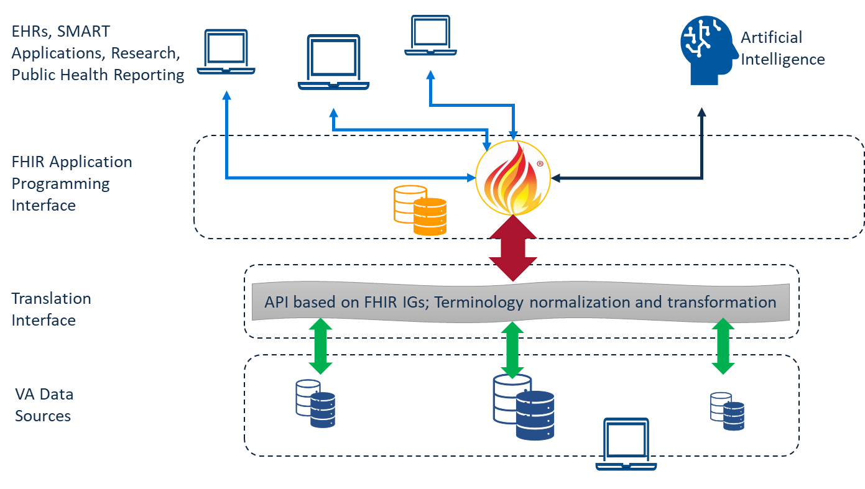
API Strategy
VA is creating a common architectural vision and strategy for streamlining system integration using standardized Application Programming Interfaces (APIs) to connect systems that support health operations
Goal #1: Maximize use of common API platform.
Goal #2: Minimize or eliminate redundant APIs.
Goal #3: Ensure secure access.
Goal #4: Minimize API consumption overhead.
Example of Interoperable FHIR Servers

Slide 53
What We Need from Industry
Patient-first mindset and Veteran-focused design
Focus products on capabilities while using standardized interfaces
Health care industry standards (Health Level 7, Fast Healthcare Interoperability Resources (FHIR), etc.)
Oracle Health integration and experience
Health care IT (biomedical device integration, application programming interface)
Innovation for the end user or point of care
Make it better for Veterans and VA employees

Slide 54
Common Types of Contracts in EHRM-IO
Oracle Health
Indefinite Delivery Indefinite Quantity (IDIQ)
Care Aware integrations (Care Aware Validation Link)
Interagency agreements (e.g., Defense Health Agency)
Existing OIT contracts
Hardware and software
Common vehicles like National Aeronautics and Space Administration (NASA) Solutions for Enterprise-Wide Procurement (SEWP)
Managed services

Slide 55
QUESTIONS? ehrmquestions@va.gov

Slide 56
THANK YOU

Slide 57
Advanced Planning Brief to Industry
Program will resume at
11:00am

Slide 58
Advanced Planning Brief to Industry
Information Technology Executive Round Table Discussion

Slide 59
Advanced Planning Brief to Industry
Program will resume at
1:00pm

Slide 60
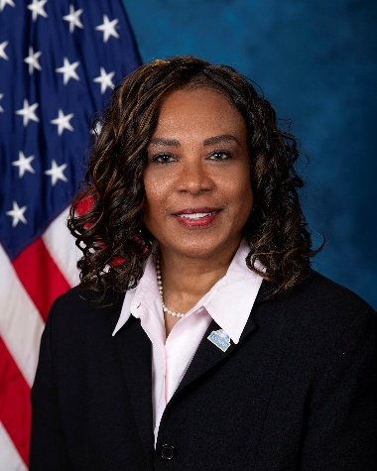
2024 Small Business Update
(OSDBU)
Chanel Bankston-Carter
Acting Executive Director, OSDBU

Slide 61
Advanced Planning Brief to Industry
Contracting Officer
Round Table Discussion

Slide 62
Wrap Up – Thank You!
Participant Surveys will be sent to all registered attendees following the event via a pop up when closing out of Webex.
We hope to see you next year!

